Slide 1



Steganography

Slide 2
Steganography:
Steganography is the art and science of writing hidden message in such a way that no one, apart from the sender and intended recipient, suspects the existence of the message.
Steganography works by replacing bits of useless or unused data in regular computer files (such as graphics, sound, text, html or even floppy disks) with bits of different, invisible information.

Slide 3
This hidden information can be plain text, cipher text or even images.
In modern steganography, data is first encrypted by the usual means and then inserted, using a special algorithm, into redundant data that is part of a particular file format such as a JPEG image, Bitmap image.

Slide 4
Steganography process :
Cover-media + Hidden data + Stego-key = Stego-medium
Cover media:
It is the file in which we will hide the hidden data
Cover-media can be image or audio file.
stego-key:
Cover-media can be encrypted using stego-key:
stego-medium.
The resultant file is of above process called stego medium.

Slide 5
Types Of Steganography
Text Steganography
Image Steganography
Audio Steganography

Slide 6
Examples of Text Steganography
Since everyone can read, encoding text
in neutral sentences is doubtfully effective
Since Everyone Can Read, Encoding Text
In Neutral Sentences Is Doubtfully Effective
‘Secret inside’

Slide 7
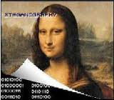
Image Steganography

Slide 8
Audio Steganography
It is a technique used to transmit hidden information by modifying an audio signal in an imperceptible manner. It is the science of hiding some secret text or audio information in a host message. The host message before steganography and stego message after steganography have the same characteristics.

Slide 9
Advantages:
No one suspects existence of message
Highly secure
Disadvantages:
It requires a lot of overhead to hide a relatively few bits of information

Slide 10
Steganography V/s Cryptography
Steganography | Cryptography
Unknown message passing | Known message passing
Steganography prevents discovery of the very existence of communication | Encryption prevents an unauthorized party from discovering the contents of a communication
Little known technology | Common technology
Technology still being develop for certain formats | Most of algorithm known by all
Once detected message is known | Strong current algorithm are resistant to attacks ,larger expensive computing power is required for cracking
Steganography does not alter the structure of the secret message | Cryptography alter the structure of the secret message

Slide 11
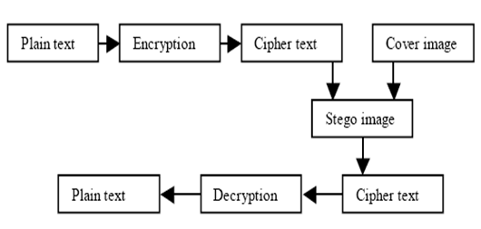
For more detail contact us

Slide 12
Where Steganography is used?
First time used in IB
Social Media Post, etc.

