Slide 1
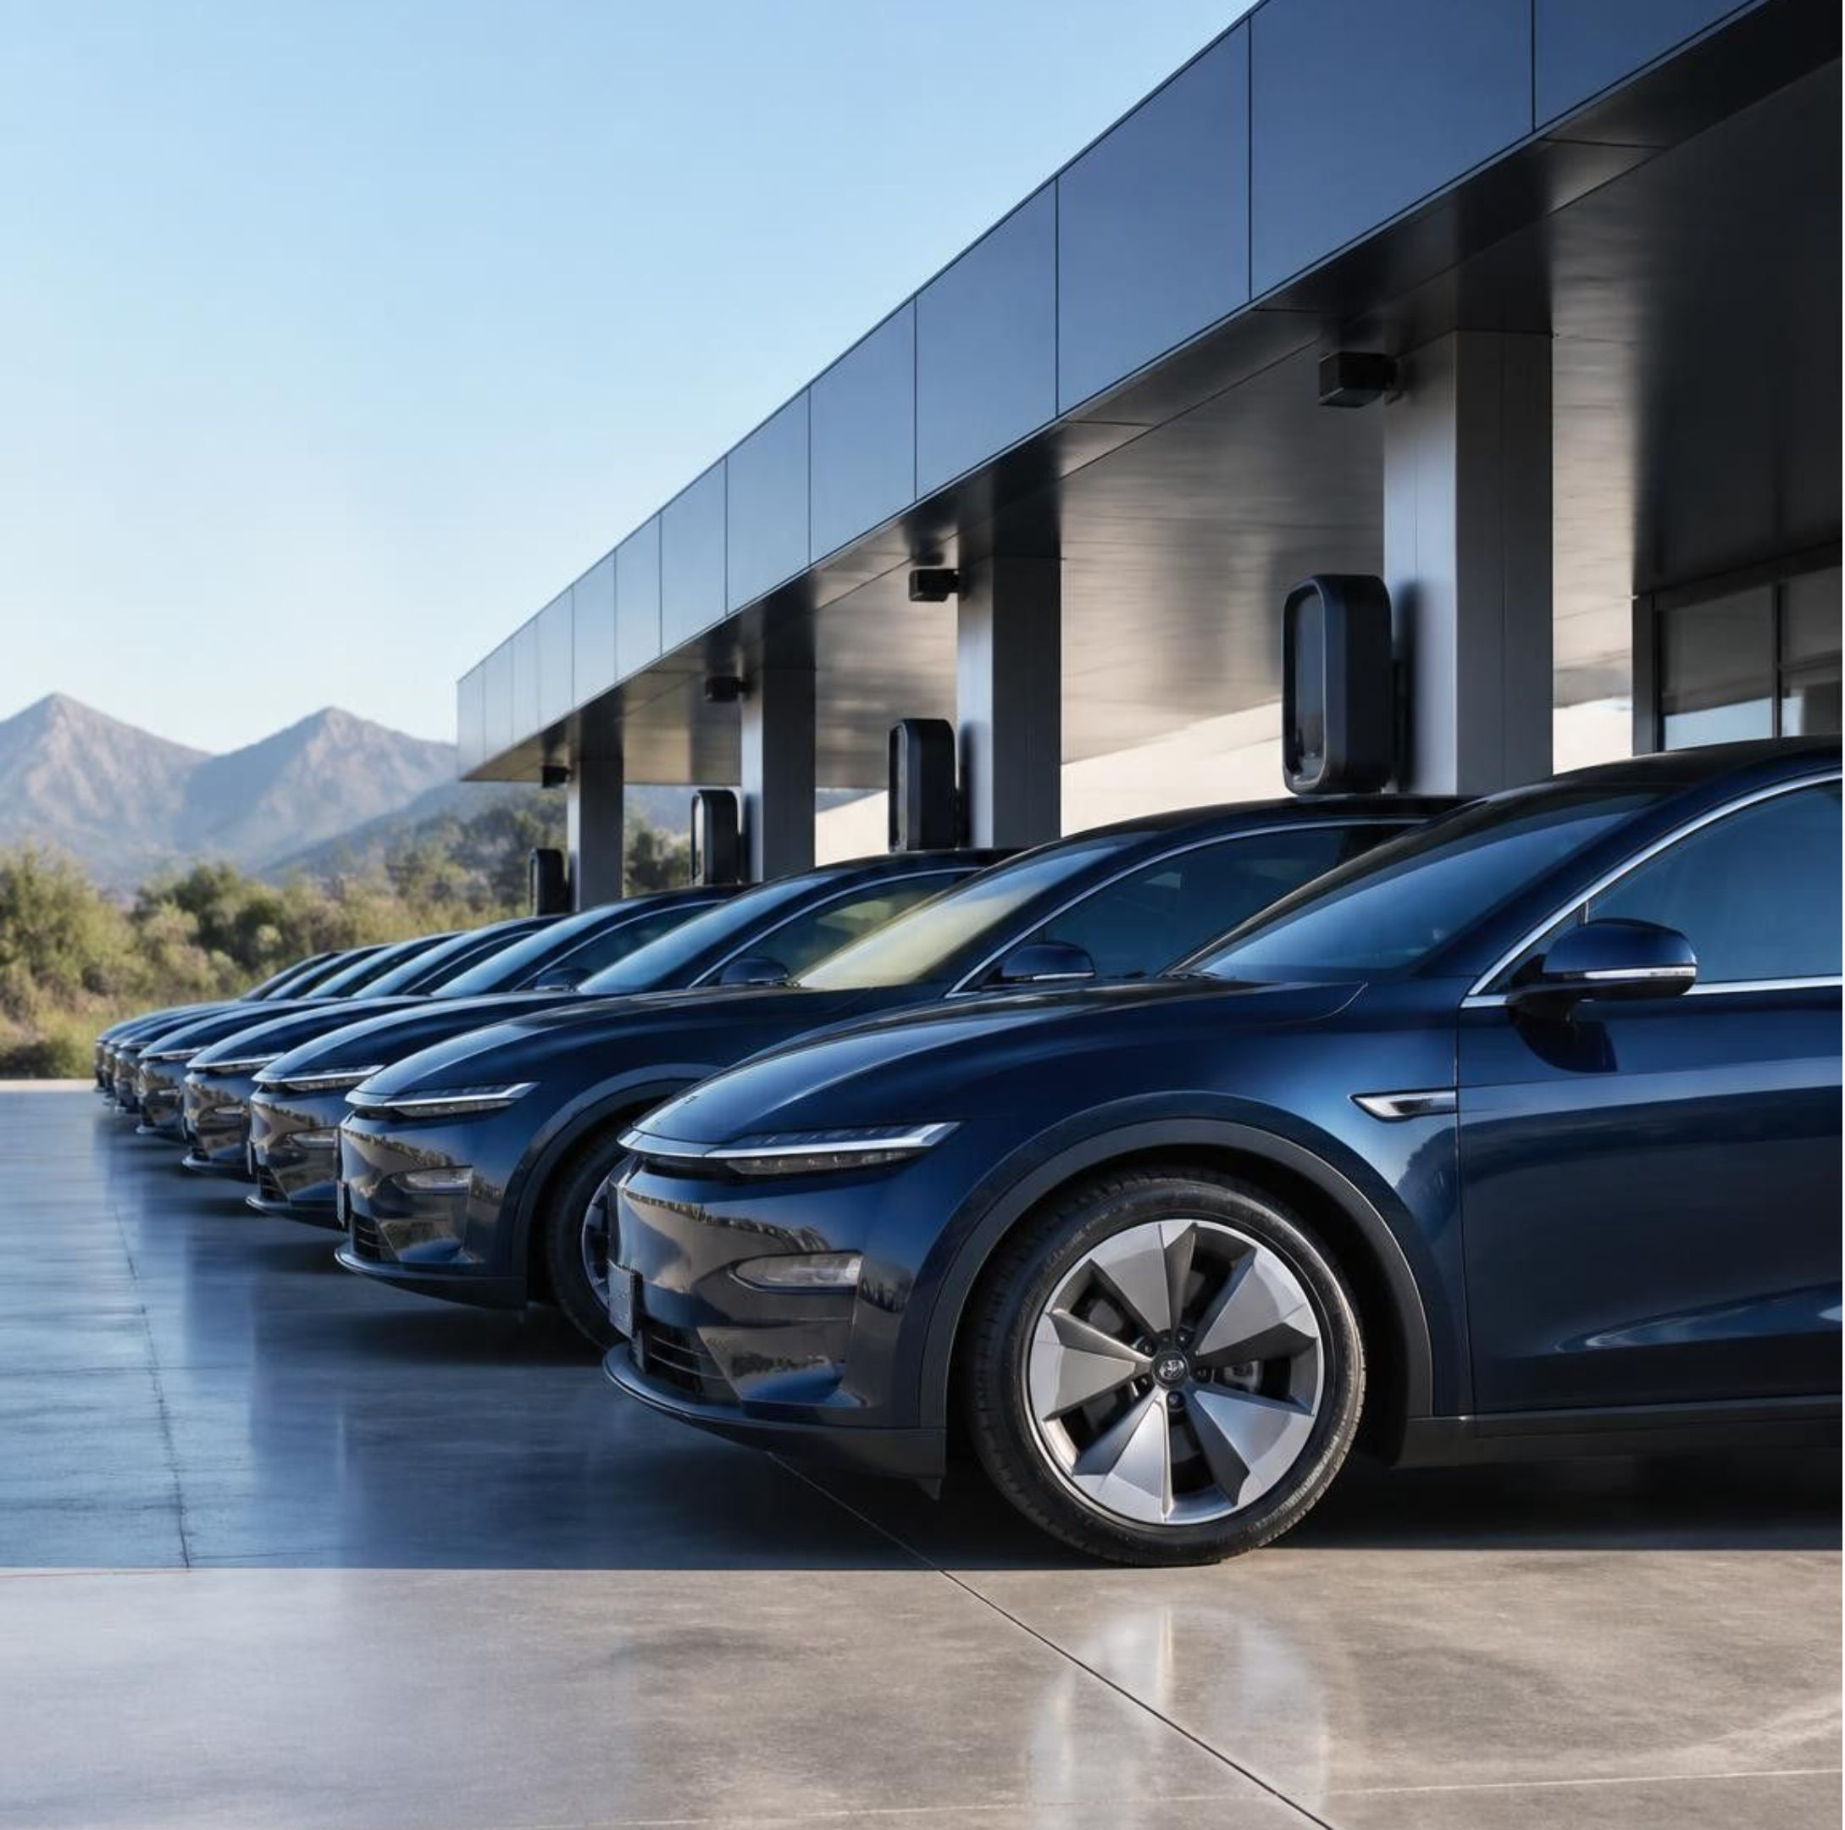
RENTWHEELS
Smart Car Rental Management System
A modern full-stack platform eliminating double-booking through atomic operations and immutable rental records.
PRESENTED BY
Yogesh · Reg. No. 12320524
ACADEMIC COHORT
B.Tech CSE, Section K23DF
FACULTY GUIDANCE
Shaik Sana Begum Ma'am
Notes:
Introduce the project: RentWheels, an automated management system addressing counter race conditions and audit loss. State student credentials and acknowledge project supervisor Shaik Sana Begum Ma'am.

Slide 2

PAPER REGISTERS AND LEGACY SYSTEMS BREAK DOWN AT THE COUNTER
THE COUNTER PROBLEM
CONCURRENT DOUBLE-BOOKING
Multiple counter clerks assign the same vehicle simultaneously without synchronized lock state.
SLOW COUNTER THROUGHPUT
Manual paperwork and fragmented checks extend customer turnaround times to over 15 minutes.
CORRUPTED AUDIT TRAILS
Direct rate overwrites in relational tables retroactively distort completed contract calculations.
Objective: Deliver an ACID-reliable, centralized platform for real-time fleet operations.
Notes:
Walk through the three failure modes observed in legacy rental counters: race-condition double bookings, counter delays, and mutable rate corruption.

Slide 3
A THREE-TIER ARCHITECTURE KEEPS LOGIC IN ONE PLACE
HTML5 / CSS / JAVASCRIPT FRONTEND
FLASK BACKEND API
MONGODB ATLAS CLOUD REPLICA SET
Request →
← Response
Request →
← Response
Manage cars, customers, and rentals.
Business logic, validation, booking, returns, billing.
Vehicles, customers, rentals, transactions.
Notes:
Explain the three tiers: the HTML5/CSS/JavaScript frontend manages cars, customers, and rentals; the Flask Backend API handles business logic, validation, booking, returns, and billing; MongoDB Atlas Cloud Replica Set stores vehicles, customers, rentals, and transactions. Requests move forward and responses return between tiers.

Slide 4
IMMUTABLE SNAPSHOTS KEEP EVERY RENTAL RECORD TRUE
MONGODB DOCUMENT: RENTALS COLLECTION · ILLUSTRATIVE VALUES
_id: ObjectId("665a1f2b9c3e4d001a8b4567") rental_id: RNT-2026-8841 | status: Active start_time: 2026-10-26T08:30:00Z
duration: Not specified in source sample vehicle_id: CAR-104 | make: Hyundai model: Ioniq 5
plate: DL-01-AB-1234 agreed_hourly_rate: 350.00 | customer_id: CUST-5012 full_name: Aarav Sharma
license_no: DL-0420190012948 phone: +91 98110 23456 | rate_basis: hourly_ceiling advance_deposit: 1000.00
DESIGN PRINCIPLE
EMBED BOOKING-TIME CONTEXT; KEEP SOURCE COLLECTIONS SEPARATE.
Car, customer, and rental data live in separate collections. At booking, car and customer details are embedded in the rental record.
No SQL-style joins to read history. Later price or customer changes never alter past rentals.
Benefits · Historical accuracy · Auditability · Simpler retrieval · Reliable billing
Car and customer collections remain normalized for active fleet operations.
Notes:
Highlight the core schema decision: embedding car and customer snapshots directly inside the rental document ensures immutable historical accuracy without multi-collection joins.

Slide 5
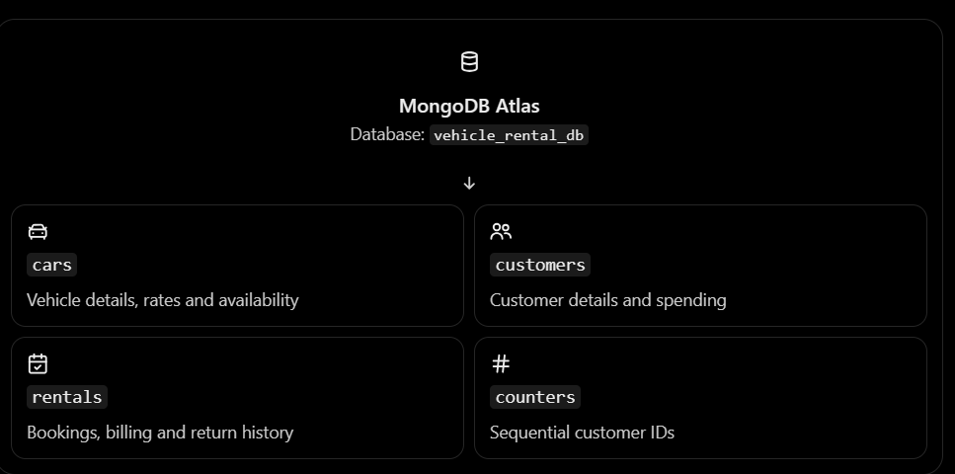
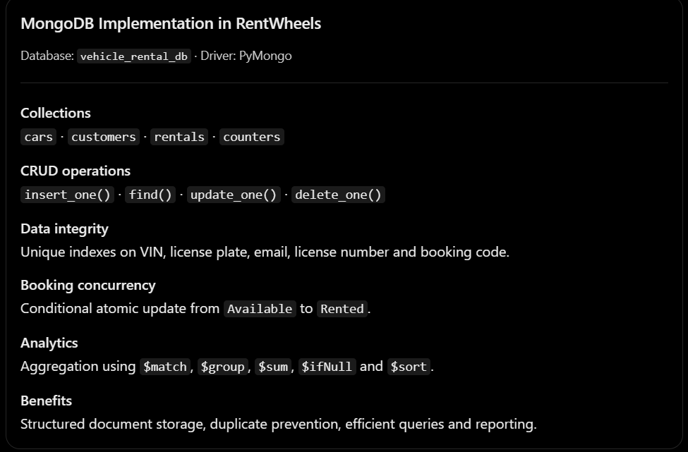
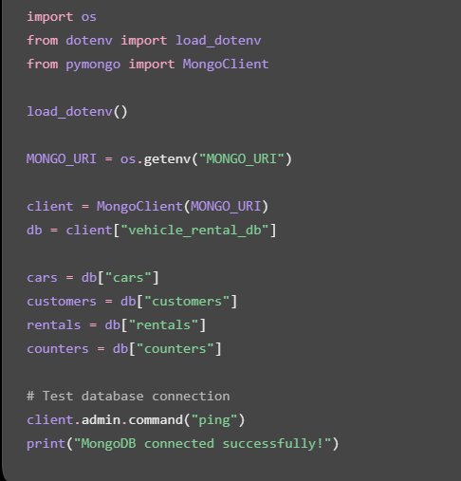
Database and its Collections
Connecting flask to MongoDB

Slide 6
ONE ATOMIC UPDATE LETS ONLY ONE USER BOOK A CAR
CONCURRENCY GUARD
END-TO-END OPERATIONAL LIFECYCLE
ATOMIC TEST-AND-SET QUERY
Onboarding: Register customers and vehicles.
Booking: Ceiling-rounded hourly billing.
Return Inspection: Good, Scratched, or Damaged.
Settlement: Final charges; damaged vehicles routed to maintenance.
Only one competing request can change the car from Available to Rented.
result = db.cars.update_one(
{"_id": car_id, "status": "Available"},
{"$set": {"status": "Rented"}}
)
if result.modified_count == 0:
return {"error": "Car is no longer available"}, 409
Notes:
Explain how update_one with a status precondition acts as an atomic mutex in MongoDB, preventing race conditions. Walk through the four clear workflow phases.

Slide 7
INDEXES AND AGGREGATIONS POWER FAST QUERIES
AGGREGATION PIPELINE
MANAGEMENT PORTAL
OPERATIONS DASHBOARD
db.rentals.aggregate([
{"$match": {"status": "Completed"}},
{"$group": {
"_id": "$car_snapshot.vehicle_id",
"total_revenue": {"$sum": "$final_charge"},
"rentals_count": {"$sum": 1}
}},
{"$sort": {"total_revenue": -1}}
])
SYSTEM INTERFACE PLACEHOLDER
[ Live Dashboard Screenshot Placeholder ]
Add a dashboard screenshot showing:
Vehicle availability
Total rentals
Revenue
Vehicle condition
Indexes on frequently queried fields such as vehicle status and rental identifiers; example: cars.status and compound index {status: 1, end_time: -1}.
Average Query Time: [ ___ ms ] (Placeholder: benchmark to be measured on target cluster)
Notes:
Discuss database indexing strategy and aggregation pipelines for manager reporting. Note the explicit benchmark and screenshot placeholders for evaluator transparency.

Slide 8
RESULTS: ONE RELIABLE SYSTEM FOR CARS, CUSTOMERS, AND RENTALS
Centralized management of cars, customers, and rentals
Less manual data entry and more reliable bookings
Historical details preserved by immutable snapshots
Faster queries through indexing
Automated billing, return inspections, settlement, and maintenance routing
EVIDENCE PLACEHOLDER
Placeholder for real screenshots or measured results

