Slide 1

Classification of Astronomical Light curves
Team 6
Adam Semple
Yogesh Kashiram Bore
Kshitija Nayak
Lijin Wang

Slide 2
Index
Introduction
EDA
Data Cleaning
Cluster Analysis
Possible Further Analysis
Conclusion

Slide 3
Exploratory Data analysis
Data Reading- for the txt and csv files
Boxplots
Correlation

Slide 4
Data Loading
645 text file given
Each Object information given in separate file
Object Distance csv file

Slide 5
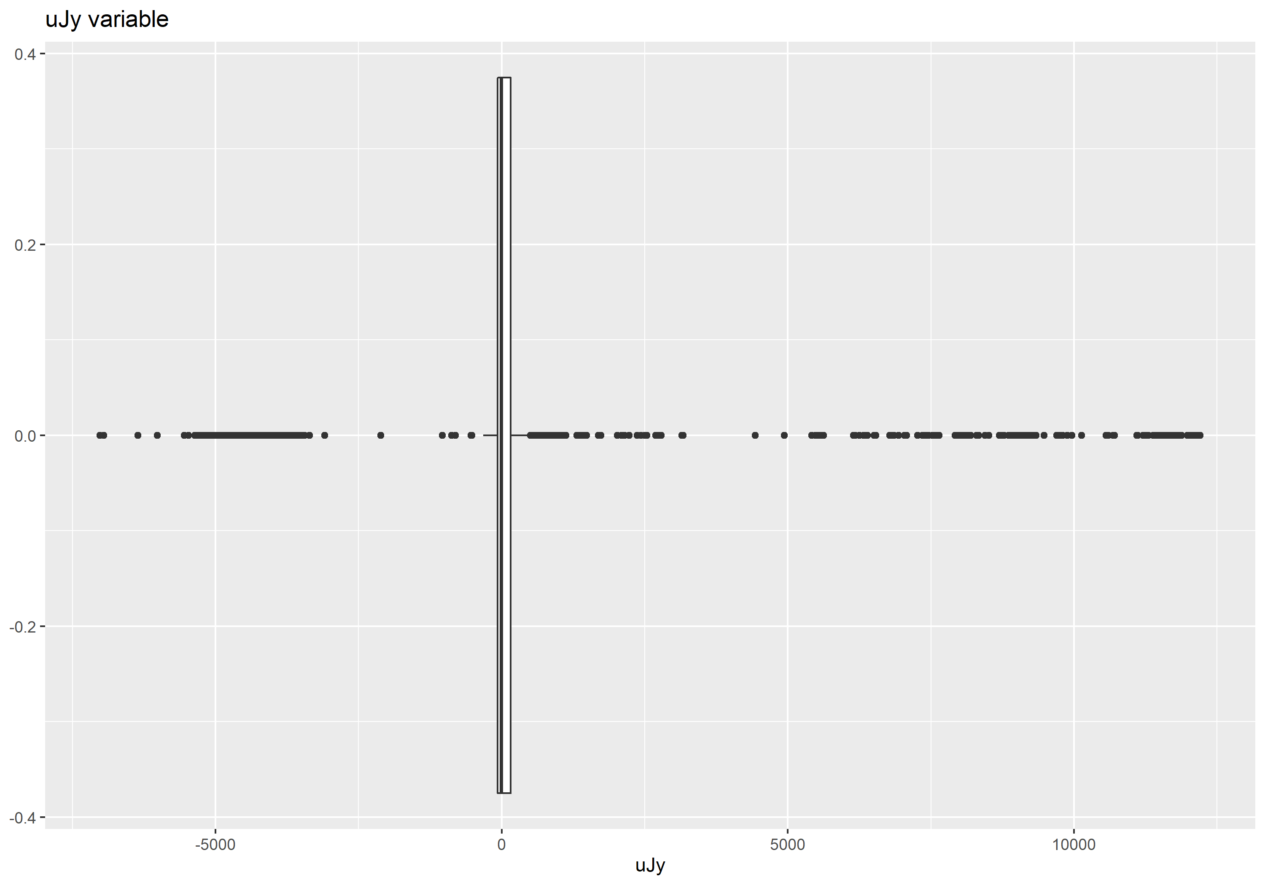
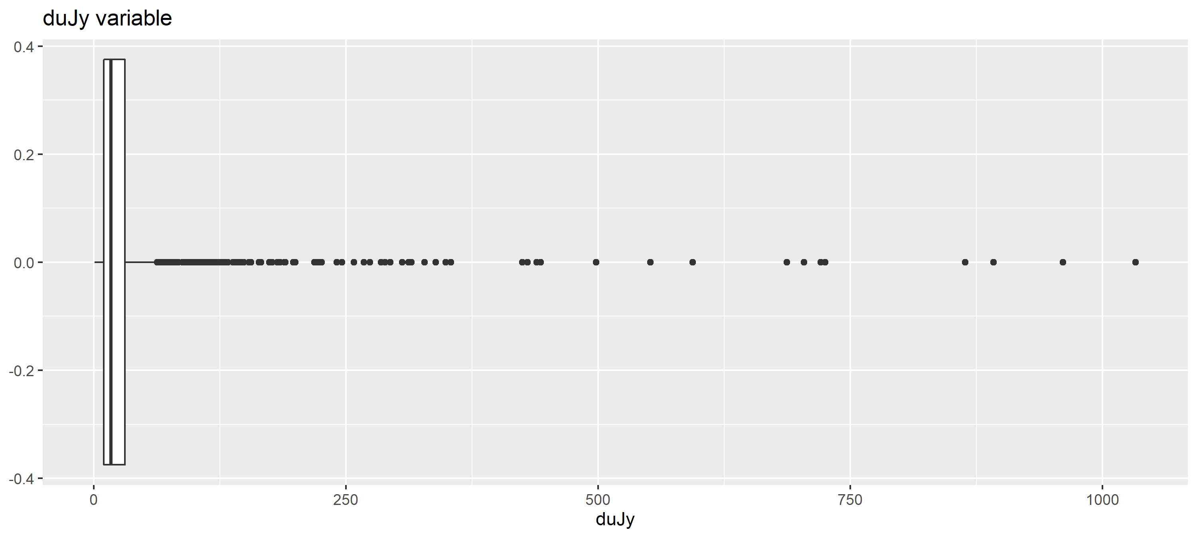
Box plots
Outliers for uJy and duJy variable

Slide 6
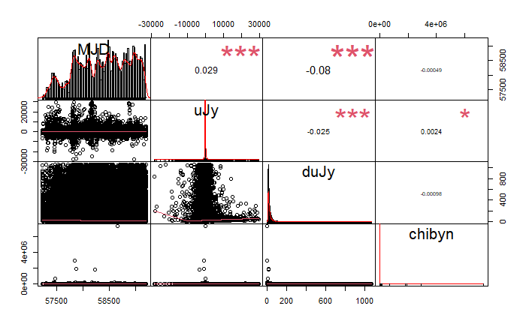
Correlation of variables
Correlation Matrix

Slide 7
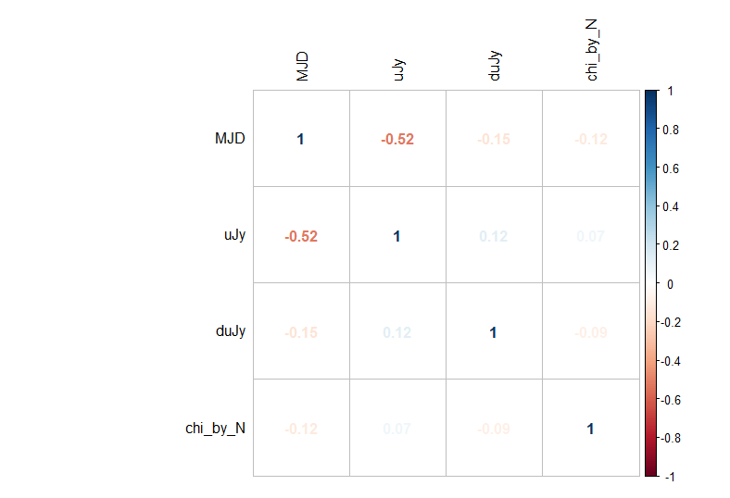
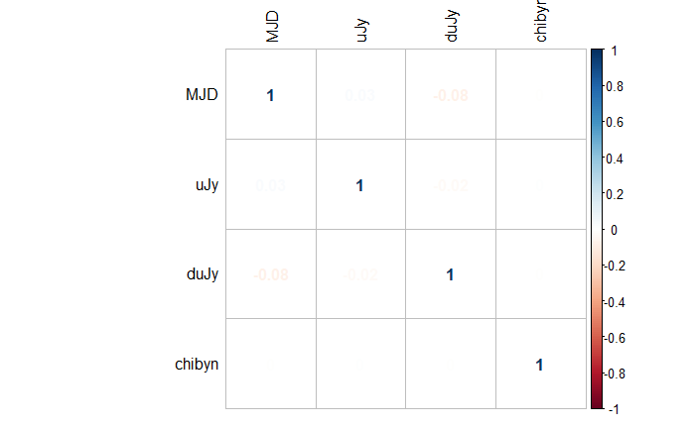
Correlation Matrix
Before Data Cleaning
After Data Cleaning

Slide 8
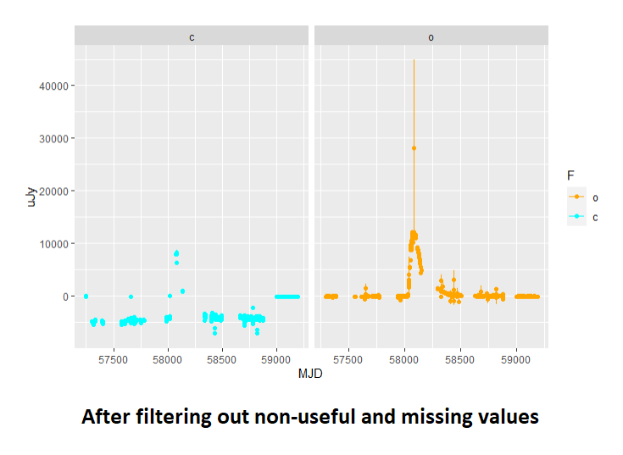
Data Cleaning
Retained only the required columns
Merged the data for all light curves with a new column for "uuid" to differentiate between them.
Renamed columns with special characters (MJD, chi/N)
Removing values for filter of color t, missing values and negative chi/N values.
Plots is for star 1000350600112828900

Slide 9
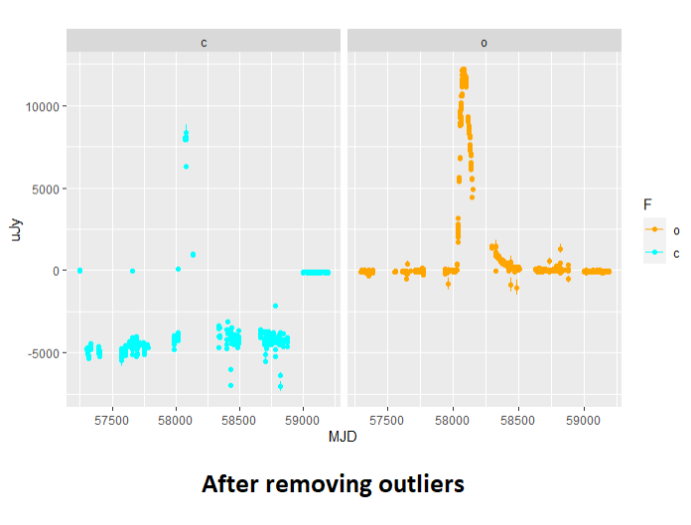
Outlier Removal
Removed values outside of 2 std deviations of median flux
Filtered out values outside of 1 std deviations of median flux error
Adjusted the baseline for negative values using rolling median for 15 days
Plot is for star 1000350600112828900

Slide 10
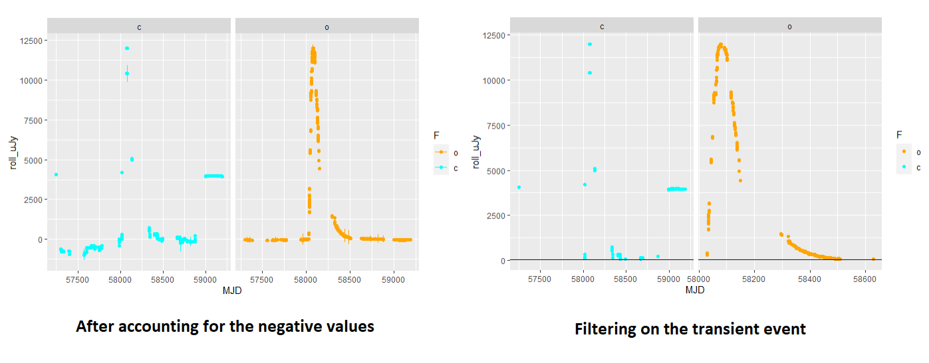
EDA and Data Cleaning Results

Slide 11
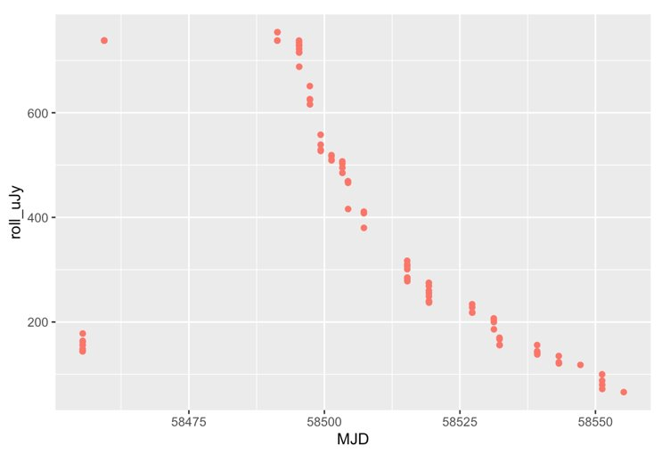
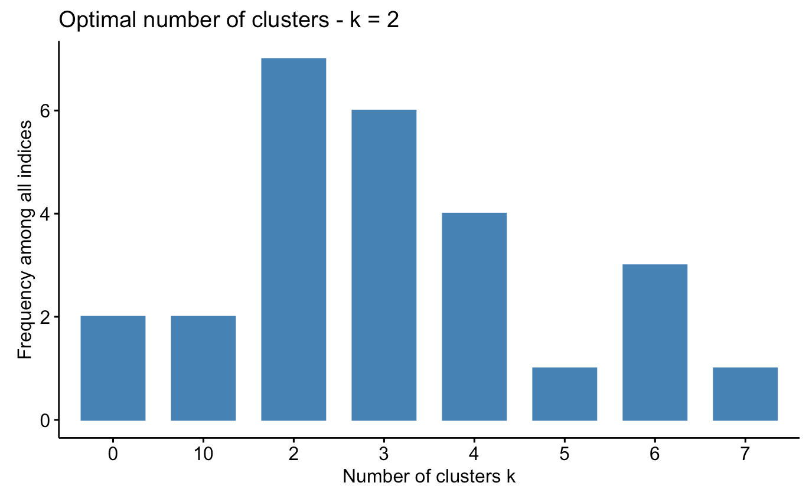
Cluster Analysis
Set flux to be above 60, works for majority
K-means clustering
GSS Graph
Plot is for star 105

Slide 12
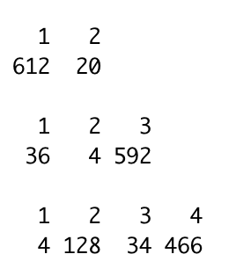
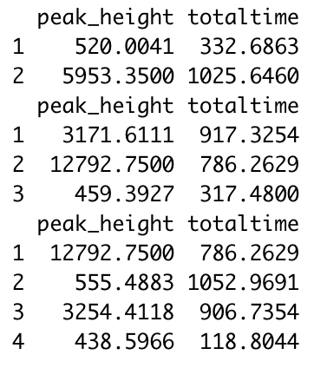
Explanation of Results

Slide 13
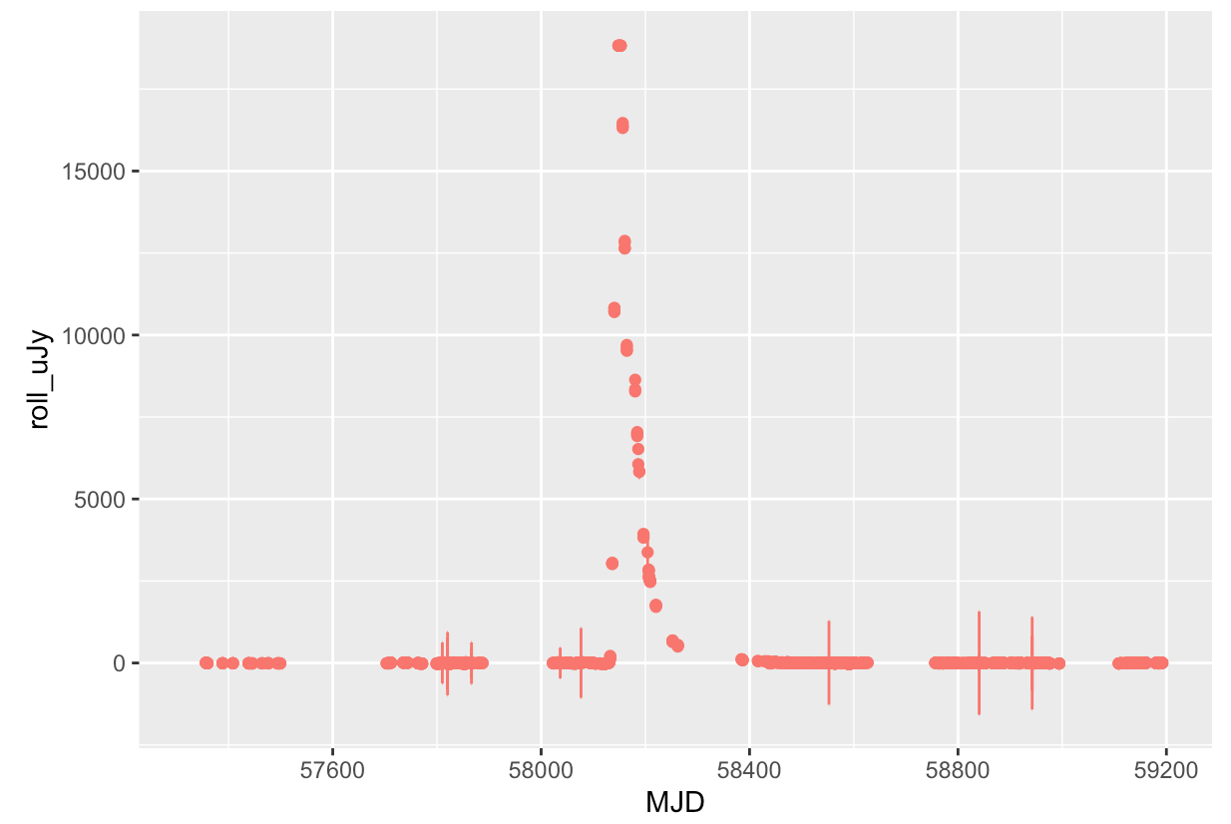
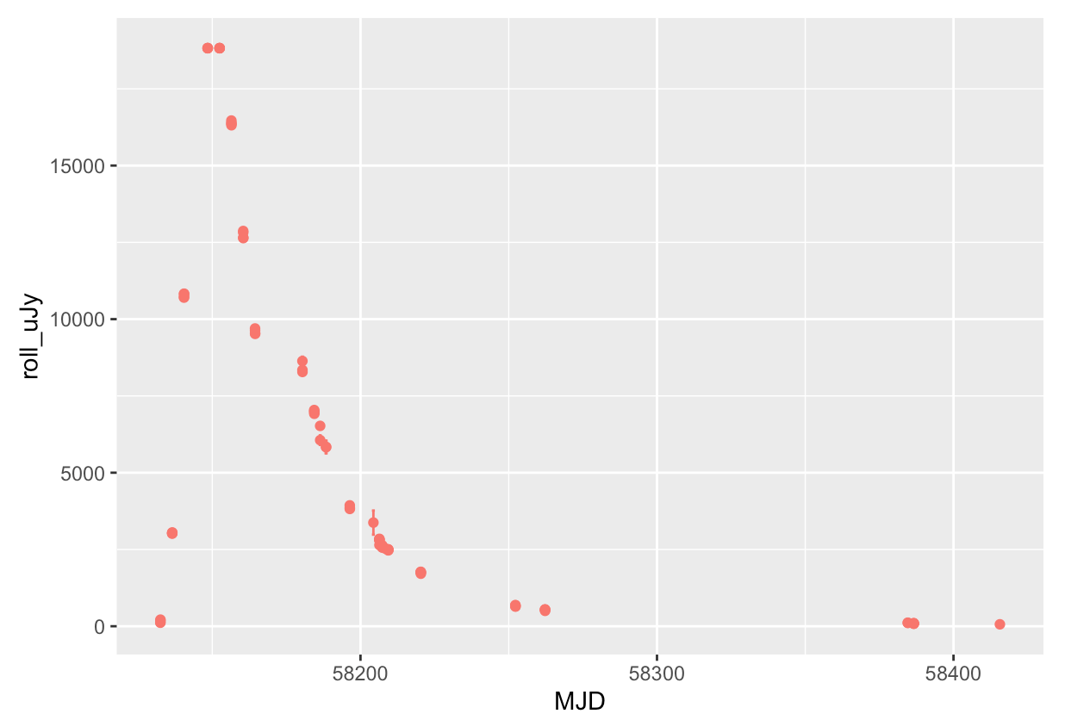
Explanation of Results: Cluster 1
Extremely High peak flux (Star 195 shown)

Slide 14
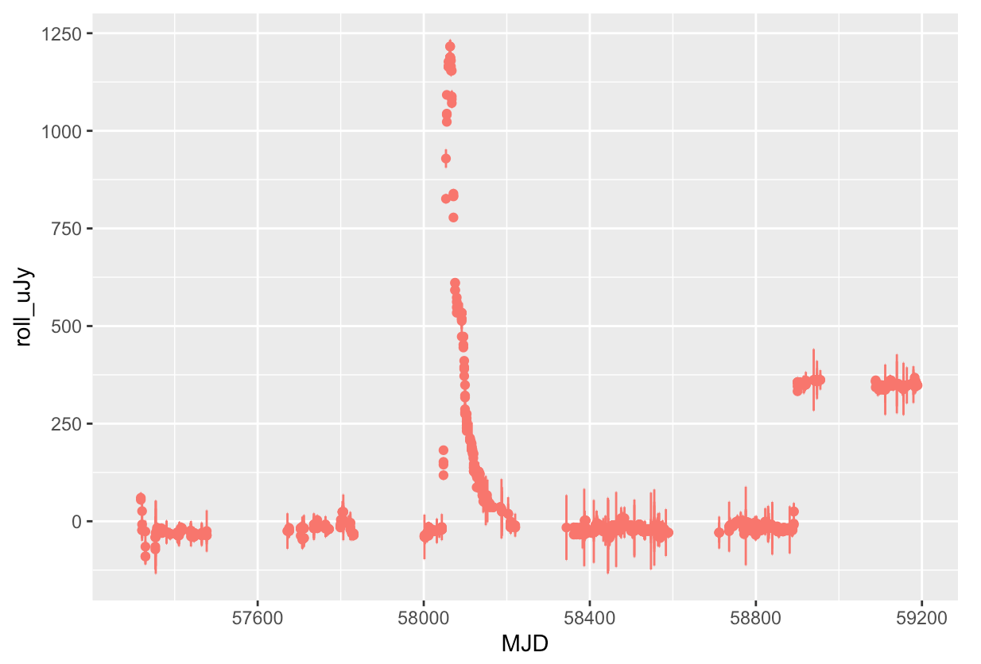
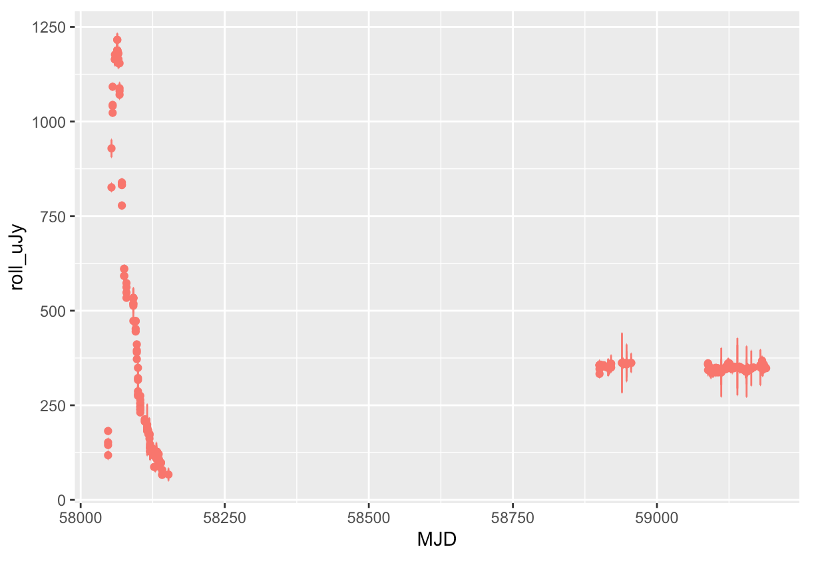
Explanation of Results: Cluster 2
Extremely long time elapsed due to arbitrary flux cut off (Star 150 shown)

Slide 15
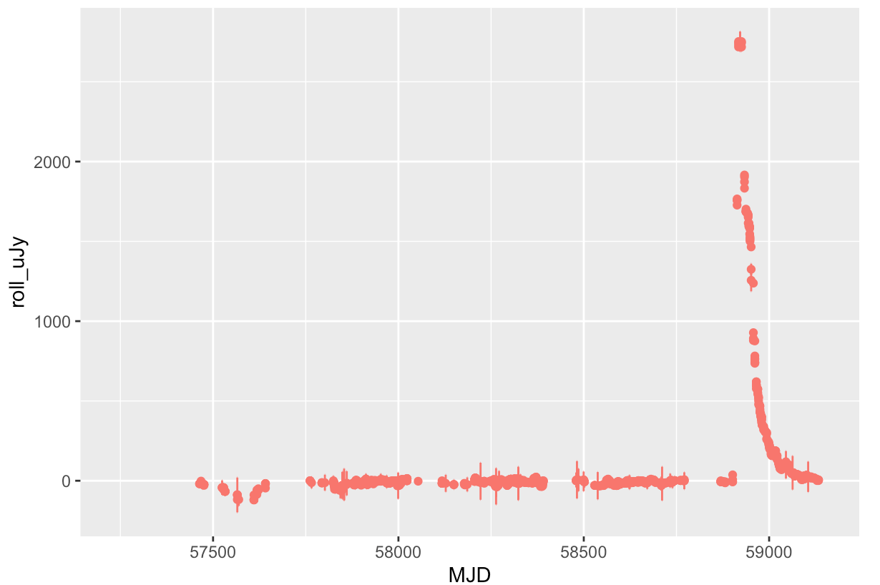
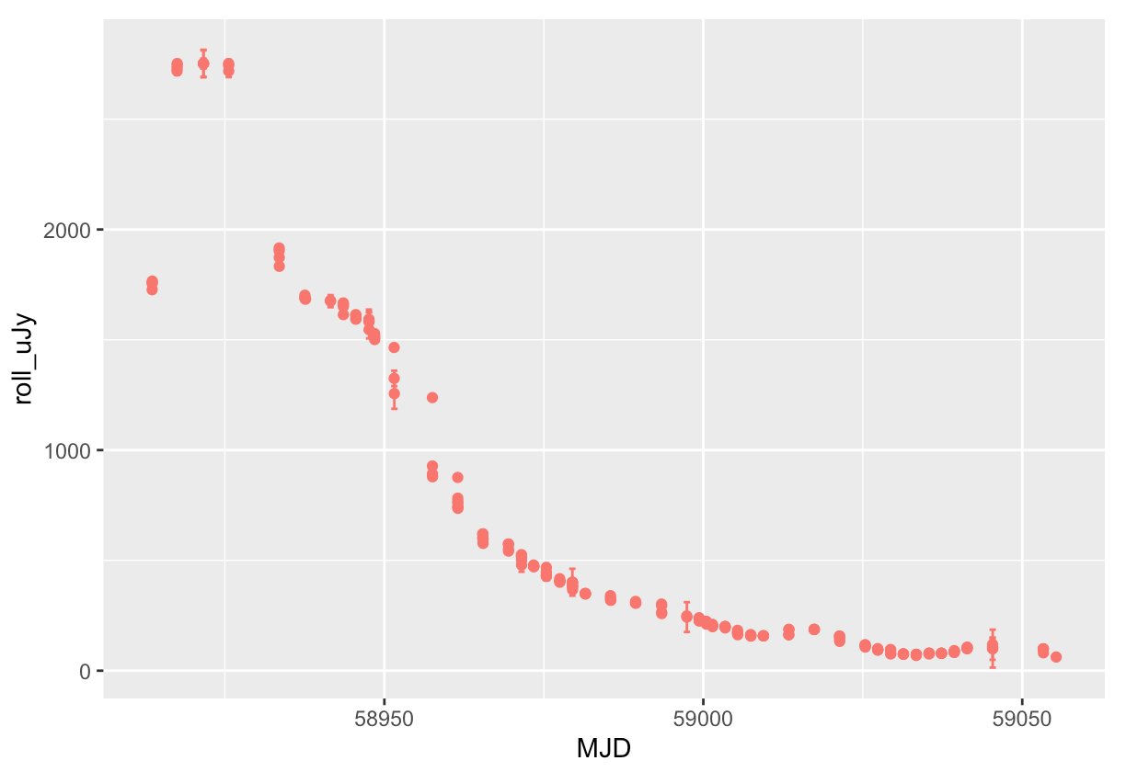
Explanation of Results: Cluster 3
High peak, long tail (Star 504 shown)

Slide 16
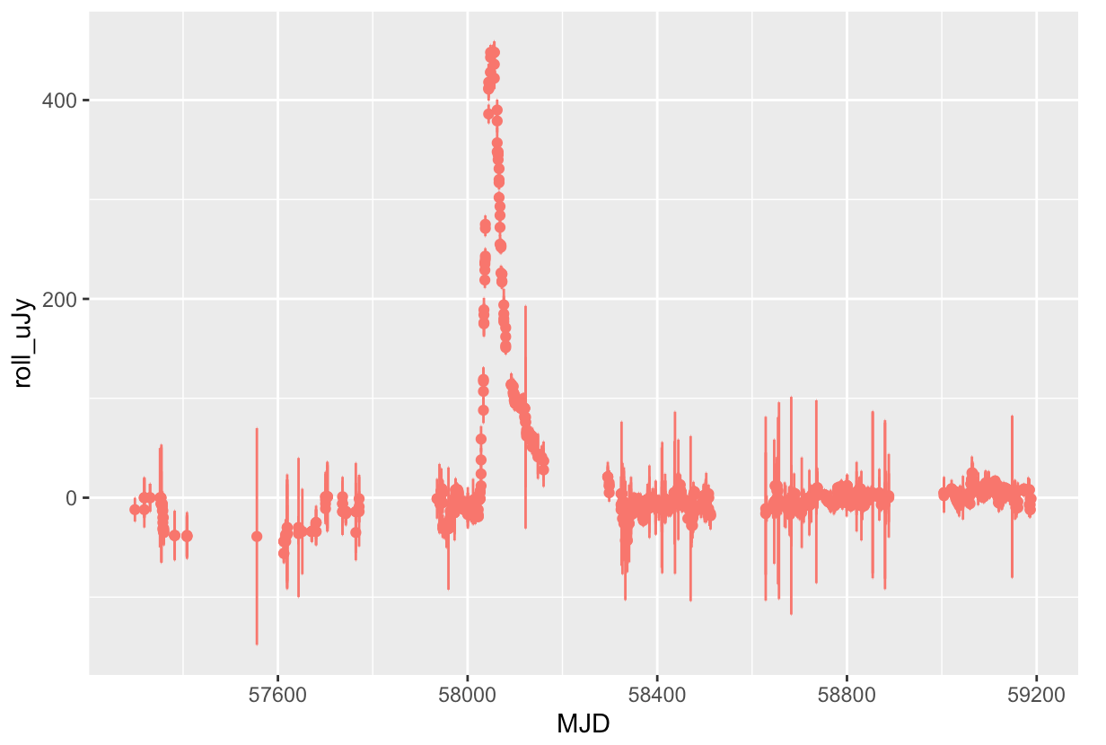
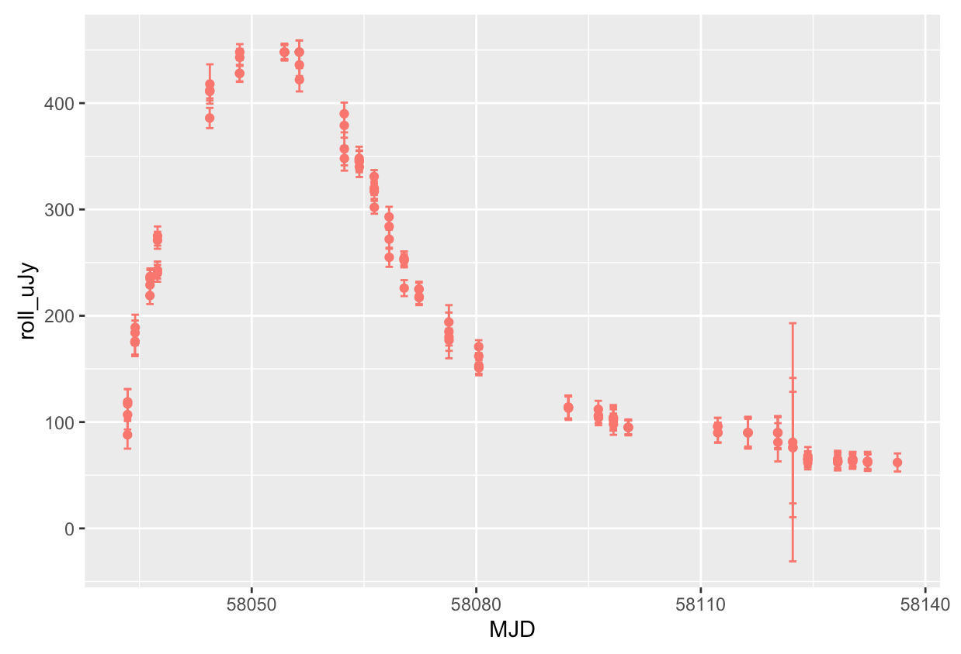
Explanation of Results: Cluster 4
Low peak, short tail (Star 12 shown)

Slide 17
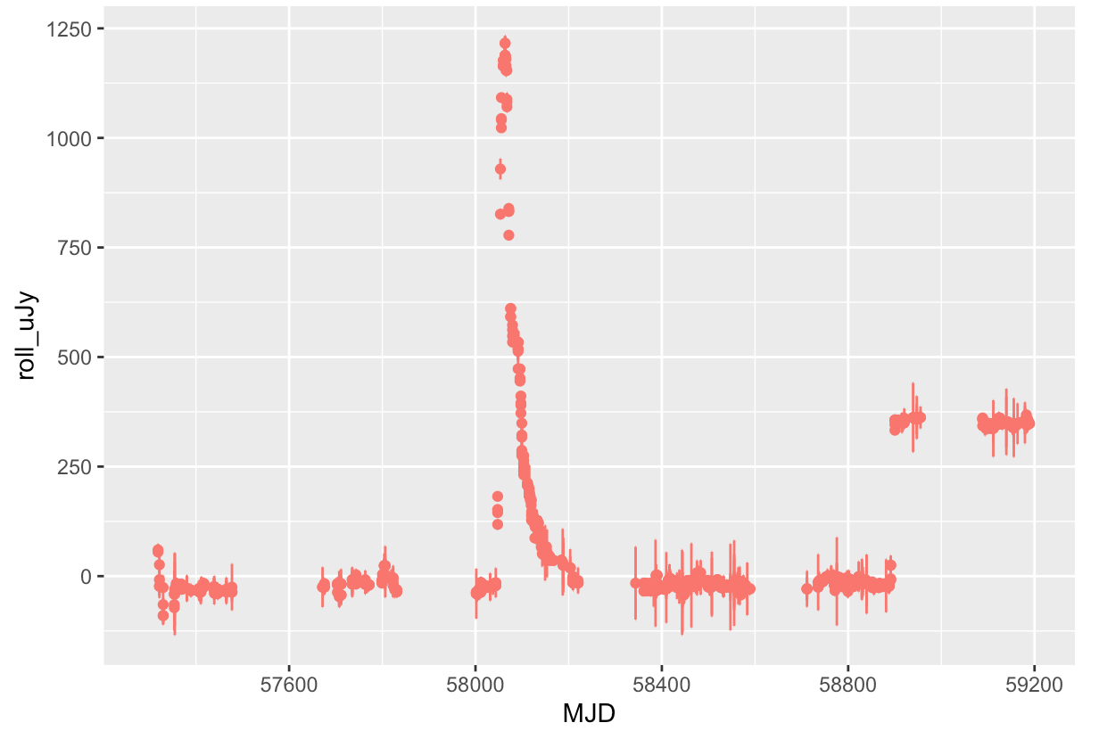
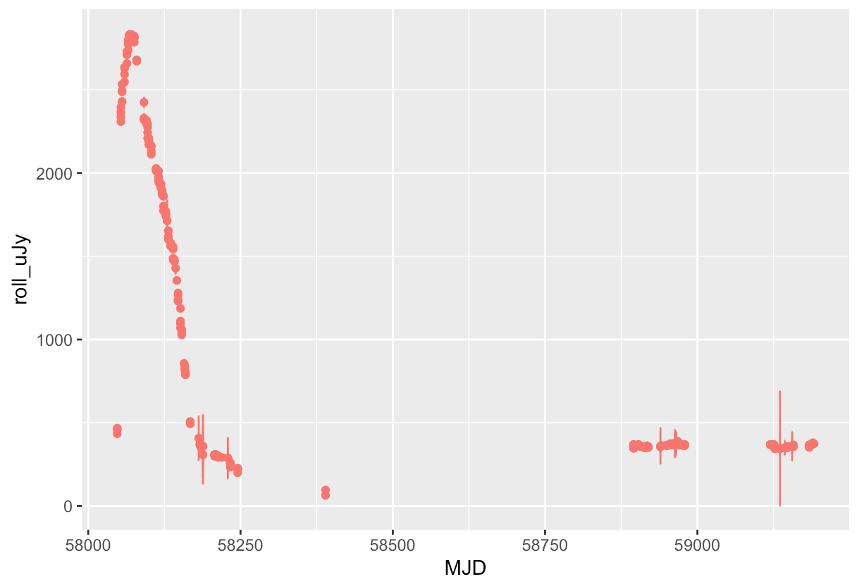
Possible Further Analysis
Use light curve functions
Find better way to isolate peaks, remove later spikes in flux equal to flux in peak (see image)
Plot is for star 200

Slide 18
Conclusion
Able to remove outliers effectively
Able to classify most curves, into type 1 and 2
Unable to identify subclasses of each type
Unable to isolate every peak in the different light curves

Slide 19
Thank you Any questions?

