Slide 1
Energia Group
The rise of the I-SEM Day Ahead Price and Trading Strategies
Yogesh Bore

Slide 2
Index
Introduction
Exploratory Data Analysis (EDA)
Significant Factors
Model and Variable Importance
Developing Trading Strategies
Trade Strategy Evaluation
Conclusion

Slide 3
Introduction
Part One : Variables that drive the DAINDEX Average Market Price (DAM)
Part Two : Focuses on developing trading strategies to try and profits across the different electricity prices

Slide 4
Exploratory Data Analysis (EDA)
Data Reading & Merging
Checked the Outliers (Boxplots)
Data Cleaning
Correlation Matrix and Chart

Slide 5
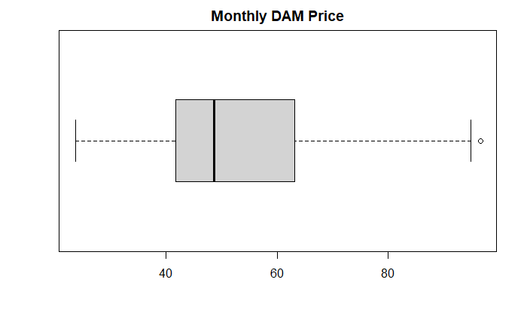
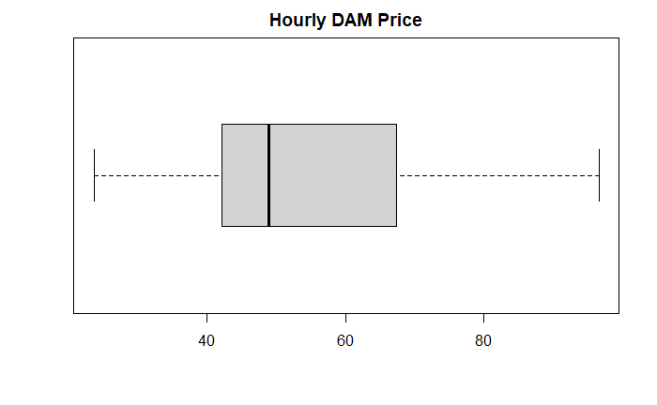
Box Plots
No outliers Present

Slide 6
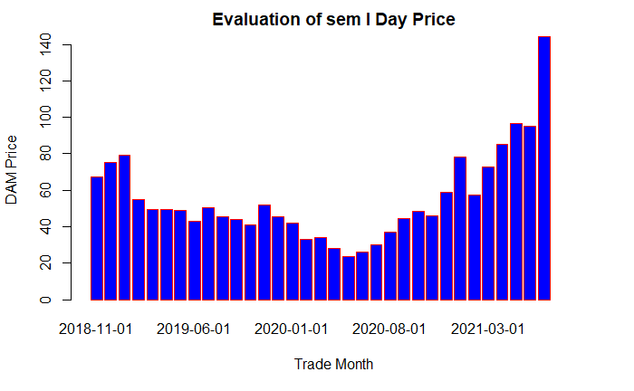
Bar Chart

Slide 7
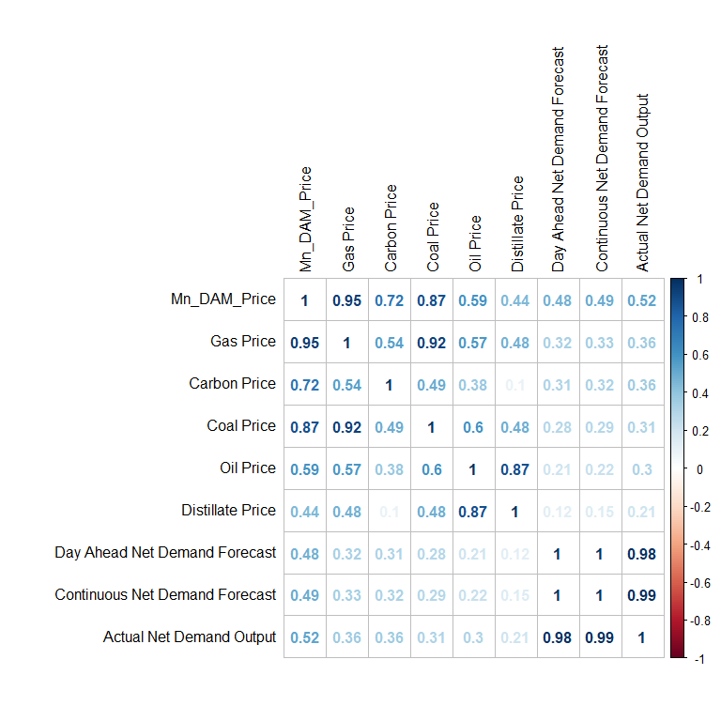
Correlation Matrix
Significant Factors:

Slide 8
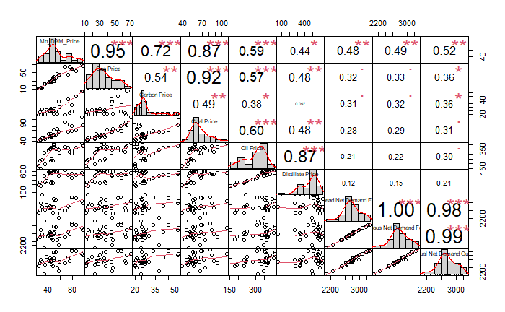
Correlation Chart

Slide 9
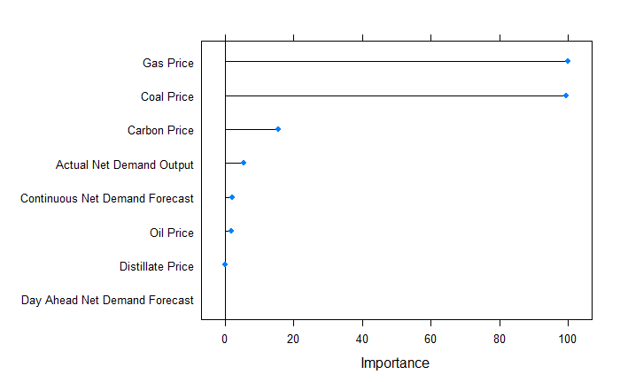
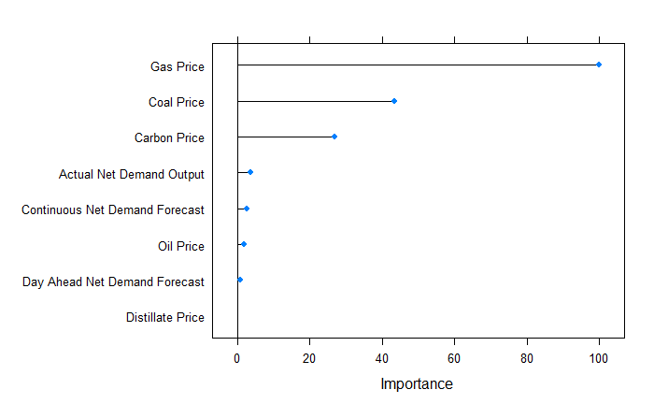
Model and Variable Importance
Random Forest
Variable Importance
Used Monthly Data
Used Hourly Data

Slide 10

Trade Strategy Evaluation
Long Trade examples
Buy 30 MW in DAM at €30. If we sell this 50MW in IDA1 at €36. We profit (€36-€30=€6)*60MW= €360
Short Trade example
Sell 30 MW in DAM at €30. If we buy this 50MW in IDA1 at €36. We lose (€30-€36=€-6)*60MWh= €-360

Slide 11
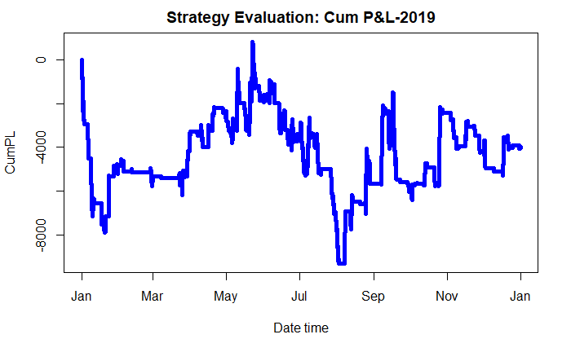
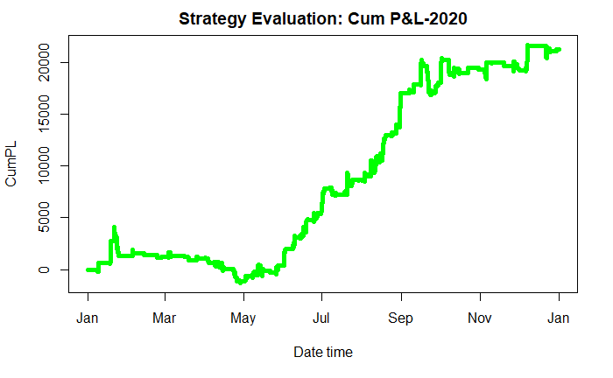
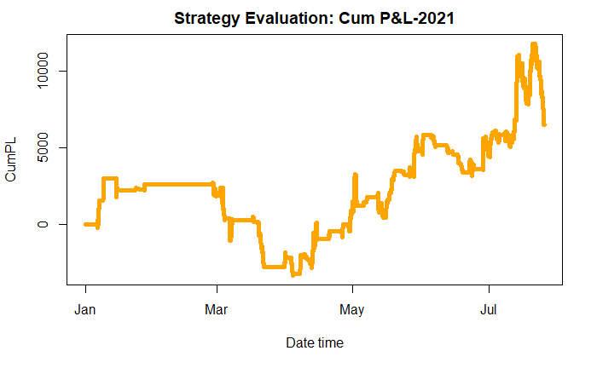
Strategy Evaluation: Cum.P&L

Slide 12
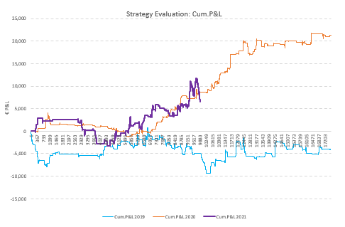
Strategies for 3 years
Sr. No. | Year | Total P&L | % of periods traded | Win Ratio
1 | 2021 | 6515.68 | 0.275080906 | 0.434191176
2 | 2020 | 21272.063 | 0.224822089 | 0.416054697
3 | 2019 | -3995.027 | 0.233561644 | 0.311339198

Slide 13
Conclusion
Successfully find the significant factors & the different trading strategies

Slide 14
Thank You !

