Slide 1
Team 6 QUB Analyathon 1
Bore Yogesh
Grefte Joshua
Jin Chao
Wang Ziqing

Slide 2
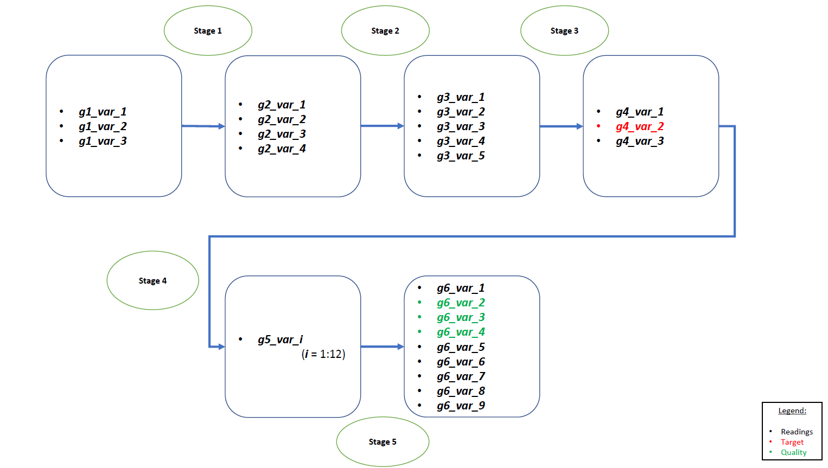
Problem overview
Data: multiple sensor recordings at each of 6 concurrent stages of a manufacturing process every 15 minutes for 6 months
Task: predicting irregularities in the g4_var_2 variable that represent 'out-of-control' process
Potential impact of 'out-of-control' process
Employee health
Machinery health
Raw material consumption
Utility consumption
Success metrics:
Predictive power
Earliest prediction

Slide 3
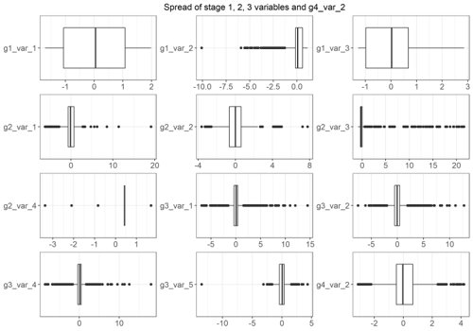
Data preparation & EDA
Two variables of zero variance removed (g3_var_3 & g6_var_9)
For modelling, stage 4 (except g4_var_2), 5 and 6 were removed
Multivariate summary statistics and boxplots confirm outliers in many variables
Missing values detected in first 21 rows of g4_var_2
Outliers to be retained in modelling therefore selected median as data imputation method

Slide 4
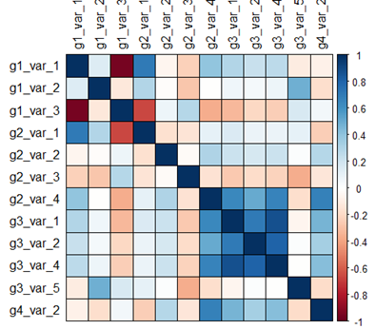
Data preparation & EDA
EDA limited to an extent with no data context
Strong negative correlation between g1_var_3 and g1/2_var_1
Strong positive correlation between the g3 variables
Correlation matrix

Slide 5
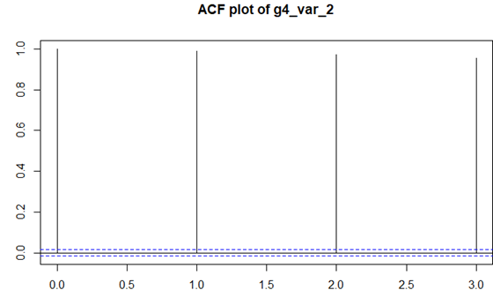
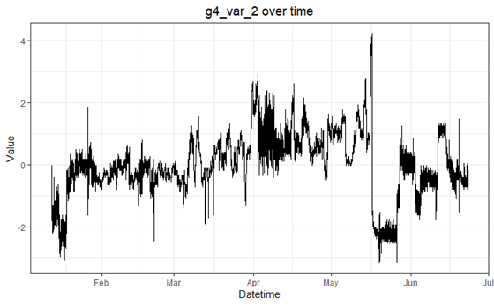
Data preparation & EDA
There does appear to be seasonal trends
ACF plot confirms autoregressive nature of the data
Variables lagged using XTS package to improve model performance
Dickey-Fuller test for stationarity at 3 lags returned a p-value of 0.01

Slide 6
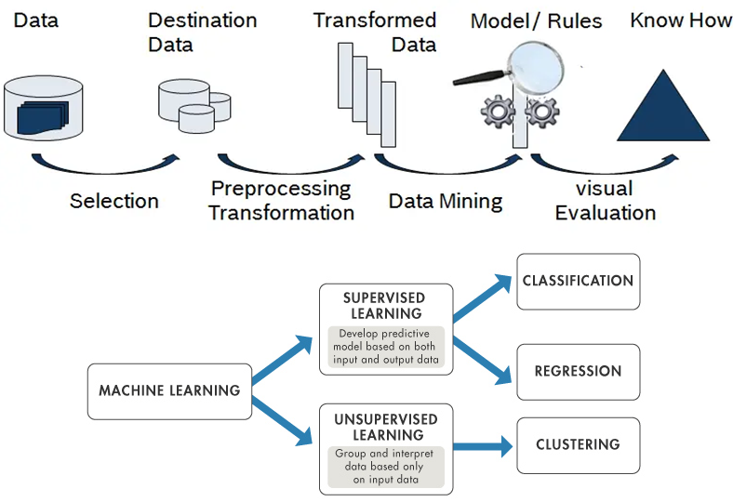
Model selection & Model outlines

Slide 7
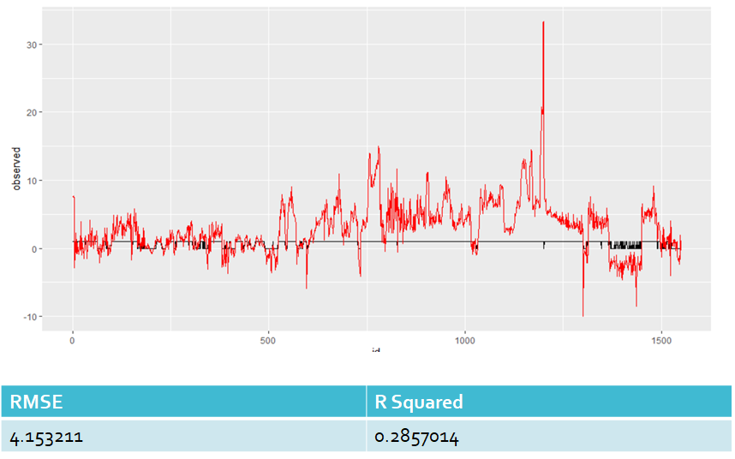
GLM - Logistic regression

Slide 8
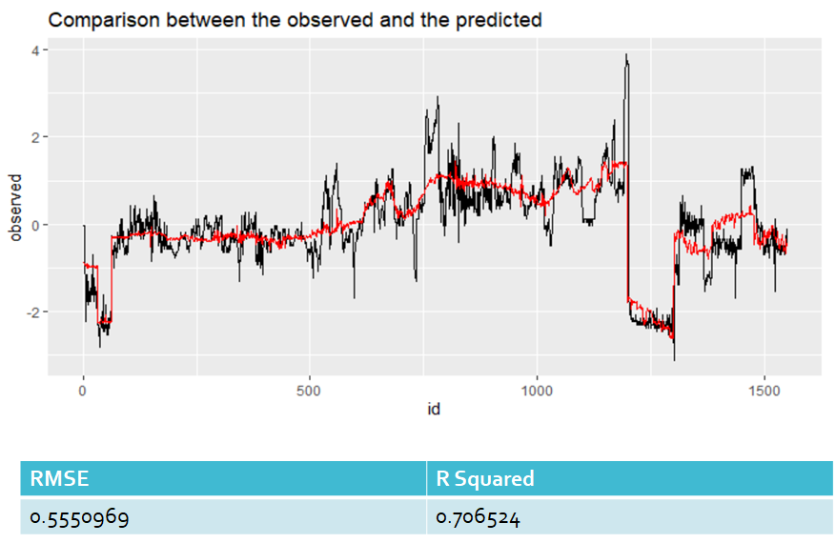
GAM - Generalized Additive Model

Slide 9
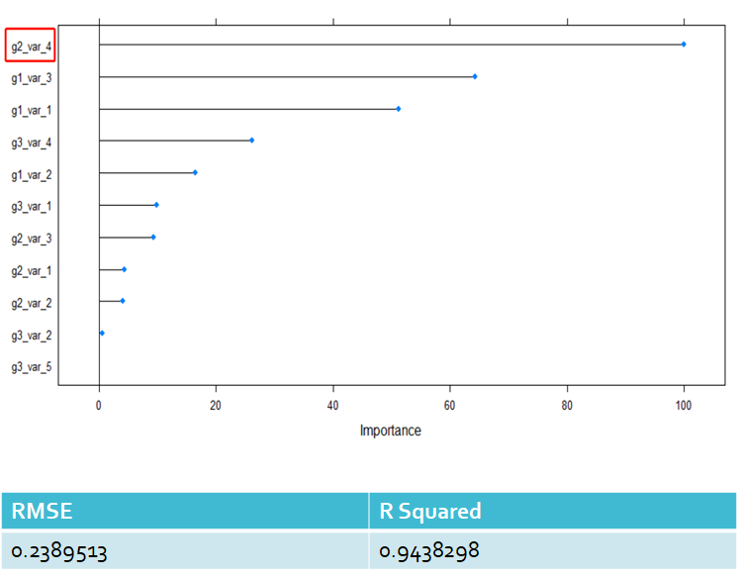
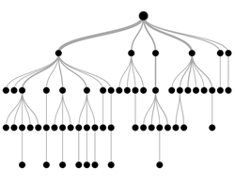
Random Forest

Slide 10
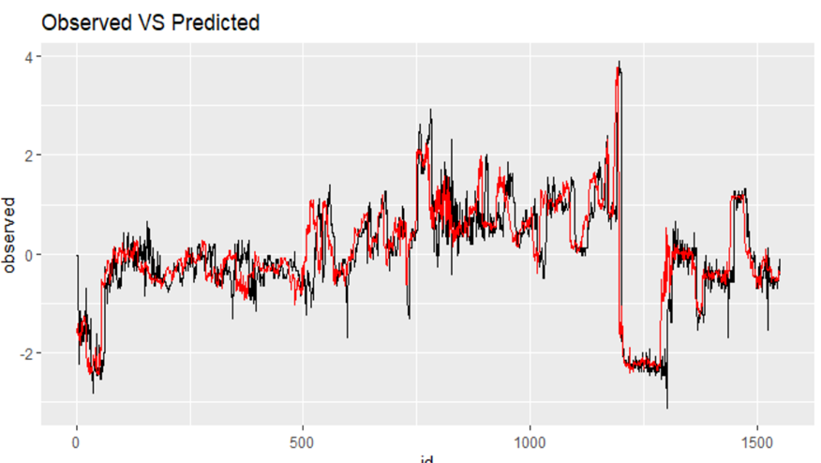
Predicted Value against Observed Value

Slide 11
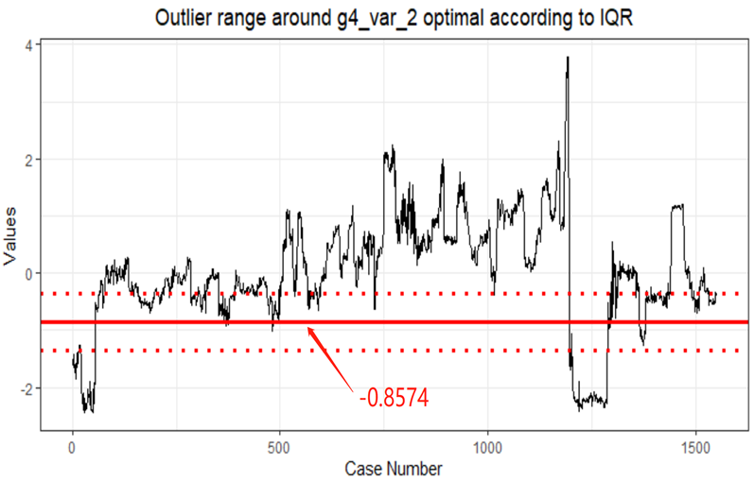
Predicted Value VS Optimal Value

Slide 12
Improvement of model
As PCA result indicates that g2_var_4 accounts for the greatest variance that is aligned with the prediction result on 3 stages’ data.
Comparison across all 3 stages:
 | Stage I Data | Stage II Data | Stage III Data
RMSE | 0.2905181 | 0.2409913 | 0.2389513
R Squared | 0.9185517 | 0.9428694 | 0.9438298

Slide 13
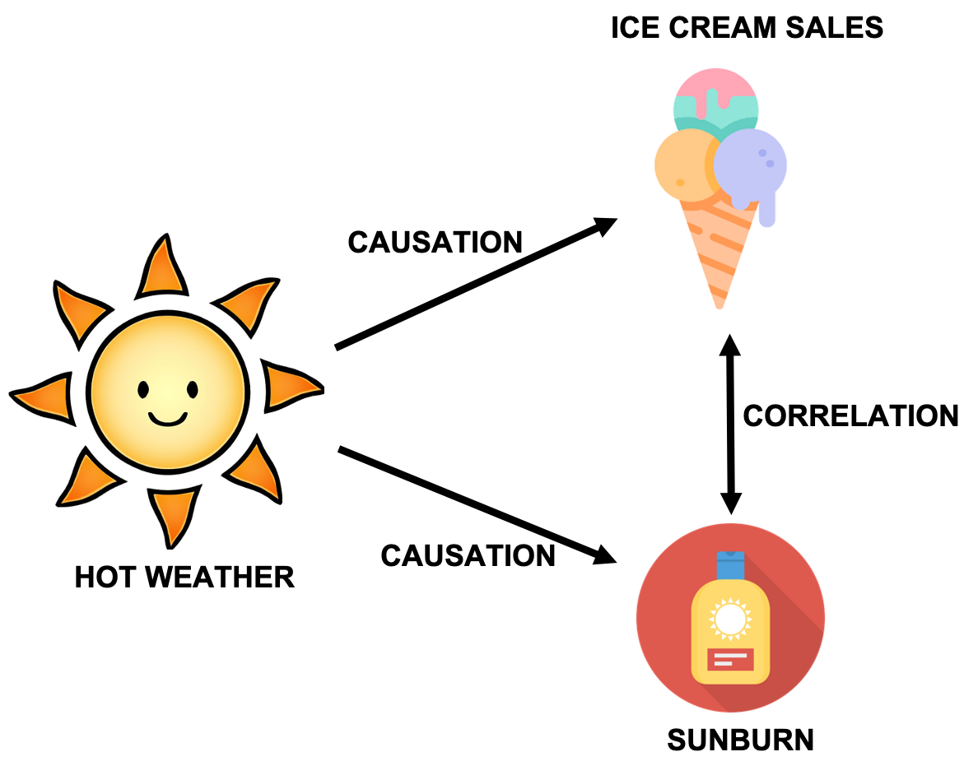
Carrelation between Variables
Correlation is a term that is a measure of the strength of a linear relationship between two quantitative variables
There is a positive relationship between hot weather and ice cream sales , sunburn
If hot weather changes both variables will also change
When ice sales increases sunburn also increase but both are not depends on each other
That is ice cream does not cause sunburn
However hot weather does cause ice cream sales and sunburn
Fig b0: Correlation and Causation

Slide 14
Relationship between g4_var_2 and g6_var_2/3/4
What is Correlation? : standardized covariance measure
Used to detect hidden patterns & relationship among variables
Used "corrplot " R package to find out relationship between group 4 variable and group 6 variables.
Given correlation plot will show case the relationships of these variables.
We can find out positive, negative and neutral relationships between given variables
This relationship is used for the prediction and decision making purpose.

Slide 15
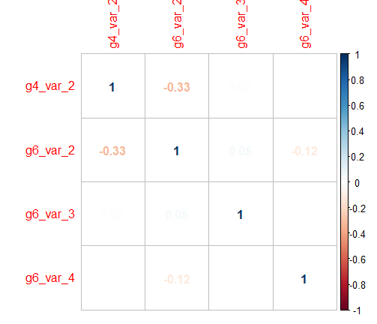
Correlation Matrix Plot
Correlation Matrix Plot
Color intensity and number are proportional to the correlation coefficients.
The variables have perfect correlation with itself can see in diagonal values
There's a weak negative correlation between g6_var2 and g4_var2 (-0.33)
There's a weak negative correlation between g6_var4 and g4_var2 (-0.12)
Neutral correlation (No relationship between g6_var4 and g4_var2 (0.05)
Variable Names
Fig b1: Correlation matrix Plot

Slide 16
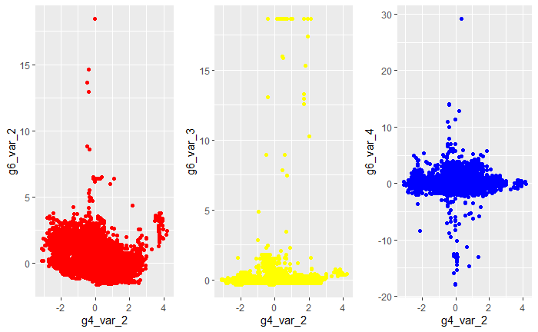
Scatter Plots
Scatter Plots of 4 variables
Correlations:
g6_var2 & g4_var2 : weak negative
g6_var3 & g4_var2: weak negative
g6_var4 & g4_var2: Neutral
Fig b2: Scatter Plots for group 4 and group 6 variables

Slide 17
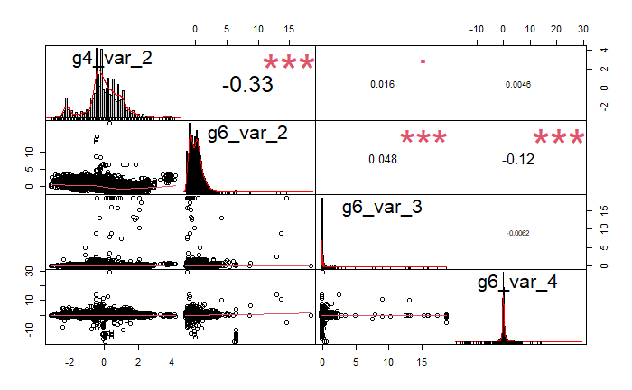
Correlations Chart
Correlation chart
The distribution of each variable is shown on the diagonal.
On the bottom of the diagonal : the bivariate scatter plots with a fitted line are displayed.
On the top of the diagonal : the value of the correlation plus the significance level as stars
Each significance level is associated to a symbol : p-values(0, 0.001, 0.01, 0.05, 0.1, 1) <=> symbols(“***”, “**”, “*”, “.”, " “)
Fig b3:Correlation Chart

Slide 18
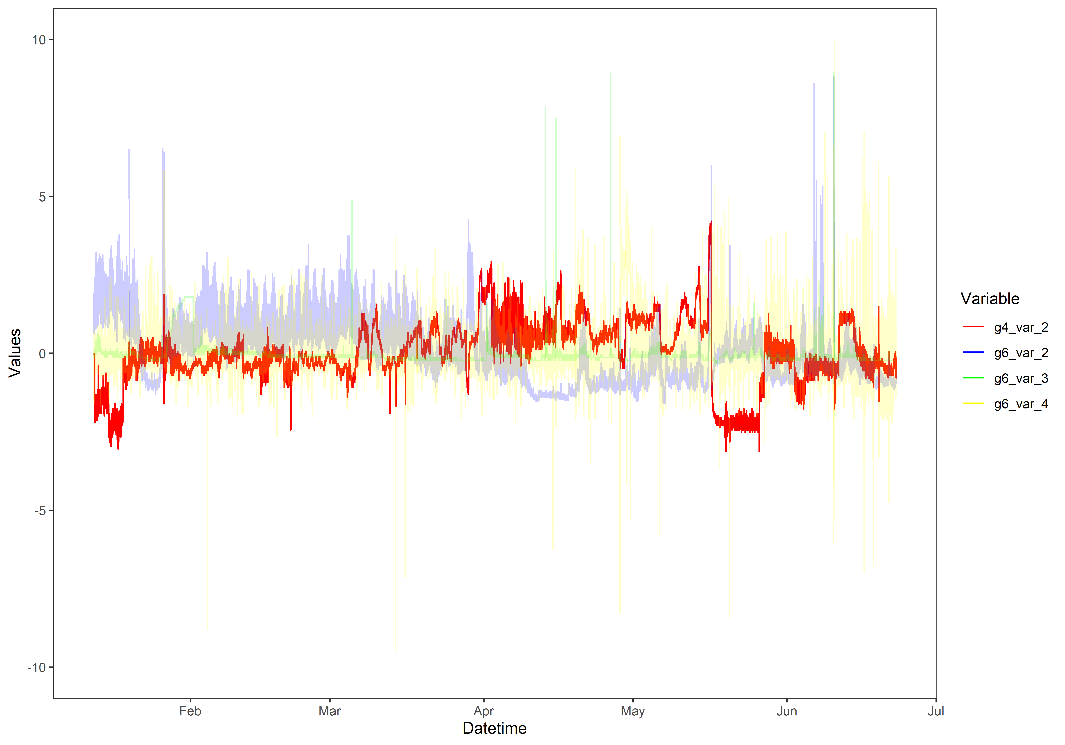
Line Graph
Line Graph for 4 variables
Ploted all 4 varibales with respect to Datetime.
All 4 variables have very weak correlation
Outliers are not overlaps Because of weak relationship between them

Slide 19
Why to use Correlations
Prediction : Predictions about one variable from another.
Validity : Concurrent validity (correlation between a new measure and an established measure).
Reliability : Used to test the reliability of the product
Research :Mostly used in areas where experimental research happed.

Slide 20
Conclusion
Tidying the data: removing columns
Checking the data: missing value imputation
Exploratory analysis: correlation between variables; outliers; data distribution;
Creating figures: Covariance matrix, PCA, Boxplot.
Statistical modeling and Prediction: ranger...
G4 _var_2 VS G6

Slide 21
Model Results
Model | Generalized additive models (GAM) | Generalized linear model(GLM) - Logistic regression | Random Forest
Results | R^2: 0.706524 RMSE: 0.5550969 | R^2: 0.2857014 RMSE: 4.153211 | R^2: 0.9438298 RMSE: 0.2389513

Slide 22
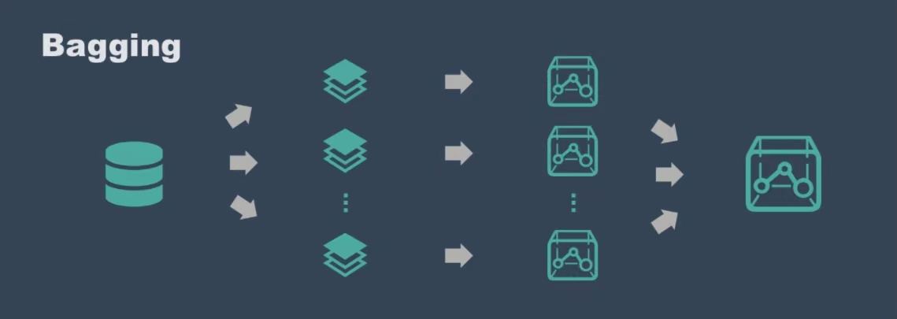
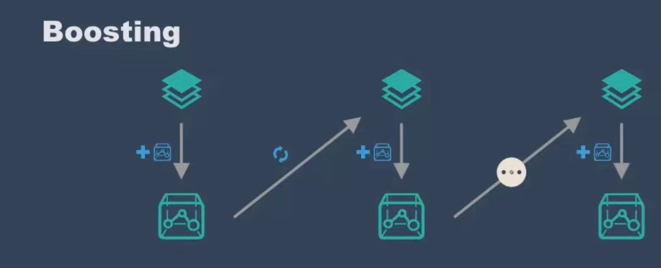
Where to go from here?
• Think about how you might integrate any models you’ve developed.
Bagging, Boosting...

Slide 23
Where to go from here?
• Think about where this data could be found.
manufacturing engineering industry, food industry, chemical industry, supermarkets/malls....
• Think about how you would carry out any pre-processing required before being processed by your model
data standardization and normalization
• Think about how you would show the results from your model.
confusion matrix, RMSE, R^2...

