Slide 1
Design and Simulations of Material Flow During Non-Uniform Deformation of Alloys
-Yogesh Nemade (ENGS1516)

Slide 2
Model
Billet
Type – 3D plastic
Cross-section – 140 mm x 80 mm
Length – 500 mm
Roller
Type – 3D rigid
Diameter – 200 mm
Width – 160 mm
Additional step for final two roller to restrict material flow

Slide 3
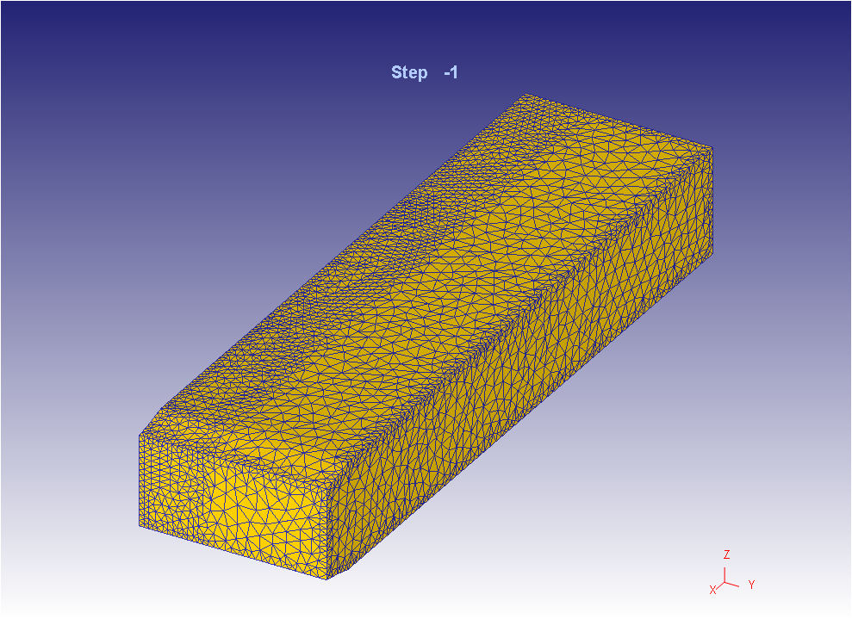
Meshing
Billet
Number of elements – 60,000
Size ratio – 4
Mesh density windows – 1 (1e-5)

Slide 4
Top Roller
Number of elements – 35,000 and 40,000
Size ratio – 4
Mesh density windows – 2 (1e-5)
Bottom
Number of elements – 35,000
Size ratio – 4
Mesh density windows – 2 (1e-5)

Slide 5
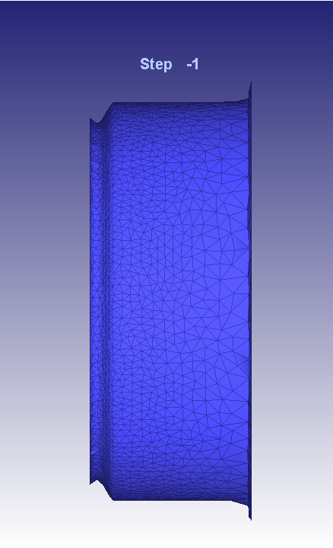
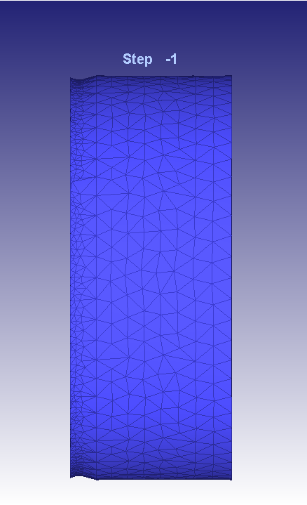
Mesh generated for top roller
Mesh generated for bottom roller

Slide 6
Contact Parameters
Penalty contact condition with μ=0.3
Mechanical to heat generation factor = 0.9
Contact thermal conductance =2000 N/sec/mm/C
Heat tranfer coefficient with environment (30 °C) = 0.02 N/sec/mm/C

Slide 7
Boundary Conditions
Condition | Part | Value
Displacement | Left face of the billet | 0
Initial temp. | Billet | 1000 °C
Initial temp. | Rollers | 400 °C
Angular vel. | Roller-1 | 1 rad/sec

Slide 8
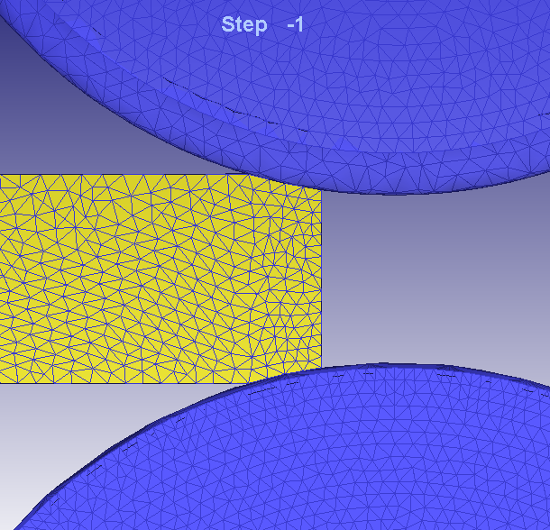
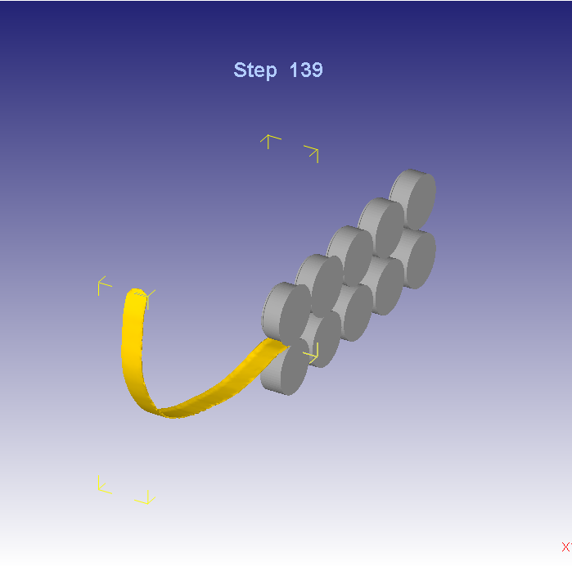
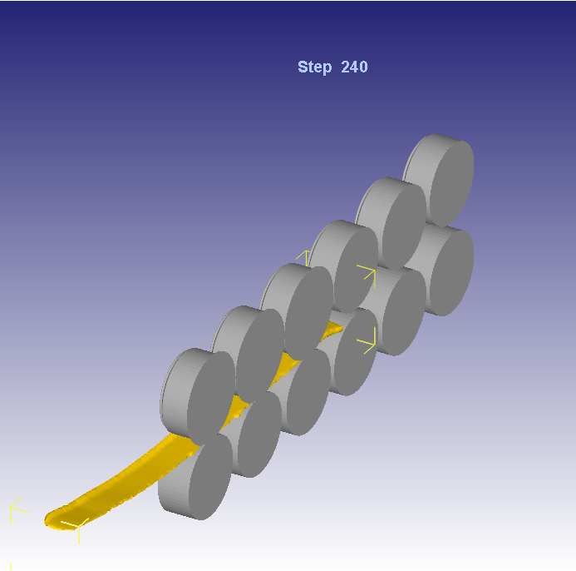
Changes done from past simulations
Reduced the contact arc to half the initial length
6 pass design
Initial Contact
Bending in 5 Pass
Less Bending in 6 Pass

Slide 9
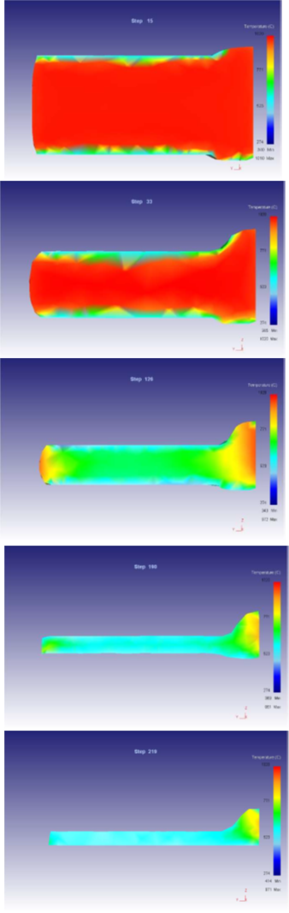
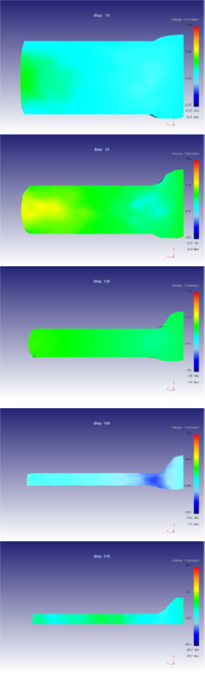
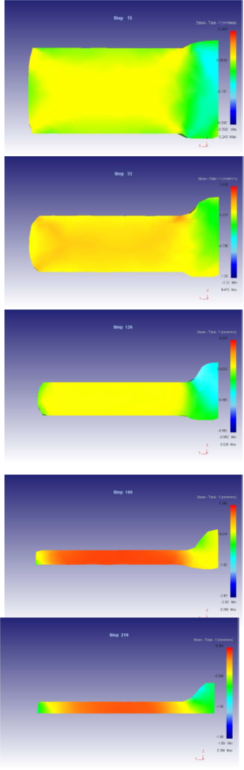
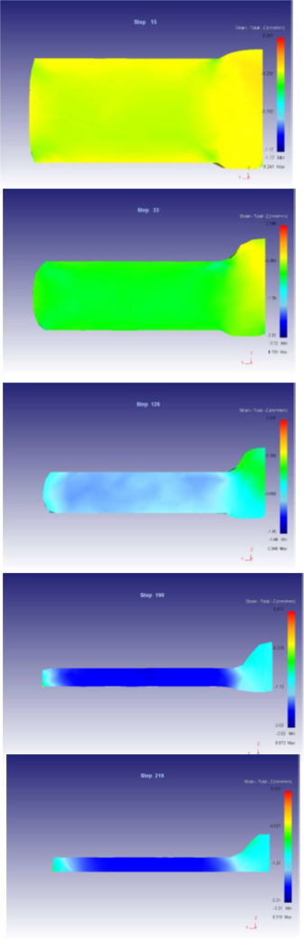
Temperature
Lateral Velocity
Lateral Strain Y
Strain Z
1
2
3
4
5

Slide 10
results
Pass | Lateral spread (mm) | Bulb height (mm) | Strain at bulb section | Strain in flat section
1 | 143.53 | 5.7456 | 0.179 | 0.1838
2 | 150.356 | 14.4424 | 0.4738 | 0.4728
3 | 155.303 | 16.9863 | 0.8684 | 0.8686
4 | 159.051 | 17.1746 | 1.458 | 1.485
5 | 160.3 | 17.218 | 1.634 | 1.657

Slide 11
summary
Simulation for non-uniform deformation of 1045 billet
Material properties from SFTC material library
The study was done for British Bulb bar dimensions that can be expanded to other standards
- THANK YOU

Slide 12
