Slide 1
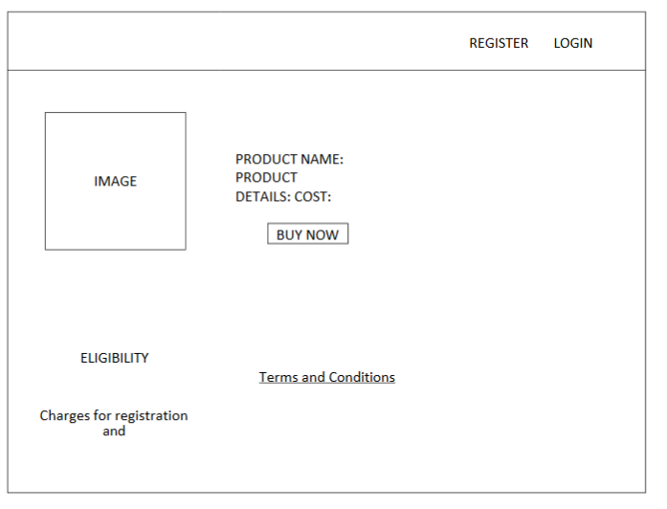
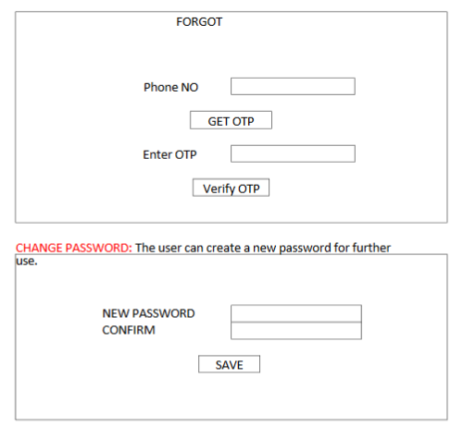
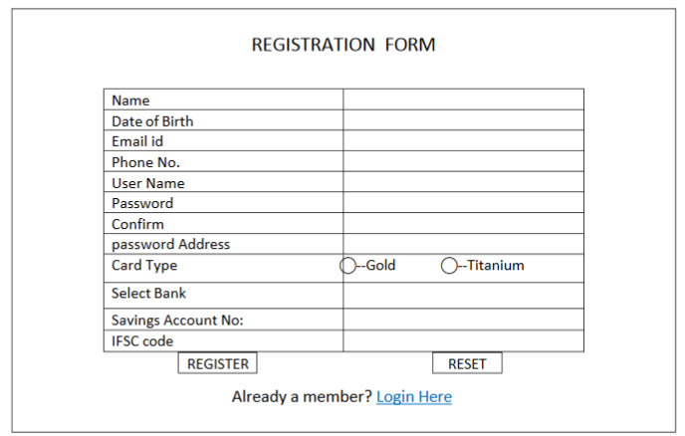
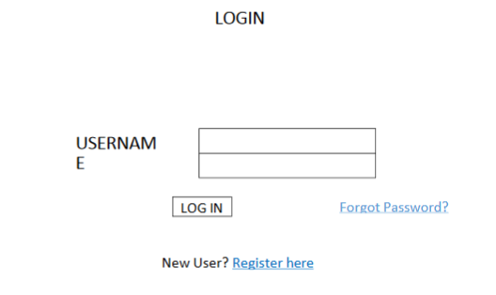
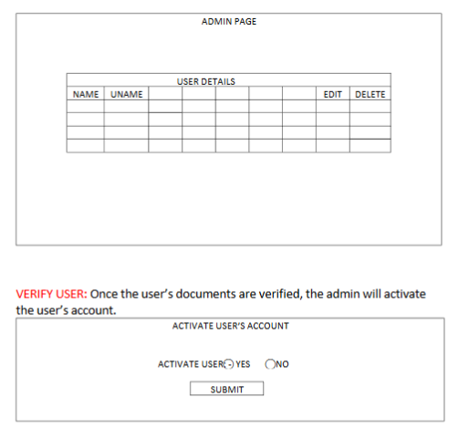

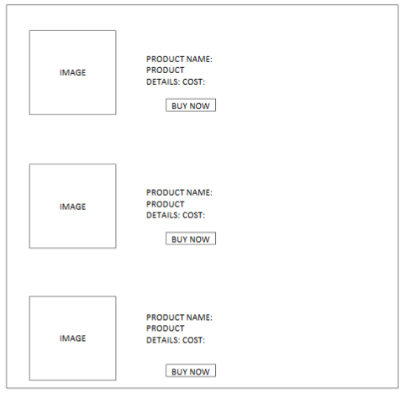
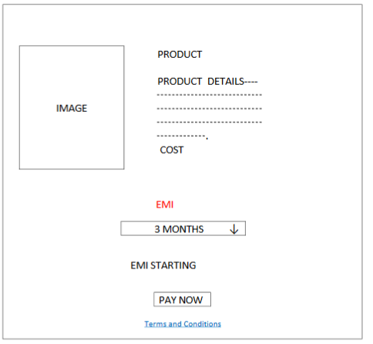
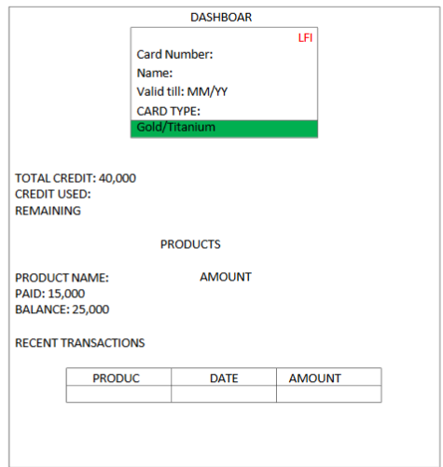

Slide 2
ERD
Login details
Card
fk+PK
User Name/customer_ID
Password
card_no;(PK)
name;
card_type;
validity;
cvv;
REGISTRATION
Name
Date of Birth
Email id
Phone No.
User Name/customer_id -
Password-
Role
Address
Card Type
Select Bank
Savings Account No:
IFSC code
Product
User Name/customer_id
product_id;(PK)
Product_name;
Product_details;
product _price;
fk
Order
pk
pk
fk
product_id;(FK)
quantity
customer_id(FK+PK)
Order date;
EMI
Admin
EMI
User Name/AdminID
EMI_Status(A/R)
User_Status(A/D)
customer_id(FK+PK)
Adhar number
name
photo

Slide 3
Resgister
Product
Dashbord
Login- User/admin
Product Details
PRODUCT INFO PAGE

