Slide 1
Status update 24/0924

Slide 2
Tasks planned for last week
Identify price scenarios
Run PWL, gurobi_ml and proposed models with the price scenarios
Verify PCAR and PCTAR models
Penalty sensitivity analysis

Slide 3
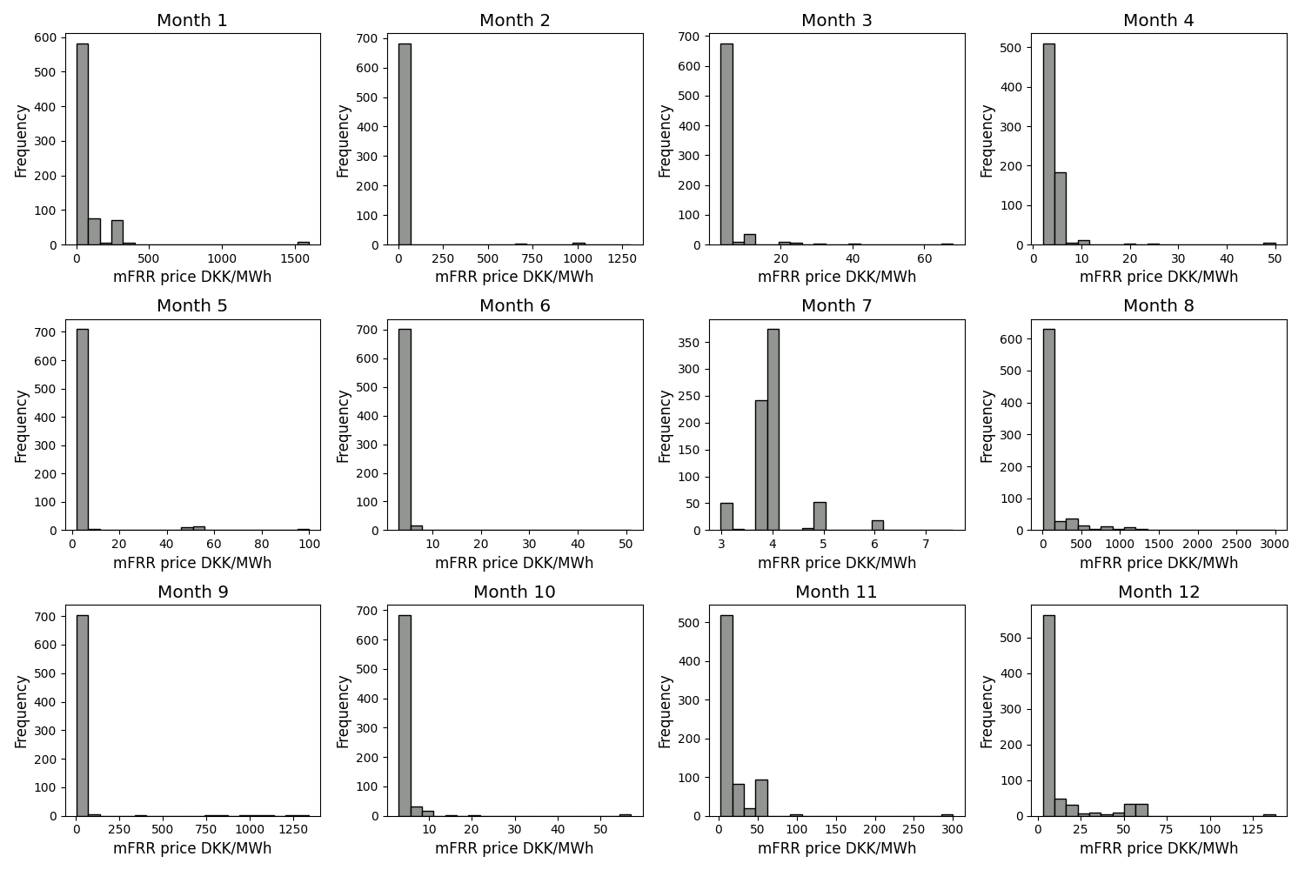
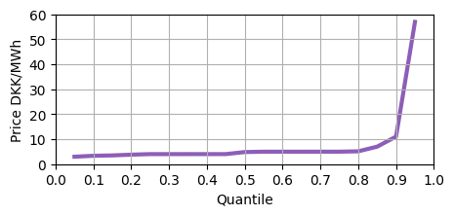
Price scenarios
Price ranges
  Low prices – 0-10 DKK/MWh
  Med prices – 25-100 DKK/MWh
  High prices 150+ DKK/MWh
Selected 10 price scenarios each
Low price scenario is most likely case

Slide 4
Run PWL, gurobi_ml, proposed models
Price scenario | Methodology | Average net revenue DKK | Average run times seconds | Average CPU times seconds | No. of suboptimal solutions
High | PWL | 50151.951 | 14.670 | 108.987 | 0
 | Gurobi ML | 50253.372 | 3.134 | 15.611 | 0
 | Proposed | 50669.906 | 0.034 | 0.042 | 0
Medium | PWL | 3900.817 | 884.304 | 8762.400 | 1
 | Gurobi ML | 3678.369 | 7.843 | 44.914 | 0
 | Proposed | 3894.101 | 0.031 | 0.041 | 0
Low | PWL | 239.108 | 2862.901 | 26112.952 | 5
 | Gurobi ML | 170.981 | 15.474 | 0.570 | 0
 | Proposed | 226.277 | 0.035 | 0.037 | 0

Slide 5
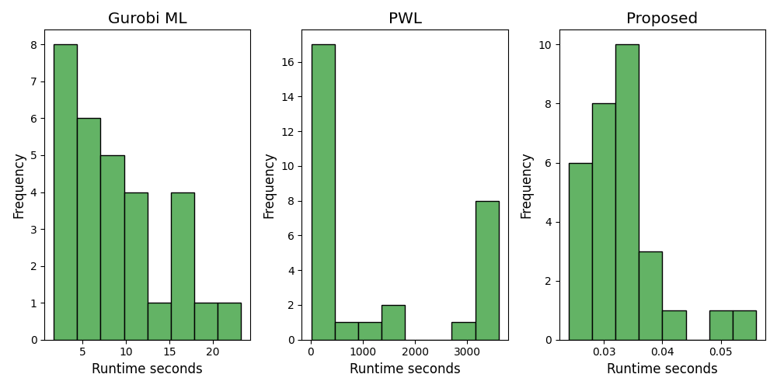
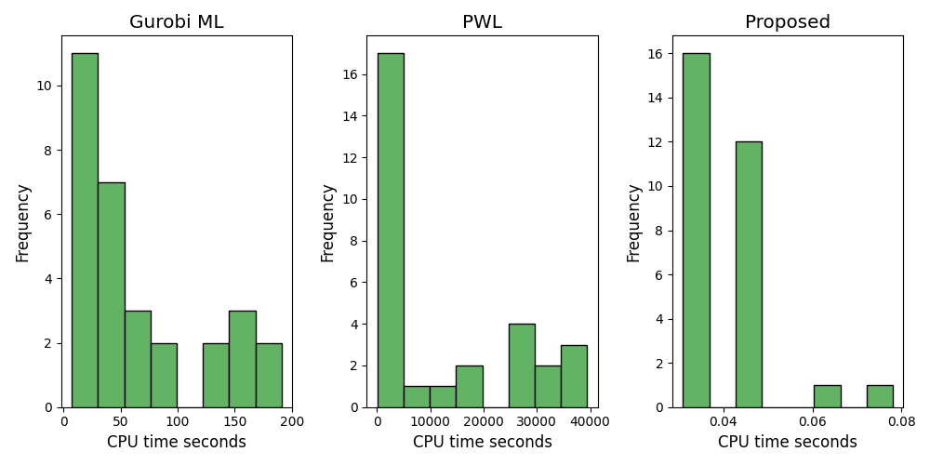
Histogram of runtimes

Slide 6
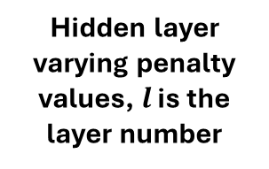
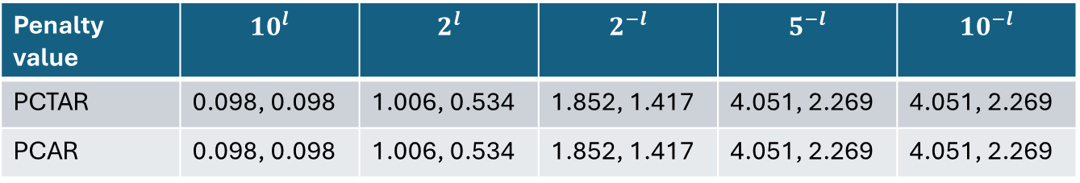
Verify PCAR and PCTAR + sensitivity analysis
Verification done by removing market constraints, fixing input values
Objective value are only the penalty functions
Expected outputs – 4.051, 2.269
Penalty value | 0.001 | 1 | 10 | 1000 | 100000
PCTAR | 1.523, 1.132 | 1.523, 1.132 | 1.523, 1.132 | 1.523, 1.132 | 1.523, 1.132
PCAR | 1.523, 1.132 | 1.523, 1.132 | 1.523, 1.132 | 1.523, 1.132 | 1.523, 1.132
Constant penalty values
Hidden layer varying penalty values, $l$ is the layer number
Penalty value | $${10}^{l}$$ | $$2^{l}$$ | $$2^{−l}$$ | $$5^{−l}$$ | $$10^{−l}$$
PCTAR | 0.098, 0.098 | 1.006, 0.534 | 1.852, 1.417 | 4.051, 2.269 | 4.051, 2.269
PCAR | 0.098, 0.098 | 1.006, 0.534 | 1.852, 1.417 | 4.051, 2.269 | 4.051, 2.269

Slide 7
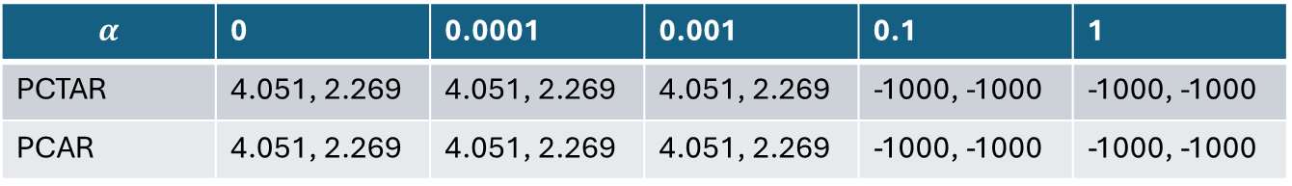
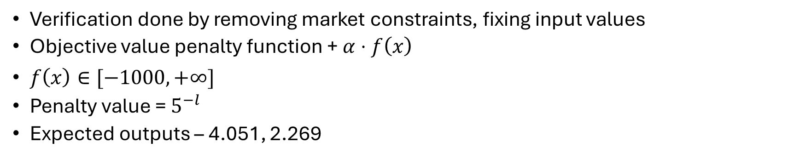
Verify PCAR and PCTAR
Verification done by removing market constraints, fixing input values
Objective value penalty function + $α⋅f\left(x\right)$
$f\left(x\right)∈[−1000, +∞]$
Penalty value = $5^{−l}$
Expected outputs – 4.051, 2.269
$$α$$ | 0 | 0.0001 | 0.001 | 0.1 | 1
PCTAR | 4.051, 2.269 | 4.051, 2.269 | 4.051, 2.269 | -1000, -1000 | -1000, -1000
PCAR | 4.051, 2.269 | 4.051, 2.269 | 4.051, 2.269 | -1000, -1000 | -1000, -1000

