Slide 1
Status update 24/10/24
By Yogesh Pipada

Slide 2
Width sensitivity analysis (WSA)
Base neural network architecture
  3 hidden ReLu layers with neuron = [10, 20, 10]
Width of NN = Number of neurons
For WSA, no. of layers = 3, neurons multiplied by [0.5, 2, 5, 10]
  4 architectures
Trained two set of NNs for each – Unconstrained and constrained
Only 10 low price scenarios considered for optimization

Slide 3
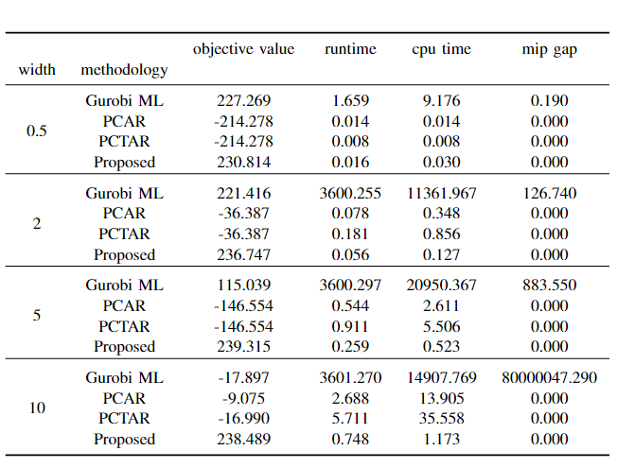
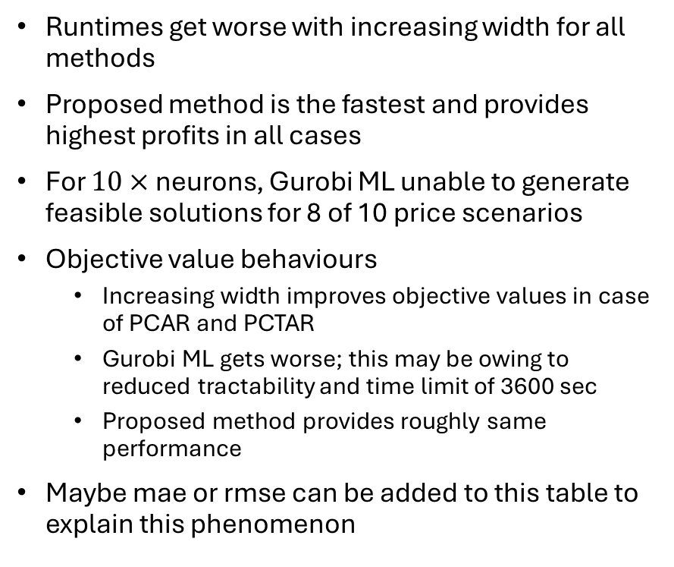
Results
Runtimes get worse with increasing width for all methods
Proposed method is the fastest and provides highest profits in all cases
For $10×$ neurons, Gurobi ML unable to generate feasible solutions for 8 of 10 price scenarios
Objective value behaviours
  Increasing width improves objective values in case of PCAR and PCTAR
  Gurobi ML gets worse; this may be owing to reduced tractability and time limit of 3600 sec
  Proposed method provides roughly same performance
Maybe mae or rmse can be added to this table to explain this phenomenon

Slide 4
Length sensitivity analysis (LSA)
Base neural network architecture
  3 hidden ReLu layers with neuron = [10, 20, 10]
Length of NN = Number of hidden layers
For LSA, no. of neurons = 40, 4 cases considered:
  1 layer, neurons = [40]
  2 layers, neurons = [20, 20]
  4 layers, neurons = [5, 15, 15, 5]
  5 layers, neurons = [2, 8, 20, 8, 2]
Trained two set of NNs for each – Unconstrained and constrained
Only 10 low price scenarios considered for optimization

Slide 5
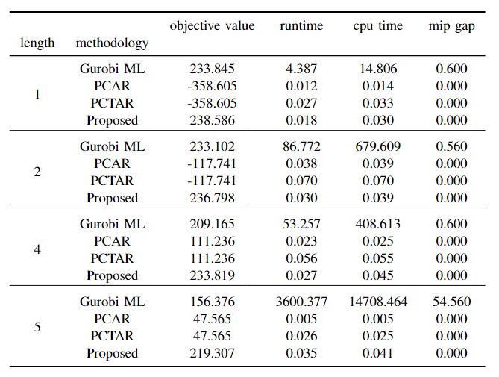
Results
Proposed method provides the best objective value for all lengths
Runtimes for the three NN methods do not vary significantly with increasing length
PCAR and PCTAR objective value improve performance with increasing lengths except length = 3 (Base case results), 5
  Maybe an odd or even thing
  Should I add 6 layer?
Gurobi ML runtime increases with increasing length

Slide 6
Journal paper structure
Introduction
  Increasing renewables and DER → Increased complexity of grid
  Modelling grid explicitly is harder → Data driven approaches may be preferable
  Optimization problem are ubiquitous in this power systems → OCL framework
  Applications of OCL framework in current state of the art(SOTA)
  Why ReLu DNNs are of interest?
  SOTA reformulations of ReLu DNN and associated challenges
    Tight ILP formulation → Tractability issues
    PCAR and PCTAR LP reformulations → Tightness not guaranteed!

Slide 7
Journal paper structure
Contributions
  Tight LP reformulation for ReLu DNNs used to represent cost functions within minimization problems
  Demonstrate performance using a BTM flexibility aggregator application
ReLu DNN reformulation
  Reformulation and proof
  Properties of non-negative weight constrained ReLu DNNs
OCL Case study
  Background: BTM aggregator, mFRR capacity market, why OCL?
  Assumptions of case study
  Mathematical models: Optimization and prosumer responsiveness
  ReLu DNN training methodology: Data generation, preprocessing and training hyperparams

Slide 8
Journal paper structure
Simulation study and results
  Optimization parameters
  Tractability and accuracy analysis
  PCAR and PCTAR sensitivity analysis
  LSA and WSA
Conclusions and Future scope
  Proposed is best performing
  It is not generalizable: limited to monotonic and minimized functions
  Develop idea for monotonically decreasing functions!
Note: Proposed method to be called non-negative weight constrained LP reformulation or NNWCLP

