Slide 1
Status update 3/10/24

Slide 2
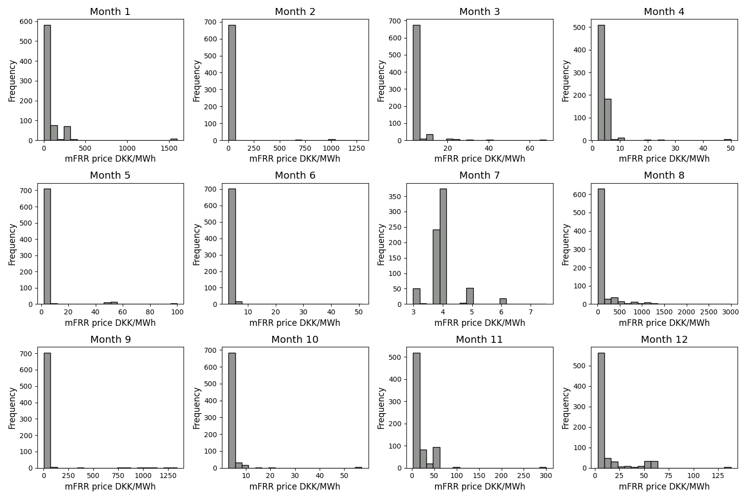
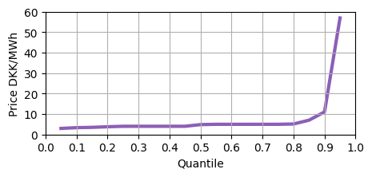
Refresher - Price scenarios
Price ranges
  Low prices – 0-10 DKK/MWh
  Med prices – 25-100 DKK/MWh
  High prices 150+ DKK/MWh
Selected 10 price scenarios each
Low price scenario is most likely case

Slide 3
Comparing ReLu DNN LP formulations
Price scenario | Methodology | Average net revenue DKK | Average run times seconds | Average CPU times seconds | No. of suboptimal solutions
High | PCTAR | 50861.258 | 0.040 | 0.051 | 0
 | PCAR | 50861.258 | 0.020 | 0.030 | 0
 | Proposed | 50669.906 | 0.034 | 0.042 | 0
Medium | PCTAR | 3870.433 | 0.040 | 0.051 | 0
 | PCAR | 3870.433 | 0.021 | 0.024 | 0
 | Proposed | 3894.101 | 0.031 | 0.041 | 0
Low | PCTAR | -514.241 | 0.049 | 0.057 | 0
 | PCAR | -514.241 | 0.032 | 0.041 | 0
 | Proposed | 226.277 | 0.035 | 0.037 | 0

Slide 4
Paper structure - I
Introduction
  Motivation + Literature review
  Contributions
ReLu DNN reformulation
  Proof
  Properties (fundamental analysis)
OCL case study
  Prosumer responsiveness model
  mFRR capacity market optimization
  Approximation techniques – PWL, Gurobi ML, PCAR, PCTAR, proposed

Slide 5
Paper structure - II
Simulation study and results
  NN training
  Case study
    Tractability analysis
    Price scenario analysis
    Accuracy analysis
  Case study – penalty sensitivity analysis
    Relevant results
  (Optional) ReLu DNN length and width sensitivity analysis
    Relevant results
Conclusions and future scope

