Slide 1

Employee Retention Insights

Slide 2
Focus Areas
Age Bracket | Age between 18-27 & 48-60
Education Field | Marketing, Medical & Others
Department | Software, Support and R&D
Job Role | Healthcare Rep, Manager, Sales Rep, Sales Executive
Despite enjoying a higher-than-average salary hike of 24.81% and boasting an impressive performance rating of 2.66, the focus area grapples with a concerning attrition rate of 52.91%, surpassing the overall average of 50.21%.
Moreover, despite the focus area's notable performance rating of 2.66, there exists a notable decline in job satisfaction, with an average of 2.47. This stark disparity raises questions about the effectiveness of salary increases and performance evaluations in addressing underlying job satisfaction issues.
Employees | Overall | Focus Area
Employee Count | 50000 | 2678
Attrition | 50.21% | 52.91%
Salary Hike | 24.62 | 24.81
Performance Rating | 2.50 | 2.66
Job Satisfaction | 2.49 | 2.47

Slide 3
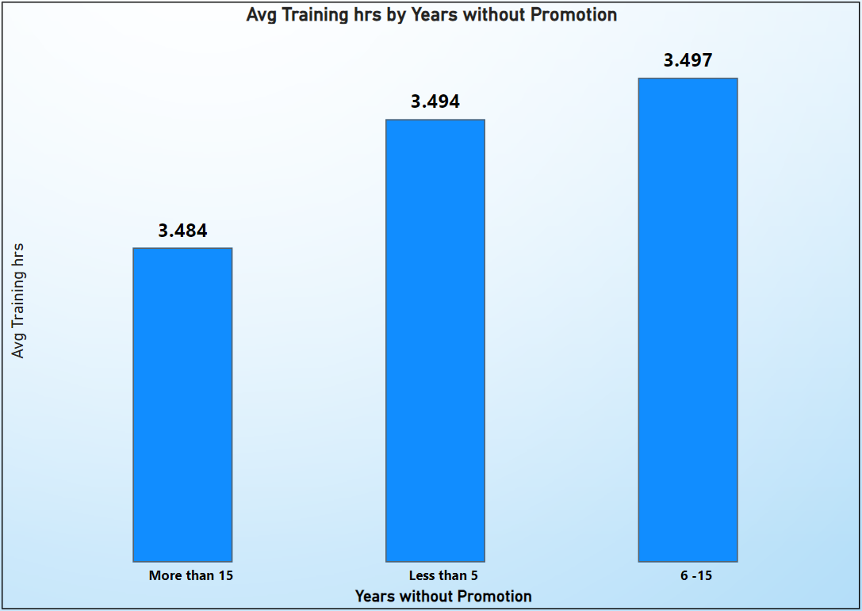
Training Disparities
Employees without promotion for 6 to 15 years receive an average of 3.50 hours of training.
Those with less than 5 years at the same level receive slightly less, at 3.49 hours on average.
Surprisingly, employees with over 15 years at the same level receive the least training, averaging only 3.48 hours.

Slide 4
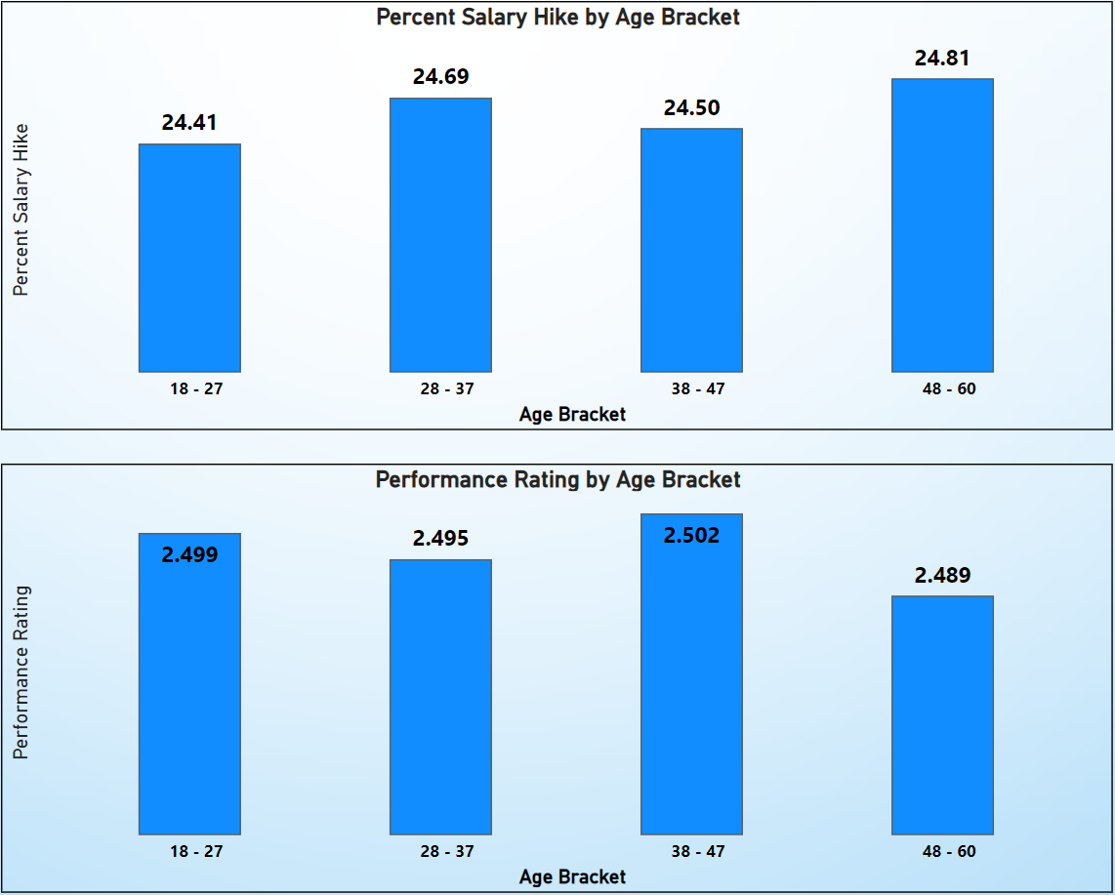
Age Brackets
Age Bracket 18-27:
Despite achieving the second-highest performance rating of 2.499, employees in this age bracket receive the lowest average percent salary hike of 24.410%.
Age Bracket 28-37:
Employees in this age bracket receive a slightly higher average percent salary hike of 24.692% with a performance rating of 2.495.
Age Bracket 38-47:
Similar to the previous bracket, employees aged 38-47 receive an average percent salary hike of 24.504% with the highest performance rating of 2.502.
Age Bracket 48-60:
Employees in the 48-60 age bracket receive the highest average percent salary hike of 24.811% but with the lowest performance rating slightly lower at 2.489.

Slide 5
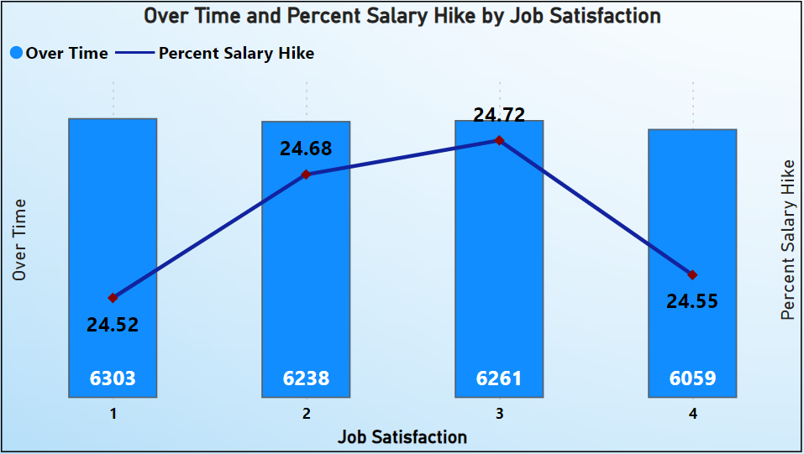
Job Satisfaction Vs Salary Hike and Overtime
Job Satisfaction Level 1:
Despite reporting the lowest job satisfaction, employees in this category are doing the most overtime, with 6303 hours recorded. Their average percent salary hike stands at 24.520% which is the lowest.
Job Satisfaction Level 2:
Employees with a job satisfaction level of 2 also report a high number of overtime hours, totaling 6238. Despite this, their average percent salary hike is slightly higher at 24.680%.
Job Satisfaction Level 3:
Similar to the previous categories, employees with a job satisfaction level of 3 report 6261 overtime hours. Their average percent salary hike is slightly higher at 24.724%.
Job Satisfaction Level 4:
Employees with the highest job satisfaction level (4) report the lowest number of overtime hours, totaling 6059. Despite this, their average percent salary hike remains relatively low at 24.549%.

Slide 6
Conclusion
Attrition and Job Satisfaction connect: Despite high salary hikes and performance ratings, the focus area faces a 52.91% attrition rate and low job satisfaction (2.47), indicating a need to reassess retention strategies beyond compensation and performance metrics.
Training Disparities: Employees with over 15 years at the same level receive the least training, suggesting a need to prioritize ongoing skill development for long-tenured staff to align with evolving job demands and enhance retention.
Age-Related Salary Hike Discrepancy: Despite commendable performance, employees aged 18-27 receive the lowest salary hike (24.41%), prompting a review of salary structures to ensure equitable compensation based on performance and age.
Job Satisfaction and Compensation: High overtime hours among employees with low job satisfaction levels, despite modest salary hikes, highlight the importance of addressing job satisfaction through compensation adjustments to improve retention and overall employee satisfaction.

Slide 7

Thank You!!

