Slide 1

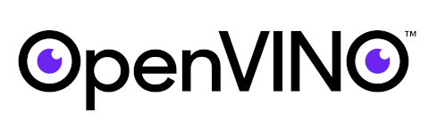
Open Visual Inference and Neural Network Optimization
Notes:
OpenVINO™ toolkit is a comprehensive toolkit for quickly developing applications and solutions that solve a variety of tasks including emulation of human vision, automatic speech recognition, natural language processing, recommendation systems, and many others. Based on latest generations of artificial neural networks, including Convolutional Neural Networks (CNNs), recurrent and attention-based networks, the toolkit extends computer vision and non-vision workloads across Intel® hardware, maximizing performance. It accelerates applications with high-performance, AI and deep learning inference deployed from edge to cloud.

Slide 2
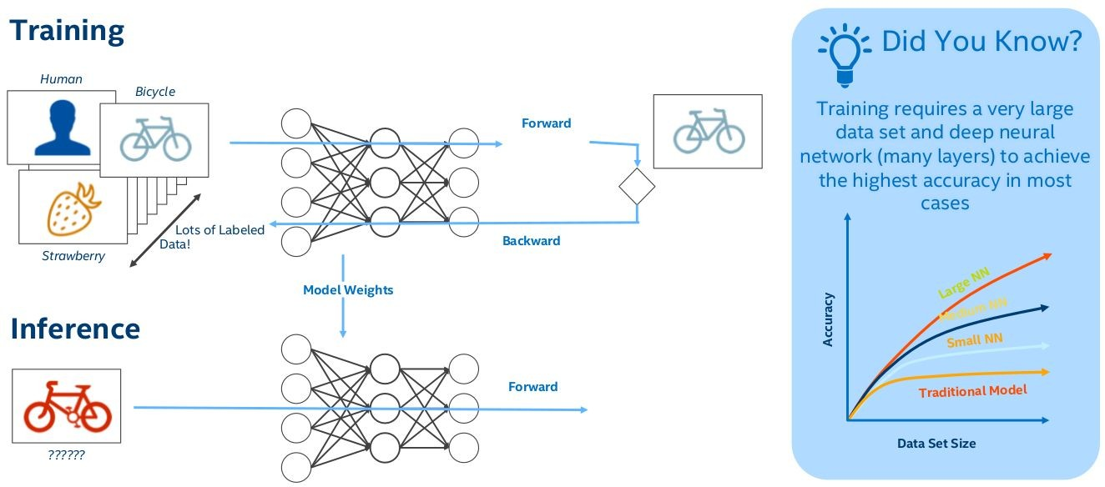
Training and Inference

Slide 3

Why OpenVino

Slide 4
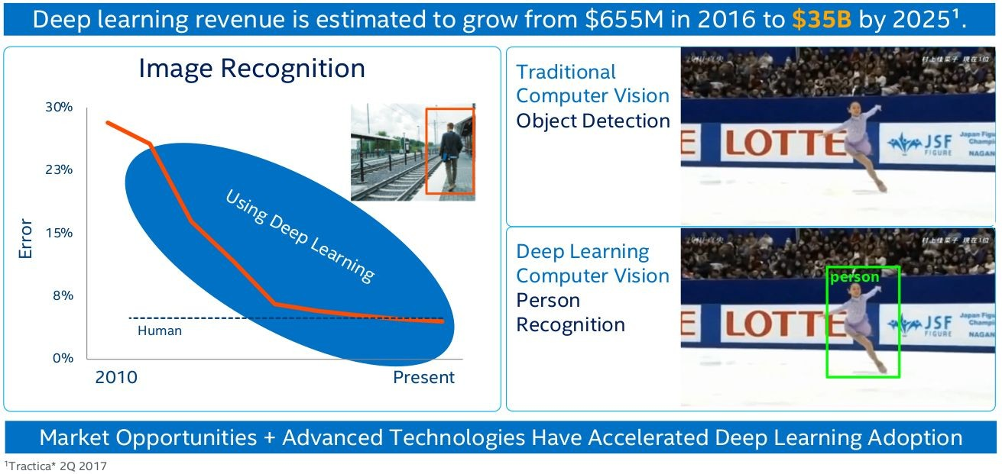
Deep Learning Usage Is Increasing

Slide 5
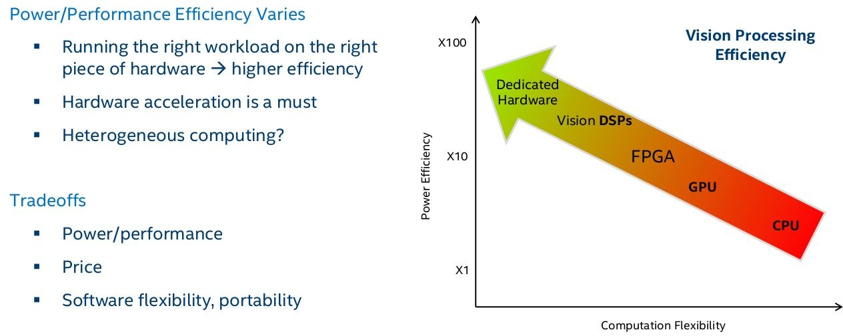
Choosing the “Right” Hardware

Slide 6
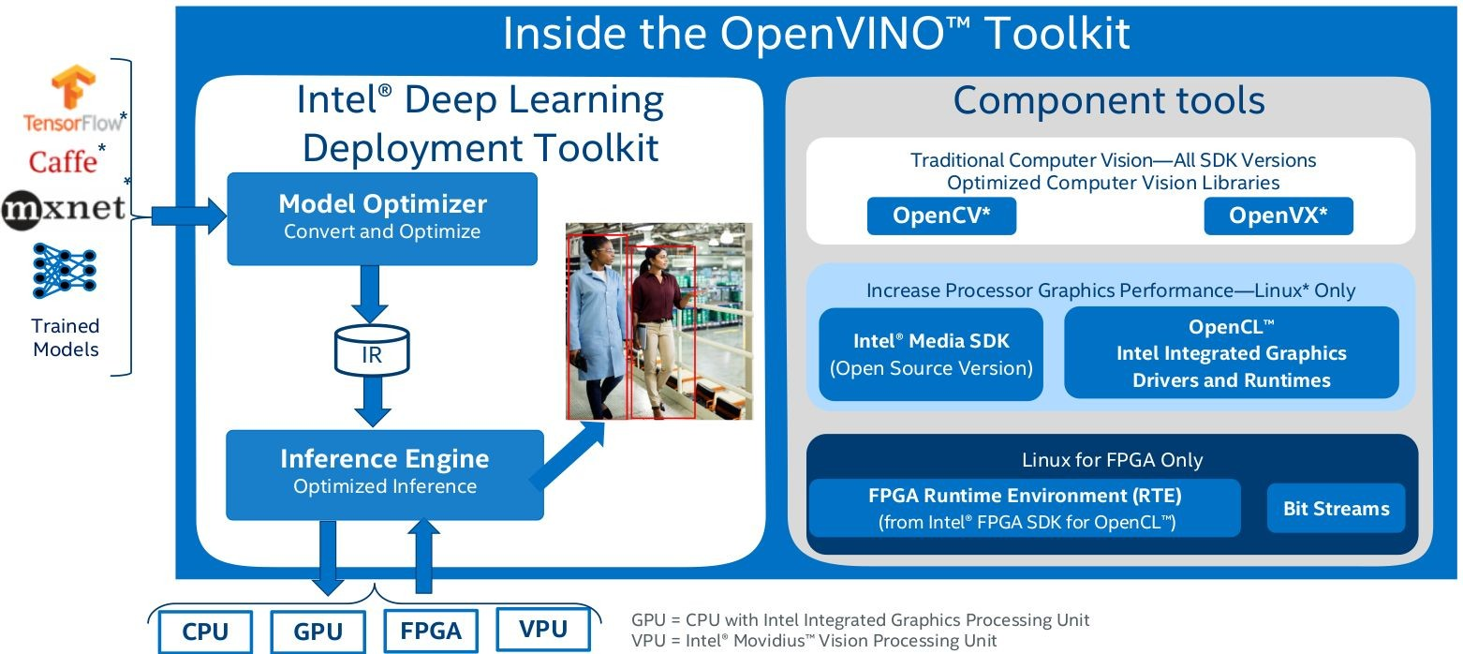
Open Visual Inference and Neural Network Optimization (OpenVINO) Toolkit and Components

Slide 7
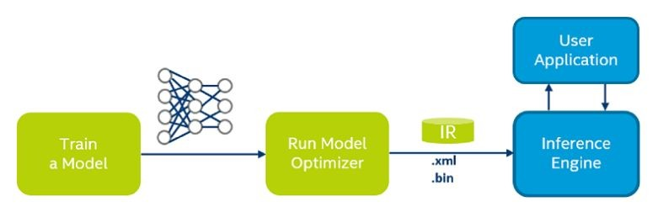
Model Optimizer
The Model Optimizer is a Python*-based cross-platform command line tool for importing trained models from popular deep learning frameworks such as Caffe*, TensorFlow*, Apache MXNet*, ONNX* and Kaldi*.
It facilitates the transition between the training and deployment environment, performs static model analysis, and adjusts deep learning models for optimal execution on end-point target devices.
The Inference Engine API offers a unified API across a number of supported Intel® platforms. The scheme below illustrates the typical workflow for deploying a trained deep learning model:

Slide 8
Model Optimizer
Model Optimizer process assumes you have a network model trained using a supported deep learning framework.
When you run a pre-trained model through the Model Optimizer, your output is an Intermediate Representation (IR) of the network. The Intermediate Representation is a pair of files that describe the whole model:
.xml: Describes the network topology
.bin: Contains the weights and biases binary data
For more information about the Model Optimizer, refer to the Model Optimizer Developer Guide.

Slide 9
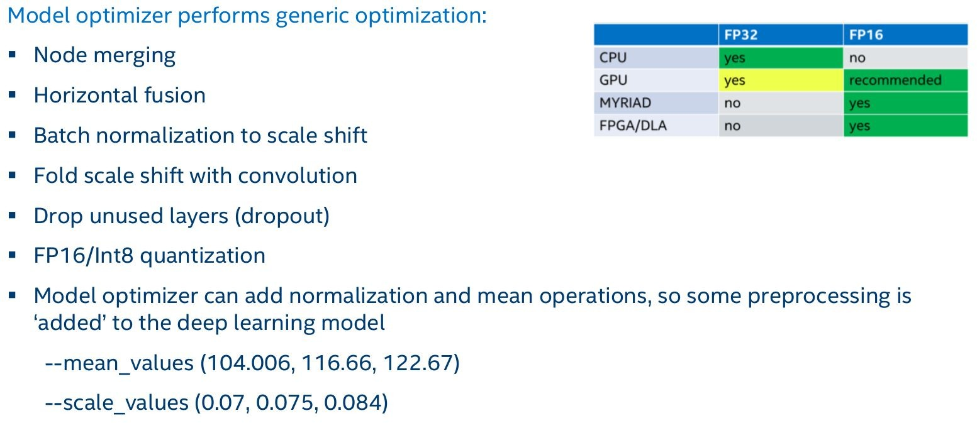
Model Optimizer

Slide 10
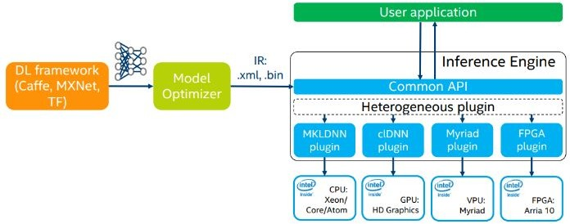
OpenVINO Inference Engine : Hardware Speciﬁc Optimizations
24

Slide 11
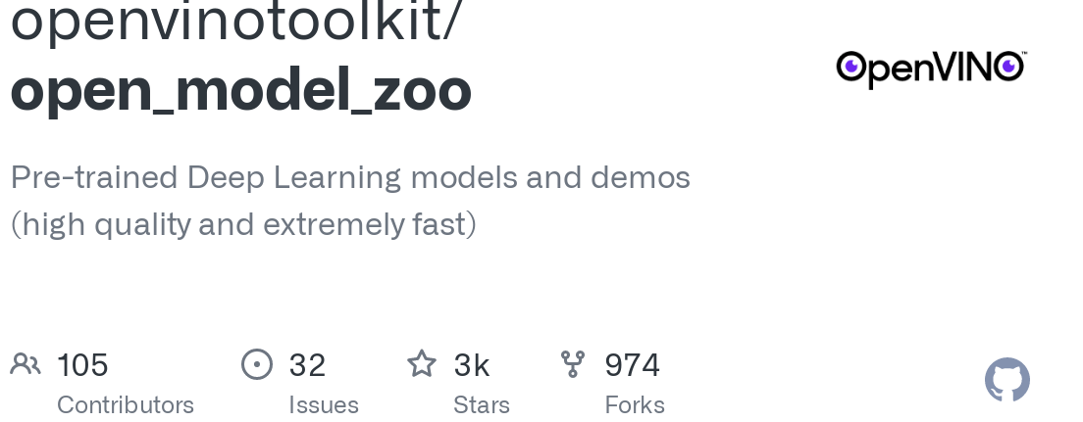
https://github.com/openvinotoolkit/open_model_zoo

Slide 12
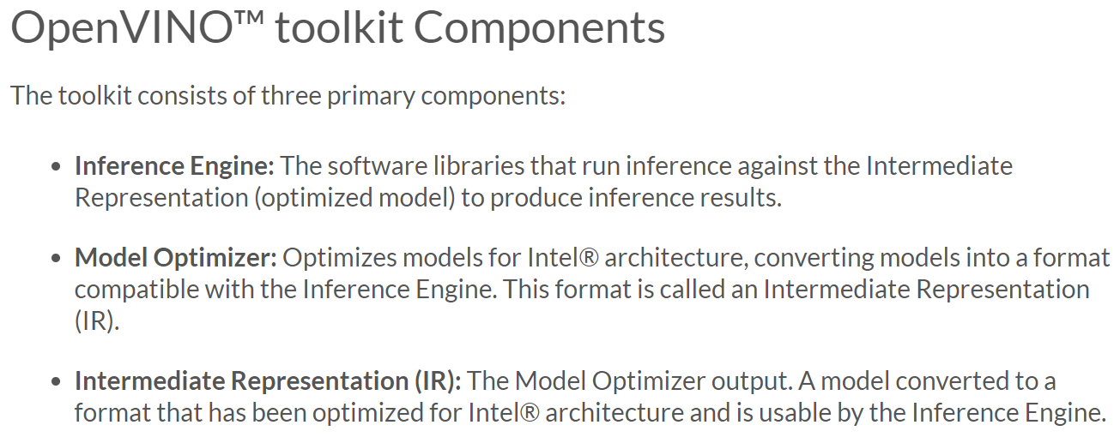

Slide 13
OpenVino
On Local System
Intel Dev Cloud for the Edge
Edge Device - Raspberry Pi

Slide 14
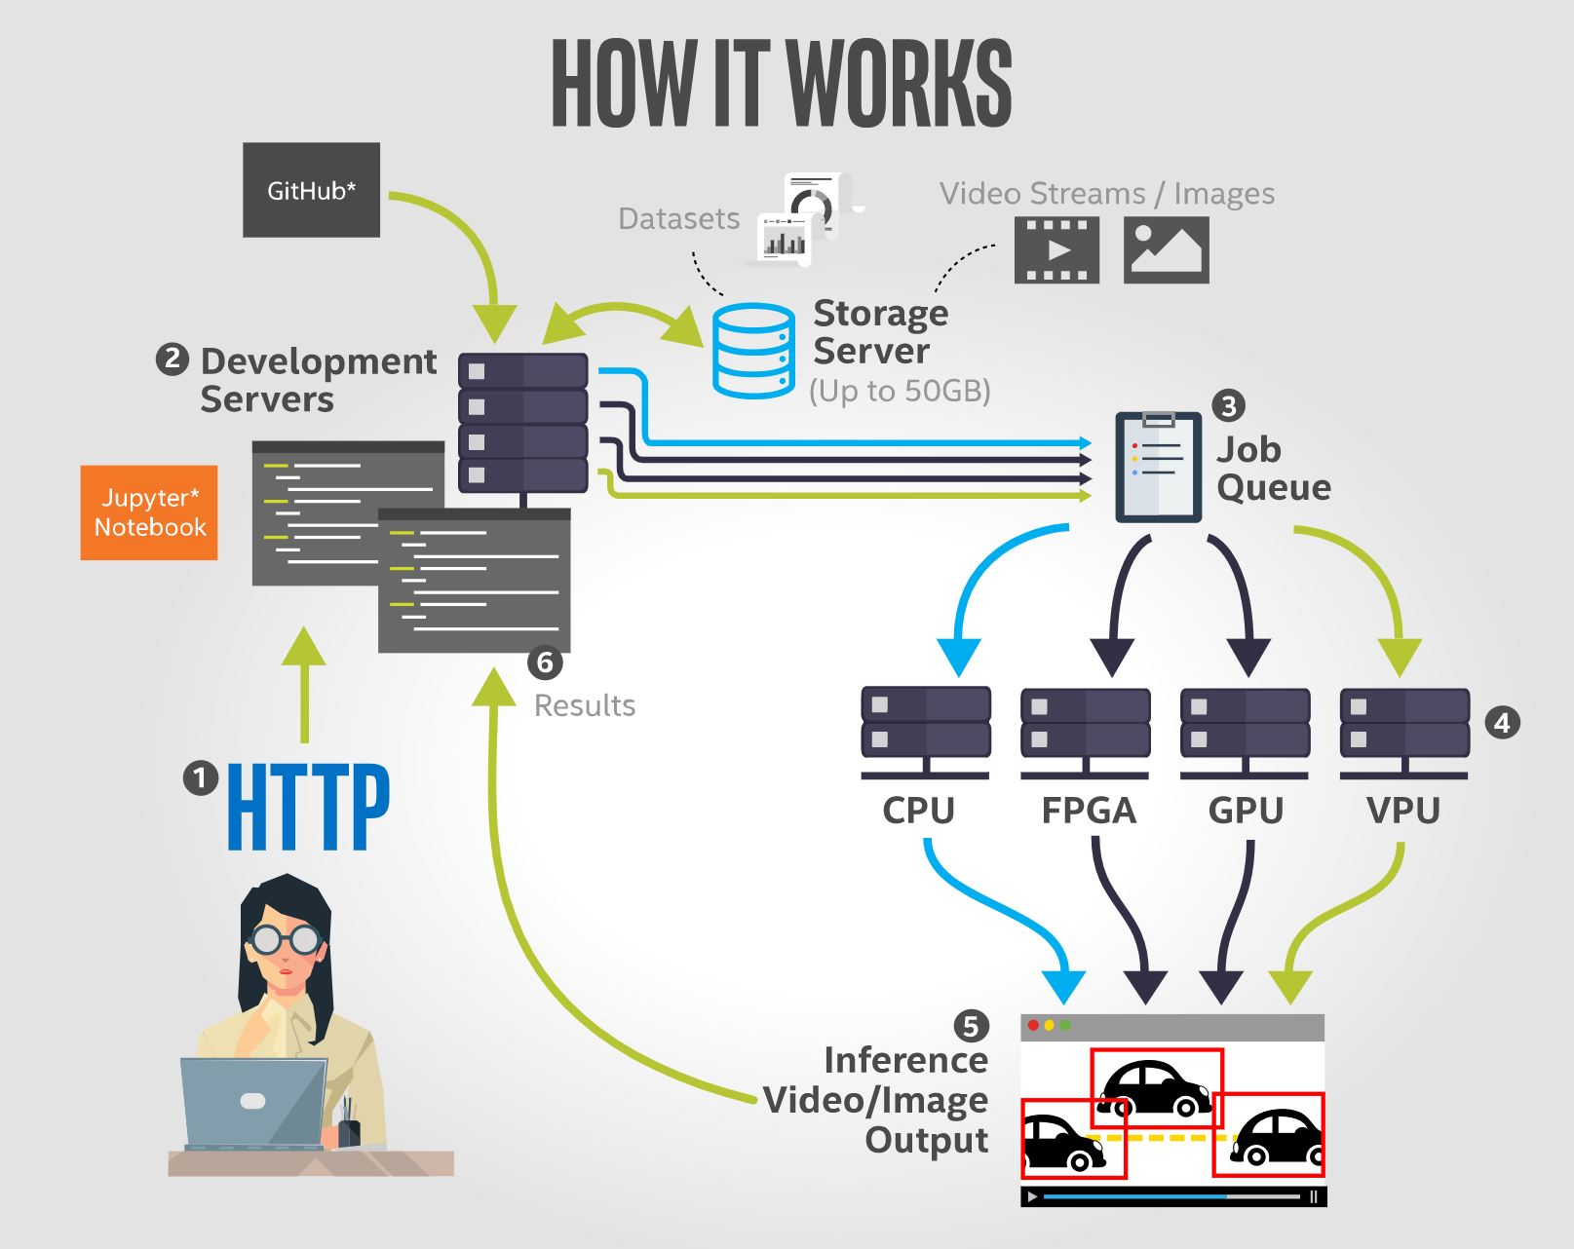
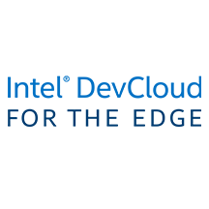
Intel® DevCloud for Edge
https://notebooks.edge.devcloud.intel.com/

Slide 15
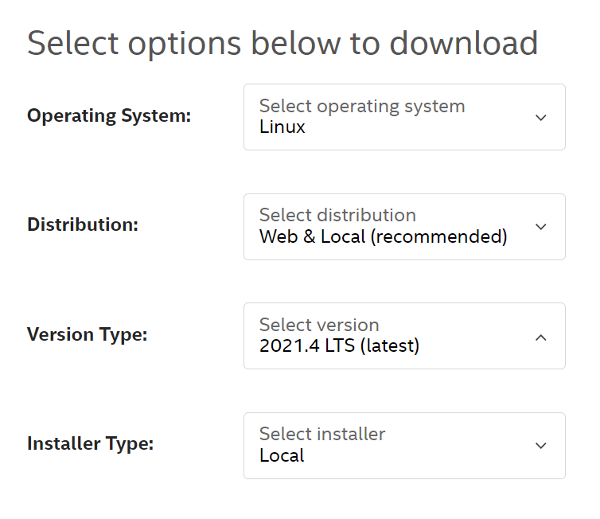
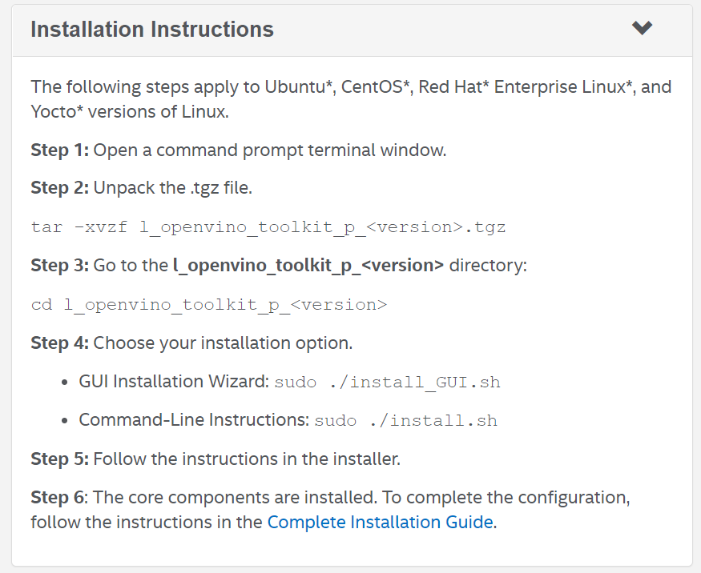
Installation of OpenVino Toolkit on Ubuntu
https://software.intel.com/content/www/us/en/develop/tools/openvino-toolkit/download.html

Slide 16
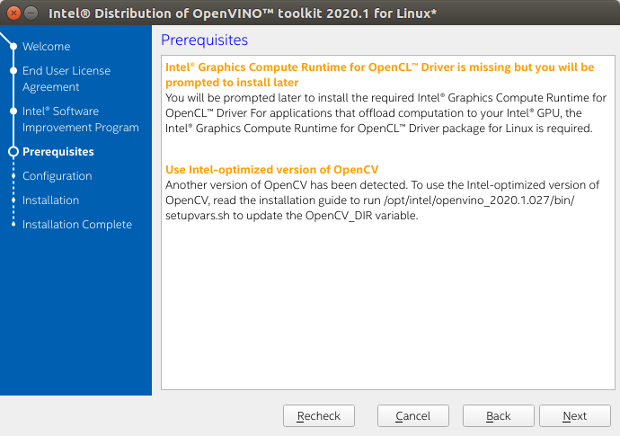

Slide 17
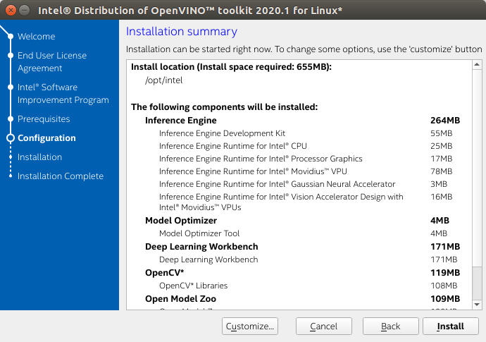

Slide 18
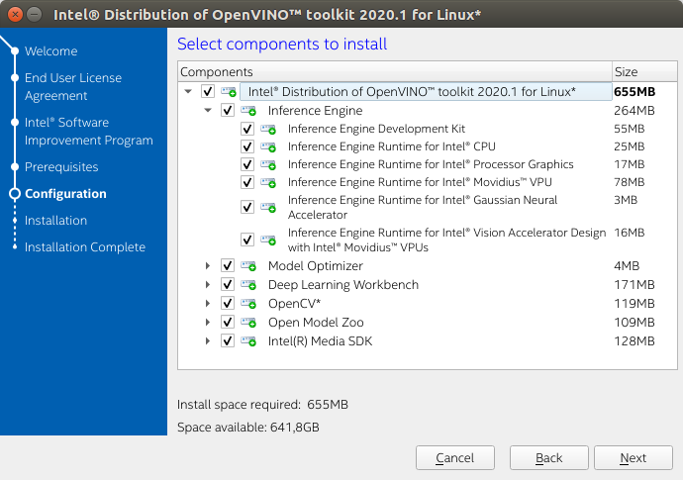

Slide 19
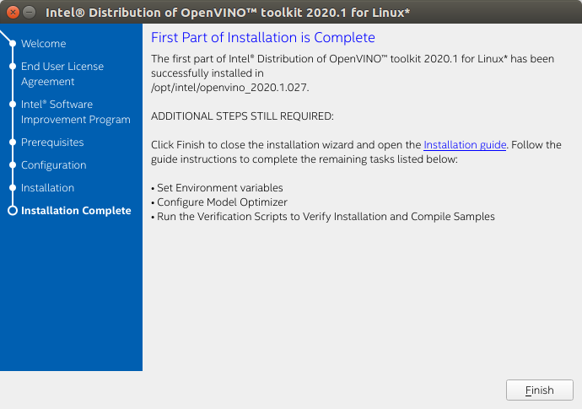

Slide 20
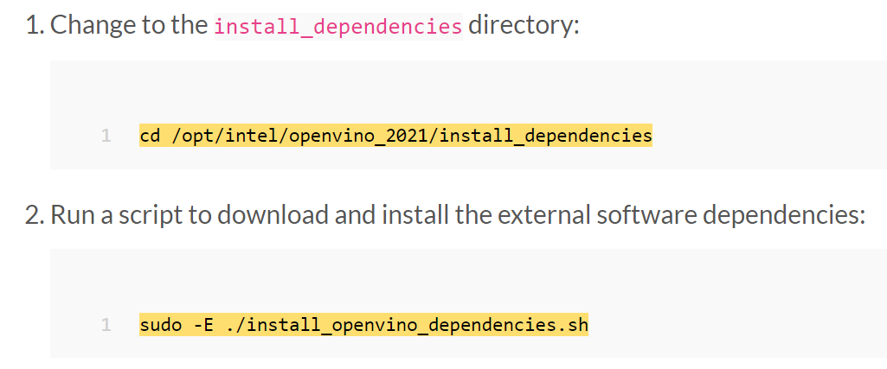
Install External Software Dependencies

Slide 21
In bin folder run source setup_vars.sh

Slide 22
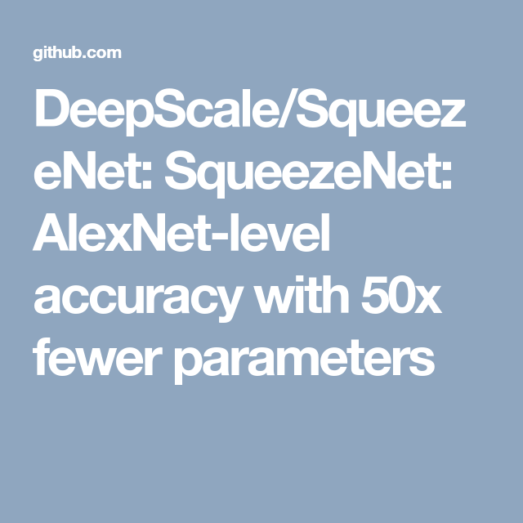
Demos
Squeezenet Demo for finding Car
Finding Car and Numberplate
SqueezeNet is the name of a deep neural network for computer vision that was released in 2016. SqueezeNet was developed by researchers at DeepScale, University of California, Berkeley, and Stanford University.
https://en.wikipedia.org/wiki/SqueezeNet

Slide 23

Please contact
Foundation for Innovation and Collaborative
Education
mentor@fice.in
www.fice.in
Please contact
Foundation for Innovation and Collaborative
Education
info@fice.in
mentor@fice.in
Notes:
Here are the lessons we are going to learn today.

