Slide 1


Slide 2
Department of Computer Engineering
D. Y. Patil Institute of Engineering & Technology, Ambi
Academic year 2020-2021
Sem : 6
Student Name: Yogesh Rajgure
Examination No : T150914279
Roll No : 20 Email Id: yogeshrajgure.vraj@gmail.com
Prof. Sagar Dhanke
Seminar Guide
Prof. Mangesh Manke
HOD Computer Engg.
Prof. Bharati Pandhare
Seminar Coordinator

Slide 3
Topic: Stock Market Analysis Using Supervised Machine Learning

Slide 4
Abstract
For the world to run on money, stock market plays the role of fuel to it. A country’s economic growth and development can be very well analyzed by taking a looking at its stock market. Small ownerships, brokerage corporations, banking sector, all depend on this very body to make revenue and divide risks; a very complicated model. Due to digitization in the field of stock market, the work has both decreased (in terms of tedious paperwork) and increased (in terms of easily accessible and manipulation of data). This data is an edge over traditional “Crowd Predicting” of the foreseen future of stocks prices. However, this paper proposes to use machine learning (ML) algorithm to predict the future stock price for exchange by using open-source libraries and preexisting algorithms to help make this unpredictable format of business a little more predictable.
We shall see how this simple implementation will bring acceptable results. The outcome is completely based on numbers, sentiment of media and assumes a lot of axioms that may or may not follow in the real world so as the time of prediction. The prediction does not include any sudden changes e.g., surprise new product launch, sudden rise in complaints, natural calamity, etc.

Slide 5

Introduction
Now if we try to graph the stock exchange price over the time period (say 6 months), is it really hard to predict the next outcome on the graph?
Before Machine Learning Algorithms existed, then too we were able to make the rough prediction of the graph using Crowd Computing.
The trick was to identify the pattern, apply some complex stats and done. But it was very less reliable and slow process, due to human speed, the computation using lots of features and data was not possible, hence was the need of more reliable and fast process,
Machine Learning Algorithm does just the same.

Slide 6
Literature Survey
Mehak Usmani et al in [2] proposed an intuitive idea of combining results from historical data, news and twitter feed sentiment analysis. This dual approach predicts the stock market trend with high accuracy. It uses technical analysis like ARIMA(AutoRegressive Integrated Moving Average) to get an idea of the market trend. These models forecast the values based on proven mathematical models. This research considers other factors like depreciation and exchange rates. This research utilizes technical analysis for prediction which has been proven inferior to machine learning in terms of accuracy. Machine learning can handle noise and lack of information more efficiently. This approach has chances of inaccuracy for market scenarios not covered in training data.

Slide 7
Problem Statement
Analyze the stock market, i.e. different perspectives of it, find the most influencing features, try to combine all those major features to form a single robust ML algorithm to predict price precisely.

Slide 8
Literature Survey
The research done by Dongning Rao et al in [6] provides great insight into proper implementation of sentiment analysis. They propose increasing the size of corpus (training data) with each test. This is done by adding non-polarizing words found in the test data not present in the corpus. Thus, making the training data more efficient with each successive testing.

Slide 9
Review Papers
M. Usmani, S. H. Adil, K. Raza and S. S. A. Ali, "Stock market prediction using machine learning techniques," 2016 3rd International Conference on Computer and Information Sciences (ICCOINS), Kuala Lumpur, 2016, pp. 322-327.
D. Rao, F. Deng, Z. Jiang and G. Zhao, "Qualitative Stock Market Predicting with Common Knowledge Based Nature Language Processing: A Unified View and Procedure," 2015 7th International Conference on Intelligent Human-Machine Systems and Cybernetics, Hangzhou, 2015, pp. 381-384.

Slide 10
Objective of Seminar
The main objective of this seminar is to identify and analyse the research work done in the field of Stock market analysis with the help of Supervised Machine Learning and mover over try extend/improve it by using different approaches and see if it provides with more satisfactory solutions for the audience of the domain. And try elaborate the future scope of the same technology with help of some new creative ideas.

Slide 11
Existing System
The existing system are of two types:
Those not using ML algorithm, but using other technologies to try to predict possible outcome.
Those who are using the ML algorithm to some extent, but either fully relying on the data or sentiment and not both at same time.

Slide 12
Modern Day Approach
Two approaches for prediction of stock market are proposed.
Qualitative Analysis
News feeds regarding stock market highly affect the market trend and thus forms a downhill movement in case of a negative news. With a combined resources of news feed and twitter feed, general population sentiment about a company can be highlighted
Quantitative Analysis
Historical data is now readily available for most markets. Using this dataset, we can apply multiple machine learning models to give accurate results for future investments.

Slide 13
Methodology
Machine Learning module
Sentiment Analysis module
Fuzzy logic Module
Fuzzy Logic Module
Machine Learning Module
Sentiment Analysis Module
Fig: Recommendation Model
Historical Data
Stock Prediction value
Stock Faith
News Headlines
Sentiment value

Slide 14


Why use Machine Learning ?
“Machine learning is the process by which system improves the performance from experience” – Herbert Simon
Ability to mimic humans and replace some monotonous tasks which requires some human like intelligence (like recognizing text from handwritten paper).
Discover new knowledge easily from large dataset which is very hard by a human.
Develop systems that are too difficult to construct manually because they require specific detailed skills or knowledge tuned to a specific task

Slide 15
1. ML module
number of features required to accurately predict a stock’s closing price for a specific day are given as follows.
Opening price of prediction day
Lowest and highest prices of the prediction day
Simple Moving Average
Exponential moving average of opening and closing prices of the prediction day
Exponential moving average of lowest and highest prices of the prediction day
Bollinger Bands of opening and closing prices of the prediction day
Bollinger Bands of lowest and highest prices of the prediction day

Slide 16
2. Sentiment Analysis module
The purpose of this module is to obtain the sentiment value of latest news headlines regarding each stock and output its average as sentiment value to fuzzy module. The steps used in this module are as follows:
Data Collection
Tokenizing
Lemmatizing
Finding Most Informative Features
Adding these features to the sentiment analyzer lexicon
Classifying the testing data into positive and negative sentiments
using training set

Slide 17
3. Fuzzy logic module
The purpose of this module is to output Stock Faith which is the strength of Recommendation.
The activation rules for this module are:
IF the News Sentiment was good or the Stock Prediction value was good, THEN the Stock faith will be high.
IF the Stock Prediction value was average, THEN the Stock faith will be medium.
IF the News Sentiment was poor and the Stock Prediction value was poor THEN the Stock faith will be low

Slide 18
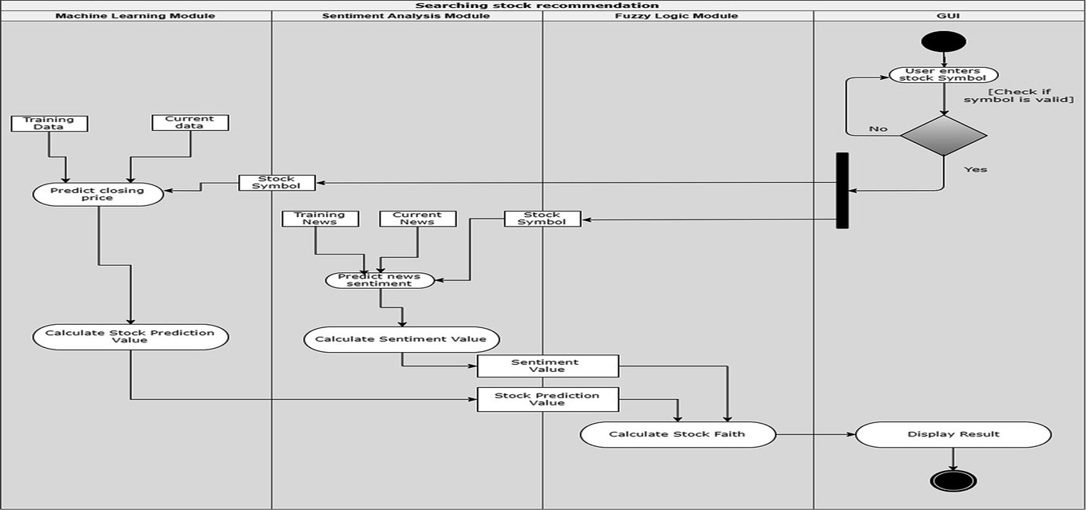
Architecture Diagram

Slide 19
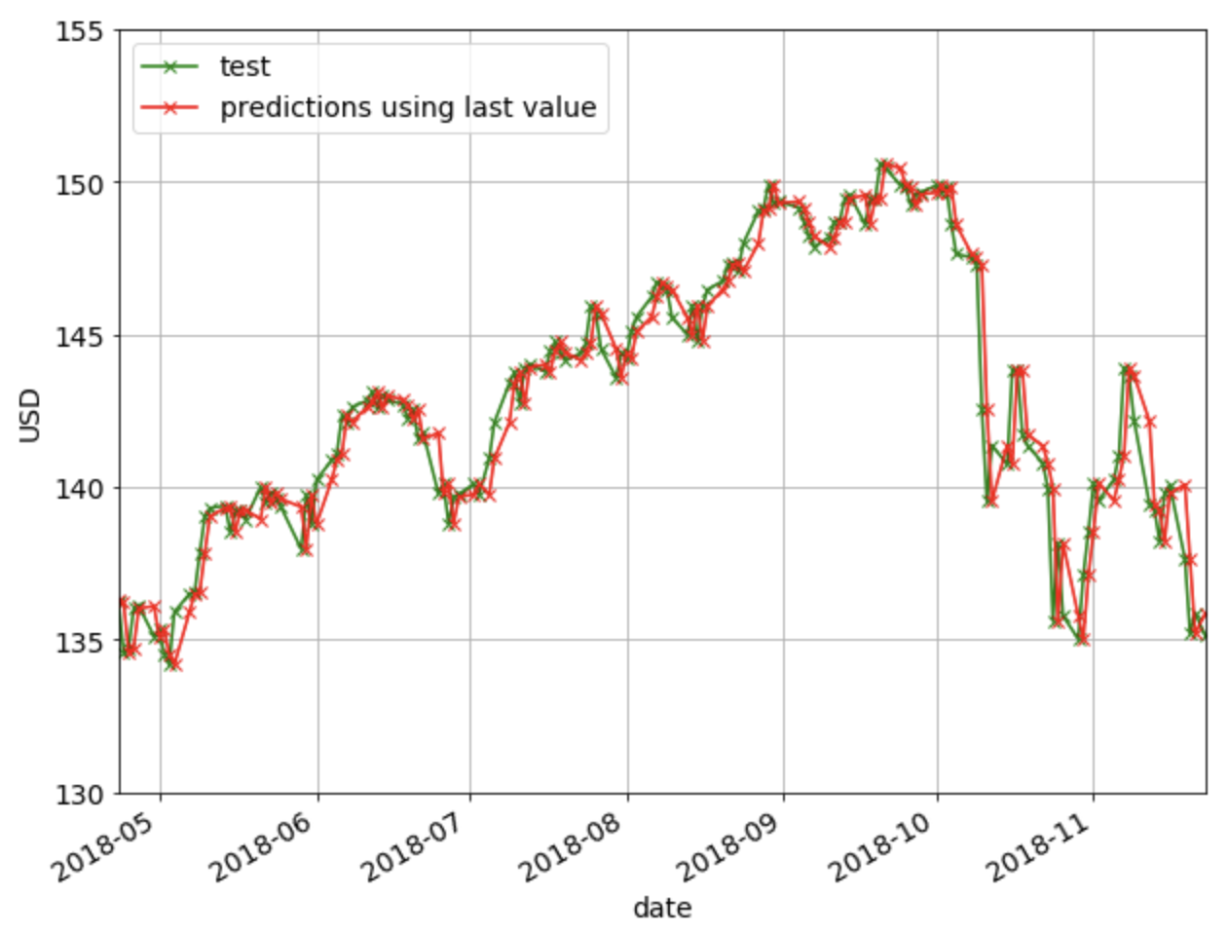
Results of implemented Algorithm

Slide 20
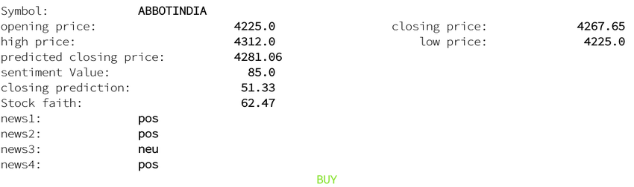
Result analysis
Case 1:
IF the News Sentiment was good or the Stock Prediction value was good, THEN the Stock faith will be high as shown in Fig

Slide 21
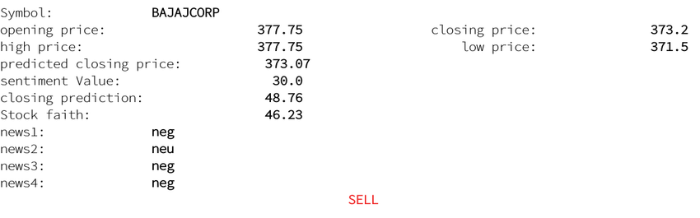
Result analysis
Case 2:
IF the News Sentiment was poor and the Stock Prediction value was poor THEN the Stock faith will be low as shown in Fig

Slide 22
Advantages
More reliable stock prediction system
Helpful for a company to decide the next move based on future predictions of the stock
More understanding about the sentiment affecting the data based on the produced results
Etc.

Slide 23
Disadvantages
ML and sentimental analysis hasn’t yet reached the level where we can fully rely on Prediction based on their results.
As the previous performance does not always help to find future of stock and sentiment analysis can not differentiate between “sargasm” in some of the news and media.
Natural Environmental factors may drastically change in the stock price and these are not included in the algorithm.

Slide 24
Applications
Better guess at stock prices, hence better chances of high returns on the same investment.
Progress report of certain set of companies, in specific criteria, of near future may show the peoples’ feelings (+ve, -ve) for those stocks.
Can be extended to find out the entire country’s approx. GDP performance by identifying the top companies market performance.

Slide 25
Conclusion & Future Scope
In this research, we propose that existing work may integrated into a robust model to predict stock market accurately. This model can be improved upon by defining refined fuzzy rules. Improving upon the training data’s scale and timeframe can result in better prediction. A trading model using the proposed methodology can be developed to compute total returns or investments in real time. This can prove the accuracy of the model. This model can successfully recommend the best stocks for investment

Slide 26
References
Andrew McCallum, Kamal Nigam, Jason Rennie, Kristie Seymore “A Machine learning approach to Building domain-specific Search engine”, IJCAI, 1999 - Citeseer
M. Usmani, S. H. Adil, K. Raza and S. S. A. Ali, "Stock market prediction using machine learning techniques," 2016 3rd International Conference on Computer and Information Sciences (ICCOINS), Kuala Lumpur, 2016, pp. 322-327.
Yadav, Sameer. (2017). STOCK MARKET VOLATILITY - A STUDY OF INDIAN STOCK MARKET. Global Journal for Research Analysis. 6. 629-632.
Montgomery, D.C., Peck, E.A. and Vining, G.G., 2012. Introduction to linear regression analysis (Vol. 821). John Wiley & Sons.
Draper, N.R.; Smith, H. (1998). Applied Regression Analysis (3rd ed.). John Wiley. ISBN 0-471-17082-8.
Robert S. Pindyck and Daniel L. Rubinfeld (1998, 4h ed.). Econometric Models and Economic Forecasts
D. Rao, F. Deng, Z. Jiang and G. Zhao, "Qualitative Stock Market Predicting with Common Knowledge Based Nature Language Processing: A Unified View and Procedure," 2015 7th International Conference on Intelligent Human-Machine Systems and Cybernetics, Hangzhou, 2015, pp. 381-384.

Slide 27
The End
Thank You..

