Slide 1
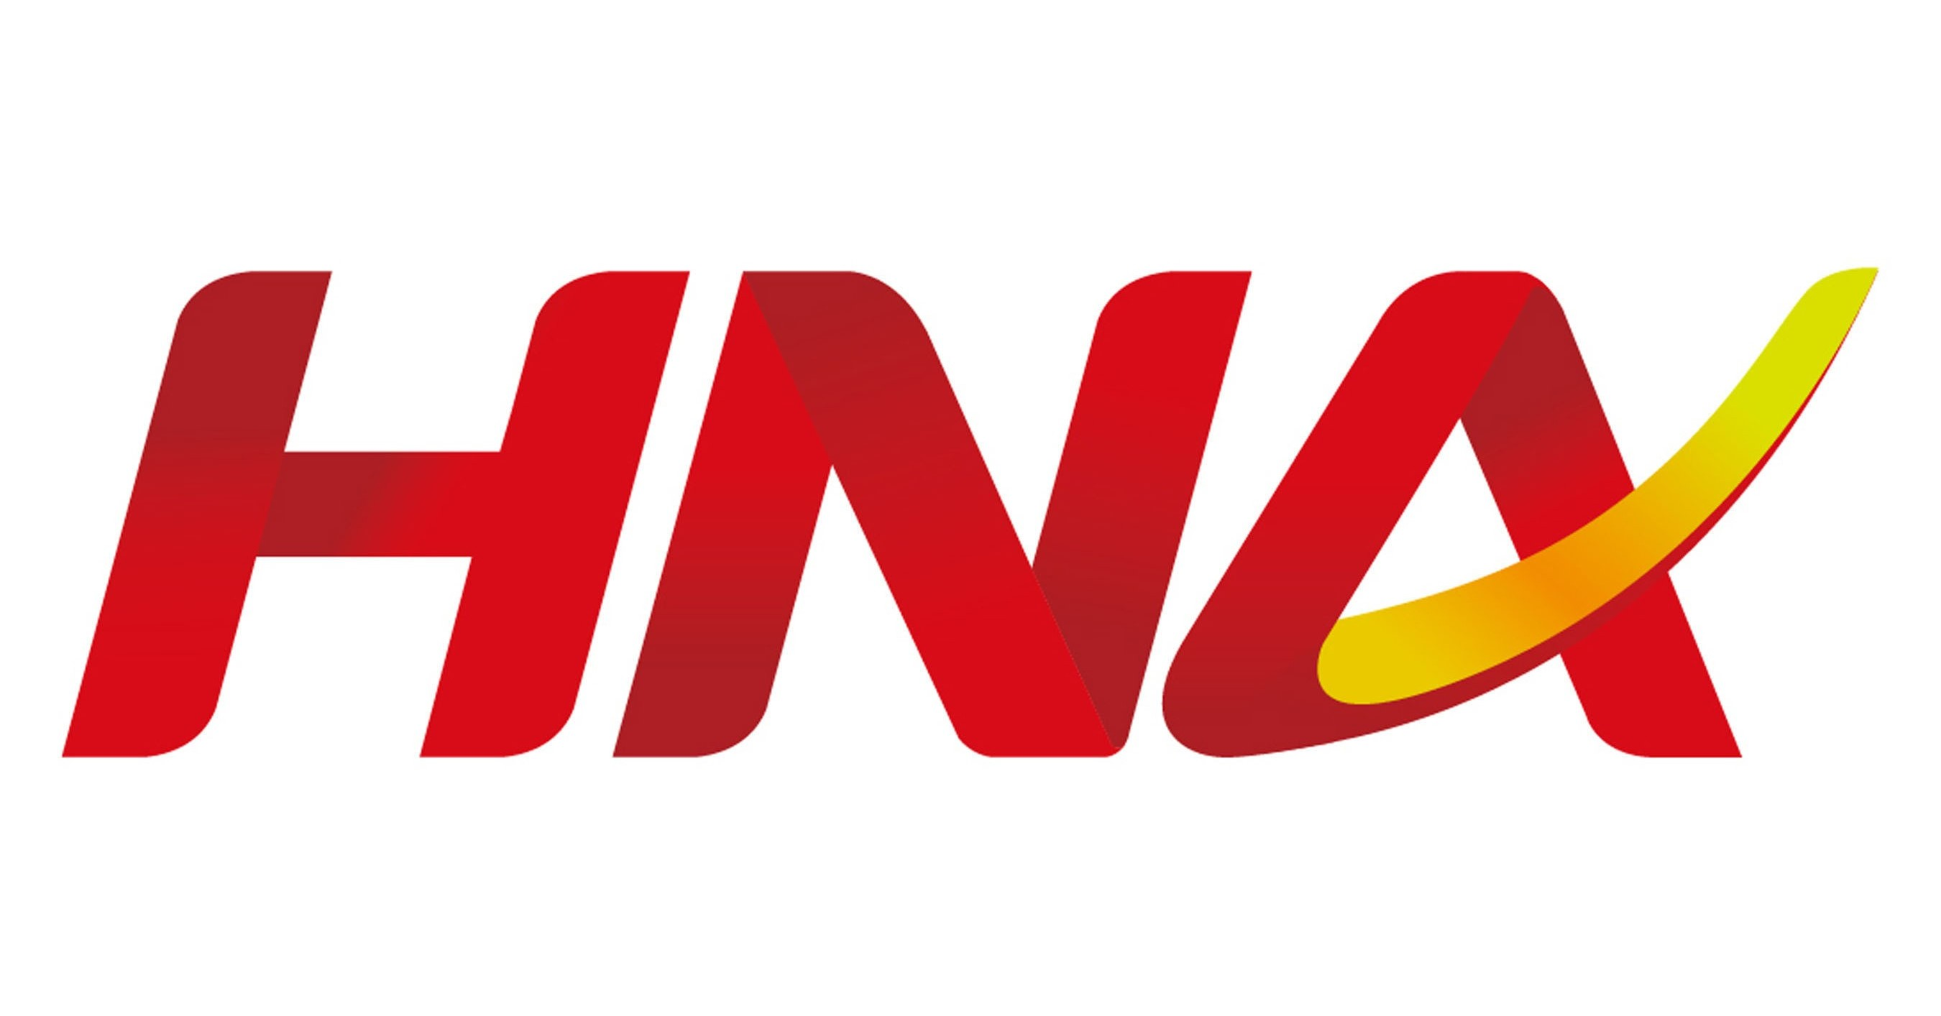
Group 3
Traditional enterprise risk management
Professor Marianna Belyavskiy
Associate Lubens Bonhomme

Slide 2
Part A: Brief Description of the event
1 | 5 Questions | 1. HNA Group, a company that business scope has aviation, tourism, heavy industry and finance, etc. and has more than 2,000 companies, faces severe liquidity problems and is planning a bankruptcy reorganization. (Who) 2. By the end of 2017, HNA Group has encountered serious liquidity problems that still present now. In 2021, it has been revealed that $10 Billion has been embezzled by shareholders of HNA's subsidiaries. (When) 3. Because the reform of the civil aviation industry in 2000, HNA groups began to increase leverage, investment and acquisition of other companies in order to survive. In 2017, the Chinese government began to tighten financial policy which left HNA unable to repay loans. In addition, some of the senior management are relatives of the CEO, causing wrong decision that are not good for the development of the enterprise. (What) 4. Aggressive overseas investment by leveraging money from creditors and banks leads to liquidity problems. After the government tighten the policy, the management personnel did not make correct and prompt decision to dispose assets to generate cash flow. Moreover, investors who are the senior management staff also misappropriated funds for their own interests and paid principal and interest. (Why) 5. Due to the impact of the epidemic, HNA Group's revenue has been severely hit, especially in the aviation and tourism industries, which has exacerbated its liquidity problem. They may dispose of assets cheaply. (How)
Notes:
HNA Group started in the aviation industry and has grown to include tourism, heavy industry and finance, etc.
By the end of 2017, HNA Group has encountered serious liquidity problems that still present now.
This was mainly reflected in the inability to repay loans and pay principal and interest on bonds.
There are many reasons for this result.
The excessive leverage led to a liquidity strain in the face of tightening national financial policies,
which, combined with multiple errors in decision making and failure to dispose of assets timely,
eventually breaking cash flow during Covid-19 as the aviation and tourism industries were greatly impacted.

Slide 3
Dashboard – 1/6
Type of Risk | Financial Risk: | Strategic Risk: | Operational Risk:
Category | Liquidity Risk | Strategy and Governance Risk | Internal fraud and Human Resources Risk
Risk Owner | Financial Risk Department / Asset Management / Respective Business Unit | Supervisory Committee / Board | HR Department / Internal Audit / Compliance
Root Cause Analysis Bow Tie | HNA aggressive overseas investment by leveraging money from creditors and banks. However, the Chinese government prohibits banks to lend money to firms for overseas investment. | Lack of competent management personnel. Strategic failure leads HNA to fail to generate enough profit to make its financial payments | Lack of financial accountability. $10 billion has been embezzled by shareholders.
Inherent Risk Rating Impact | Catastrophic a. HNA owes $171 billion debt to creditors b. Net Profit goes to less than 0.5% of the Revenue 70 million penalties for risk personnel c. Chairman and CEO detained by Police d. HNA files for debt restructuring or bankruptcy
Notes:
It contains three risk types, which are financial risk, strategic risk and operation risk.
In the financial risk, HNA group faced liquidity risk. Its root cause was aggressive overseas investment by leveraging money.
For the Strategic Risk, HNA group faced Strategy and Governance Risk. Its root cause was Lack of competent management personnel.
While operational risk was mainly about Internal fraud and Human Resources Risk, due to Lack of financial accountability.
And we rate this event as Catastrophic according to its impact.

Slide 4
Dashboard – 2/6
Type of Risk | Financial Risk: | Strategic Risk: | Operational Risk:
Category | Liquidity Risk | Strategy and Governance Risk | Internal fraud and Human Resources Risk
Impact Rationale | After experiencing the liquidity crisis in 2018, HNA Group’s pillar industries were once again severely frustrated by the epidemic. This means that HNA Group does not have sufficient control over its liquidity. | HNA group, regardless its financial ability, decided to expand its market share by leveraging. The lack of competent people to dispose the assets in time resulted in the group not having enough profit to repay the loan. If there still were a decision not to dispose of the assets in a timely manner, the group would be in trouble again. | After experiencing liquidity problems and the detainment of the CEO, the CEO misappropriated funds for his own interests and paid principal and interest to his friends and relatives first who are the senior management staff. There was also embezzlement of funds by shareholders and illegal guarantee.
Notes:
Here are the reasons.
For the liquidity risk, HNA Group suffered two major incidents in three years reflects that the Group does not have sufficient control over its liquidity.
For the strategic risk, If there is still no competent person to make the right decision, HNA Group would be in trouble again.
For the operational risk, The problem of misappropriation of funds was very serious.

Slide 5
Dashboard – 3/6
Type of Risk | Financial Risk: | Strategic Risk: | Operational Risk:
Category | Liquidity Risk | Strategy and Governance Risk | Internal fraud and Human Resources Risk
Inherent Risk Rating Likelihood/Frequency | Imminent HNA has been in a financial crisis since 2018, and the liquidity problem has not been solved. HNA has been consistently failing to correct this. | Imminent Ignorance of CEO to report failing strategies to Board and senior leadership. Ignoring to change, the failing strategy of investing in other business, despite of lacking funds and leveraging sums of money from banks for more than 3 years. | Imminent Lack of oversight of the behavior of CEO and substitutes. Ignorance of adhering to Code of Conduct.
Notes:
And we rate all three inherent risks as Imminent.
Since the liquidity problem was still existed, The company strategies were messy due to decision makers, and The company lacked oversight of the behavior of CEO and substitutes.

Slide 6
Dashboard – 4/6
Type of Risk | Financial Risk: | Strategic Risk: | Operational Risk:
Category | Liquidity Risk | Strategy and Governance Risk | Internal fraud and Human Resources Risk
Missing / Weak Controls | a. Missing controls for exposure limits in scenarios of liquidity crunch. b. Missing controls on limiting money leveraged from creditors or banks c. Missing Business Continuity Plans for plausible cases of operating and financial failures. d. Missing controls to analyze and predict scenarios exposing firm's assets to depreciation. | a. Missing governance control for CEO/missing board oversight for CEO's actions and plans. b. Inadequate asset management leading to growing asset depreciation c. Failure of internal audit and compliance teams to report, CEO's unnecessary multiple investments, to board and regulators. | a. Missing accounting and auditing checks for handling of firm's funds by senior executives and/or relatives of CEO and chairman b. Missing governance control for CEO/missing board oversight for CEO on favoring payments to friends at the cost of company's debt. c. Failure of internal audit and compliance teams to report, internal fraud and power bias amongst employees, to board and regulators.
Notes:
Missing controls are certain methods that the company could take to reduce parts of the inherent risks. When we look thorough into the company’s over leveraging, we found that lacking of overview from the board, leads to internal fraud that covers the misbehaviors of the CEOs. On the other hand, when failing to conduct the business plans, the senior managements were not able to gain clear sights on their investment landscape, leading to large losses on assets depreciation and unnecessary money outflows,

Slide 7
Dashboard – 5/6
Type of Risk | Financial Risk: | Strategic Risk: | Operational Risk:
Category | Liquidity Risk | Strategy and Governance Risk | Internal fraud and Human Resources Risk
Action Plan | a. Categorize and Analyze every expenses - it could help the company to easily set up spending limit and increase the transparency of the spending. b. Set up leverage limitations- appropriate level of the capital structure. c. Form a contingency fund for plausible cases. d. Set up tolerance level for depreciation and report to the board when it is necessary. (Report assets conditions on a regular basis) | a. Set up KPI for the CEO to oversight his/her actions and plans. b. Establish asset management group to follow the asset's up-to-date value and report to the board of directors. c. Establish an internal audit and compliance team to monitor the CEO's investments plans, provide suggestions or suspend the program when it is necessary. d. Establish an internal audit and compliance team to monitor the overall strategy according to the current situation of company. | a. Improvise and regulate accounting and audit team to handle the transactions of the firm's funds, report any internal frauds to the board and suspend the transaction when it is necessary. b. Conduct regular personnel reviews to avoid inappropriate behavior by CEO and relatives. c. Supervise employees and managers to learn Code of Conduct on a regular basis.
Notes:
Action plan is a corrective plan based on Missing/Weak Controls. For example, because of missing controls for exposure limits, HNA group should categorize expenses in order to set up spending limit and increase the transparency of the spending. We also suggest setting up KPIs for the CEO, setting up an internal audit and compliance team, and conducting regular personnel reviews for employees, etc.

Slide 8
Dashboard – 6/6
Type of Risk | Financial Risk: | Strategic Risk: | Operational Risk:
Category | Liquidity Risk | Strategy and Governance Risk | Internal fraud and Human Resources Risk
Residual Risk Rating (Considering actions in 6 would be implemented) | Impact: Low - Moderate Likelihood: Infrequent - Occasional | Impact: Low - Moderate Likelihood: Infrequent - Occasional | Impact: Low - Moderate Likelihood: Infrequent - Occasional
Residual Risk Rating Rationale | a. Impact of such risk events would be lowered if company followed strict principles for limiting leveraged money flows and limiting spending's/expenses. b. Implementing and following strict advised procedures would reduce frequency of any such events occurring. | a. Impact of such risk events would be lowered if company introduced a committee to suggest and provide oversight to CEO for his strategies and action plans. b. Implementing and following strict advised procedures would reduce frequency of any such events occurring. | a. Impact of such risk events would be lowered if accurate measures to audit activities of each employee including C-Level executives would be conducted appropriately. b. Implementing and following strict advised procedures would reduce frequency of any such events occurring.
Please Note | Typically, the measures mentioned in 6 would reduce the risk rating to Low, however considering major triggering events as human negligence and errored decision making impact would go to 'Moderate' and frequency 'Occasional'
Notes:
If controls mentioned actually take place, as we have analyzed before in missing controls, both the impact and likelihood of the inherent risk would be largely reduced.

Slide 9
 | Control Deficiency (same as 4) | Control Improvement (same as 6) | KRI | Frequency | KRI Owner(s) | Monitoring
Liquidity Risk | a. Missing controls for exposure limits in scenarios of liquidity crunch. b. Missing controls on limiting money leveraged from creditors or banks c. Missing Business Continuity Plans for plausible cases of operating and financial failures. d. Missing controls to analyze and predict scenarios exposing firm's assets to depreciation. | a. Categorize and Analyze every expenses - it could help the company to easily set up spending limit and increase the transparency of the spending. b. Set up leverage limitations- appropriate level of the capital structure. c. Form a contingency fund for plausible cases. d. Set up tolerance level for depreciation and report to the board when it is necessary. (Report assets conditions on a regular basis) | a. Gearing ratio: Debt/Equity b. Interest coverage ratio: Profit before income and tax/ Interest (3-7 best) c. The time interval between the report of depreciation conditions of assets | Annual or Semi-annual reporting since most companies make statements once a year. Semi-annual reporting is recommended because it is important for current HNA to know the real-time financial situation | Financial Department and Respective business unit | Financial data control dashboard. Financial Department made summary calculation and analysis based on the data provided by all departments, and reported to the board of directors in time if KRIs breach limits
Notes:
KRIs involves leverage, interest coverage ratio, etc. These data should be monitored by the Financial Department and reported to the board of directors if KRIs breach limits. We suggest semi-annual reporting. Because the current financial situation is not optimistic, such as high leverage and excessive asset depreciation. It is important for current HNA to know the real-time financial situation.

Slide 10
 | Control Deficiency (same as 4) | Control Improvement (same as 6) | KRI | Frequency | KRI Owner(s) | Monitoring
Strategy and Governance Risk | a. Missing governance control for CEO/missing board oversight for CEO's actions and plans. b. Inadequate asset management leading to growing asset depreciation c. Failure of internal audit and compliance teams to report, CEO's unnecessary multiple investments, to board and regulators. | a. Set up KPI for the CEO to oversight his/her actions and plans. b. Establish asset management group to follow the asset's up-to-date value and report to the board of directors. c. Establish an internal audit and compliance team to monitor the CEO's investments plans, provide suggestions or suspend the program when it is necessary. d. Establish an internal audit and compliance team to monitor the overall strategy according to the current situation of company. | a. Professional certifications of new/existing senior management b. Number of investment plans not updated in past twelve months c. Comparison of current operating situation with overall strategy | Quarterly or Monthly since most of the investment projects are short - and medium-term investments | Investment Department, Board of Directors and Financial Department | Supervisory Committee and Investment Department can jointly oversee the company's investment strategies. Supervisory Committee can monitor the board's behavior and plan as well as the development of the company's pace and the alignment of strategic objectives
Notes:
The main reasons for strategy and governance risk are the lack of supervision, the wrong decisions of the CEO and the incompetence of senior executives. We have set up KRIs for these three aspects and we recommend supervisory Committee and Investment Department jointly oversee the company's investment strategies. Also, supervisory Committee should monitor the board's behavior as well as the overall strategy.

Slide 11
 | Control Deficiency (same as 4) | Control Improvement (same as 6) | KRI | Frequency | KRI Owner(s) | Monitoring
Internal fraud and Human Resources Risk | a. Missing accounting and auditing checks for handling of firm's funds by senior executives and/or relatives of CEO and chairman b. Missing governance control for CEO/missing board oversight for CEO on favoring payments to friends at the cost of company's debt. c. Failure of internal audit and compliance teams to report, internal fraud and power bias amongst employees, to board and regulators. | a. Set up accounting and audit team to handle the transactions of the firm's funds, report any internal frauds to the board and suspend the transaction when it is necessary. b. Conduct regular personnel reviews to avoid inappropriate behavior by CEO and relatives. c. Supervise employees and managers to learn Code of Conduct on a regular basis. | a. Code of Conduct learning days b. Number of behaviors that breach Code of Conduct(e.g. internal fraud, illegal guarantee, embezzlement) c. Educational level of new hires | Monthly reporting | All employees and Internal audit and Compliance | a. HR Department monitor all employees b. Internal Audit and Compliance team monitor HR department actions and board
Notes:
Regarding Internal fraud and Human Resources Risk, our KRI mainly revolves around code of conduct. These KRIs will apply to all of the employees. We suggest that HR Department monitor all employees, then the internal Audit and Compliance team monitor HR department actions and board.

Slide 12
Part B – Consent Order
December 1st, 2021
The China Securities Regulatory Commission (CSRC) issued a Consent Order against HNA Group, requiring a detailed response of the actionable and project plan by end of May 2022. The order requires the group to take comprehensive corrective actions to address identified deficiencies:
The firm undergoing liquidity crunch due inappropriate expenditure on expansions and operations.
The firm does not have funds reserved in cases of financial or operational failures to support Business Continuity plans.
The firm has missing limitations on leveraging money from local banks for overseas investments.
The firm lacks management of assets which in turn leads to growing asset depreciation.
Notes:
Part B is the consent order. The consent order was issued on December 1st, 2021. The China Securities Regulatory Commission requires HNA Group to resolve the four identified deficiencies, which are expense management, contingency fund management, leverage restrictions, and the tolerance level for depreciation.

Slide 13
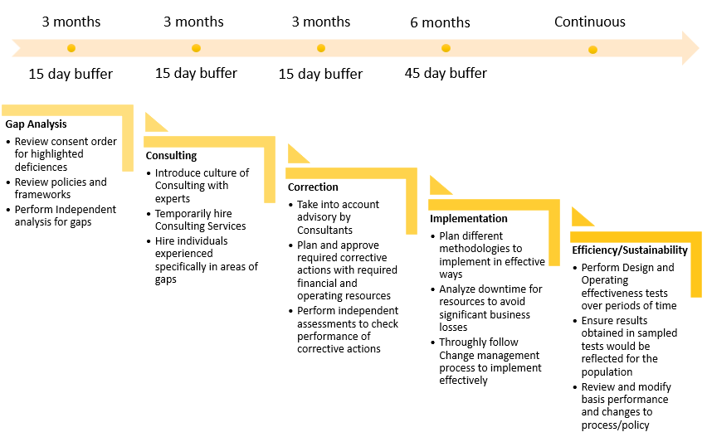
Project Plan
Notes:
This is a brief look for how our project looks like, and in the next few slides, we are going to explain each phases in details and introduce the resources that is needed.

Slide 14
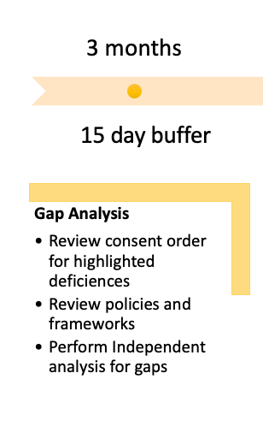
Phase 1 - Gap Analysis
Explain the phases:
At this stage, we are doing individual Gap Analysis for the deficiencies that is highlighted in the consent order
Involving parties:
Business unit – Project owner
Internal Audit – Oversight
Risk management – To assess risk in the current policies
Resources:
4 analysts (2 from business unit and 2 from risk management)
2 leads (1 from each business department and risk management)
1 manager (from business unit)
Notes:
The first phases that we are having is Gap Analysis, the process takes 3 months in total plus 15 day buffer. At this stage, the goal is to collect the deficiencies that we are having and the process will be conducted in granular basis, therefore, our main resources focus on analyst. And we will also have risk management department involved to assess the risk for the current policies. Internal Audit will be oversighting the whole process.

Slide 15
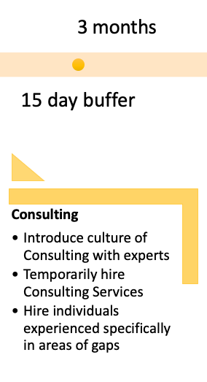
Phase 2 - Consulting
Explain the phases:
In order to have a more compliance environment, it is necessary to hire external parties who are familiar with the financial area to help us find out deficiencies and build up new policies.
Business unit, Risk department and external consulting should work together to make up policy and procedure which suits the HNA company culture
Also, it is necessary to hire individuals with rich experiences on the Business unit field to provide the company with timely suggestions
Involving parties:
Business unit, Risk department, Internal audit, HR, The board
External consulting company
Resources:
4 External parties
2 new hiring expertise
Notes:
At the consulting stage, we plan to finish in 3 months and giving it 15 days buffer. As you may notice, we will hire external parties and new experts. The reason why we are seeking external party’s assistance at this stage is because, according to the consent order, we will have new things that needs to be set up, but the company does have related experts in those area. Also we have a time limit on the execution of the consent order, therefore using external parties could help us fix the problem quicker and easier. In addition, in order to avoid communication barriers between the company and the external parties, we decided to hire new experts. They will be responsible for the project processing, follow-up monitoring and training.

Slide 16
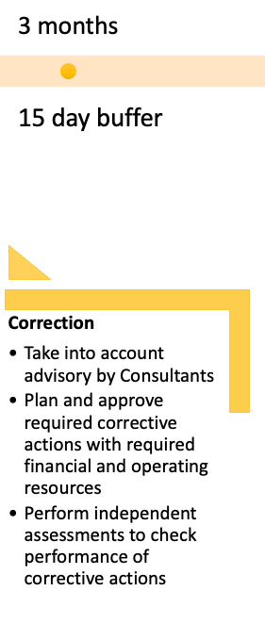
Phase 3 - Correction
Explain the phases:
Combine the findings and consultants' suggestions to develop a new requirement for the existing deficiencies.
Involving parties:
Business unit – Action plan owner
Risk management – Advisory
Internal Audit – Monitoring
Resources:
3 analysts (3 from Business unit and1 from risk management)
2 leads (1 from each Legal and internal audit)
2 manager (1 from each internal audit and risk management)
Notes:
We will do the correction at phase 3, the whole process takes 3 months plus15 day buffer. At this stage, we will set up the new requirements and related assessment. Therefore, as you might noticed, we allocate more resources on the upper management levels.

Slide 17
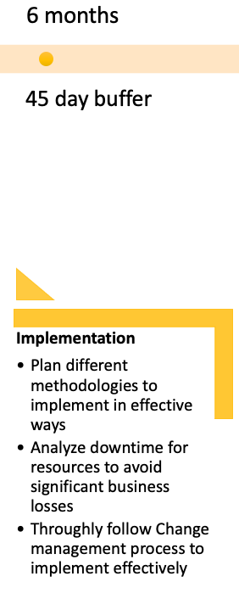
Phase 4 - Implementation
Explain the phases:
In order to reduce human error, the technology department would build an internal monitoring system to monitor the implementation status.
Although this may increase the budget, involving the IT department resulting in more man-hours, it is a long-term benefit that human error could be reduced and to implement efficiency.
Involving parties:
Business unit – Project owner
Risk management – Advisory
Internal Audit – Oversight
Resources:
6 analysts (3 from Business unit and 3 from IT management)
3 leads (2 from business unit and 1 from IT management)
1 manager (from Business unit)
Notes:
Phase 4 is the implementation. This will last for 6 months with a 45-day buffer period. From our research, we learned that human error is one of the main challenges facing the company. Therefore, in order to minimize such risks, we will ask the IT department to establish a monitoring system for us. This may increase our current budget, but the monitoring system could efficiently reduce human errors and save manhour in the future, in other words, it is a long-term benefit.

Slide 18
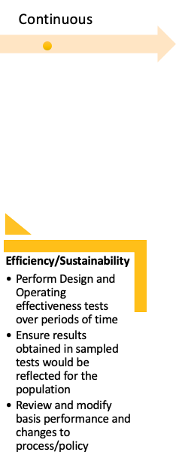
Phase 5 - Efficiency/Sustainability
Explain the phases:
After the action plan is done and launched, we will continue to monitor the implementation status, making sure the implementation meets the expected requirement.
When new deficiencies are found, we might consult or hire experts to make a corrective plan, report to the board, and revise the policy.
Involving parties:
Business unit – Project owner
Risk management – Advisory
Internal Audit – Oversight
Resources:
4 analysts (2 from Business unit and 2 from risk management)
2 leads (new hired experts for Business unit)
1 manager (from Business unit)
Notes:
So our last stage is efficiency/sustainability, and this stage will last forever. Although we have responded to the consent order, we believe it is necessary to continue to monitor the action plan to ensure that it does not become a problem again. If a new defect is discovered, we do not need to pay external resources to help us solve the problem. The new expert we hired in Phase 2 will be responsible for the implementation of the plan and correct the defect.

Slide 19
Detailed Scope of Work
Actions Phases |  | Expense Management | Contingency fund | Leverage Limitations | Depreciation tolerance levels
1 | Gap Analysis | a. Lack of categories and analysis of expenses, overlapping investment activities which cases large centralized risks in certain areas. b. Examine the current Expense Analysis performance, list out deficiencies. | a. A contingency fund is required to be formed for business continuity in riskier times. b. Conduct analysis and surveys for all subdivisions/ sub-business units requiring such contingency fund. Identify core business operations for these units. | a. Missing policies for restricting leverages. Required to set up such policies and enforce them firm-wide. b. Show breakdown of leverage limitations against each business unit by prioritizing on criticality of their operations and revenue generation. | a. Missing policies for tolerance level for depreciation. Required to set up such policies and enforce them firm-wide. b. Show breakdown of tolerance level for each business unit by prioritizing on criticality of their operations and revenue generation.
2 | Consulting | Enquire with financial consulting firms for their expertise and insight on current expense report and understand ways to reduce these. For e.g. reducing operating costs by reducing workload on vendors and hiring full time staff for the same. | Enquire with financial and accounting consulting firms for their expertise and insight for planning and forming such a huge fund capable enough to fund critical business operations during such risk events. | a. Enquire with financial and accounting consulting firms for their expertise and insight for effective policy and decision-making advisory, such as to set limitations in order to make business operate as well as avoid overdraft/ defaults on these payments. b. Hiring a new expert in the field of government (leverage) regulation. The new experts will become the communicator, communicating and set up the whole process with the outside consulting company. Also, they will be in charge of the new policy training and the follow-up monitoring. (Communication content includes: the nature and the size of company, the company expectation on the goal) | a. Consult with assets management firms for their expertise and insight for setting up tolerance levels. b. Hiring a new experts in the field of capital management. The new experts will become the communicator, communicating and set up the whole process with the outside consulting company. Also, they will be in charge of the new policy training and the follow-up monitoring. (Communication content includes: capital depreciate, benchmark of depreciation method, useful life of assets)
Notes:
Since we were given 4 major deficiencies by CSRC, we planned 4 overall actions required to be undertaken.
We know the controls and measures for these deficiencies are lacking, hence we will perform a gap analysis to identify the exact requirements for effected business units.
External financial and accounting firms would be consulted for their expertise and advisory to address the gaps identified. For a long-term requirement, experts would be hired to continue these activities.

Slide 20
Detailed Scope of Work
Actions Phases |  | Expense Management | Contingency fund | Leverage Limitations | Depreciation tolerance levels
3 | Correction | a. Filling the gaps between the current deficiencies and expected performance. Correlation analysis for every expenses to avoid large centralized risk in certain areas. b. Plan and approve the new set up for Expense Categories and Analysis with senior leadership. | a. Filling the gaps between the current deficiencies and expected performance. Set up enough Contingency fund b. Plan and approve the new set up for Contingency fund- for the projects that want to invest in, use appraisal methods to sort them and leave fund priority to projects with high return.
4 | Implementation | a. Categorize expenses by project, by departments. Implement an internal system to monitor if the company has violated expenses limit. b. We allow the internal system downtime to be 1 day, because the company has a lot of expenses every day, so the downtime cannot exceed this time. | NPV, discounted payback period etc. to appraise the investment cases. For instance, higher NPV usually means higher return. If we have a low NPV but believe that is a good investment, we should contain more contingency fund for the project. | a. Implement an internal system to monitor if the company has violated leverage threshold. b. If the internal system has been broken, we will not be able to monitor leverage in real time.(Internal system downtime: one month at most, because the company will not borrow frequently in a month and the interest is usually paid monthly) | a. Implement an internal system to monitor if the company has breached depreciation tolerance levels. b. If the internal system has been broken, we will not be able to monitor depreciation level in real time.(Internal system downtime: one month at most, for that equipment depreciation should be counted monthly)
Notes:
For any incorrect processes and procedures followed, the correction phase would be employed to rectify that at a logical level.
The implementation phase would undergo all the activities required to achieve the end goals. Additionally, the effectiveness of different methodologies would be tested here before implementing.

Slide 21
Detailed Scope of Work
Actions Phases |  | Expense Management | Contingency fund | Leverage Limitations | Depreciation tolerance levels
5 | Efficiency / Sustainability | a. Ensuring the correlation between each expenses categories should not exceed 60%. b. Inspecting quarterly income statements for reduced expenses of different units. | a. Performance measure - Observe use of these funds in a highly complex stimulated environment where firm faces similar scrutinies. b. KPI - The contingency fund shall be not less than the maximum loss estimated by the project. | KRI - Gearing ratio: Following the standards set by the regulator, a gearing ratio would measure upper limit of allowed leverage the firm can have. It can be calculated by a simple deb to equity ratio method. Suggested: No more than recommended leverage standard or 80% of the mandatory standard. | a. KRI - Depreciation rate: The level of tolerance for depreciation is dynamically adjusted with reference to the depreciation rate of each type of asset over the years. For the moment, a range can be defined as: 8% or less depreciation rate is normal, 8%-15% need to pay attention to, more than 15% may need to report to the board. b. Performance measure - Monthly price change rate: For assets with disposal plans, pay attention to the assets' selling prices at in the market. If the price has dropped by more than 5% from the previous month, it may need to report to the board.
Notes:
The final phase would work continuously to monitor and evolve for such risks. Within it any phase of the plan could be employed again without any fixed order to improvise and implement further identified deficiencies.

Slide 22
Budget
Team | Count | Rate per manhour(in $) | Manhours | Cost
Manager | 1 | 75 | 28 | $2,100.00
Lead | 2 | 50 | 100 | $10,000.00
Analyst | 4 | 35 | 400 | $56,000.00
Gap Analysis - Phase 1 Total |  |  | 528 | $68,100.00
External parties | 4 | 50 | 400 | $80,000.00
Hiring new expertise | 2 | 100 | 128 | $25,600.00
Consulting - Phase 2 Total |  |  | 528 | $1,05,600.00
Manager | 2 | 75 | 28 | $4,200.00
Lead | 2 | 50 | 100 | $10,000.00
Analyst | 3 | 35 | 400 | $42,000.00
Correction - Phase 3 Total |  |  | 528 | $56,200.00
Manager | 1 | 75 | 56 | $4,200.00
Lead | 3 | 50 | 200 | $30,000.00
Analyst | 6 | 35 | 800 | $1,68,000.00
Implementation - Phase 4 Total |  |  | 1056 | $2,02,200.00
Manager | 1 | 75 | 28 | $2,100.00
Lead | 2 | 50 | 100 | $10,000.00
Analyst | 4 | 35 | 400 | $56,000.00
Sustainability - Phase 5 Total |  |  | 528 | $68,100.00
All Phases Combined |  |  | 3168 | $5,00,200.00
Buffer period |  | 50 | 720 | $36,000.00
Combined Total |  |  | 3888 | $5,36,200.00
The above calculation assumes of 8-hour workday and 22-day work month.
Additionally, Phase 5 cost could be considered recurring cost every quarter.
Notes:
The budget given here is specific to each phase with the buffer period stated separate since that is something which could be optional/modified by the senior management subjective to requirement.

Slide 23
Impact
Current Losses
Project benefits
The company and its affiliates were placed into bankruptcy administration in February as corporate disclosures revealed that billions of dollars of its funds had been used for non-business purposes.
A risk of bankruptcy or delisting still exists, if HNA’s financial results don’t meet regulatory requirements.
HNA has at least 406 billion yuan ($63 billion) in debt claims.
Close monitoring and continuous growth would avoid such misuses of funds. Additionally, the contingency fund could be used in such critical situations.
Further penalties could be avoided by addressing requirements of consent order by China Securities Regulatory Commission (CSRC).
Project budget is approximately for $550,000 which would help reduce the similar financial risks faced.
Further, for Strategic and Operational Risk, similar plans could be employed with nearly same budget to reduce overall risks faced by HNA.

Slide 24
Benefits and Conclusion
External consultants have expertise in the field of financial risk and regulations which HNA lacks. After setting up the policies and procedures with them, the probability of encountering the similar risks in the future would be reduced. Even though this would add to the expense at this stage, the long term benefit far outweighs the cost.
Involving the IT department would result in more man-hours, but the long-term benefit that human error could be reduced and to improve implement efficiency would cover future vulnerabilities to these.
Looking ahead, we believe that the impact and lessons learned from this incident are far-reaching, and that with the adoption of relevant measures, similar situations can be greatly avoided in the future, allowing the company to grow smoothly.
The biggest problem that HNA Group encountered is liquidity risk, strategy and governance risk, and internal fraud and human resources risk. The inherent risk rating for all the risks is imminent which requires immediate attention on the problem, but after the action plan, we believe the residual risk rating will go down to low-moderate, and it will happen infrequent-occasional. We have also set up KRIs to monitor the action plan. In the second part, we received a consent order from China Securities Regulatory Commission, requiring us to resolve the four identified deficiencies, which are expense management, a contingency fund, leverage restrictions, and the tolerance level for depreciation. And we provided detailed scope of work and project plan for each deficiencies.

Slide 25
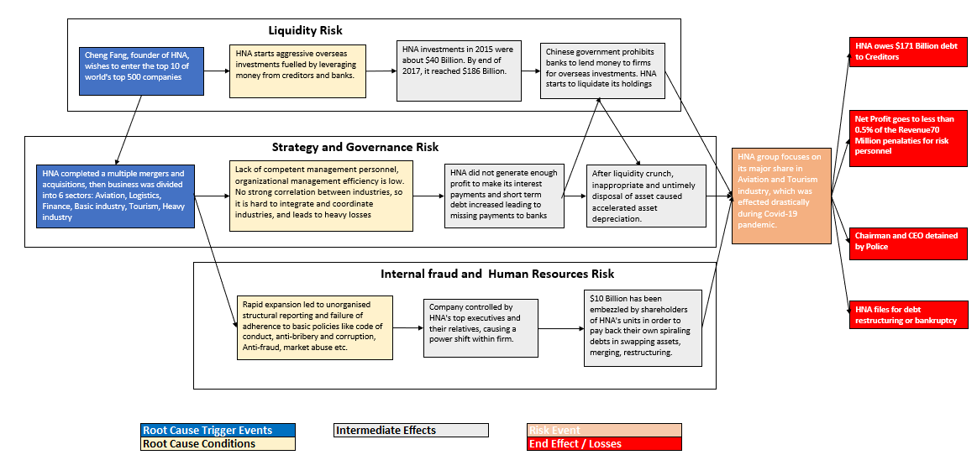
Appendix: Bow Tie – Root Cause Analysis

Slide 26
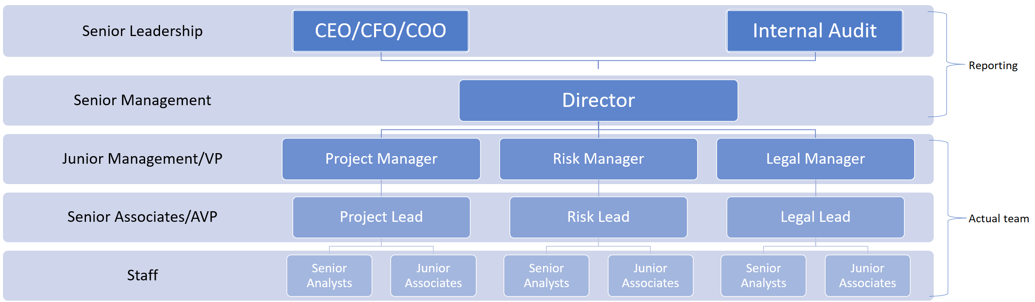
Appendix: Team Structure

Slide 27
Presented by:-
Questions and Feedbacks
Yan Li yl4988@columbia.edu Yogesh Rohra yar2115@columbia.edu Yongshi Xue yx2715@columbia.edu Youwen Cao yc3917@columbia.edu Zhuocheng Kong zk2252@columbia.edu

