Slide 1
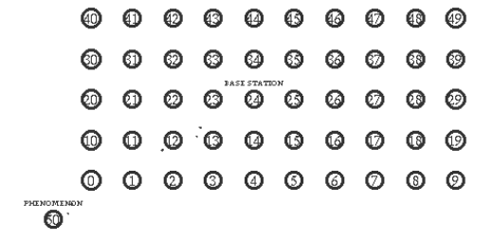
Write a tcl script for AODV, DSDV and DSR protocol by using the following parameters given below. Compare the protocol performance in terms of PDR, throughput and end to end delay ( For graph plotting take nodes - (10, 20, 30, 40)
The pattern contain nodes placed in the form of a matrix with an area covering 500 m * 250 m. 50 nodes are placed at every 50m distance in both X and Y directions.
Node 50 ( source node) - (2,2)
Node 0 - (50,50)
Base station - (250,150)
Give some mobility to node 50 -
$ns at 0.2 "$node_(50) setdest 300.0 250.0 25.0"
$ns at 49.0 "$node_(50) setdest 500.0 2.0 50.0"

Slide 2
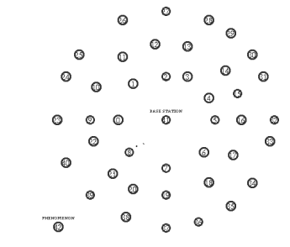
Totally 42 nodes are placed for the entire area of 500m * 500m. The phenomenon (source) node is initially placed at (2, 2) and made to move through the area of 500 m * 500 m.
Base station - (250,250)

