Slide 1
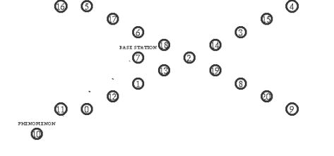
Write a tcl script for AODV, DSDV and DSR protocol. Find the protocol performance in terms of PDR, throughput and end to end delay
20 nodes are used for the area of 500m * 250m. The phenomenon node is placed at (2,2) and the base station node is placed at the position (250,150). The source node movement is similar to other patterns.

Slide 2
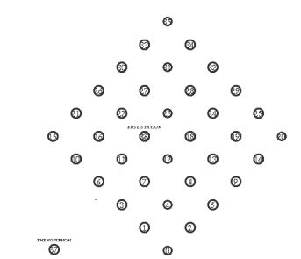
Write a tcl script for AODV, DSDV and DSR protocol. Find the protocol performance in terms of PDR, throughput and end to end delay
Totally 37 nodes are placed to cover the area of 500m * 500m. The source node is placed at an initial position of (2, 2) and the movement is similar to other patterns. The base station node is placed at the centre i.e. (250,250)

