Slide 1
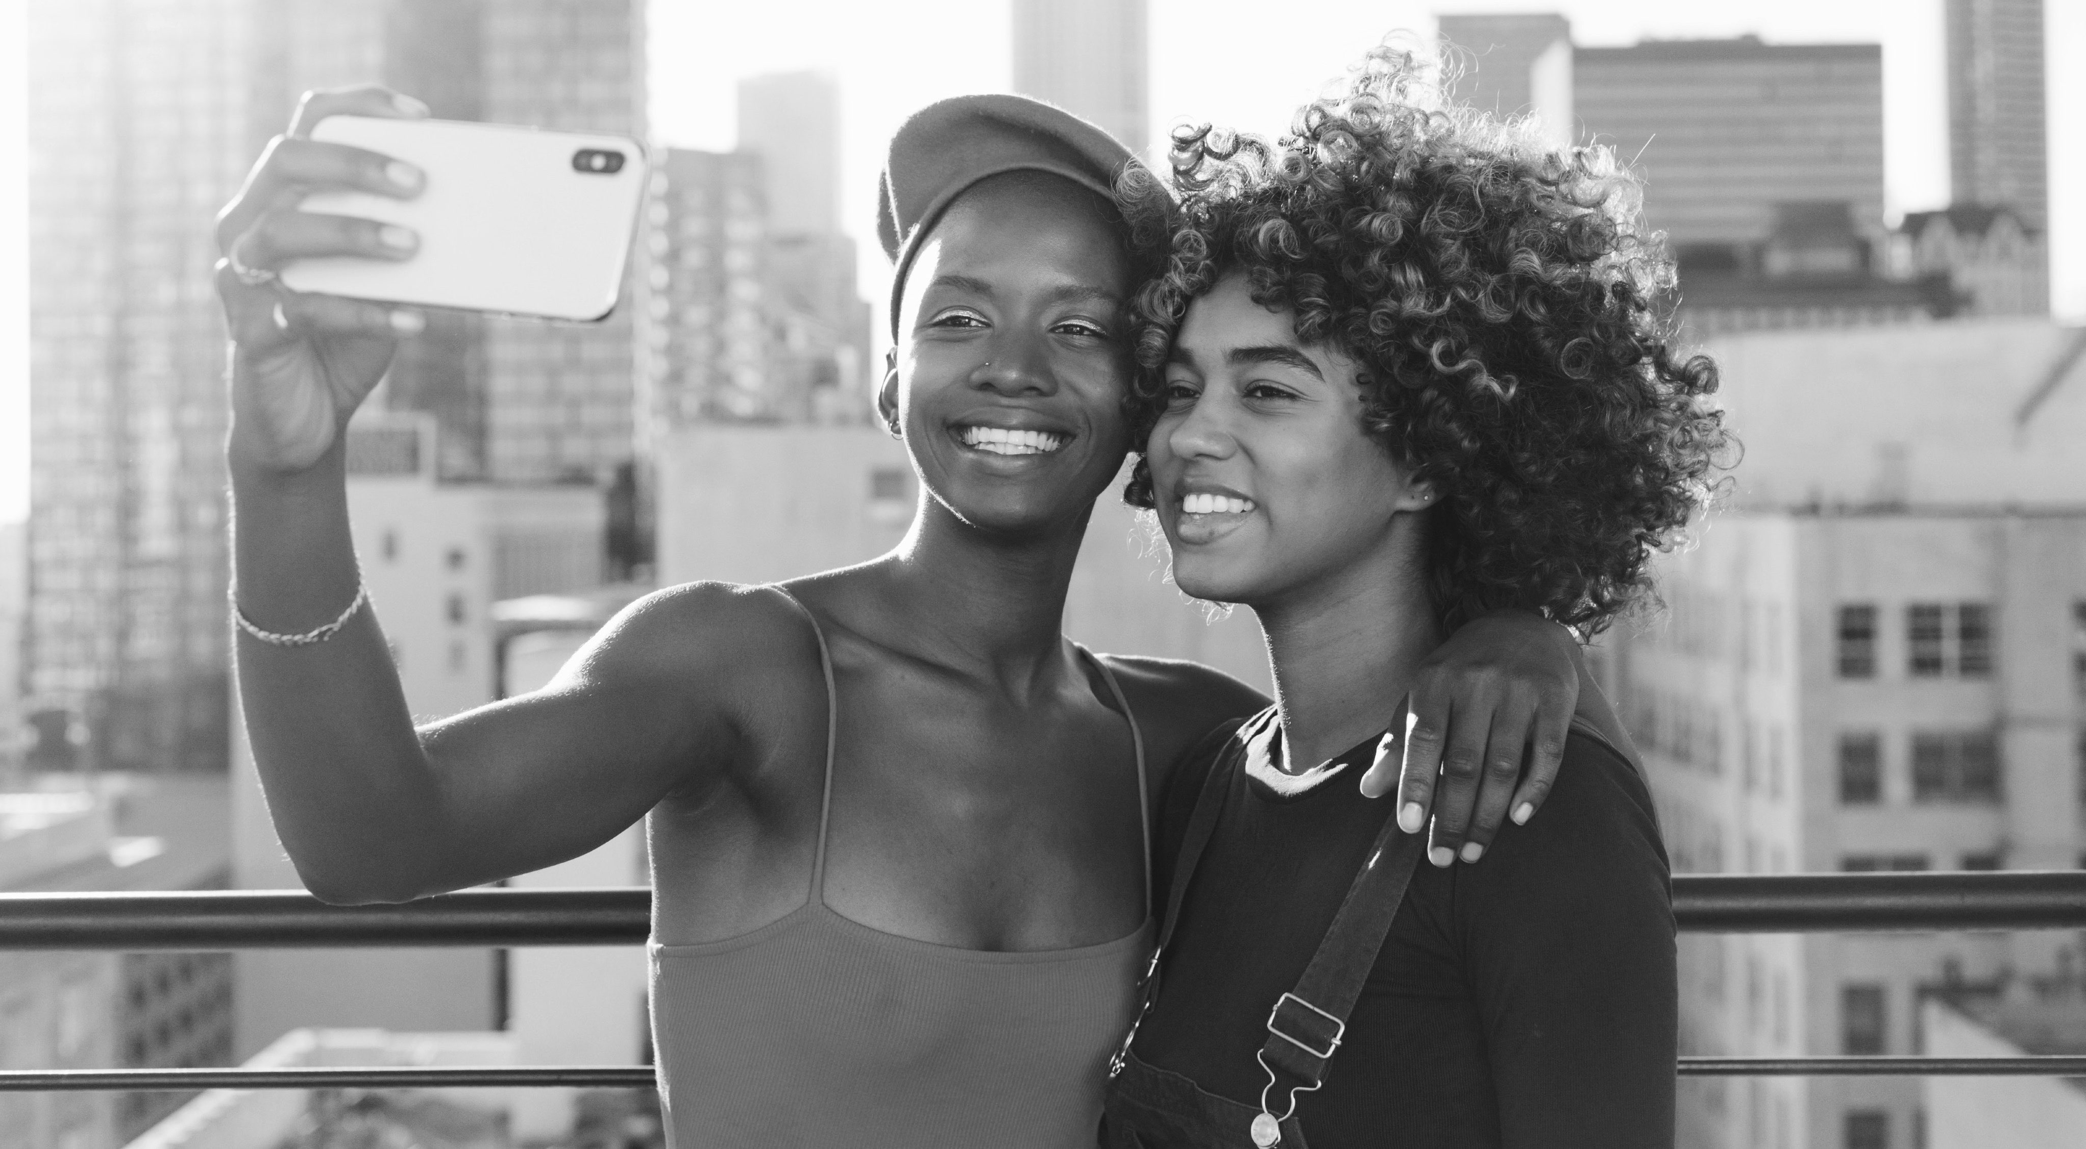
UK & Ireland Trend Campaigns Strategy - Q3 2025
Yogesh Sivakumar
MSc. in Business Analytics
yogeshsivakumar18@yahoo.com
+353 894329013
Entertainment, News &
Tech

Slide 2
Project Overview
A regional product ops simulation focused on surfacing and growing key trends through data, content strategy, and cross-functional collaboration.
Goals:
Improve trend discovery & engagement
Test platform levers
Optimize localized content strategy

Slide 3

Project Focus
Selected Content Verticals
Entertainment: Viral TV shows, celebrity culture, film events, nostalgic content.
News: Cultural moments, local politics, docuseries, live events.
Technology: AI-generated content, production tech, digital creativity.
Target Regions
United Kingdom
Ireland
Methodology & Approach
Trend research using TikTok Discovery, Google Trends, YouTube
Campaign design with platform levers and KPI simulations
Regional analysis and cultural context integration

Slide 4
Trend Research Summary
Key Trends Identified:
1. #NoughtiesNostalgia – UK throwback content surge
2. Studio Ulster Film Boom – Virtual production innovation
3. Irish Sports & Events – Real-time cultural engagement
4. AI in British Media – Creator-driven tech experimentation

Slide 5
#NoughtiesNostalgia Campaign
Objective:
Reignite 2000s pop culture engagement among Gen Z & Millennials.
Region:
UK & Ireland
Strategy:
Hashtag Challenge: #MyNoughtiesLook (recreate 2000s styles/scenes)
TikTok Levers: Discover tab push, effects, banner placement
Cross-Promotion: Nostalgic audio clips
KPIs:
Hashtag reach: 15M+
UGC creation: 50K+

Slide 6
Studio Ulster Film Boom
Objective:
Showcase Northern Ireland’s leadership in virtual film production.
Region:
Northern Ireland
Strategy:
Creator Collab: Film students and studio partners
Levers: Tech spotlight, creator funding, banners
KPIs:
Shares: 250K+
Creator engagement: 20K+ comments
Industry outreach: 3+ partnerships

Slide 7
Overview of Growth
65%
Expected increase in creator follower growth
Over a 2-week period (Within 3 weeks (Boost for creators involved in relevant content)
60%
20%
Expected increase in UGC Creation
Over a 2-week period (Via hashtag challenges and creator participation across 4 trends)
Expected increase in Discover tab management.
Within the first 7 days of campaign launch (Driven by search prompts and editorial banners)

Slide 8
What this Project demonstrates
Product thinking with real-time content strategy
Data-driven operations insight
Cultural and regional content fluency
01
02
03

Slide 9
THANK YOU
+353 894329013
yogeshsivakumar18@yahoo.com

