Slide 1

Docker
By- Yogesh Tripathi
October - 2020

Slide 2
Contents
What is Docker ?
What is Container ?
What is Docker Image ?
How to install Docker .
Making first Docker Image
How to share Docker Images
Docker Commands
Adding Docker Support to .NET API / Console App
What is Docker Hub
Pushing Image to Docker Hub

Slide 3
What is Docker ?
Docker is a container management service. The keywords of Docker are develop, ship and run anywhere. The whole idea of Docker is for developers to easily develop applications, ship them into containers which can then be deployed anywhere.
Docker is a tool designed to make it easier to create, deploy, and run applications by using containers.
Docker has become one of the fastest-growing technologies in devops and web development.
It is a complete package containing the right version of OS, the desired version of the language, any external dependencies of your application and your application code. That too in a lightweight, isolated and resource controllable way.
Docker has many advantages but the most important one is the container analogy. That you don't only ship your code but ship the whole OS and all related layers with each deployment in a standard way.

Slide 4
What is Container ?
Containers can be termed as the standard boxes where the goods can be packaged in a standard way, so you just have to focus on developing the item you develop do not worry about how it will run .
Like a physical plastic container, a Docker container:
Holds things
Is portable
Docker Containers are run time instances of the Docker image.
Containers allow a developer to package up an application with all of the parts it needs, such as libraries and other dependencies, and ship it all out as one package.
A second way you can think of a Docker container is as an instance of a living thing. An instance is something that exists in some form. It’s not just code. It’s code that has brought something to life.

Slide 5
What is Docker Image ?
An image includes everything needed to run an application -- the code or binary, runtimes, dependencies, and any other file system objects required.
Docker run hello-world
The Docker command is specific and tells the Docker program on the Operating System that something needs to be done.
The run command is used to mention that we want to create an instance of an image, which is then called a container.
Finally, "hello-world" represents the image from which the container is made.

Slide 6

How to get Docker
https://hub.docker.com/?overlay=onboarding
This is an .exe file you need to download and install for running the Docker .
Docker Desktop does not start automatically after installation. To start Docker Desktop, search for Docker, and select Docker Desktop in the search results.
When the whale icon in the status bar stays steady, Docker Desktop is up-and-running, and is accessible from any terminal window.

Slide 7
Making your first Docker Image
Follow the Steps:-
Open the command prompt (win+r=>cmd).
Docker build -t <dockerdemo> (Location of your project ).
Check the image is successfully build using Docker images command.
You successfully created an image.

Slide 8
How to share Docker Images
Multiple team members may wish to share images
Images can be in production, under development or under test
Docker Hub is a repository where images can be stored and shared.
Each image is tagged to allow versioning
Any image can be “pulled” to any host (with appropriate credentials)
Tagging as “latest” allows updates to be propagated.
Pull :latest gets the last image checked into repository with that name.

Slide 9
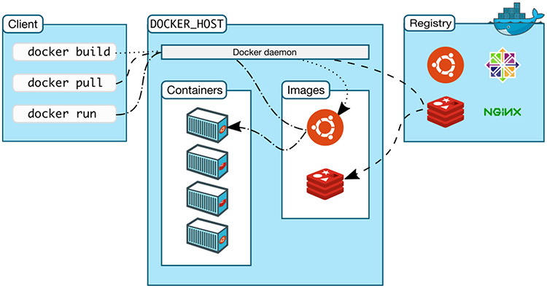
Docker Commands
Docker version (this give the docker version).
Docker run hello-world (This mean run that container based on hello-world image).
---in this the client went to the daemon the daemon then checks if there is a hello-world image present locally . If it finds the image then do the necessary ,else it have to move away and have to look into the DOCKER HUB (library of the docker) for the image ,it pulls the image and uses this image to create a new container.

Slide 10
Docker ps –Shows the list of containers and if there are currently running images or containers.
Docker ps –a ------Shows the previously running containers which has now exited.
Docker info ---- It shows the number of Containers and images present and there state (running, paused, stopped).
Docker images----- It shows the list of images present (that are stored locally) .. It has following attributes…
REPOSITORY—NAME OF THE IMAGE.
TAG—IT IS JUST A NAME WHICH HAS VALUES(LATEST,OLD)
IMAGE ID---EVERY IMAGE HAVE THE UNIQUE HASS KEY..
CREATED--- Days or time created.
SIZE—THE SIZE OF THE IMAGE.
Docker container – Shows the list of containers present.

Slide 11
Adding Docker Support to .NET API / Console App
Docker is a way of encapsulating everything you need to run an application such as .net core app including the code ,frameworks ,packages it depends on and underlying O.S ,so Docker container is a way of putting them altogether in one neat package and to use it or put in wherever you need to.
Open Visual Studio and follow the steps below:-
File=>New=>Project=>ASP.NET Core Web Application (Name your application) =>API =>Click OK.
In the solution explorer
Right click on your project name=>click Add=>Docker Support=> Specify the OS you want to target=>Click Ok (This will create a Docker file in the project.)
Now you have successfully added Docker support to your project.

Slide 12
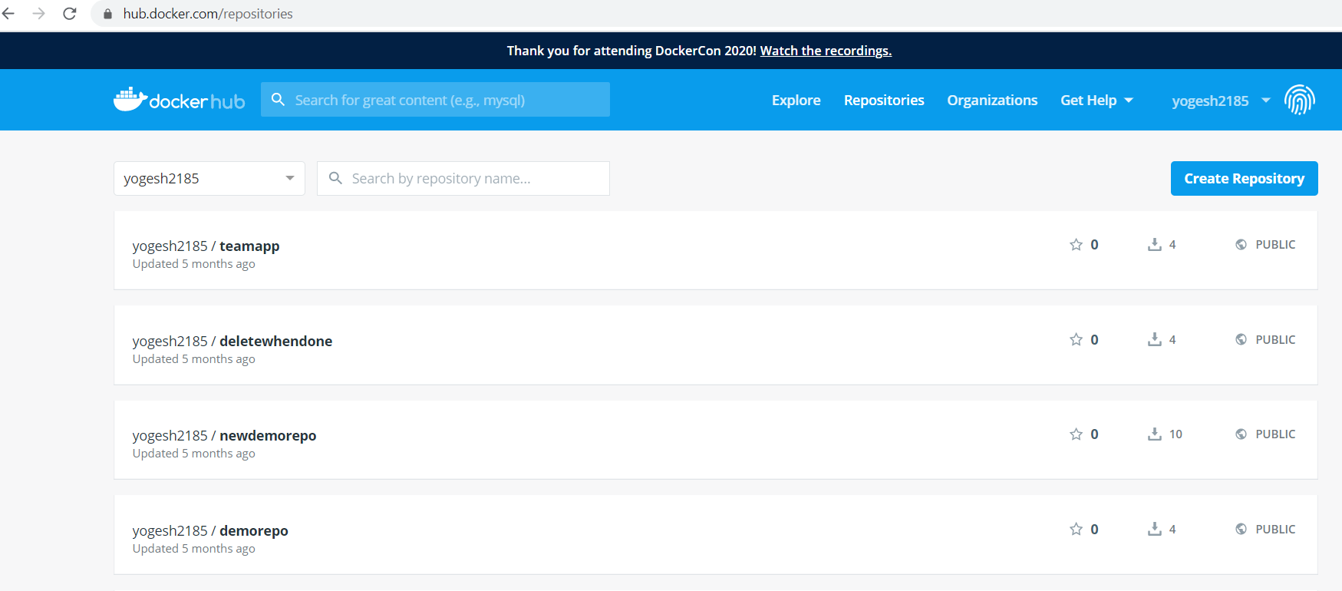
What is Docker HUB ?
Docker Hub is a registry service on the cloud that allows you to download Docker images that are built by other communities. You can also upload your own Docker built images to Docker hub.

Slide 13
Pushing Image to Docker Hub
Follow the steps below:-
Step 1:- Login Docker using your Docker credentials.
Docker login
Step 2:- Docker images
REPOSITORY TAG IMAGE ID CREATED SIZE
dockerdemo dev 1689e0cfaf32 2 days ago 514MB
Step 3:- docker tag <IMAGE ID> <docker_username/docker repositoryname:tag>
Step 4:- docker push <docker_username/docker repositoryname>
Docker image successfully pushed to docker Hub.

Slide 14
Thank YOU

