Slide 1
Tablet PC can be a future of computer
Rahul Dewangan • 11640750

Slide 2
Overview
What is a Tablet PC?
Advantages
Disadvantages
Tablet VS Computer
Conclusion

Slide 3
What is Tablet PC?
A mobile computer with display circuitry and battery in a single unit.
Tablet PCs are portable, touch screen devices
Essentially a small laptop computer.
Equipped with sensors, including cameras, microphone, mouse and keyboard.

Slide 4
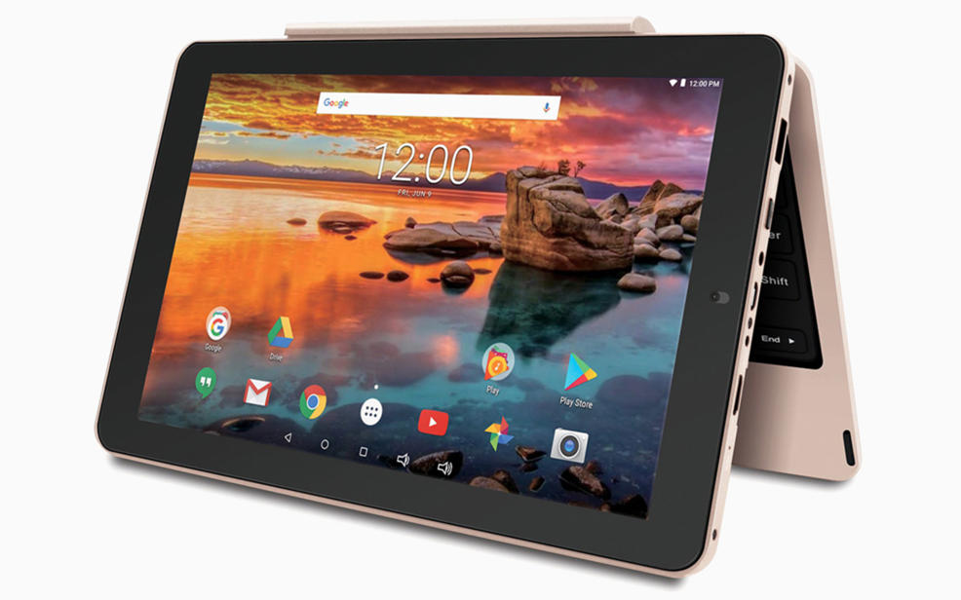

Slide 5
Advantages
Smaller weight and size
Touch Interface
Portability
Functionality
Social Networking Tools
Improved digital reading
Connectivity
Stylish Look

Slide 6
Disadvantages
No keyboard and mouse
Low processor speed
Screen Size
Tends to lack ports
Less portable than a mobile phone
Fragile

Slide 7
Tablet VS Computer

Slide 8
Tablets are much more compact and cannot offer the same amount of processing power as a high-end computer.
Most tablets offer a limited amount of accessories that usually include input devices such as a keyboard and access to some printers.
Tablets come with built-in storage ranging from 8 GB to 128 GB. In some cases, an expansion slot may be available for adding additional storage.
Power
Cost
Storage
Operating System
Software and accessories
Tablets can also vary in price based on power and various features, but not as much as computers.
Tablets come with a more slimmed down operating system because of the limited computing power and memory.

Slide 9
Conclusion
The tablets are more portable as compare to the PC and laptops.Though desktop and laptop computers are still extremely popular, there are dozens of everyday situations where a smartphone or tablet is the best solution. They're fun, easy to use devices best suited to web browsing and apps.Looking all the features and its advanced functions Tablet PC’s could be considered as the next best inventions.

Slide 10
Thank You...

