Slide 2
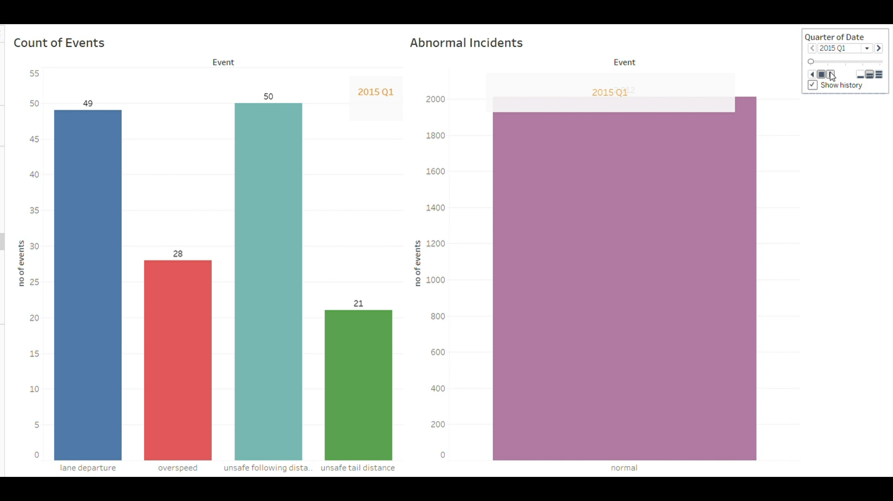
Animating All events by Quarter wise

