Slide 1
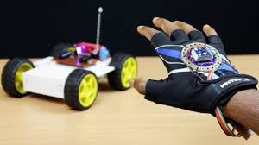
Hand Gesture recognition using motion sensors

Slide 2
AIM:
The main aim of the project is to control the movements or directions of air planes, trains and cars by using MEMS technology.

Slide 3
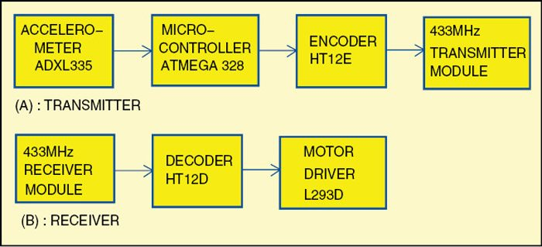
BLOCK DIAGRAM :

Slide 4
CONTENT’S OF THE PROJECT:
TRANSMITTER :
1-ACCELEROMETER
2-COMPARATOR
ENCODER(HT12E)
RF TRANSMITTER
RECEIVER:
RECEIVER
DECODER
ACTUATOR(motor driver)

Slide 5
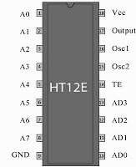
ENCODER:

Slide 6
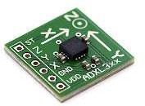
ACCELEROMETER:
It is a kind of sensor
It can work by giving analog data in X,Y,Z directions
X-on pin receive analog data in x- direction
Y-on pin receive analog data in y- direction
Z-on pin receive analog data in z- direction

Slide 7
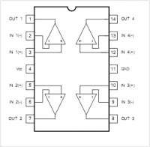
COMPARATOR:

Slide 8

RF TRANSMITTER MODULE:
433.92 MHz frequency
Low cost
1.5-12 volts of operation
11 mA currents consuption at 3volts
Small size
4 dB output power at 3 volts

Slide 9
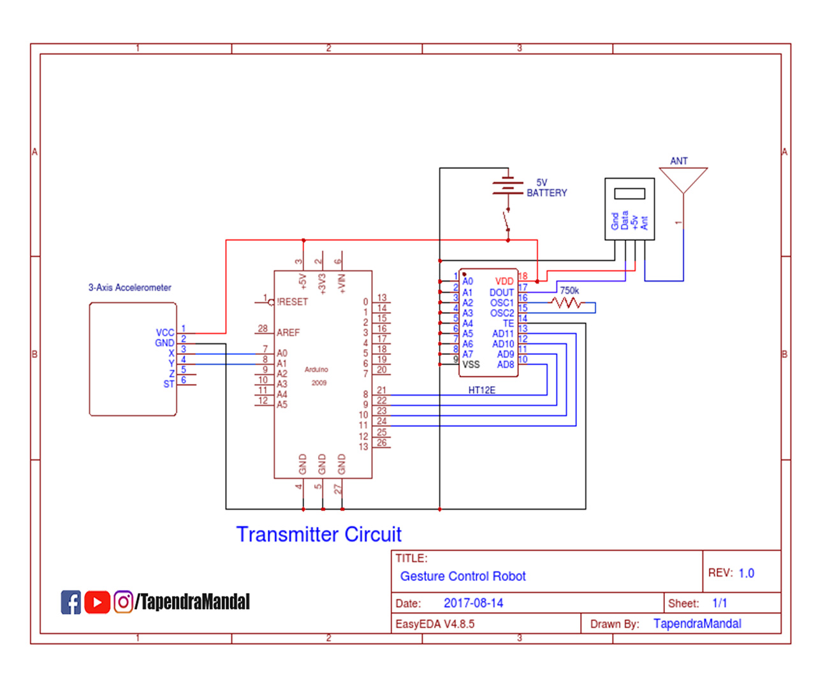
Block diagram of transmitter

Slide 10

RF RECEVIER MODULE:
Low cost
5 volts operation
3.5 mA current drain
No external parts are required
Receiver frequency-433.92 mhz
Typical sensitivity’-105dB
IF frequency 1 MHz

Slide 11
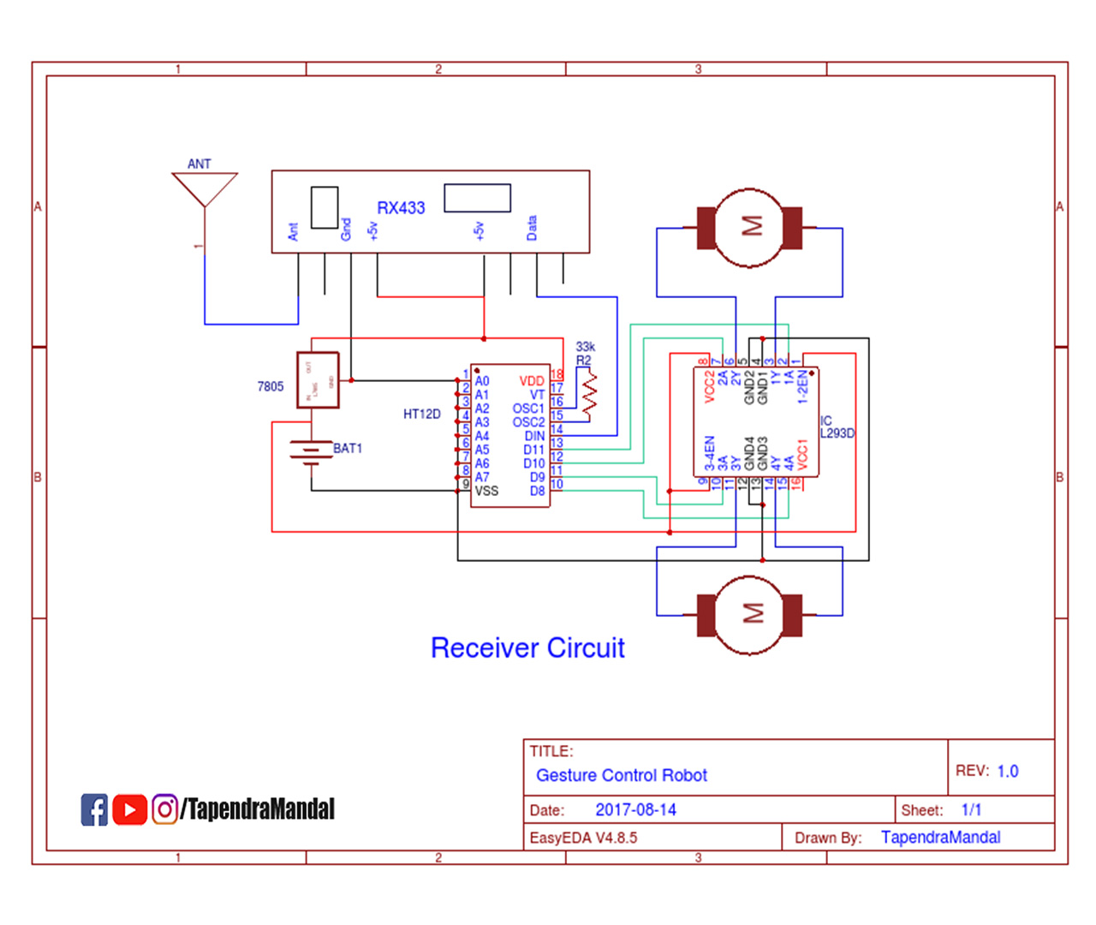

Slide 12
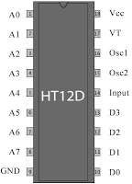
DECODER:
It is used convert serial data into parallel which is received by the RF receiver.
A valid transmission indicated by a high signal at VT pin

Slide 13
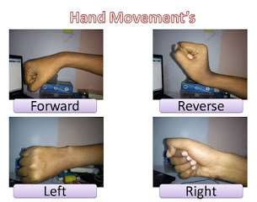
Hand Movement’s:

Slide 14
APPLICATIONS:
MEMS based sensors are a crucial component in electronics
It is used in medical equipment

Slide 15
THANK YOU

