Slide 1

SYNCFUSION ESSENTIALS
YOGESHKUMAR S
SOFTWARE ENGINEER

Slide 2



MOST POPULAR COMPONENTS
LISTS:-
  DataGrid
  Charts
  ListView
  Schedular
  Diagram
  PDF viewer
  Excel Library
Tuesday, February 2, 20XX
Sample Footer Text

Slide 3
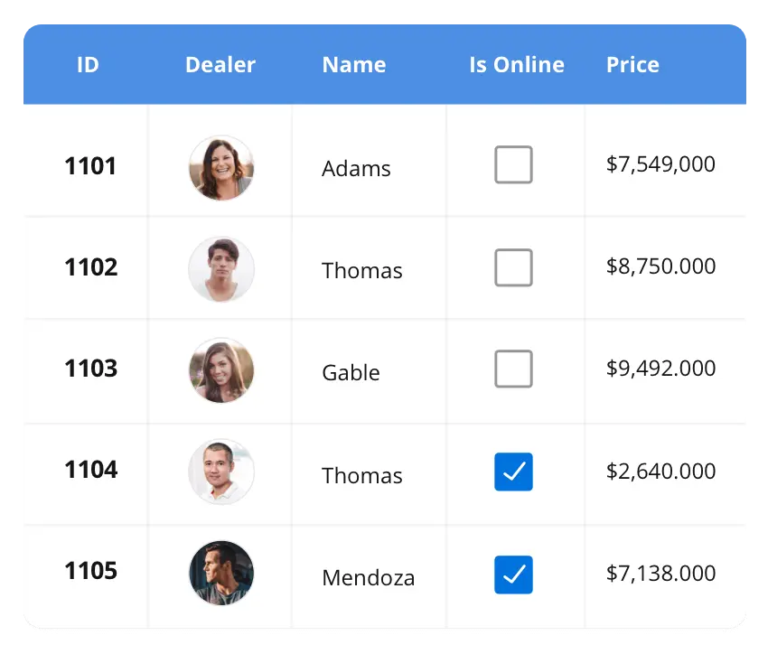


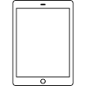
DataGrid:-
The DataGrid control is a high-performance grid component that helps display and manipulate large amounts of data in a tabular format.
Its rich feature set includes functionalities like data binding, sorting, grouping, editing, filtering, swiping, dragging, resizing, loading more items, pull-to-refresh, and exporting to Excel and PDF file formats.
SUPPORTED PLATFORMS
|
|
|
Javascript
Angular
React
Vue
Blazor
Fluter
jQuary
ASP.NET MVC
ASP.NET Core
ASP.NET Web Forms
WinForms
WPF
WinUI
Flutter
UWP
Xamarin
Flutter
UWP
Tuesday, February 2, 20XX
Sample Footer Text

Slide 4
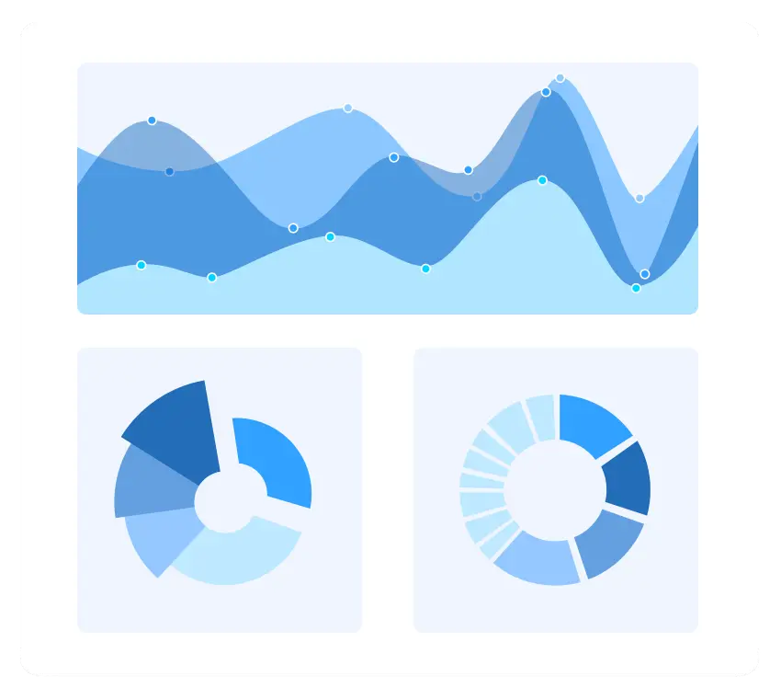
Charts:-
The Charts control can plot a wide range of chart types, ranging from line charts to specialized financial charts.
Its rich feature set includes functionalities like data binding, multiple axes, legends, animation, data labels, annotations, trackballs, tooltips, and zooming
SUPPORTED PLATFORMS
|
|
|
Javascript
Angular
React
Vue
Blazor
Fluter
jQuary
ASP.NET MVC
ASP.NET Core
ASP.NET Web Forms
WinForms
WPF
WinUI
Flutter
UWP
Xamarin
Flutter
UWP
Tuesday, February 2, 20XX
Sample Footer Text
3
Notes:
3

Slide 5
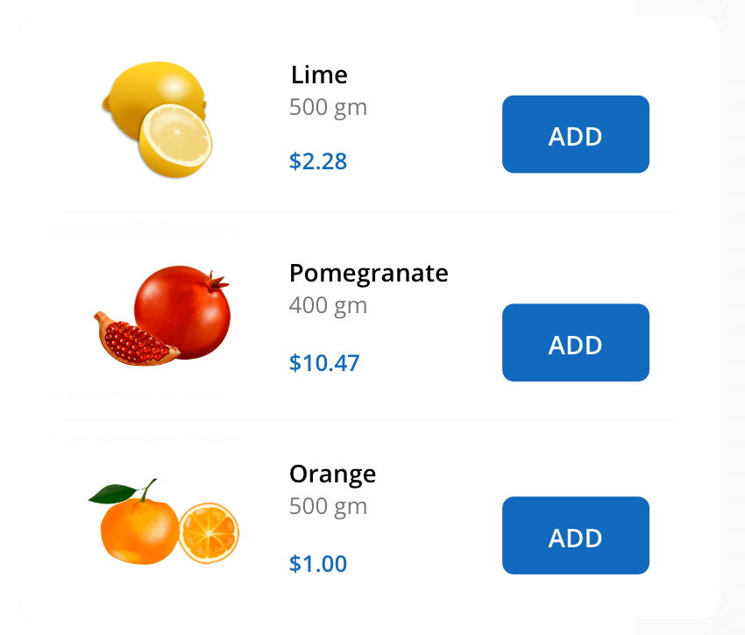
ListView:-
The ListView renders a set of data items with UI views or custom templates. It has many features like grouping, sorting, filtering, paging, swiping, multiple selection, drag and drop, and different layout types.
The ListView control has been optimized to work with large amounts of data.
SUPPORTED PLATFORMS
|
|
|
Javascript
Angular
React
Vue
Blazor
Fluter
jQuary
ASP.NET MVC
ASP.NET Core
ASP.NET Web Forms
WinForms
WPF
WinUI
Flutter
UWP
Xamarin
Flutter
UWP
Tuesday, February 2, 20XX
Sample Footer Text
3
Notes:
3

Slide 6


Thank You
YOGESHKUMAR S
SOFTWARE ENGINEER
Tuesday, February 2, 20XX
Sample Footer Text

