Slide 1
Guidewire Overview
14 July 2022
Notes:
Guidewire training materials contain Guidewire proprietary information that is subject to confidentiality and non-disclosure agreements. You agree to use the information in this manual solely for the purpose of training to implement Guidewire software solutions. You also agree not to disclose the information in this manual to third parties or copy this manual without prior written consent from Guidewire. Guidewire training may be given only by Guidewire employees or certified Guidewire partners under the appropriate agreement with Guidewire.

Slide 2
Lesson objectives
This lesson is to provide an overview on:
Guidewire Organization
Guidewire Products
Guidewire Core suite landscape
Typical integrations to Guidewire
This lesson uses the notes section for additional explanation and information. To view the notes in PowerPoint, choose View→Normal or View→Notes Page. If you choose to print the notes for the lesson, be sure to select “Print hidden slides.”

Slide 3
Lesson outline
Guidewire Organization
Guidewire Products
Guidewire Core suite landscape
Typical integrations to Guidewire
Notes:
PolicyCenter Overview - 3

Slide 4

Guidewire Organization
Guidewire Software, Inc., commonly Guidewire, is an American software company established in 2001 based in San Mateo, California.
Guidewire offers an industry platform for property and casualty (P&C) insurance carriers in U.S. and worldwide.
With 1,000 + Implementations Guidewire serve more than 450 P&C insurers in 30+ countries and provide software, services, and partner ecosystem
Notes:
PolicyCenter Overview - 4

Slide 5
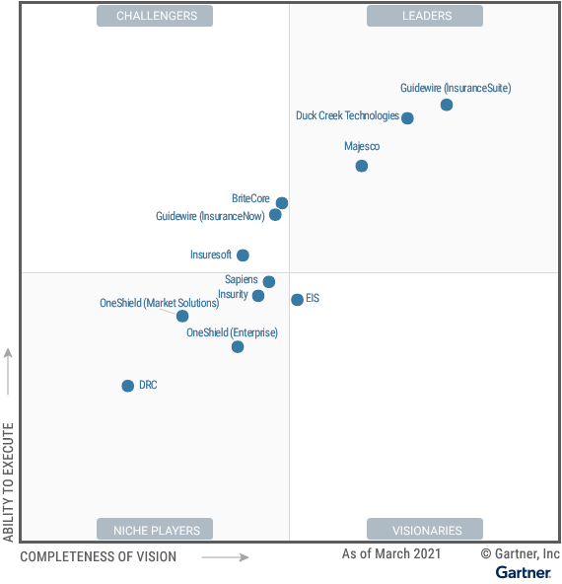
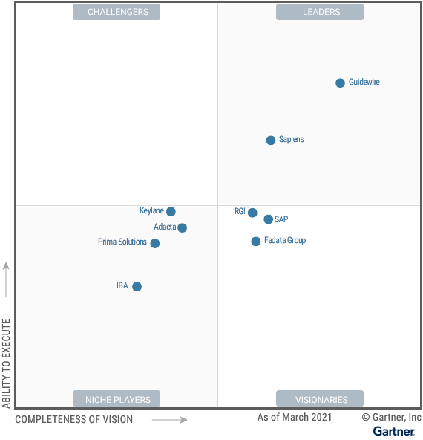
Gartner Report - Magic Quadrant
Magic Quadrant for P&C Core Platforms
North America
Europe
Notes:
This Magic Quadrant provides insight into the market for P&C core platforms aimed at very large Tier 1 insurers. It is a review of established and emerging vendors offering P&C core platforms with broad customer, partner, data and employee-focused capabilities suitable for multiline P&C insurers. The version of the vendor’s product(s) evaluated by Gartner for this report is what was generally available as of 31 March 2021.

Slide 6
Magic Quadrant Contd…
Strengths | Comments
Platform Vision | Core Modules, Data and analytics solution, Suite of portals, Partner Solutions through Insurance App Store
Sales Execution | Highest Wins – 29% in NA 2020 - 21
Implementation Partners | 10,000 formally certified SI consultants
R&D Investment | $200 million - 35% of its total revenue
Cautions | Comments
SaaS Model | Does not offer a true SaaS model
Cloud Execution | 31% (NA) and 81% (Europe) of New Wins are On-premises
Cloud Service-Level Agreements | Standard SLAs for uptime at 99.7%
Implementation Effort | Complex platform that offers users myriad options and configurations
Localized content availability | Local market content release is in progress
Notes:
Platform Vision: In addition to the core modules, the vendor has a comprehensive data and analytics solution, a suite of portals for different user types, a predictive analytics solution and the greatest number of partner solutions offered through its insurance app store
Sales Execution: For the fifth year running, Guidewire has secured the highest number of new wins for its insurance core modules. Guidewire accounted for 29% of new wins in North America in 2020 and 1Q21, across the vendors profiled in this report.
Implementation Partners: Guidewire has an expansive network of technology and service partners. The vendor has more than 10,000 formally certified SI consultants.
R&D Investment: Guidewire invests over $200 million in R&D annually, accounting for 35% of its total revenue.

Slide 7
Guidewire InsurancePlatform
Guidewire InsurancePlatform™ provides the standard upon which insurers can optimize their operations, increase engagement, drive smart decisions, innovate quickly, and simplify IT
Guidewire InsurancePlatform is the P&C industry platform that unifies Software, Services, and Partner Ecosystem to power customers’ business.
Software: Applications support the entire insurance lifecycle
Services: Implementation, support, and operational services
Partner Ecosystem: Access to applications and content provided by established players
Notes:
Software: Guidewire’s software applications support the entire insurance lifecycle—from digitally engaging with customers to optimizing core operations to enabling smart decision-making.
Services: Guidewire services include implementation, support, and operational services, including simplifying IT through cloud services to support customers after go-live.
Partner Ecosystem: GW partner ecosystem provides access to applications and content provided by established players and insurtechs, promoting insurers’ ability to innovate quickly

Slide 8
Guidewire InsurancePlatform Contd…
Guidewire develops the Gosu programming language, released as open source in 2010.
The platform has been developed in Java supporting Microsoft SQL Server and Oracle Database, and its SaaS offering is underpinned by Amazon Web Services (AWS).
In 2020, Guidewire delivered a new analytics platform for embedding intelligence to automate core insurance processes, a UBI solution and a self-service console for managing cloud deployment.
Notes:
PolicyCenter Overview - 8

Slide 9
Lesson outline
Guidewire Organization
Guidewire Products
Guidewire Core suite landscape
Typical integrations to Guidewire
Notes:
PolicyCenter Overview - 9

Slide 10
Guidewire offerings
Guidewire Core
The core systems cover the entire P&C insurance lifecycle.
Guidewire Data and Analytics
Guidewire’s data and analytics solutions gives a full view of the data
Guidewire Digital™
Supports digital sales, service, and claims journeys
Guidewire Cloud™
Guidewire delivers Software-as-a-Service (SaaS) solutions via Guidewire Cloud.
Notes:
Guidewire Core
With a comprehensive set of capabilities— underwriting, policy administration, billing, and claims management— the core systems cover the entire P&C insurance lifecycle.
Guidewire Data and Analytics
With Guidewire’s data and analytics solutions one can get a full view of the data to enable and even automate the right decisions at the right time across the insurance lifecycle
Guidewire Digital™
Reach policyholders, agents, employees, and vendors where it’s most convenient by supporting digital sales, service, and claims journeys.
Guidewire Cloud™
Guidewire delivers Software-as-a-Service (SaaS) solutions via Guidewire Cloud. Guidewire Cloud enables insurers to focus on business agility while transferring undifferentiating IT responsibilities to Guidewire, in exchange for a subscription fee that is adjusted for usage to increase the predictability of cost
PolicyCenter Overview - 10

Slide 11
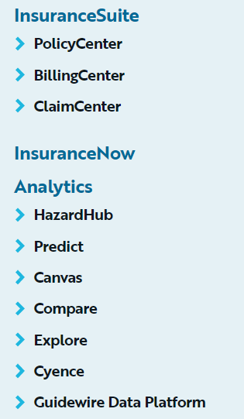
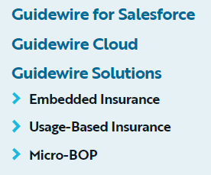
Guidewire products
Notes:
PolicyCenter Overview - 11

Slide 12
Guidewire InsuranceSuite
InsuranceSuite is a modular solution covering policy, billing, claims, rating, portal solutions and BI/analytics tools
Policy management, which provides full, end-to-end policy management and issuance functionality — including (but not limited to) quoting, rating, underwriting, policy generation and statistical reporting.
Claims management, which combines claims administration and business process management (BPM) to support every phase of the end-to-end claims process for non-life insurers, from first notice of loss (FNOL) through settlement and reporting.
Billing management, which supports the entire insurance billing and collections cycle, including (but not limited to) functionality such as electronic bill presentment and payment (EBPP).
Notes:
PolicyCenter Overview - 12

Slide 13


Guidewire InsuranceNow
Traditional P&C core systems are complex requiring large teams of people to implement, integrate and support.
InsuranceNow is purpose built for insurers with limited IT resources. It gives Insurers a ready-to-go core platform that is complete, but not complex.
InsuranceNow is a complete platform that unifies the core functionality of policy, claims, billing with digital and Analytics
Notes:
Traditional P&C core systems are complex as they are designed to serve the need of all insurers including the world’s largest and most complex requiring large teams of people to implement, integrate and support.
PolicyCenter Overview - 13

Slide 14

Guidewire InsuranceNow
InsuranceNow installs as a single system, reducing integration complexity enabling rapid implementation and regular upgrades
“InsuranceNow GO” prepackaged implementations enable faster time to value
Everything is served in cloud, so it’s secure, complaint and always on
Notes:
PolicyCenter Overview - 14

Slide 15
Guidewire Analytics
Analytics products deliver embedded predictions to underwriters and claims adjusters so they can make smarter decisions on risk selection, pricing, claims triage, and settlement.
Notes:
PolicyCenter Overview - 15

Slide 16
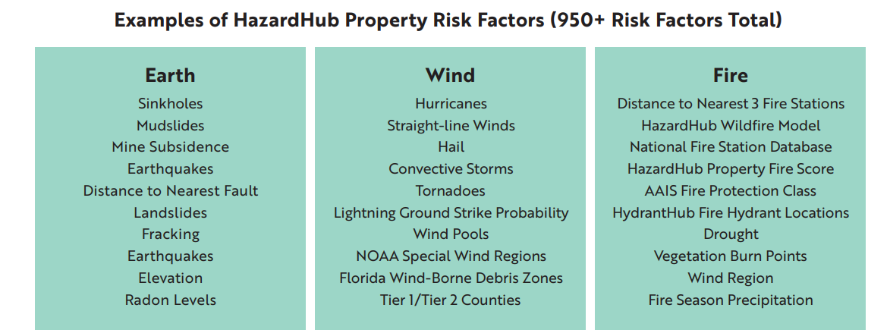
Guidewire Analytics - HazardHub
HazardHub Property is a cloud-native solution delivered via an API. Insurers need to enter only a U.S. address to receive valuable risk scores on properties in less than two seconds.
Insurers can make informed decisions based on more than 950 risk variables, including perils from air, water, earth, and fire
Notes:
PolicyCenter Overview - 16

Slide 17
Guidewire Analytics - Predict
Guidewire Predict is an advanced, P&C-specific machine-learning platform that empowers insurers to make intelligent, data-driven decisions throughout the insurance lifecycle.
Predict for Claims
Predict for Profitability
Predict consists of three key applications that work together to embed real-time insights into core processes:
BUILD
DEPLOY
MONITOR
Guidewire Predict seamlessly integrates with Guidewire ClaimCenter, Guidewire PolicyCenter, and Guidewire InsuranceNow to deliver scoring results in real time along with the impacting predictive factors
Notes:
BUILD: Upload, validate, and promote your data; invoke the analytic engine to create models based on the data; and apply preexisting models to a new set of data or to data that was aged. BUILD also includes utilities to create, update, and review scenarios that specify models to be applied to new or aged data, and then submit the processing job. The BUILD application provides efficiency and consistency with a repeatable process.
DEPLOY: Combine one or more models, augment those models with supplemental logic, and create an API endpoint that can be called from the core system. DEPLOY also includes the Bring Your Own Model (BYOM) capability to import ready-touse models built using third-party systems (along with their data sets) and deploy those models as solutions. DEPLOY also includes an embedded analytics framework (EAF), which quickly operationalizes multiple modeling solutions into PolicyCenter, ClaimCenter, and InsuranceNow in a matter of minutes.
MONITOR: Business conditions and modeling data change all the time. Therefore, it is essential to continuously evaluate how a model is performing. MONITOR conducts continuous, real-time audits to assess performance and notify users of adverse situations.
PolicyCenter Overview - 17

Slide 18
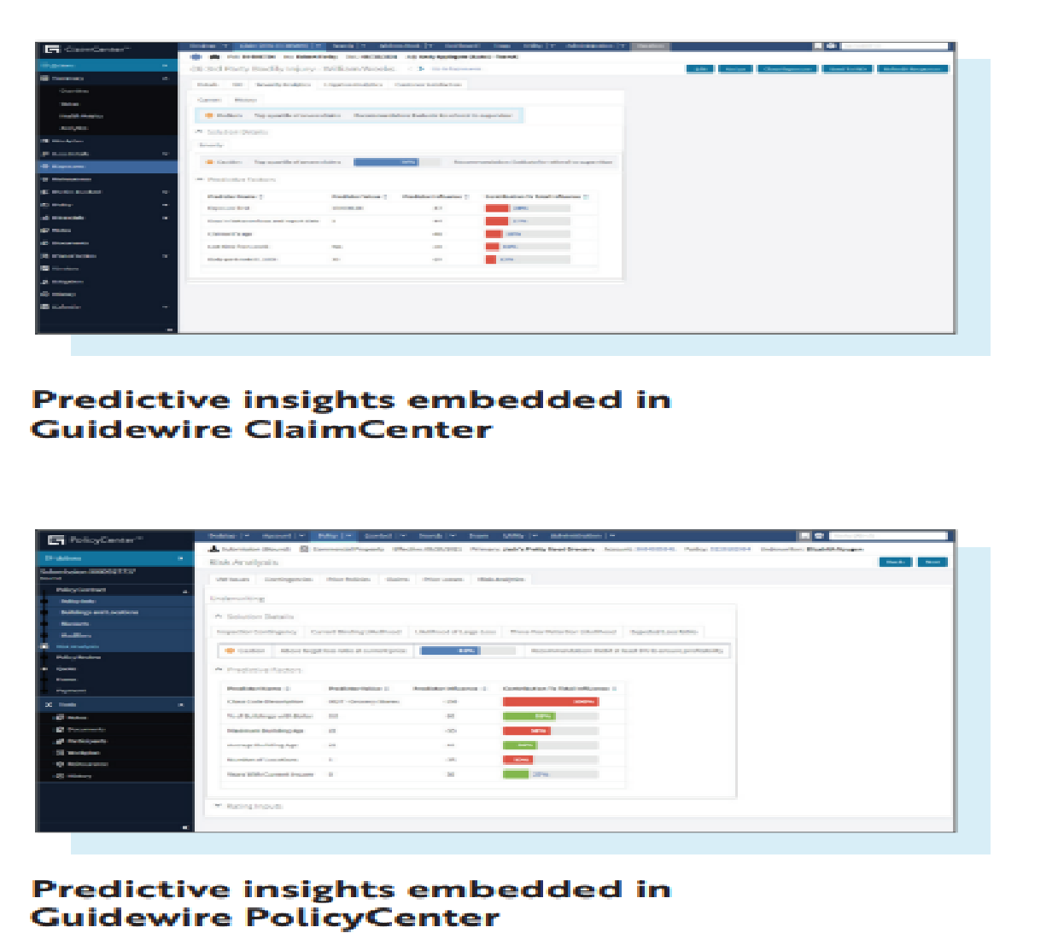
Guidewire Analytics - Predict
Notes:
PolicyCenter Overview - 18

Slide 19
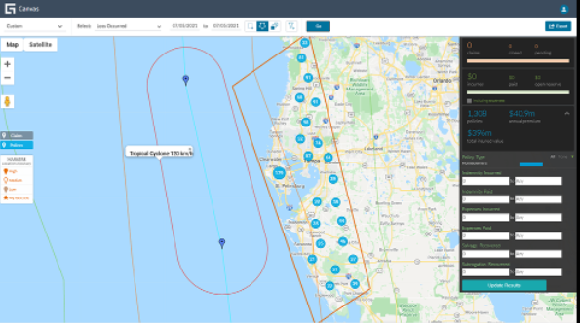
Guidewire Analytics - Canvas
Guidewire Canvas enables claims management and catastrophe response teams to geo-visualize claims and policy locations in the context of other internal and external data
Notes:
Guidewire Canvas is an interactive app that is included with Guidewire ClaimCenter cloud subscription
PolicyCenter Overview - 19

Slide 20
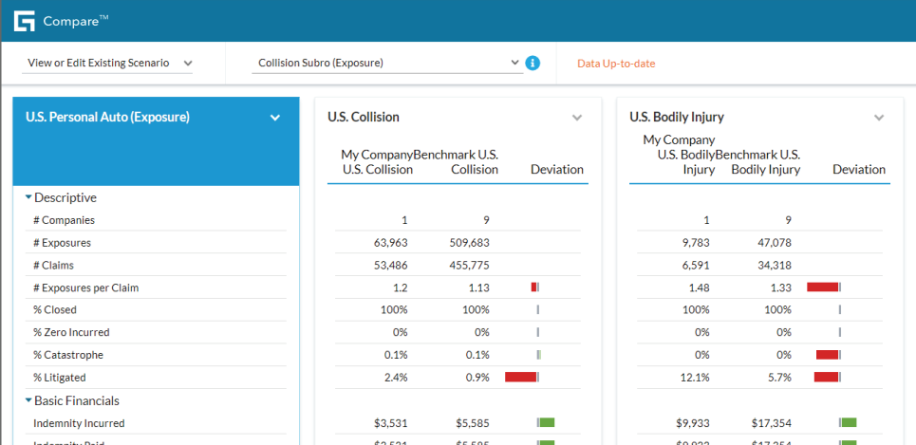
Guidewire Analytics - Compare
Guidewire Compare monitors key claims measures and gives feedback on how you’re performing. It also helps optimize claims decisions with peer and industry benchmarking.
Notes:
Guidewire Compare is a cloud-native analytic application that is included with ClaimCenter subscription.
• Monitor key claims measures • Set up claims and exposure scenarios • Feedback with continuous tracking and measurement • Secure, anonymous, and comparable peer insurer benchmarks • Simple design, easy to use, boosts user productivity
PolicyCenter Overview - 20

Slide 21
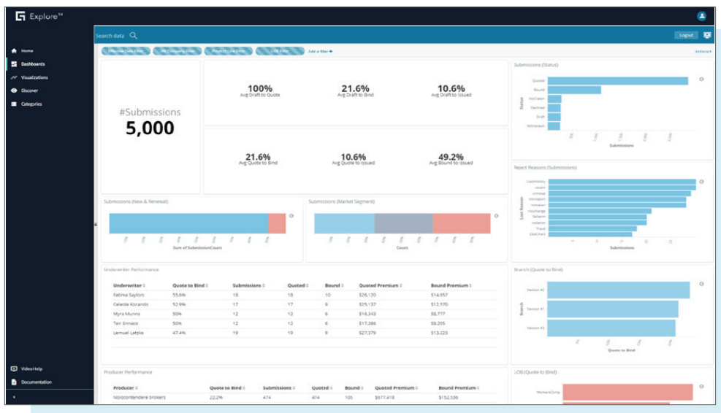
Guidewire Analytics - Explore
Guidewire Explore gathers and curates data from Guidewire InsuranceSuite in near real-time. It then visualizes that data to empower teams to make informed business decisions across claims, underwriting, sales, and service management.
Notes:
• Access to curated Guidewire core system data in near-real time • Personalized solutions for claims, underwriting, sales, and service management • Simple, intuitive, collaborative user experience • Self-service BI
PolicyCenter Overview - 21

Slide 22
Guidewire Analytics - Cyence
Guidewire Cyence (Cyber insurance risk modeling and analytics) Assess and quantify cybersecurity risk for individual companies to enable the insurers to make better cyber underwriting, portfolio management, and risk transfer decisions
Accurately measure the financial impact of cyber risk for businesses.
Cyence's proprietary data listening engine collects cyber-threat data in real time at internet scale from 400+ sources and 1,000+ data points. Cyence is the authoritative source of cyber exposure data.
Notes:
PolicyCenter Overview - 22

Slide 23
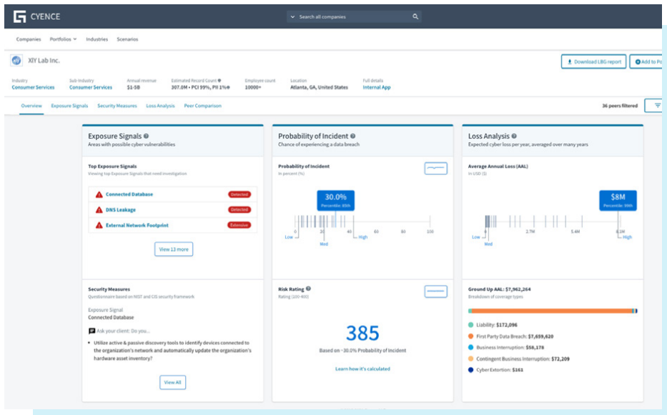
Guidewire Analytics - Cyence
Notes:
• Data listening: Collect technical and behavioral threat data from 400+ sources and 1,000+ data points in real time. Get a complete view of target companies and portfolios. • Risk modeling: Model the frequency and severity of cyberattacks with accuracy. Easily see which companies are at risk for a cyberattack. • Granular insights: Get personalized risk factors and dynamic loss analysis for companies, portfolios, industries, and more. Use insights to power underwriting and risk management.
PolicyCenter Overview - 23

Slide 24
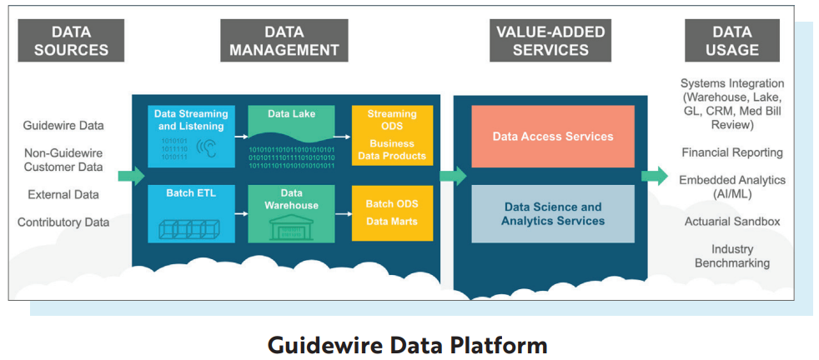
Guidewire Analytics – Data Platform
Guidewire Data Platform is the most complete P&C insurance–specific data platform delivered as a cloud service enabling data as a service to support data access, curation, and conformance across multiple systems while maintaining fidelity and latency requirements
Notes:
Guidewire Data Platform gathers data from Guidewire core systems, legacy core systems, and external and third-party data, as well as from data contributed by the Guidewire customer universe. Data is collected via streaming into a data lake–type repository and via batch ETL into a data warehouse–type repository. The data is then curated, first using simple principles of leveraging metadata and then into business-ready data sets and batch data marts. The valueadded services of the data platform then use the curated data to support customer data usage scenarios and to power Guidewire applications and solutions.
PolicyCenter Overview - 24

Slide 25
Guidewire Cloud
Guidewire Cloud is powered by Amazon Web Services (AWS) and uses more than 30 web services including Amazon Aurora.
With Guidewire Cloud, all Guidewire products are now available as cloud services.
Each Guidewire Cloud subscriber’s core systems are isolated as single tenants so that each customer can decide when the service is updated
Increasingly, Guidewire is adding new capabilities as multitenant services. These services can be always on as well as updated whenever subscribers want — without down time or waiting for a maintenance window. For Ex: Ratings service, Rules service, and Provisioning service for InsuranceSuite customers
In addition to prod and pre-prod environments, dev environments can be set up automatically and on demand
Notes:
PolicyCenter Overview - 25

Slide 26
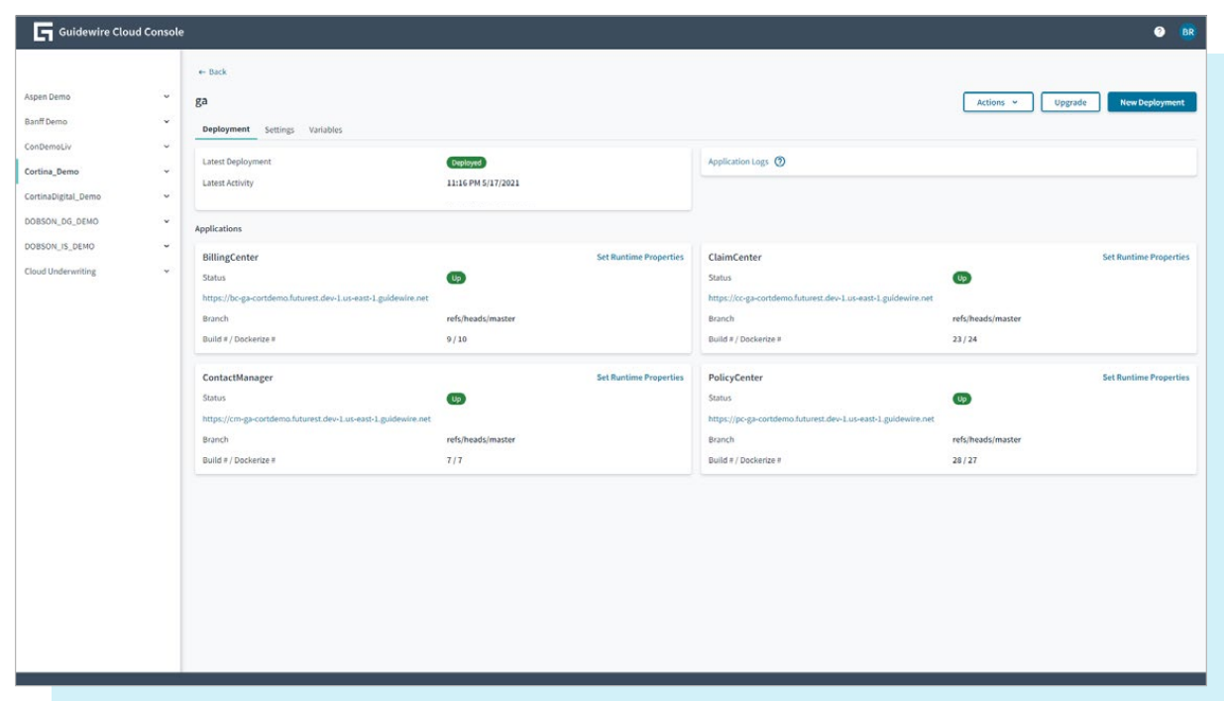
Guidewire Cloud Contd…
Guidewire Cloud Console provides an intuitive way for insurers to manage source code, CI/CD, environments, secrets, users, billing, and auditing.
Notes:
PolicyCenter Overview - 26

Slide 27
Guidewire Ecosystem
Marketplace – A collection of pre-built, validated and trusted apps specifically built for GW platform.
PartnerConnect brings together more than 10,000 technology consultants, systems integrators, and solution providers
Insurtech Vanguards is a Guidewire initiative to help insurers learn about the hottest-new insurtechs — and how to leverage them — faster and easier
Guidewire Ventures supports companies across insurance ecosystem that offer innovative solutions to GW customer base
Guidewire Community, Education, Documentation
Notes:
Guidewire Telematics Partners • TrueMotion • Cambridge Mobile Telematics
PolicyCenter Overview - 27

Slide 28
Lesson outline
Guidewire Organization
Guidewire Products
Guidewire Core suite landscape
Typical integrations to Guidewire
Notes:
PolicyCenter Overview - 28

Slide 29
Guidewire product landscape
Guidewire provides core systems used by carriers as operational systems of record
Core Operations Support
External Access
Data Management & Business Intelligence
Monitoring & Guidance
Operational Systems of Record
Notes:
Guidewire builds software products that help property and casualty (P&C) insurers replace their legacy core systems and transform their business. Guidewire provides core systems and data management/business intelligence tools used by insurers as operational systems of record. Additional products provide support for anytime/anywhere access and guidance and monitoring.
Who uses Guidewire products?
Everything in the blue circle is targeted at internal users at insurance companies—claims adjusters, underwriters, risk managers, customer service representatives, billing clerks, and so on.
External Access includes two types of users:
Third-party users such as policyholders and vendors, who can't log in to the core systems but need to access some of the data that lives in those systems.
Authorized users of the core systems who have special requirements, such as an adjuster who is currently mobile after a catastrophe and has no internet access but needs to take pictures and take notes to upload later.
Monitoring and Guidance describes a variety of hosted services that enable carriers to use cloud-based applications in their day-to-day workflow. Hosted services include geographic visualization, catastrophe capture, and comparison of peer insurer benchmarks, among others.
PolicyCenter Overview - 29

Slide 30







Guidewire Core
Mobile & Portals
Guidewire Live
InfoCenter
DataHub
Notes:
Operational Systems of Record
In the area of Core Operations Support, Guidewire InsuranceSuite provides a complete set of applications to support a carrier's core operations—underwriting, policy administration, billing, and claim management. The slide provides a high-level view of the core Guidewire products. It is not an exhaustive list of all applications and licensed features. Therefore, some features and products, such as ContactManager, Client Data Management, PolicyCenter Rating, PolicyCenter Reinsurance, and the ISO Standards-Based templates, are not shown.
In the area of Data Management and Business Intelligence, Guidewire DataHub is an operational data store that unifies, standardizes, and stores data from a carrier's own systems as well as external sources. Guidewire InfoCenter is a business intelligence warehouse that is purpose-built for P&C insurance. It provides easy-to-use reporting formats for business intelligence, analysis, and enhanced decision making. Using InfoCenter, carriers gain operational insight across the enterprise.
Monitoring and Guidance
Guidewire Live is a network that connects peer insurers, core systems data, external sources of information (such as weather services), and expert tools. Users access Guidewire Live through applications hosted by Guidewire and designed for specific challenges faced by P&C insurance professionals.
External Access
Mobile & Portals is a new set of applications that feature add-on products to the Guidewire core suite, providing self-service transactions through various mobile channels.
PolicyCenter Overview - 30

Slide 31


Guidewire applications architecture
Users
Operational Database
Guidewire Application
Claims Admin.
Authen- tication
Reporting
Address Book
Billing Admin
Notes:
PolicyCenter Overview - 31
Three-tier architecture is a client-server architecture in which the operational data, application logic, and user interface are developed and maintained as independent modules on separate platforms. Three-tier architecture is one of the industry-standard software architectures.
The data tier contains the business and operational database. It is hosted in an Oracle or SQL Server database or cluster of databases.
The application tier contains the functional process logic. It is hosted in an application server such as WebLogic, WebSphere, Apache Tomcat, or JBoss EAP.
The presentation tier contains the user interface. The Guidewire user interface is supported in these web browsers: Google Chrome, Mozilla Firefox, and Microsoft Internet Explorer.
Refer to the "Guidewire Platform Support Matrix" for the latest and most complete information about the software Guidewire supports. You can access it from the customer portal by navigating to http://guidewire.hivelive.com/pages/home, selecting "Resources -> Documentation", and clicking "Platform Matrix".

Slide 32
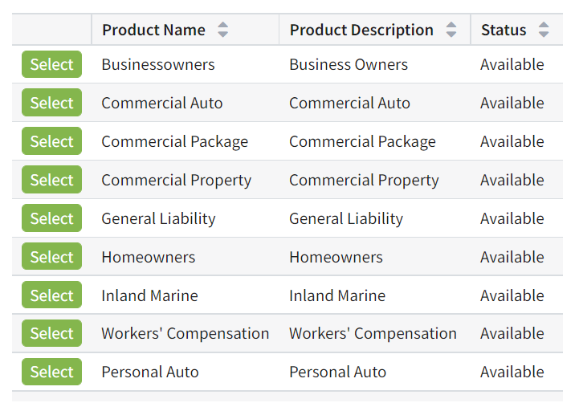
Guidewire PC10 OOTB LOBs
Notes:
PolicyCenter Overview - 32

Slide 33
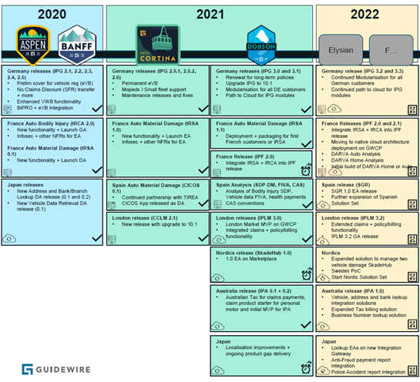
Guidewire Versions
Notes:
PolicyCenter Overview - 33

Slide 34
Lesson outline
Guidewire Organization
Guidewire Products
Guidewire Core suite landscape
Typical integrations to Guidewire
Notes:
PolicyCenter Overview - 34

Slide 35
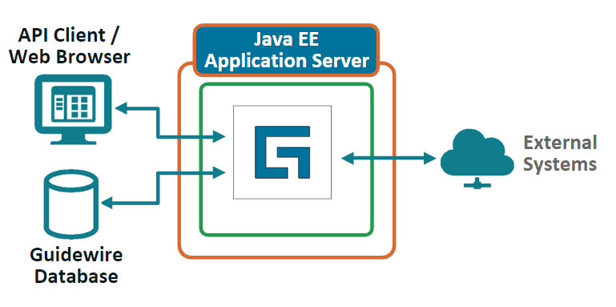
InsuranceSuite Integration
InsuranceSuite implementations use a wide variety of industry standard mechanisms to share information with external systems including:
Batch Processes
Database tables
Web Services
Messaging
Plugins
Notes:
The Application Server implements Java EE Technology which defines the standard for multitier enterprise applications. The Java EE platform simplifies enterprise applications by basing them on standardized, modular components, by providing a complete set of services to those components, and by handling many details of application behavior automatically, without complex programming

Slide 36
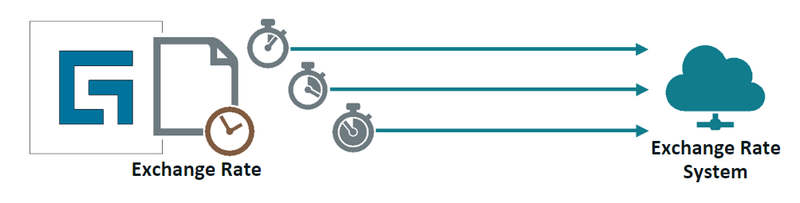
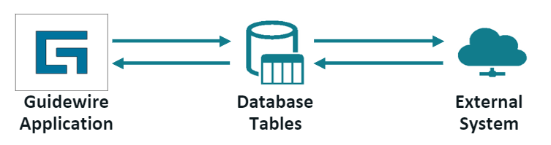
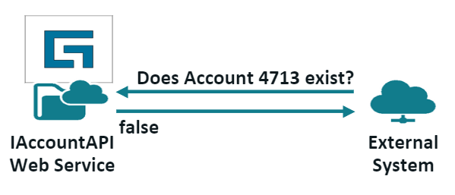
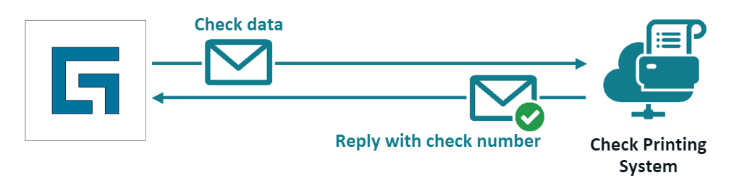
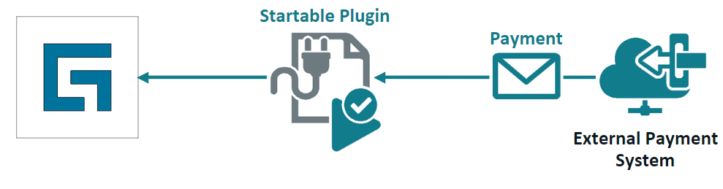
Integration mechanisms
Batch Processes: A background process that performs a periodic task independent of a user
Database tables: An integration table is a database table that both systems can access
Web Services: Information exchange systems that use the internet for direct application-to-application interaction.
Messaging: Asynchronous exchange of data between systems as messages
Plugins: Interface provided by GW.
Predefined, Messaging, Startable
Notes:
GW supports REST and SOAP
Common Messaging technologies: JMS and IBM’s MQSeries
Predefined Plugins – Used to implement customizable behavior for predefined points in application
Messaging Plugins – used to send messages to external systems and process the resulting replies
Startable Plugins – Used to listen for incoming messages from external systems and process them asynchronously

Slide 37
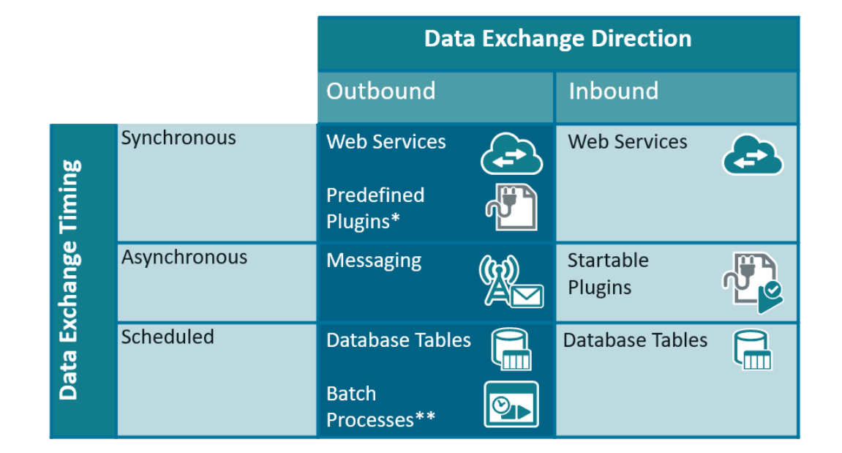
Contrasting integration mechanisms
The table below contrasts different integration mechanisms with respect to data exchange timing and direction, but it does not describe absolute rules
Notes:
Predefined plugins do not typically interact with other systems
Batch process can be initiated by scheduler or by a web service call. So, technically they are both inbound or outbound

Slide 38
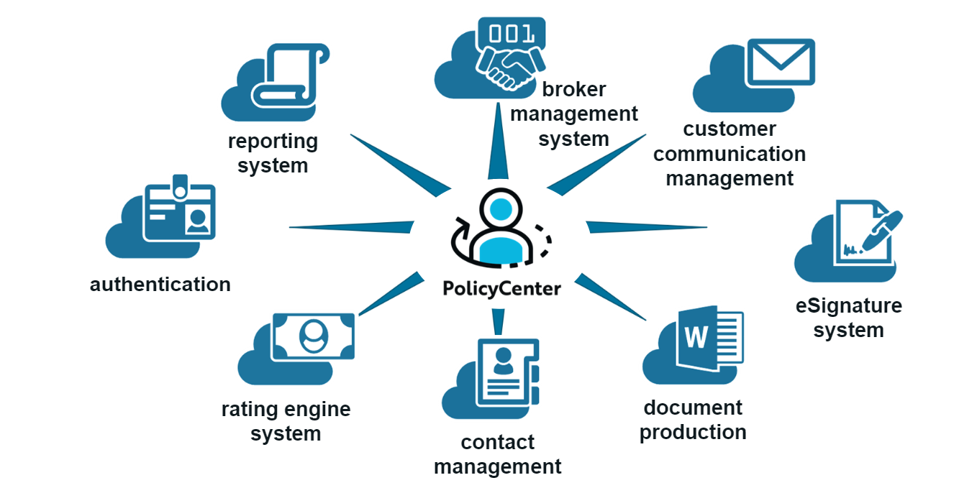
PolicyCenter Integrations
PolicyCenter interacts with several external systems. Below are some typical integration systems

Slide 39
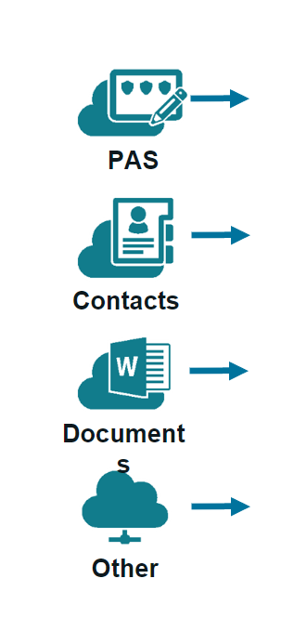
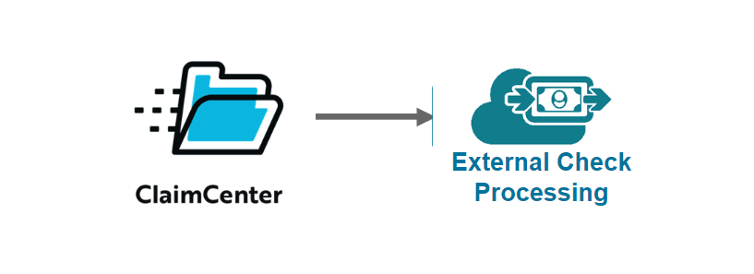
ClaimCenter Integrations
ClaimCenter interacts with several external systems. Below are some typical integration systems

Slide 40
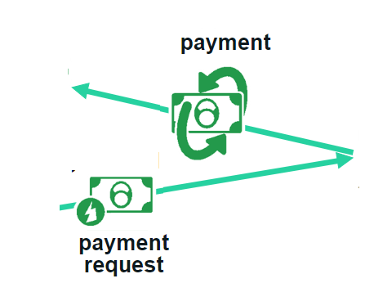


BillingCenter Integrations
BillingCenter interacts with several external systems. Below are some typical integration systems

Slide 41
Common points of integration
Policy Processing
Legacy policy admin.
Document production
Document storage
Billing
Policy Pricing
ISO
Credit rating
Claims
Rating
User Management
Authentication
Agent Management System
Contact Manager
Miscellaneous
Address normalization
Reporting
Notes:
A definition for each integration point appears below:
Legacy policy administration system - This external system maintains policies created prior to the implementation of PolicyCenter (or policies for which PolicyCenter is not the system of record but for which PolicyCenter needs information).
Document production system - This is an external system used to store document templates and create documents.
Document storage system - This is an external document storage system which is used for storage and document retrieval.
Billing system - This is an external billing system which sends bills to the insured (so that they pay the premium) and reports when accounts are overdue.
ISO - (This integration point is common only for American carriers.) This is an American company which maintains rating information for fire protection for every place in the United States. A city can have many fire protection classes, therefore the information is defined at the location/address level. ISO also maintains Building Code Effectiveness grades of how well any community enforces their building codes. This is used for fire, EQ and wind/storm rating.
Credit rating system - This is a system which maintains credit rating information about the insured, such as Dun and Bradstreet.
Claims system - This is the system that managed claims for the carrier and is relevant at renewal time to determine if the policy should be renewed and if the rates should be raised.
(continued)

Slide 42
Notices
Copyright © 2001-2014 Guidewire Software, Inc. All rights reserved.
Guidewire, Guidewire Software, Guidewire ClaimCenter, Guidewire PolicyCenter, Guidewire BillingCenter, Guidewire Reinsurance Management, Guidewire ContactManager, Guidewire Vendor Data Management, Guidewire Client Data Management, Guidewire Rating Management, Guidewire InsuranceSuite, Guidewire ContactCenter, Guidewire Studio, Guidewire Product Designer, Guidewire Live, Guidewire DataHub, Guidewire InfoCenter, Guidewire Standard Reporting, Guidewire ExampleCenter, Guidewire Account Manager Portal, Guidewire Claim Portal, Guidewire Policyholder Portal, ClaimCenter, BillingCenter, PolicyCenter, InsuranceSuite, Gosu, Deliver Insurance Your Way, and the Guidewire logo are trademarks, service marks, or registered trademarks of Guidewire Software, Inc. in the United States and/or other countries.
All other trademarks are the property of their respective owners.
This material is confidential and proprietary to Guidewire and subject to the confidentiality terms in the applicable license agreement and/or separate nondisclosure agreement.
This file and the contents herein are the property of Guidewire Software, Inc. Use of this course material is restricted to students officially registered in this specific Guidewire-instructed course, or for other use expressly authorized by Guidewire. Replication or distribution of this course material in electronic, paper, or other format is prohibited without express permission from Guidewire.
Guidewire products are protected by one or more United States patents.
Notes:
PolicyCenter Overview - 42

