Slide 1
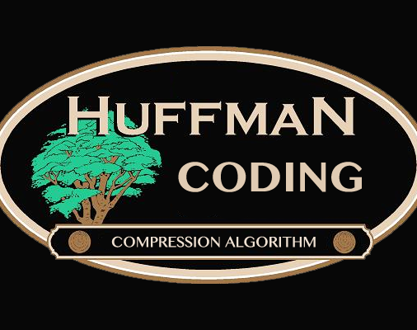

Name : Yogesh Shrestha

Slide 2
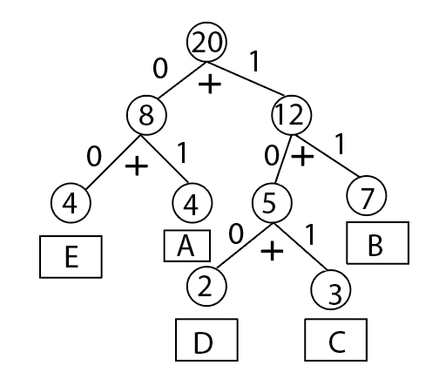
Agenda
Introduction
Detail Process
Pseudocode
Time Complexity
Advantage and Disadvantage

Slide 3
Introduction
Huffman Algorithm was discovered or developed by David Huffman in 1951
It is a data compression technique in which the data size is to be reduced.
Huffman Algorithm follows the prefix rule and the most generated char will get the small code and the least generated char will get the larger code

Slide 4
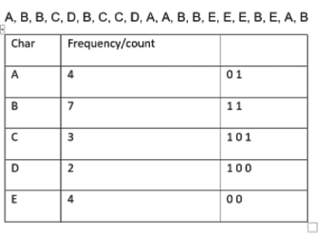
Detail Process
Let’s take one example
Total Volume of message
is 20 * 8 = 160 bits

Slide 5
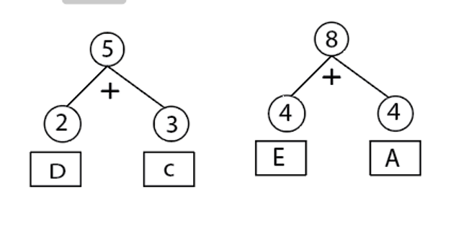

Slide 6
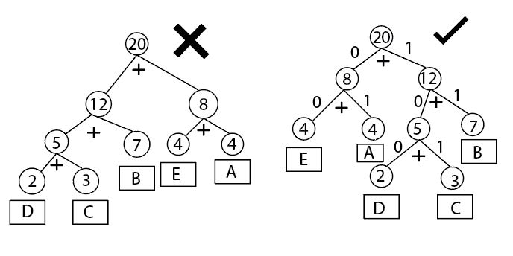
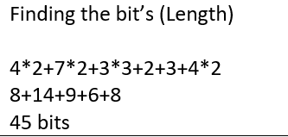
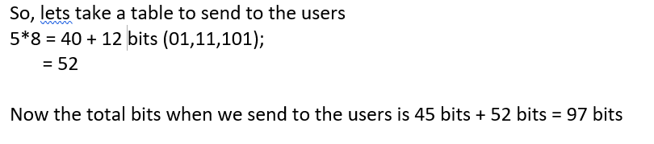

Slide 7

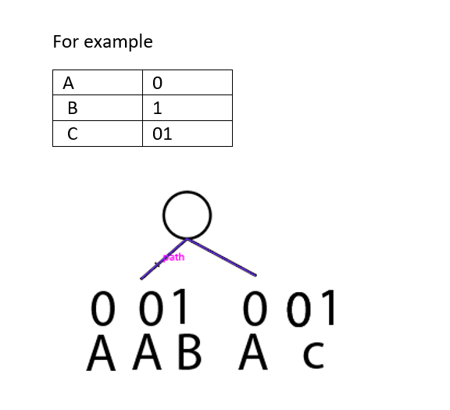

Slide 8
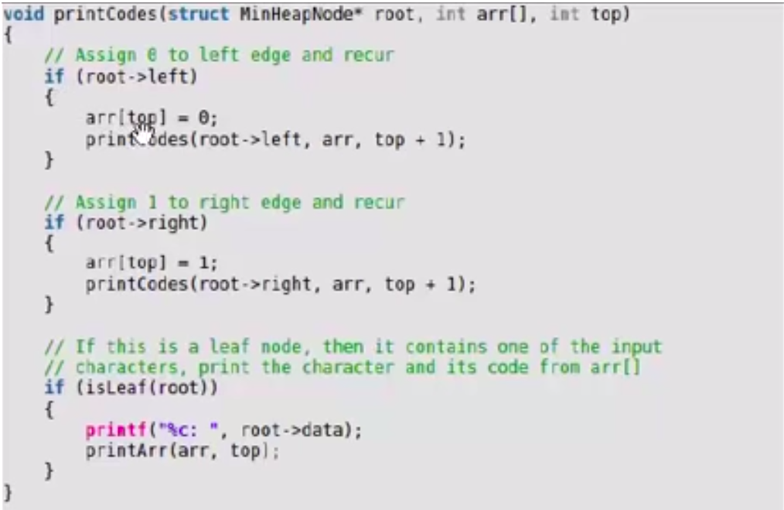
Pseudocode

Slide 9
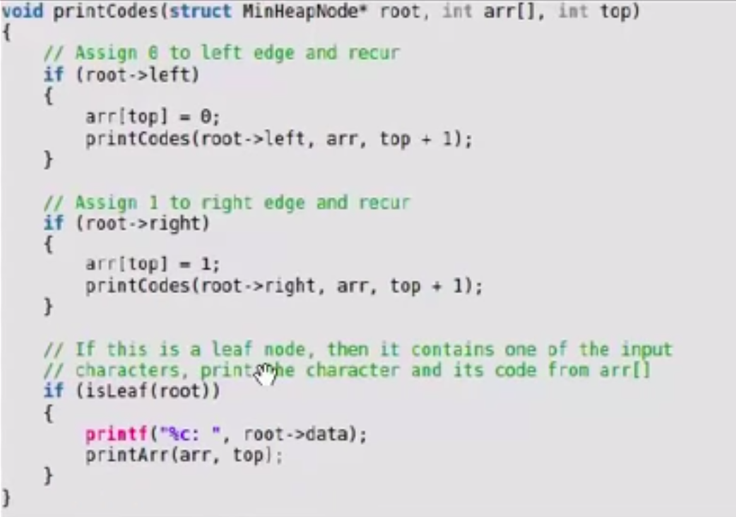

Slide 10
Time complicity
Time Complicity : O(nlogn)
Where n = number of unique characters

Slide 11
Advantage
Easy to implement and fast
Used to compress the data
Maximum compressing ratio assuming correct probolities of occurrence

Slide 12
Disadvantage
Need to passes for both encoder and decoder
Need to know the symbol frequency distribution
It takes much time
A Table is needed that lists each input symbol and it’s corresponding code

Slide 13


