Slide 1



UNIVERSITY PARTNER
i/Jcademy
Quality Education Improving Lives *
UNIVERSITY OF
WOLVERHAMPTON
HERALD
COLLEGE
KATHMANDU
Kadane’s Algorithm
Yogesh Shrestha
Student-ID:NP03A190299
DC:8

Slide 2
Agenda
General Introduction
Pseudocode
Working Method
Complexity
Applications
Limitations
Conclusion

Slide 3
Introduction
Kadane’s algorithm is known as finding the largest sum of a contiguous subarray in one dimensional array.
It uses brute-force to solve problems of subarrays, keeping the global maximum and comparing it.
It also uses the dynamic programming which approach to finding the maximum (minimum) subarray ending at each position from the maximum (minimum) subarray ending at the previous position.
For example: for the sequence of the values −3, 1, −3, 4, −1, 2, 1, −4, 4; the contiguous subarray with the largest sum is 4, −1, 2, 1, with sum 6.

Slide 4
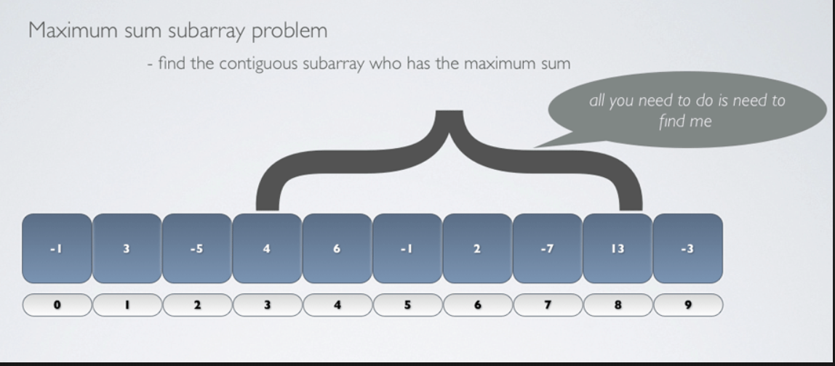
Problems
The maximum subarray problem is to find the contiguous subarray having the largest sum.
The minimum subarray problem is to find the contiguous subarray having the smallest sum.
Problems can solve by turning two nested loops in a simple ignorant way. In other words, when the length of the array is n, we can turn i=1~n, j=i~n and find the sum of the sub-arrays at each step and get the maximum value of it.

Slide 5
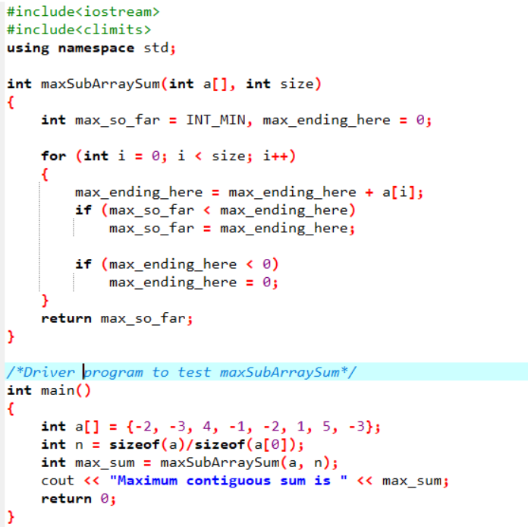
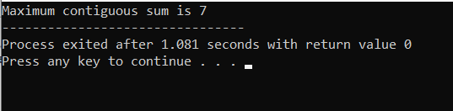
Pseudocode
The pseudocode of the largest sum contiguous subarray. Using c++;
Therefore, maximum 0utput is 7.

Slide 6
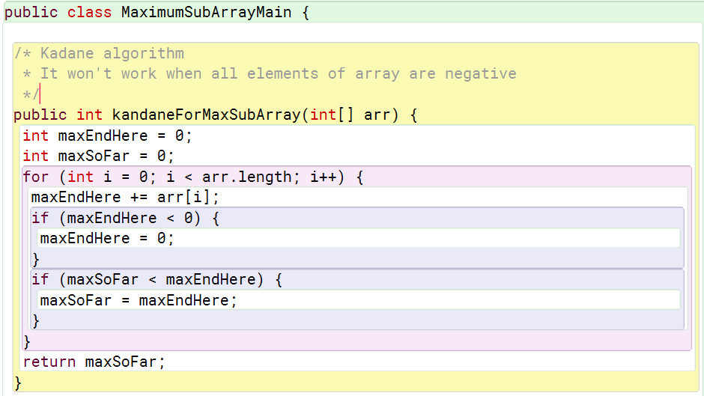
Pseudocode
Pseudocode in java

Slide 7
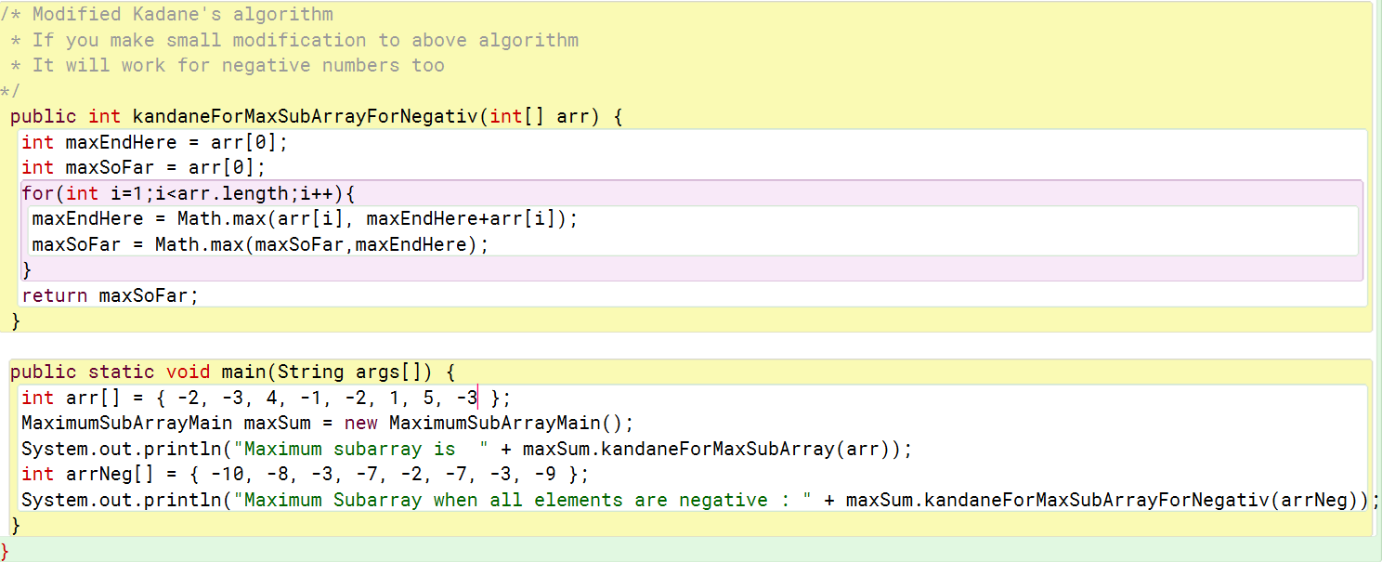

Pseudocode

Slide 8
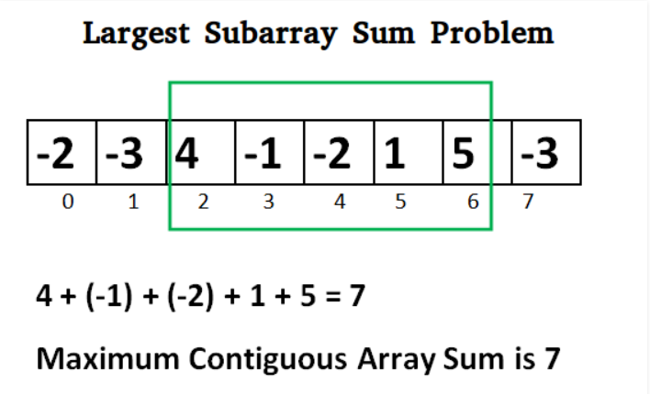
Working Method
Kadane’s algorithm states that

Slide 9
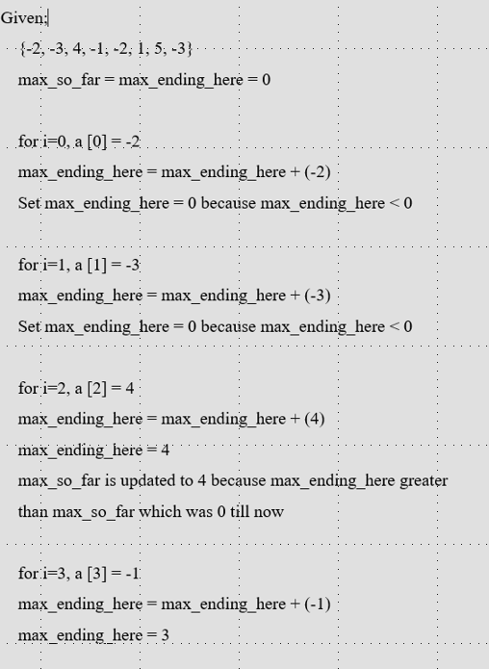
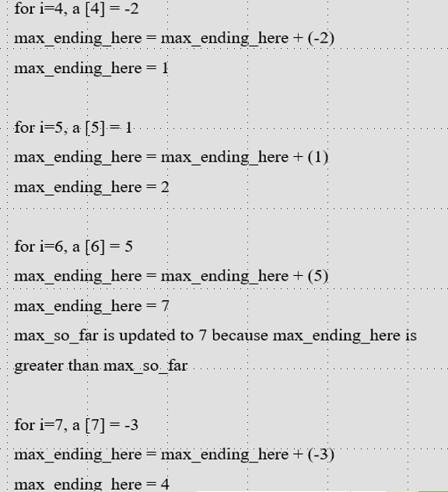

Slide 10
Time complexity
It’s is linear time complexity is O(n) Where,
n = number of unique characters
It’s space complexity time is O(1).

Slide 11
Application
Maximum subarray algorithm are found in computer vision which uses on bitmap images to detect the brightest area in an image.
Maximum subarray problems also occurs in field like, genomic sequence which analysis employs maximum subarray algorithms to identify important biological segments of protein sequences.

Slide 12
Limitations
The problems solves through using brute force in kadane’s algorithm does not output cleaver answer most of the times.
It requires to remember previous number to find largest number.

Slide 13
Conclusion
This algorithm can be viewed as a simple example of dynamic programming because of the way in which this algorithm uses optimal substructures.
The maximum subarray ends at each position is calculated in a simple way from a related but smaller and overlapping subproblem: the maximum subarray ends at the prior position.
It can find the maximum sum of a contiguous subarray in an array that has an O(n) runtime.
Thank You

