Slide 1
VidyutFlow
Cloud-to-Edge Orchestration for Power Utilities
“Enter Once, Use Everywhere”
PS000125 · Future-Ready, Secure and Intelligent IT Infrastructure &
User-Friendly ERP/Portal Ecosystem · Uttar Gujarat Vij Company Ltd (UGVCL)
Seva First Innovation Challenge · Team: Yogesh (Lead) · Utsav · Aakash · Sandip · Arnav
Notes:
30-second opener: one flow that removes re-entry, manual routing and blind SLA firefighting — with honest AI that assists, never decides.

Slide 2
The problem — PS000125 pain points
Same applicant details re-typed across ERP, portals and field systems
Requests moved manually between desks — routing takes hours (planning assumption), files stall
Field work stops without network; naive re-sync creates duplicates
SLA breaches discovered after the deadline; consumers visit offices for status
PS points addressed head-on: 1, 2, 3, 4, 5, 8, 9, 11 (full map: REQUIREMENT_MAPPING.md)
Notes:
Name PS points verbally. The 4-8h routing figure is a design-document planning assumption — label it if asked.

Slide 3
VidyutFlow — one click-and-get-work-done flow
SUBMIT → VALIDATE → CLASSIFY (ML) → SLA-RISK (ML) → ROUTE & ASSIGN → FIELD (offline) → DECIDE
Consumer submits once — the SAME record feeds officer queue, engineer task, admin KPIs
Rule validation + ML triage run automatically; SLA clock starts at submit
Field engineer works offline; sync is idempotent (each UUID accepted once)
The officer approves/rejects — every action is audit-logged
Notes:
Emphasise: ML triages and explains; the officer decides. Core invariant.

Slide 4
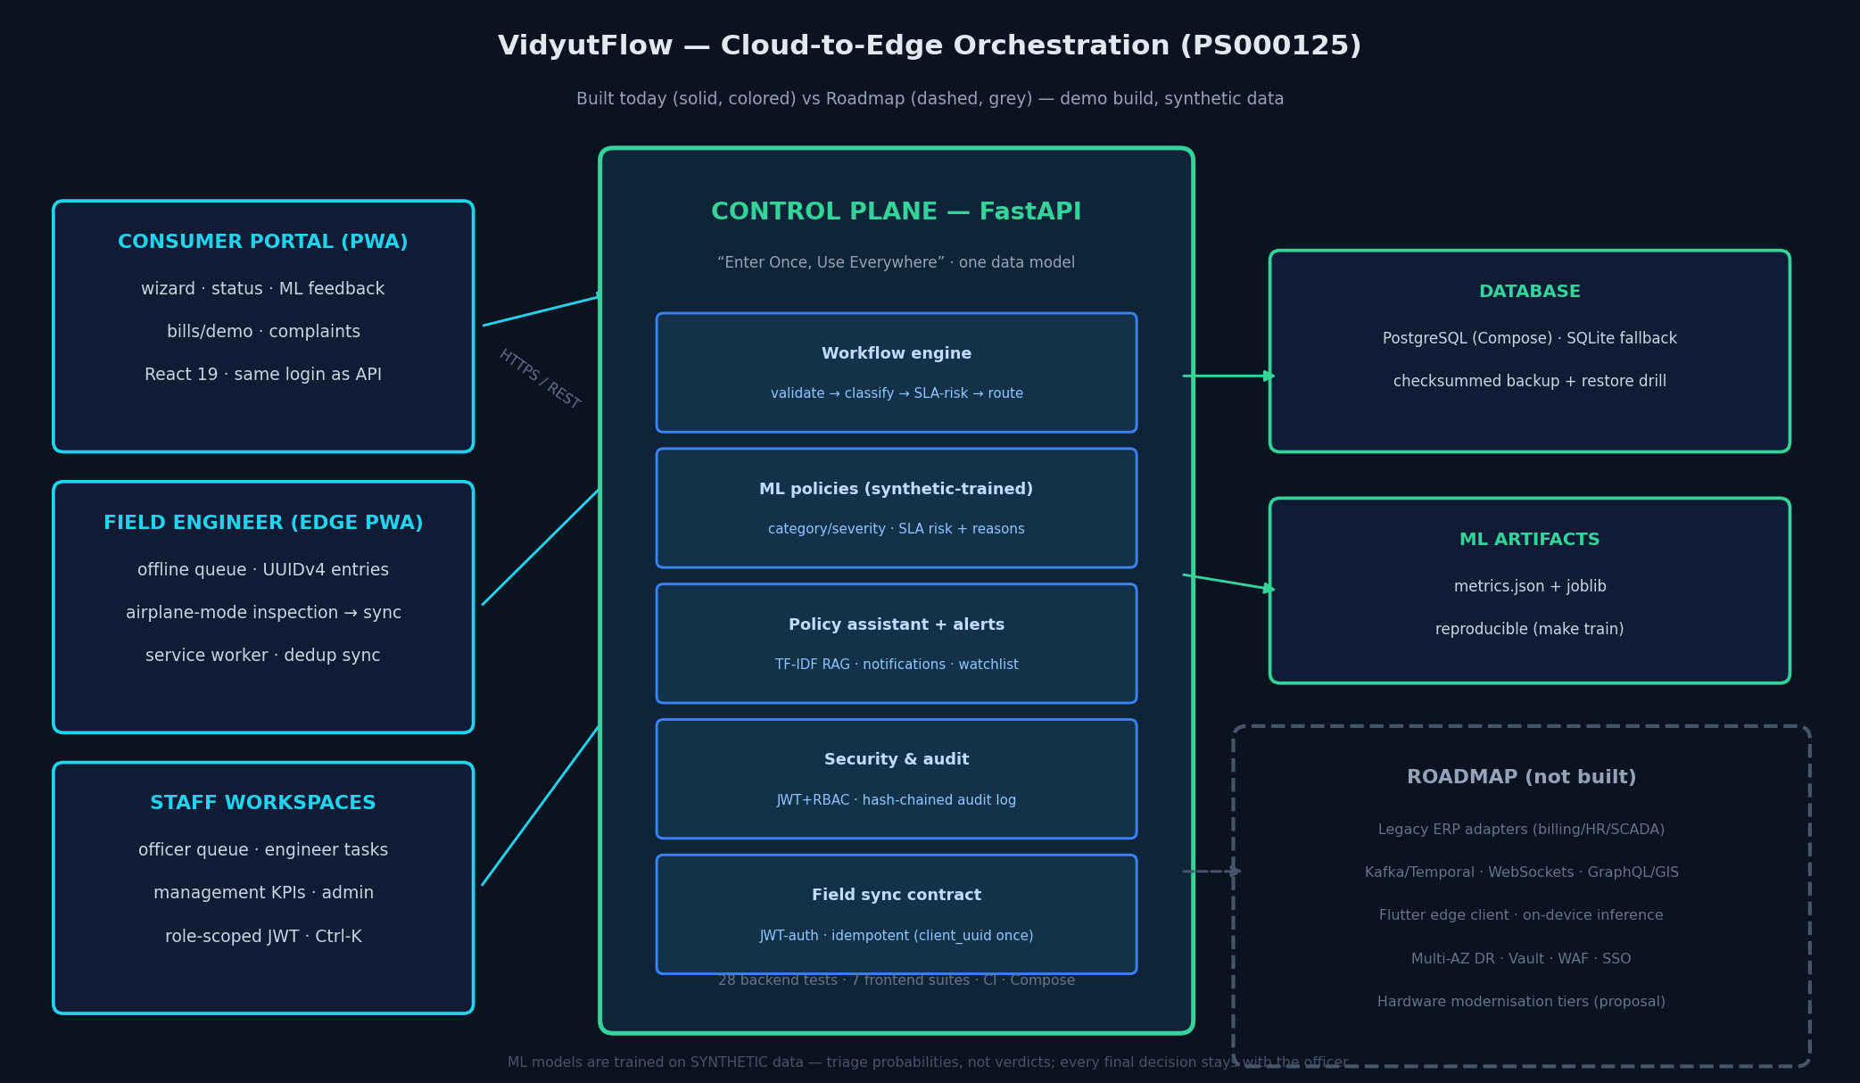
Architecture — built (color) vs roadmap (grey)
Notes:
Point at the grey dashed box FIRST: everything grey is honestly roadmap. API contracts stay stable while engines change.

Slide 5
Workflow demo — the real backend, not mockups
1 · Consumer wizard submit → live API returns ML category/severity + SLA risk in the toast
2 · Officer Live Request Queue — real rows, auto-refresh 45s, SLA-risk reasons visible
3 · Management/Admin Live Workflow KPIs + SLA-Risk Watchlist (model output)
4 · Server-side alert centre: notifications on submit / status change / field sync
Screenshots pack: Utsav (before video shoot) · live demo path: docs/DEMO_SCRIPT.md
Notes:
Say: 'this is the live API — one credential set covers portal and API'. Screenshot placeholders to be filled by Utsav.

Slide 6
Offline sync & de-duplication — plus backup/restore
Field PWA queues inspections with UUIDv4 keys while offline (airplane mode)
Sync is JWT-authenticated; the server accepts each UUID exactly once
Sync twice → duplicate:true, no second row (proven by regression test + demo)
Backup → checksum verify → tamper-reject → wipe → restore → live-serve drill: PASS
Evidence: docs/verification/r4-backup-restore.txt
Notes:
Live the demo step: airplane-mode → queue → sync → sync again. Then mention the restore drill as the data-permanence story.

Slide 7
AI — honest by design
Two small scikit-learn models: category/severity classifier + SLA-breach risk with REASONS
TF-IDF policy assistant over 3 policy extracts — answers cite sources
SLA-Risk Watchlist puts model output + reasons where officers act
SYNTHETIC training data · triage probabilities, not verdicts · officer decides, always
30-second honesty script: docs/ML_REPORT.md
Notes:
Say the honesty script VERBATIM from ML_REPORT.md. Safety guardrail escalates unknown danger phrasing conservatively.

Slide 8
Security — and practical accessibility
JWT + RBAC + assignment/zone scoping (fail-closed) · bcrypt (72-byte safe) · CORS allowlist
Tamper-evident audit log: sha256 hash chain + admin verify endpoint
Login throttle (20/min/IP) · security headers · production guards reject dev secrets & demo data
One credential set for portal + API; browser state grants nothing
Known prototype gaps and their one-line defences: SECURITY.md
Notes:
If challenged on localStorage JWT: 'documented prototype trade-off; production moves to HttpOnly cookies — listed in SECURITY.md'.

Slide 9
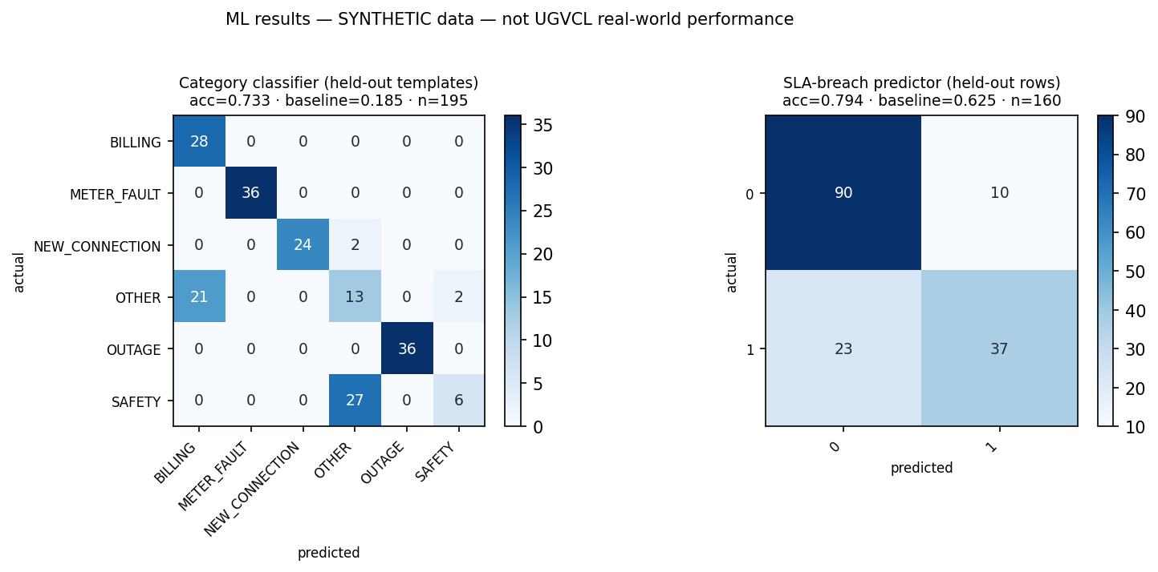
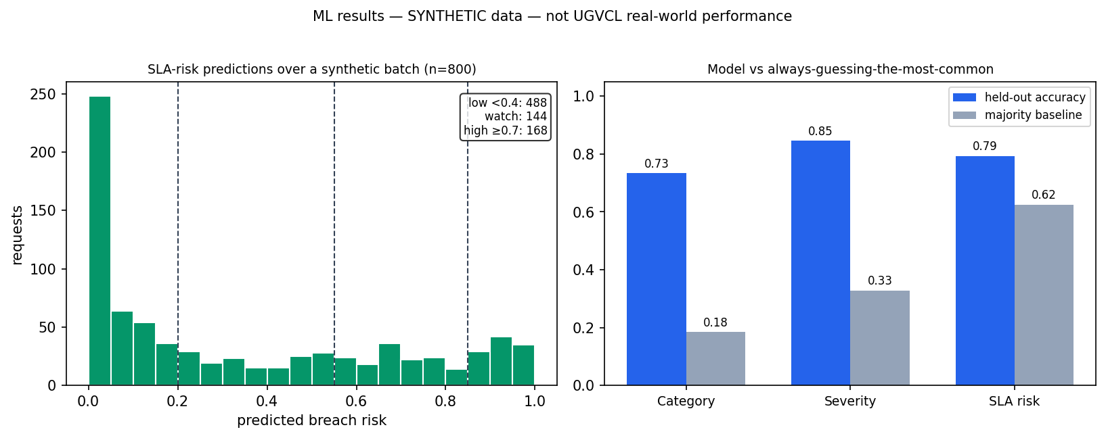
Results — on SYNTHETIC data (labelled)
Category 0.733 vs 0.185 baseline · Severity 0.846 vs 0.328 · SLA 0.794 vs 0.625 (n=195/195/160)
Latency measured LOCAL, SYNTHETIC: p50 3.1 ms · p95 4.5 ms · 100 reads · 0 errors — not a UGVCL figure
Notes:
Never say 'accuracy is X for UGVCL'. Reproduce: make train (byte-identical metrics.json).

Slide 10
Requirement → solution map (PS000125)
12 problem points: 7 fully built · 4 lite/partial · 1 proposal-only (hardware)
14 expected outcomes: 12 met · 1 measured-claim kept as target (productivity) · 1 hardware/DR as proposal
Every row has named evidence in REQUIREMENT_MAPPING.md (built / lite / roadmap)
We never claim a roadmap item as built — that rule is written into the repo
Notes:
This slide pre-empts 'did you cover our PS?'. Pull up REQUIREMENT_MAPPING.md if asked for any row.

Slide 11
Roadmap & scale-up (contracts stay stable)
1. Legacy ERP adapters (billing/HR/SCADA wrappers) — first item
2. Kafka / Temporal orchestration · WebSockets · GraphQL + GIS
3. Flutter/Couchbase edge client · on-device inference
4. Fine-tuned LLM in VPC · Zero Trust · multi-AZ DR · Vault · WAF · SSO
5. Hardware modernisation tiers — costed proposal (INFRASTRUCTURE_ROADMAP.md)
The frozen API contract (20 ops) lets engines change without touching the workflow
Notes:
Answer to outcome 8/10 lives here: hardware and DR are a proposal, the software runs on Compose today.

Slide 12
Team & next steps
R1 Backend & Workflow — Yogesh (Lead) · R2 Frontend & PWA — Utsav
R3 ML & AI — Aakash · R4 DevOps/Security/QA — Sandip · R5 Docs & Demo — Arnav
Pilot plan: governed UGVCL data → retrain → re-baseline → before/after timing study
That study is how outcome 13 (productivity) becomes a measured number
Ask: approval for a scoped pilot on one subdivision's new-connection flow
Notes:
Close on the measurement plan, not on claims. Q&A sheet: docs/DEFENCE_QA.md — every member has a copy.

