Slide 1

Team Name : CodewithHackers
Team Leader Name : Yogesh Thakur
Problem Statement : Build an AI-powered solution that improves access to information, resources, or opportunities for communities and public systems.

Slide 2


Brief about the Idea:

Slide 3
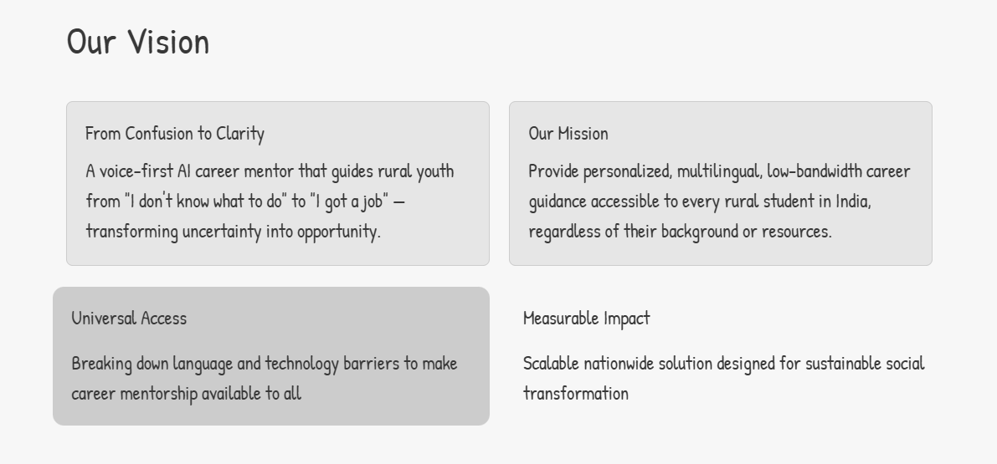
Your solution should be able to explain the following:
How different is it from any of the other existing ideas?
How will it be able to solve the problem?
USP of the proposed solution

Slide 4
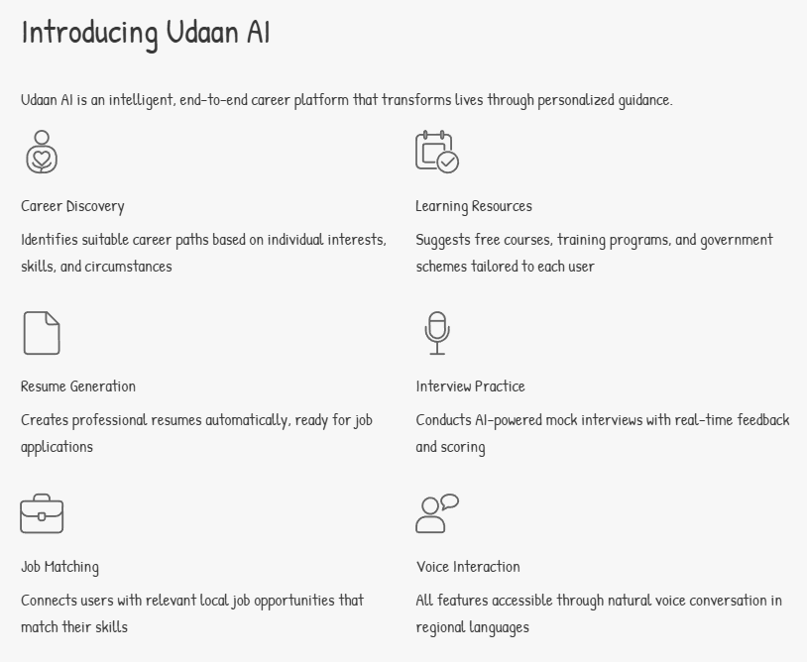
Your solution should be able to explain the following:
How different is it from any of the other existing ideas?
How will it be able to solve the problem?
USP of the proposed solution

Slide 5
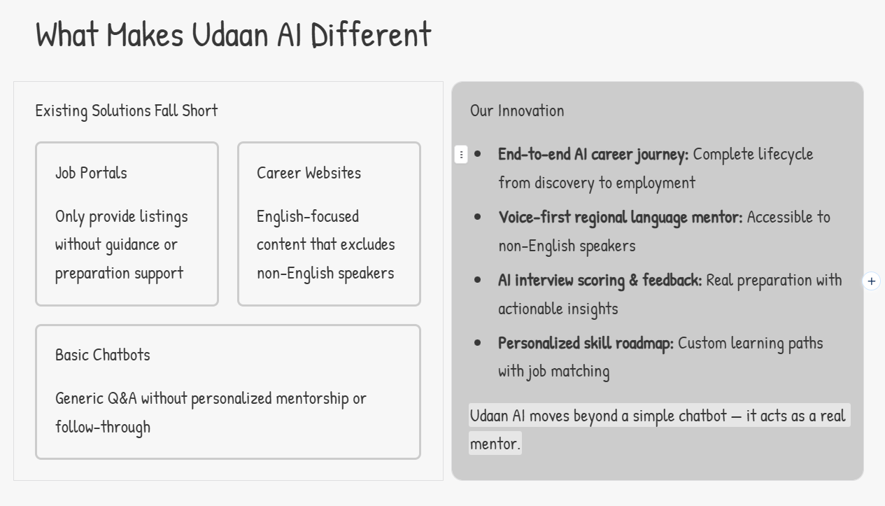
Your solution should be able to explain the following:
How different is it from any of the other existing ideas?
How will it be able to solve the problem?
USP of the proposed solution

Slide 6
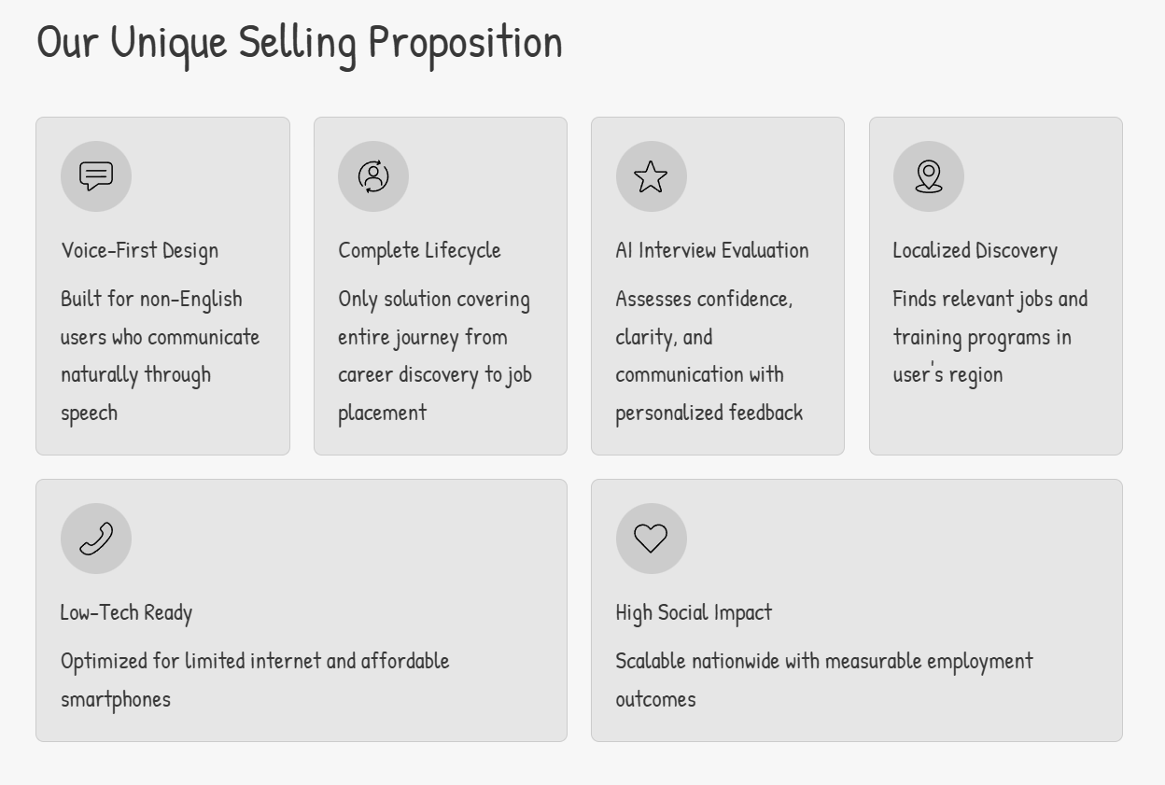
Your solution should be able to explain the following:
How different is it from any of the other existing ideas?
How will it be able to solve the problem?
USP of the proposed solution

Slide 7
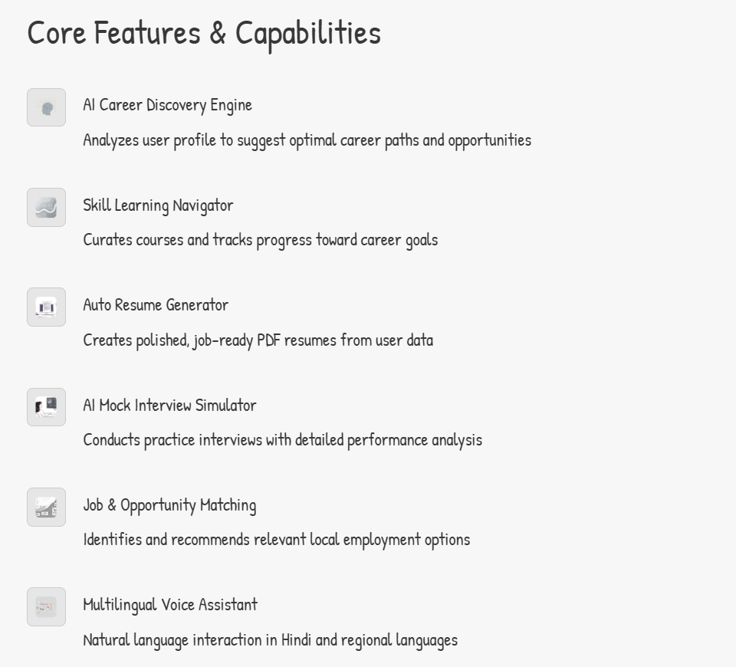
List of features offered by the solution
It is always better to add a few visual representations (drawings/sketches/illustrations etc.) to your presentation, it adds to the power through which it reaches the audience.

Slide 8
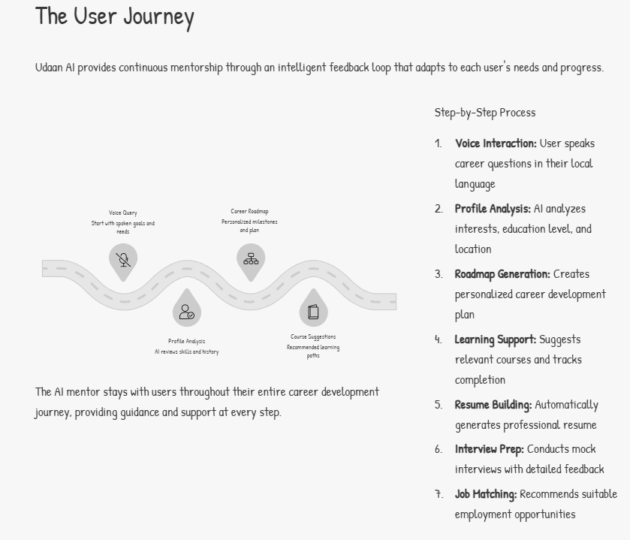
Process flow diagram or Use-case diagram
Add a flow diagram or a use case diagram or an architecture diagram.

Slide 9
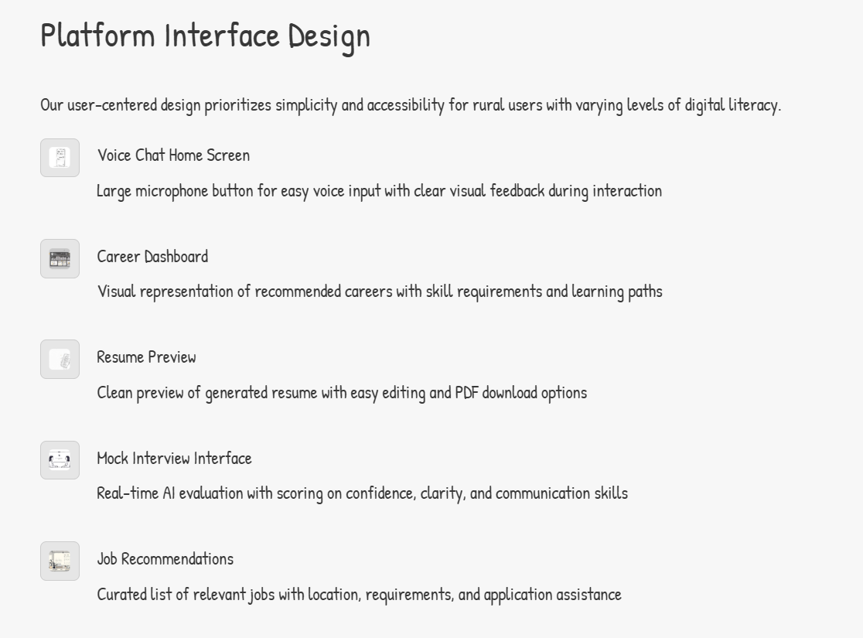
Wireframes/Mock diagrams of the proposed solution (optional)

Slide 10
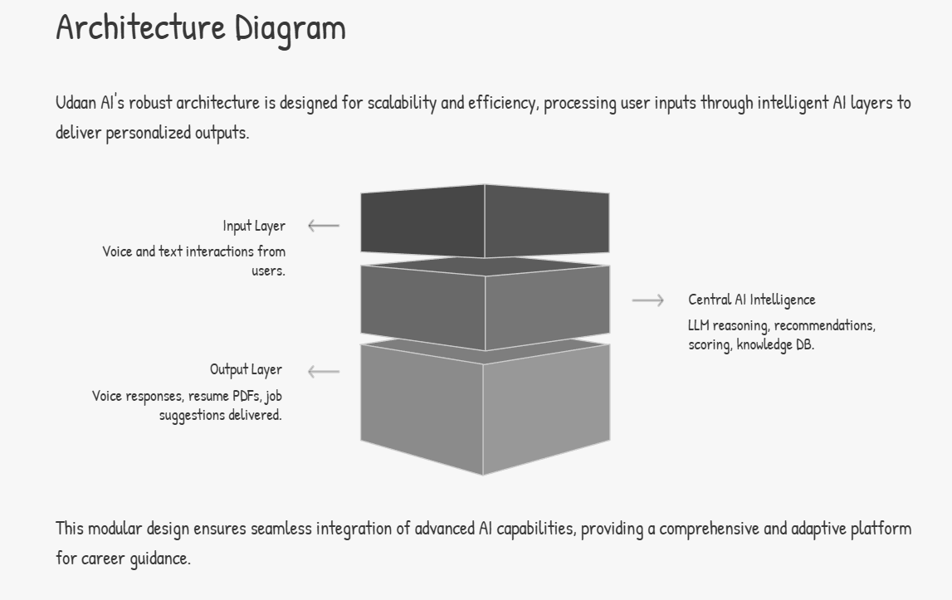
Architecture diagram of the proposed solution:

Slide 11
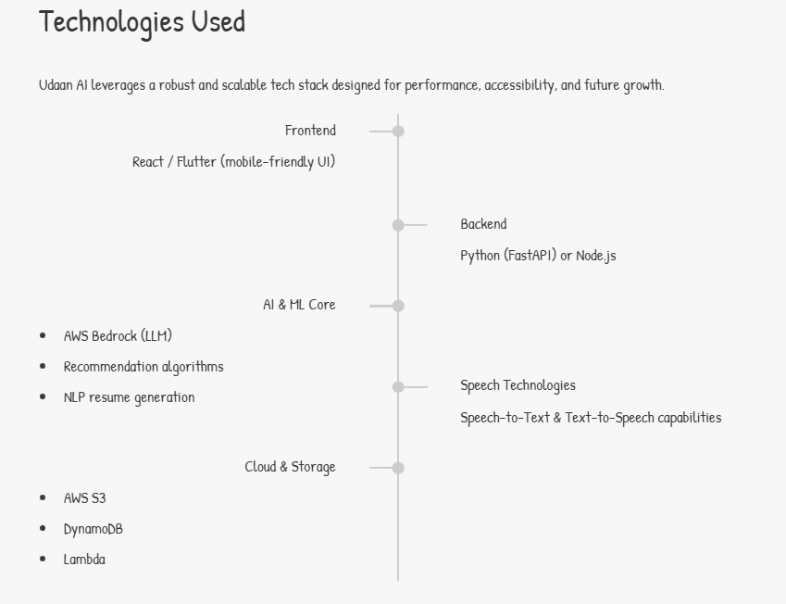
Technologies to be used in the solution:

Slide 12
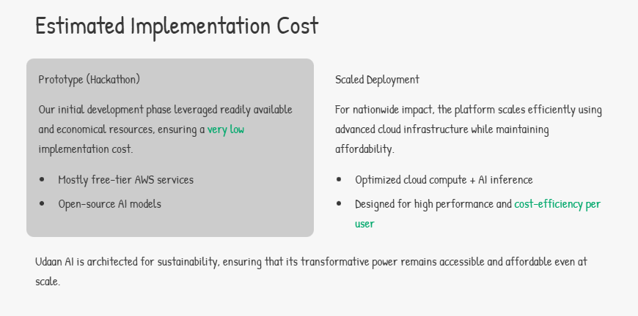
Estimated implementation cost (optional):

Slide 13
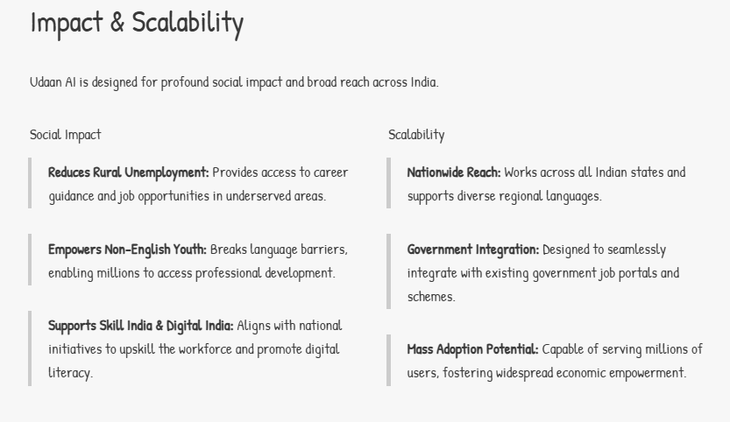
Add as per the requirements for the hackathon:

Slide 14
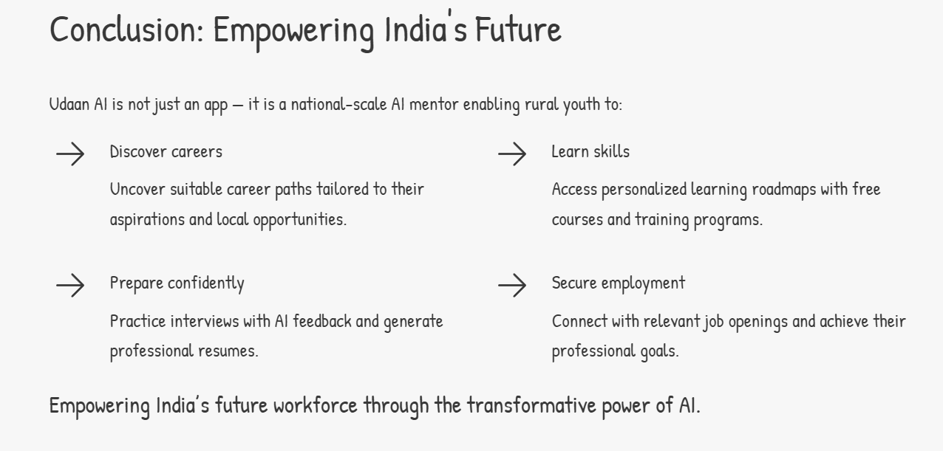
Add as per the requirements for the hackathon:

Slide 15


