Slide 1

ICE BREAKERS
Project Title: Al-Driven Real-time Collaboration Tool
PS: Develop a real-time collaboration tool using the MERN stack, enhanced with Al features like auto- completion, error detection, and language translation. The application should support collaborative coding, document editing, or design work, where Al assists in improving efficiency and communication among team members.
TEAM MEMBERS:
C M Yogeshwar (TL) Kanchana Krishna Tharun Raju Acsah Susan Mathew Sachin Kumar

Slide 2
Introduction
A platform for real-time code editing and collaboration, supporting multiple programming languages.
Features:
Real-time code editing
Multi-language support (Python, Java, C++, C, JavaScript)
AI-powered coding suggestions and improvements
Benefits:
Enhanced team collaboration
Increased coding efficiency
Immediate feedback and code improvement
Technologies Used: MERN Stack, Meta Llama 3 AI

Slide 3
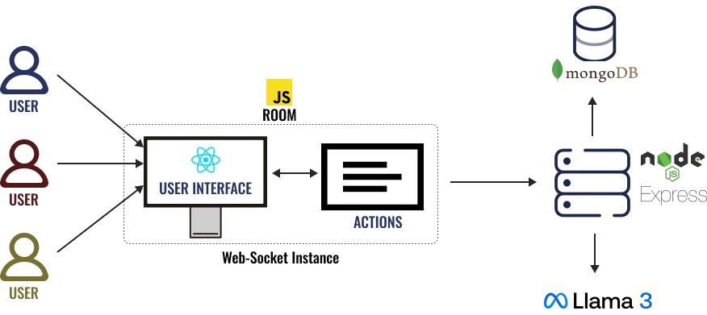
Sequence Diagram & Tech Stack
Front-End: ReactJS, Tailwind CSS
Back-End: Node.js, Express, WebSocket (SocketIO)
Database: MongoDB Atlas
AI Integration: Ollama
The sequence diagram shows how users interact with the front-end to edit code in real-time, which is processed by the back-end, stored in the database, and enhanced with AI suggestions before synchronizing across all clients. It highlights the flow of data and collaboration in the system.

Slide 4
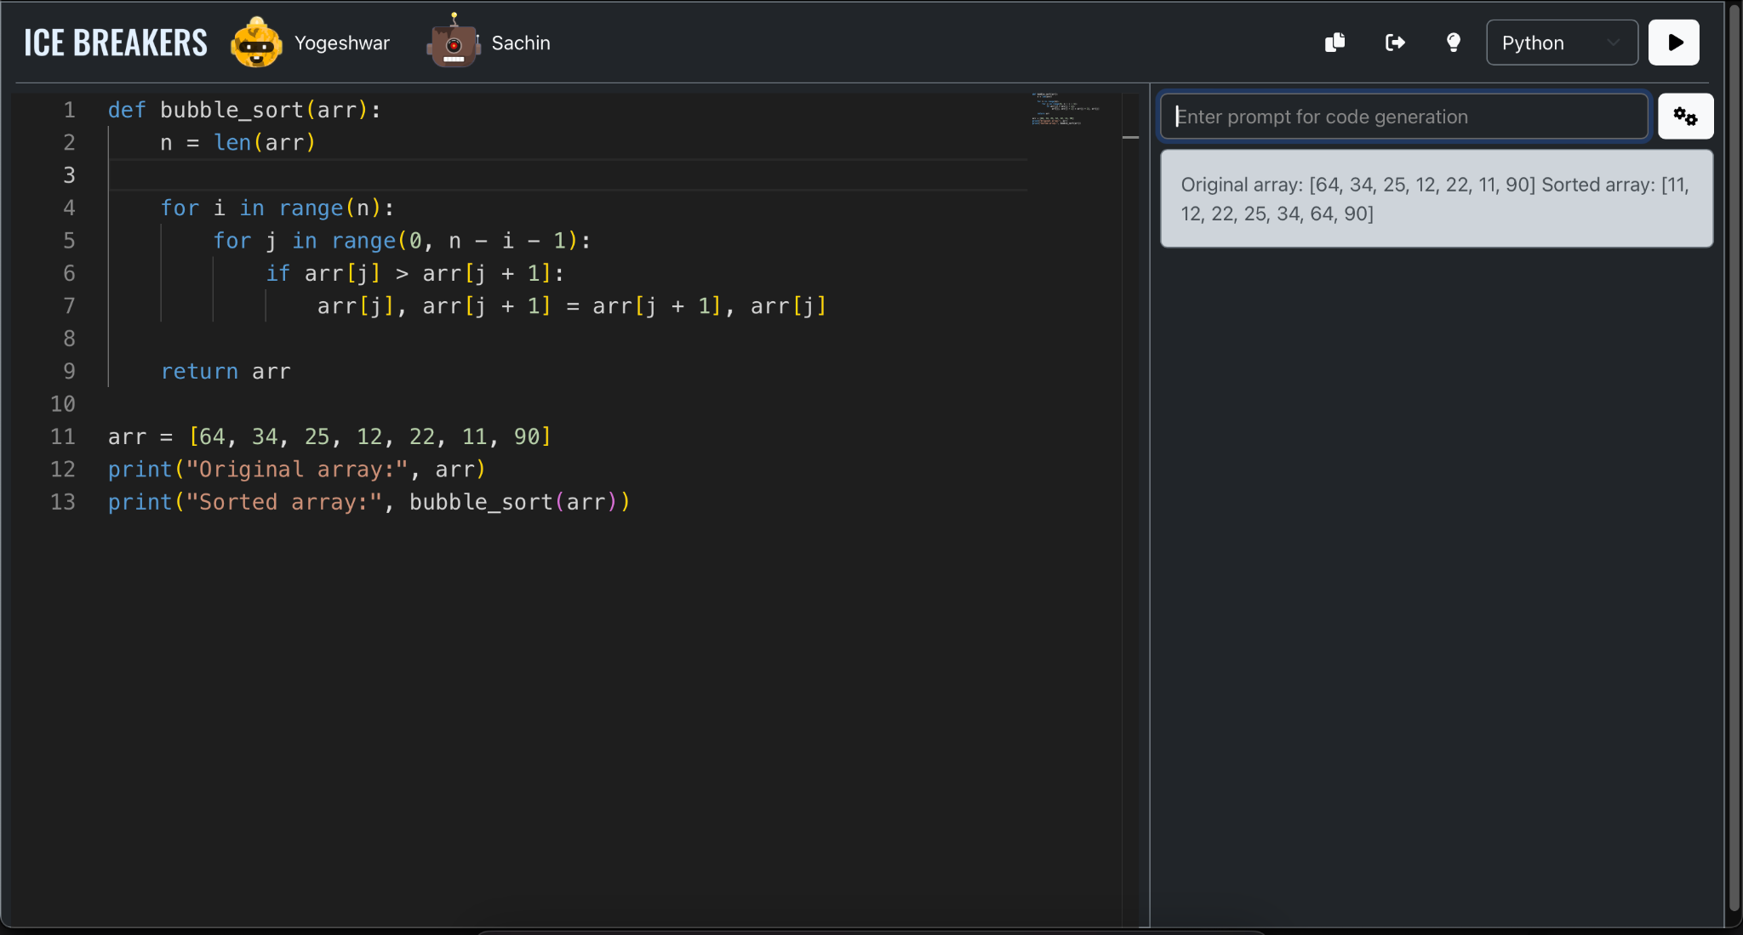
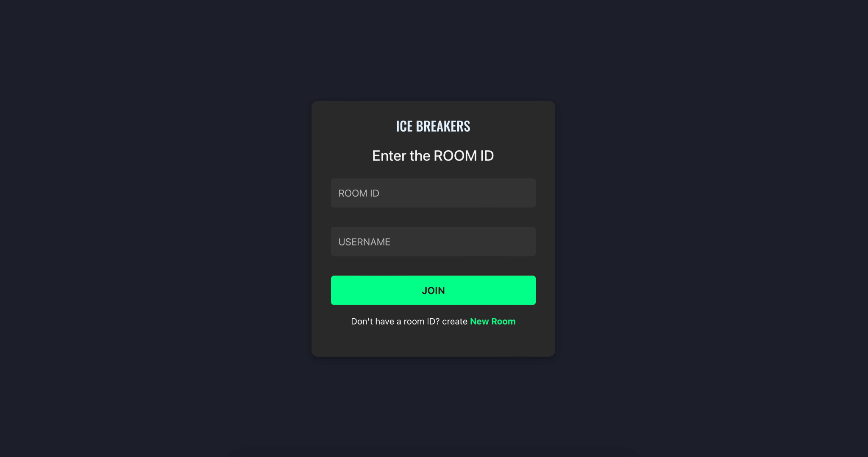
Navigation Flow
Home Page: Create or join a room using any nickname.
Editor Page:
Nav Bar: Displays room members, options to leave, copy room code, get AI suggestions, compile code, and select language.
Editor Area: Real-time collaborative coding using the Monaco Editor.
Right Pane: AI prompt for code generation and a window for compilation results.

Slide 5
Key Notes
Real-Time Collaboration and AI Integration
Session and Code Management
The project uses WebSockets (Socket.IO) for real-time code editing and synchronization, allowing seamless collaboration. Ollama AI is integrated to provide code suggestions and generation, enhancing the coding experience.
The system uses WebSocket connections for session management and MongoDB to manage state and store code per room, with automatic expiration after 7 days. Caching is not utilized, focusing on real-time interactions.
Technology Stack and Development
User Experience and Future Enhancements
Built with the MERN stack, the project leverages Tailwind CSS, React Bootstrap, and Monaco Editor for a modern and responsive interface. Meta Llama 3.1 for AI Integration
User-friendly toasts and confirmation messages enhance user experience. Future improvements will focus on expanding AI capabilities and refining the user interface for better usability.

Slide 6
References
R. W. Hamming, “Error detecting and error correcting codes,” The Bell System Technical Journal, vol. 29, no. 2, pp. 147-160, April 1950.
V. Pimentel and B. G. Nickerson, “Communicating and Displaying Real-Time Data with WebSocket,” IEEE Internet Computing, vol. 16, no. 4, pp. 45-53, July-Aug. 2012.
P. Srivani, S. Ramachandram, and R. Sridevi, “A survey on client side and server side approaches to secure web applications,” in 2017 International Conference on Electronics, Communication and Aerospace Technology (ICECA), Coimbatore, India, 2017, pp. 22-27.
Dr. Santosh Kumar Shukla, Shivam Dubey, Tarun Rastogi, and Nikita Srivastava, “Application using MERN Stack,” International Journal for Modern Trends in Science and Technology, vol. 8, no. 06, pp. 102-105, 2022.
C. Győrödi, R. Győrödi, G. Pecherle, and A. Olah, “A comparative study: MongoDB vs. MySQL,” in 2015 13th International Conference on Engineering of Modern Electric Systems (EMES), Oradea, Romania, 2015, pp. 1-6.
S. Tilkov and S. Vinoski, “Node.js: Using JavaScript to Build High-performance Network Programs,” IEEE Internet Computing.
L. Sinanaj, J. Ajdari, M. Hamiti, and X. Zenuni, “A comparison between online compilers: A Case Study,” in 2022 11th Mediterranean Conference on Embedded Computing (MECO), Budva, Montenegro, 2022, pp. 1-6.
J. Ferreira, J. Noble, and R. Biddle, “Agile Development Iterations and UI Design,” in Agile 2007 (AGILE 2007), Washington, DC, USA, 2007, pp. 50-58, doi: 10.1109/AGILE.2007.8.
J. Lu, L. Yu, X. Li, L. Yang, and C. Zuo, “LLaMA-Reviewer: Advancing Code Review Automation with Large Language Models through Parameter-Efficient Fine-Tuning,” in 2023 IEEE 34th International Symposium on Software Reliability Engineering (ISSRE), Florence, Italy, 2023, pp. 647-658.
B. S. Rawal, L. Berman, and H. Ramcharan, “Multi-client/Multi-server split architecture,” in The International Conference on Information Networking 2013 (ICOIN), Bangkok, Thailand, 2013, pp. 696-701.

Slide 7

Thanks!
ICE BREAKERS

