Slide 1
PROJECT TITLE :Integrated Crop Management System
PIP104 University Project-II
Viva Voice
Batch Number:CSE-112
Roll Number | Student Name
20211CSE0540 | Yogeshwar L
20211CSE0558 | Nischith S Gowda
20211CSE0568 | Ramprakash Gowda
Under the Supervision of,
Dr. Joseph Micheal Jerard V
Professor
School of Computer Science & Engineering
Presidency University

Slide 2
Introduction
Abstract:
This study introduces an innovative system that integrates machine learning (ML) and artificial neural networks (ANNs) to address key challenges in agriculture.
The proposed solution includes a Crop Recommendation System (CRS) that analyzes soil and climatic parameters like nitrogen, pH, temperature, and rainfall to provide tailored crop recommendations.
Additionally, a crop production prediction model estimates yields based on environmental factors, soil quality, and agronomic practices.
By offering actionable insights and decision-support tools, the system empowers farmers to make informed decisions, optimize resources, and enhance productivity.
This approach bridges traditional methods with modern technology, fostering sustainable, resilient, and data-driven farming practices.

Slide 3
Literature Review
This chapter examines the synergy between Integrated Crop Management (ICM) and machine learning (ML) in agriculture.
ICM focuses on optimizing resources, improving soil health, selecting resilient crop varieties, adapting to seasonal patterns, and managing water efficiently to ensure sustainability.
ML complements ICM by analyzing complex datasets, including soil properties, weather patterns, and crop traits, enabling more precise and informed decision-making.
Together, they enhance productivity, environmental stewardship, and resource efficiency.
The chapter also reviews ML models for crop production prediction, addressing challenges in their application and highlighting their potential to revolutionize farming practices through data-driven, sustainable approaches.

Slide 4
Research Gaps in Integrated Crop Management
Research gaps in Integrated Crop Management (ICM) include the limited availability of comprehensive, localized datasets integrating soil, climate, and crop-specific variables.
There is a need for advanced machine learning models that can handle diverse and heterogeneous agricultural data while ensuring scalability for small-scale farmers.
Additionally, research on integrating real-time IoT-based monitoring systems with ICM remains underexplored.
The lack of accessible and user-friendly platforms for farmers to implement ICM strategies is a significant barrier.
Furthermore, studies on the long-term environmental and economic impacts of ICM practices are limited, highlighting the need for multidisciplinary approaches to enhance sustainable agricultural development

Slide 5
Proposed Methodology
Requirement Gathering:
Identify key functionalities: Crop insights, and agricultural trading. Understand user needs to make the platform farmer-friendly.
System Design: Develop a clear and intuitive user interface. Plan backend architecture for seamless data management.
Development:
Frontend: Design using Visual Studio Code for HTML, CSS, and JavaScript.
Backend: Implement logic in Python Django using PyCharm.
Database: Store and manage data with MySQL in XAMPP.
Testing: Perform functionality and usability testing. Refine based on user feedback.

Slide 6
Objectives
Develop a machine learning-based system for personalized crop recommendations using environmental and soil data.
Implement a crop yield prediction model to estimate future production based on key agronomic factors.
Optimize resource use and sustainability through data-driven insights and decision-support tools.
Integrate real-time data from IoT sensors for accurate, on-the-ground analysis.
Provide farmers with a user-friendly interface for actionable insights to enhance productivity and resilience.

Slide 7
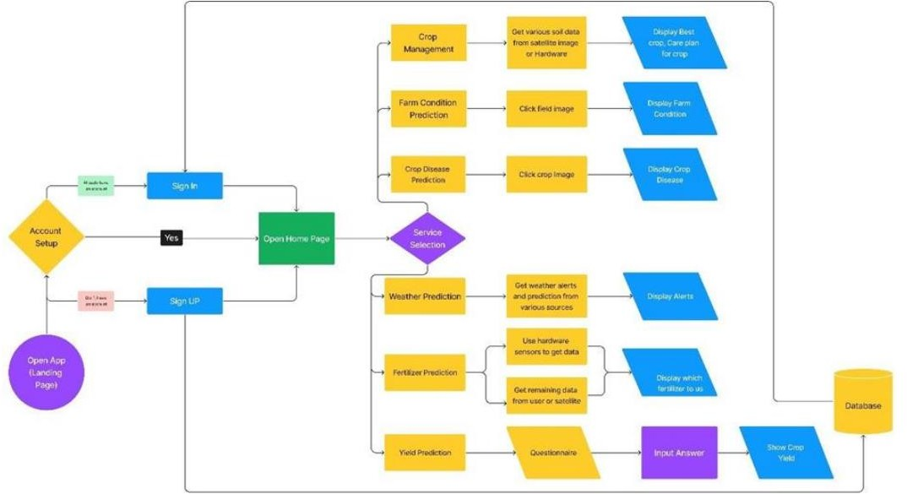
System Design and Implementation

Slide 8
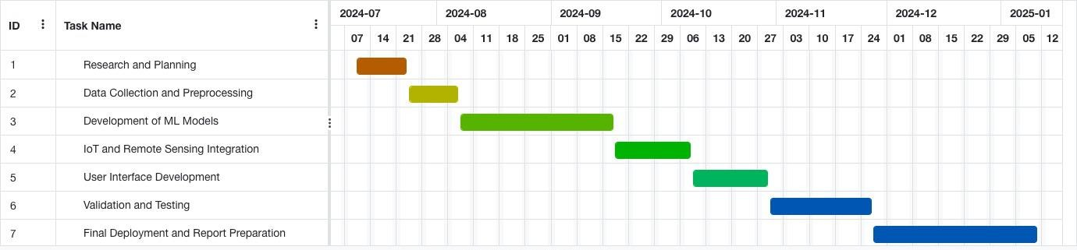
Timeline of Project

Slide 9
Outcomes
Accurate, data-driven crop recommendations tailored to specific soil and climate conditions.
Reliable crop yield predictions that help farmers plan resources and mitigate risks.
Improved resource efficiency through optimized irrigation, fertilization, and crop rotation strategies.
Enhanced environmental sustainability by minimizing waste and promoting sustainable practices.
Increased productivity and profitability for farmers through informed decision-making.
Real-time insights from integrated IoT sensors, ensuring up-to-date and actionable data.
Empowerment of farmers, policymakers, and agricultural stakeholders with predictive tools and strategies for long-term agricultural resilience.

Slide 10
References
[1] “ Qaim, M, & Kouser, S. A Review of Contemporary Agriculture:
GM Crops and Precision Agriculture”
[2] “ Kamilaris, A, & Prenafeta-Boldú, F. X . Applications of Machine Learning to Agriculture: A Survey”
[3] “Sudha, B, & Vijayakumar, V. Smart Agriculture Using IoT and Machine
Learning”
[4] “ Patil, P., & Kumar, R .Survey on Techniques of Image Processing for Disease Detection of Plants”
[5] “ Chakraborty, S., & Bandyopadhyay, S .Artificial Intelligence for Precision
Farming”
[6] “Zhang, X., & Hartemink, A. E.Advancements in Soil Analysis
and Nutrient Management Using Machine Learning Techniques”
[7] “Patel, P. S., & Jain, R. K. (2018). Mobile applications for farmer
market and crop forecasting. IEEE Mobile Computing ”.

Slide 11
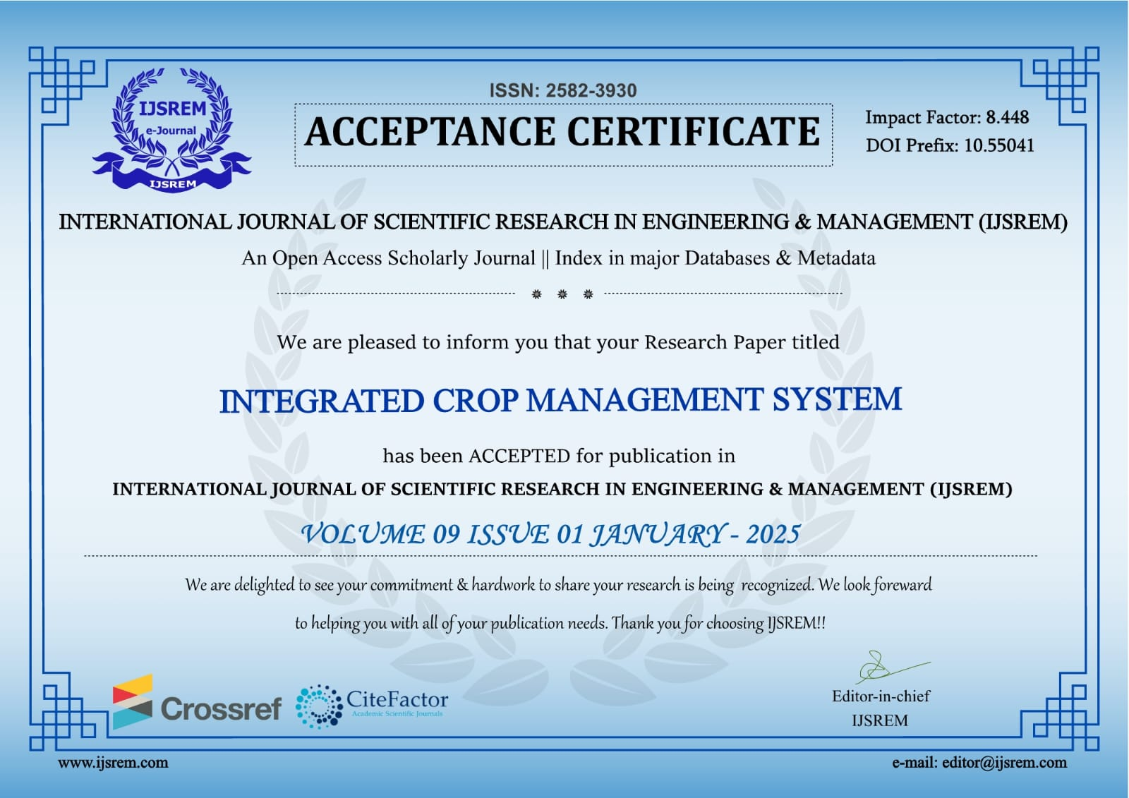
Publication Details
Published Website:INTERANTIONAL JOURNAL OF SCIENTIFIC RESEARCH IN ENGINEERING AND MANAGEMENT IJSREM

Slide 12
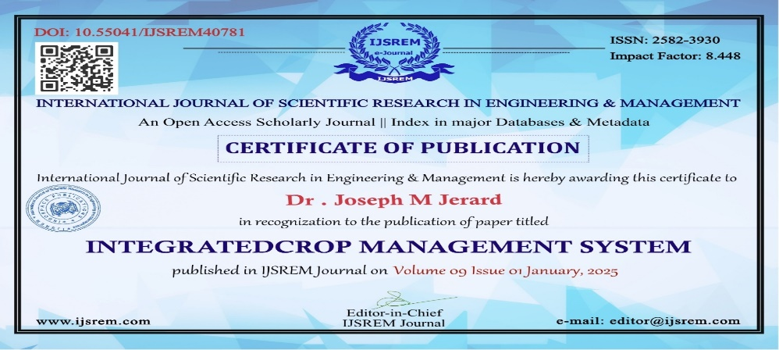
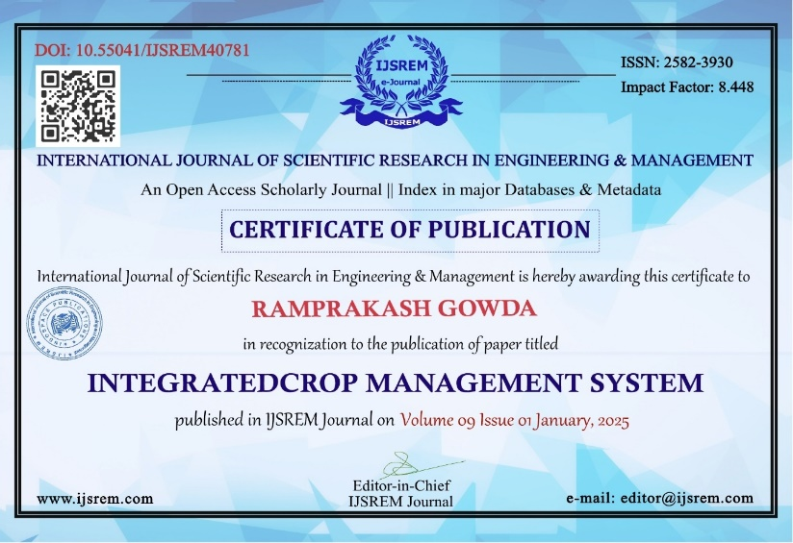
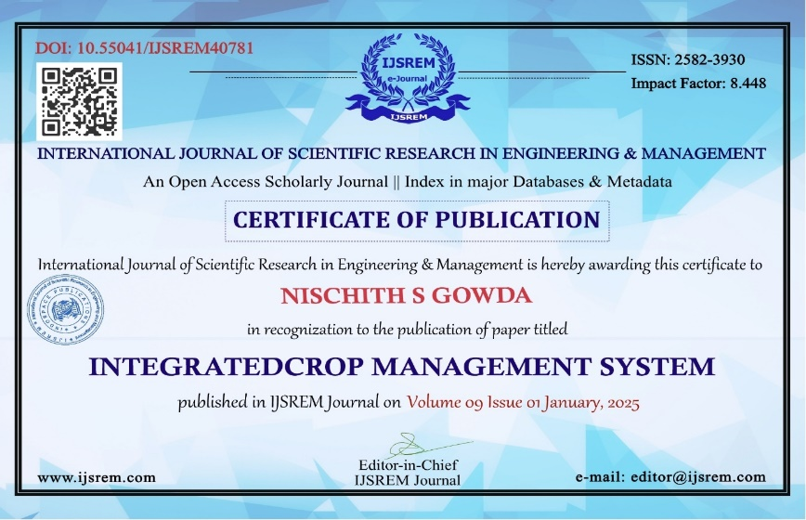
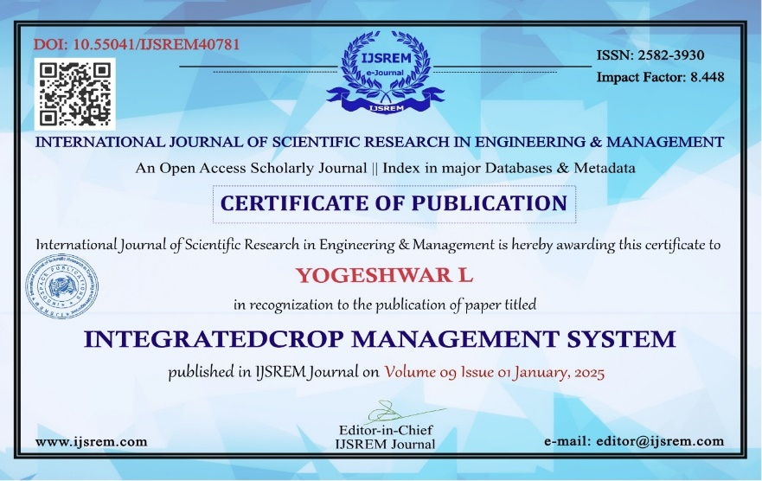
Achievements
Published Website:INTERANTIONAL JOURNAL OF SCIENTIFIC RESEARCH IN ENGINEERING AND MANAGEMENT IJSREM

Slide 13
Thank You

