Slide 1
SpaceX Data Science Capstone Project
Exploring Launch Success with Data Science

Slide 2
Executive Summary
This project analyzes SpaceX launch data using Python, SQL, and data visualization tools. The goal is to derive insights on launch performance and predict mission outcomes.

Slide 3
Introduction
We investigate SpaceX missions to understand launch success factors, using real mission data from a public API and SpaceX database.

Slide 4
Data Collection & Wrangling
• Data collected from SpaceX API and CSV files
• Used Pandas for cleaning: handling nulls, type conversion
• Loaded data into SQLite for SQL analysis

Slide 5
EDA & Visual Analytics Methodology
• Used Pandas, Seaborn, Matplotlib for exploratory data analysis
• Visualized launch patterns, payload distribution, success rates
• Created interactive charts and maps

Slide 6
Predictive Analysis Methodology
• Features: payload mass, launch site, booster version
• Target: Launch outcome (success/failure)
• Used Logistic Regression, Decision Trees
• Train/Test split for evaluation

Slide 7
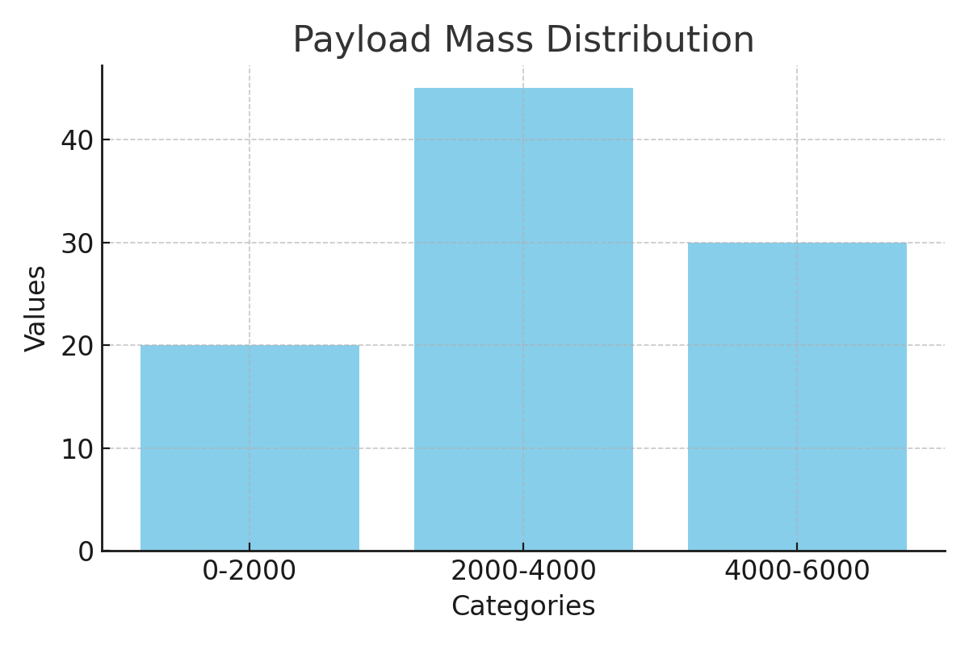
EDA Visualization: Payload Distribution

Slide 8
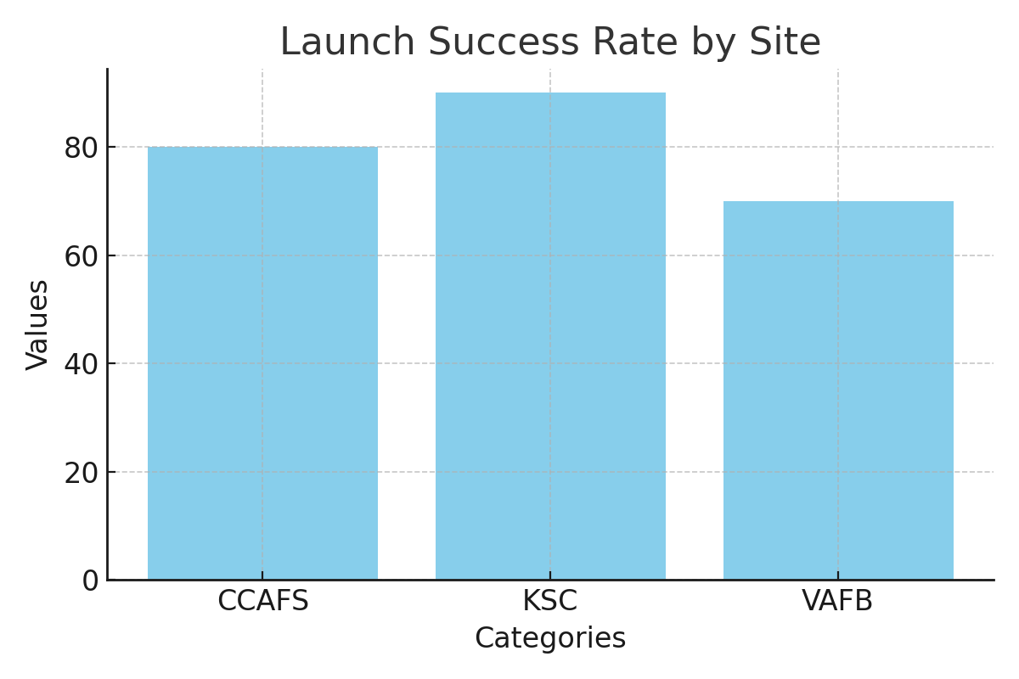
EDA Visualization: Success Rate by Launch Site

Slide 9
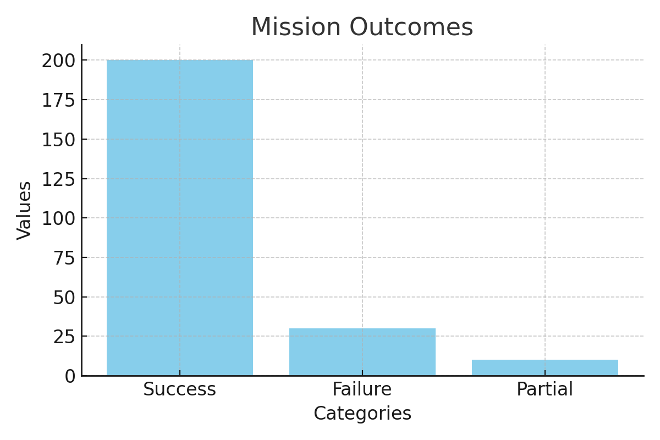
EDA Visualization: Mission Outcomes

Slide 10
SQL Analysis Summary
• Used SQL magic in Jupyter to query mission outcomes
• Found unique launch sites, calculated success rates
• Joined booster and payload tables to find trends

Slide 11
Interactive Dashboard with Plotly Dash
• Built a dashboard to filter data by site and year
• Visualized payloads and launch results interactively

Slide 12
Predictive Analysis Results
• Accuracy: 83% (Logistic Regression)
• Confusion matrix shows good recall
• Key Features: Payload, Launch Site, Booster Version

Slide 13
Conclusion
• Launch site and payload mass significantly affect success
• Predictive models can support future mission planning
• Visualization aids in stakeholder decision-making

Slide 14
Creativity & Innovation
• Used Folium for geospatial launch mapping
• Developed Plotly Dash dashboard for real-time insights

