Slide 1
Smart Irrigation System using IoT
Teammates: Jaajana
Mansi
Yogeshwari

Slide 2
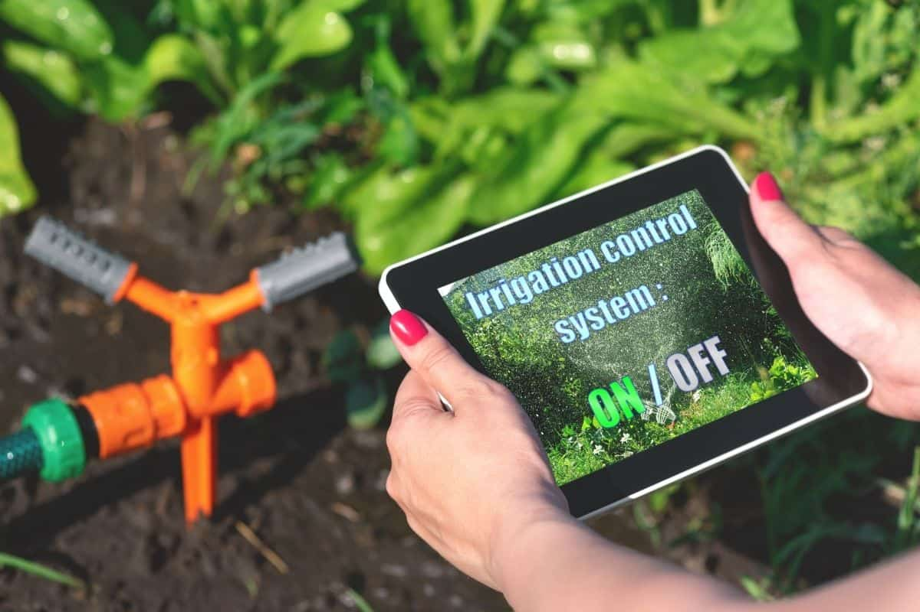
Contents:
*Abstract *Introduction *Problem statement *Literature survey *Proposed system *Flow Diagram *Future scope *Conclusion *Refrences

Slide 3
ABSTRACT:-
⇒ India’s population has reached beyond 1.2 billion and the population rate is increasing day by day, so after 25-30 years there will be serious problem of food, such that the development of agriculture is necessary. Today, farmers incur the problem of water scarcity due to lack of rain.
⇒The project's main goal is to create an automated irrigation system that saves time and money in the long run. The traditional farm land irrigation techniques require manual intervention. With the automated technology of irrigation, the human intervention can be minimized.
⇒ Whenever there is a change in humidity of the soil, the sensor senses the humidity change and irrigates the field automatically using a popular technology called the ‘Internet of Things’. The project makes use of simple IOT technology and is economic making it feasible even in economically backward areas.

Slide 4
INTRODUCTION
➦The Internet of Things (IoT) refers to a system of interrelated, internet-connected objects that are able to collect and transfer data over a wireless network without human intervention.
➦The Internet of things refers to a type of network to connect anything with the Internet based on stipulated protocols .Through information sensing equipment's to conduct information exchange and communications in order to achieve Smart recognitions, positioning, tracing, monitoring, and administration.
➦An IoT ecosystem consists of web-enabled smart devices that use embedded systems, such as processors, sensors and communication hardware, to collect, send and act on data they acquire from their environments. IoT devices share the sensor data they collect by connecting to an IoT gateway or other edge device where data is either sent to the cloud to be analyzed or analysed locally.

Slide 5
PROBLEM STATEMENT
✤As water supply is becoming scarce in today's world there is an urgency of adopting smart ways of irrigation.
✤The project describes how irrigation can be handled smartly using IOT.
✤It also helps in conserving water by providing water to the plants depending on the water requirements.

Slide 6
LITERATURE SURVEY
SR.NO & TITLE | AUTHOR | JOURNAL | DESCRIPTION
1) Smart Irrigation System Based on NodeMCU | Aadithyan V, T Sai Samrat Goud, G Karthik Reddy, P Naga Chaitanya, V Jaya Surya, Dr K Prabhakara Rao | IOSR Journal of Electronics and Communication Engineering (IOSR-JECE) Volume 14, Issue 5, Ser. I (Sep.-Oct. 2019), PP 01-04 | The purpose of this paper is to automate the irrigation process in agriculture. This is accomplished by the use of a smart device comprised of NodeMCU, Moisture sensor, and Humidity sensor. This removes the need for manual irrigation, enabling farmers to focus their time on other important tasks.

Slide 7
LITERATURE SURVEY
SR.NO&TITLE | AUTHOR | JOURNAL | DESCRIPTION
2) Smart irrigation system using IOT | Meghana Gupta Arakere, Avik Seal and Tejomurthula Bhuvana Teja | Asian Journal of Science and Technology, 09, (06), 9756-9768. | The concept of this project is to allow the owners of fields to observe the growth of their plants in their farms. it is done by using a smart platform of IoT and solenoid valves to control the flow of water. It is easy to use for anyone with a Smartphone and doesn’t require maintenance once set up.

Slide 8
PROPOSED SYSTEM
This proposed work includes an embedded system for automatic control of irrigation. This project uses a sensor and Nodemcu to track an irrigation system in real time.
This method ensures that the agricultural farm receives the exact amount of water it needs and prevents water wastage.
When the moisture level in the soil falls below a certain threshold, the machine turns on the pump.
When the water level returns to normal, the pump turns off automatically. The motor's current status and sensed parameters will be reflected on the user's Android application.

Slide 9
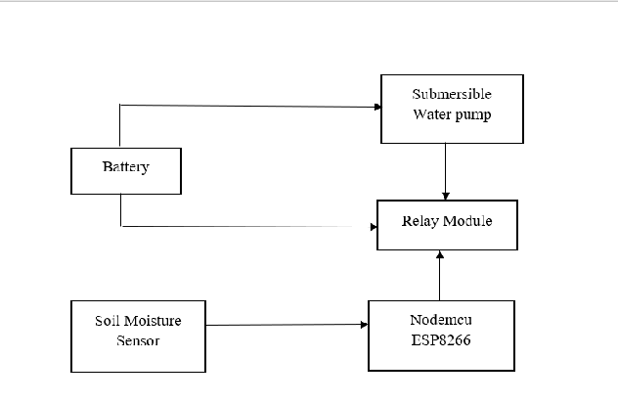
BLOCK DIAGRAM

Slide 10
FUTURE SCOPE AND CONCLUSION
Farmers in the modern period use a manual irrigation technique in which they irrigate the land at regular intervals. This procedure appears to be time-consuming .
Water wastage occurs as a result of using more water. Furthermore, in a dry climate, Irrigation becomes necessary in areas where rainfall is insufficient .
As a result, we'll need an automated system, that precisely track and regulate the amount of water required in the field. After, Installing a smart irrigation system will help you save time and money. This system ensures that water is used wisely.
Furthermore, this structure Nodemcu is used, which guarantees a 20% improvement in machine life by lowering the power consumption It also lowers the human intervention ,therefore less energy of the farmer is required.
This smart irrigation system extends watering time for plants, and provides ideal growth condition. It saves time and timer delay as per the environmental condition can be added for automatic watering. This smart irrigation system can be adjusted and modified according to the changing environment.

Slide 11
REFRENCES:
1.Aadithyan V, T Sai Samrat Goud, G Karthik Reddy, P Naga Chaitanya, V Jaya Surya, Dr K Prabhakara Rao "Smart Irrigation System Based on NodeMCU" IOSR Journal of Electronics and Communication Engineering (IOSR-JECE) e-ISSN: 2278-2834,p- ISSN: 2278-8735.Volume 14, Issue 5, Ser. I (Sep.-Oct. 2019), PP 01-04
2.Meghana Gupta Arakere, Avik Seal and Tejomurthula Bhuvana Teja(2019) “Smart irrigation system using IoT”, Asian Journal of Science and Technology, 09, (06), 9756-9768.
3.Pavankumar Naik,Arun Kumbi ,Kirthishree Katti,Nagaraj Telkar "AUTOMATION OF IRRIGATION SYSTEM USING IoT" International Journal of Engineering and Manufacturing Science. ISSN 2249-3115 Volume 8, Number 1 (2018) pp. 77-88.
4. Premalatha C "Automatic Smart Irrigation System Using IOT" International Journal of Scientific Research in Computer Science and EngineeringVol.7, Issue.1, pp.1-5, February (2019).

Slide 12
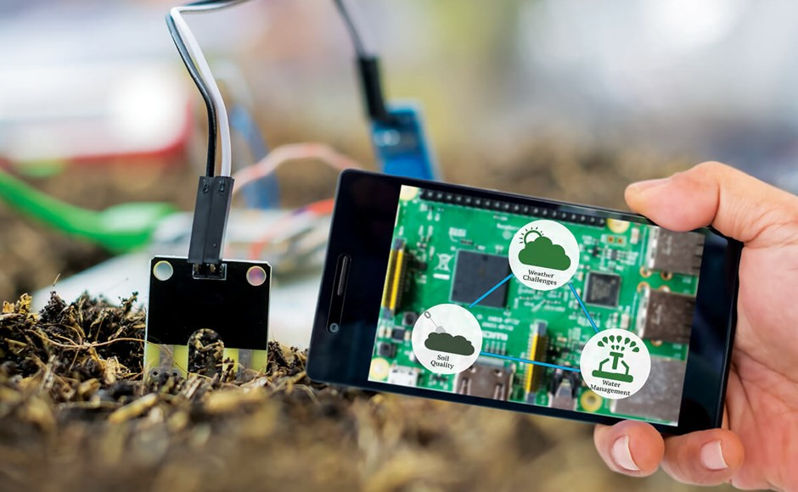
THANK YOU

