Slide 1
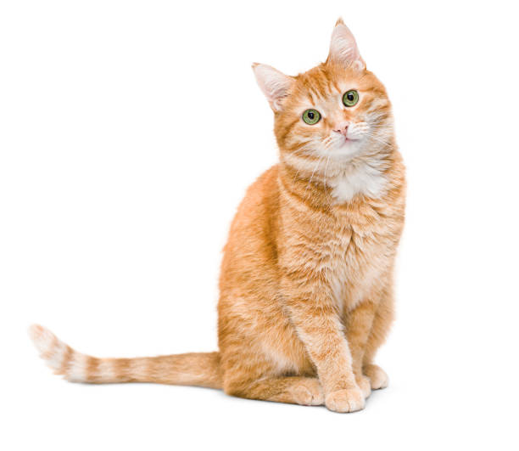
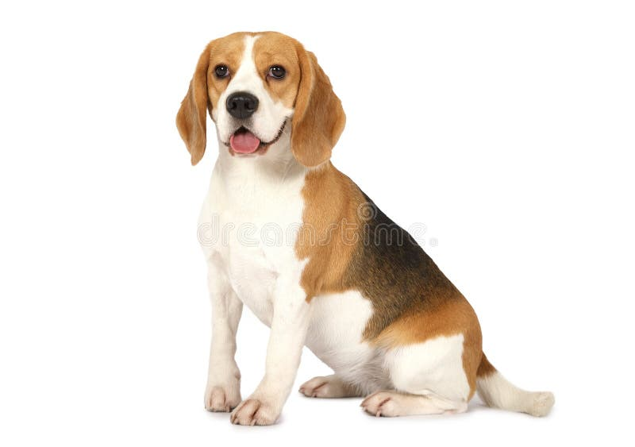
Image Classification using CNN
Presentation By
21i216 – GOWTHAM M
21i242 – RAGUL T
21i262 – VISHAL A
21i265 – YOGHARAJ A R

Slide 2
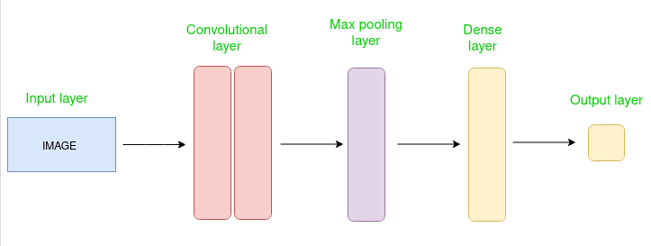
What is CNN?
Convolutional Neural Network (CNN) is a type of deep learning neural network primarily used for analyzing visual data.
CNNs are well-suited for tasks like image recognition, object detection, and image classification.
Layers of CNN
Input Layer
Convolutional Layer
Pooling Layer
Fully Connected Layer
Output Layer

Slide 3
Difference between CNN and Neural Network
Aspect | Convolutional Neural Networks (CNNs) | Traditional Neural Networks
Input | Grid-like data, e.g., images | General data types
Layers | Convolutional, pooling, fully connected | Primarily fully connected
Feature Learning | Hierarchical representations of features | Global relationships in data
Parameter Sharing | Yes, in convolutional layers | No, each neuron has own parameters
Translation Invariance | Captures translational invariance | Lacks inherent translation invariance
Computational Efficiency | Efficient due to weight sharing | Less efficient for grid-like data
Application | Computer vision tasks like image classification | General-purpose tasks

Slide 4
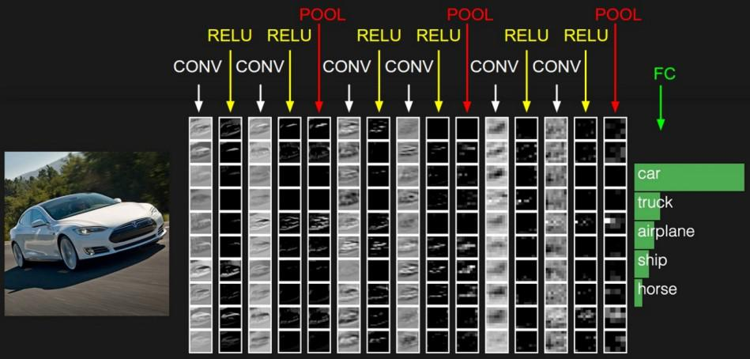
Applications of CNN
Image Classification
Object Detection
Face Recognition
Medical Image Analysis
Natural Language Processing
Video Analysis
Autonomous Vehicles
Artificial Intelligence in Gaming

Slide 5
What is TensorFlow?
TensorFlow is a open source framework for Deep learning and Machine learning developed by google
This algorithm takes image as input and classifies it into one of the output class labels.
CNNs can automatically learn features from images and classify them into different categories.
This provides prebuilt layers and APIs specifically designed for constructing CNN.
This is mainly used for:Classification,Perception,Understanding, Discovering,prediction and Creation
Data Flow Graphs
Dataflow is a common programming model for parallel computing.
Tensorflow uses a dataflow graph to respresent your computation.

Slide 6
Preprocessing techniques for image classification:
Resizing:
Ensures all images have the same dimensions, simplifying model training.
Normalization:
Scales pixel values to a range, typically between 0 and 1, stabilizing the learning process.
Data Augmentation:
Generates additional training samples by applying transformations like rotation, flipping, and zooming, increasing dataset diversity.

Slide 7
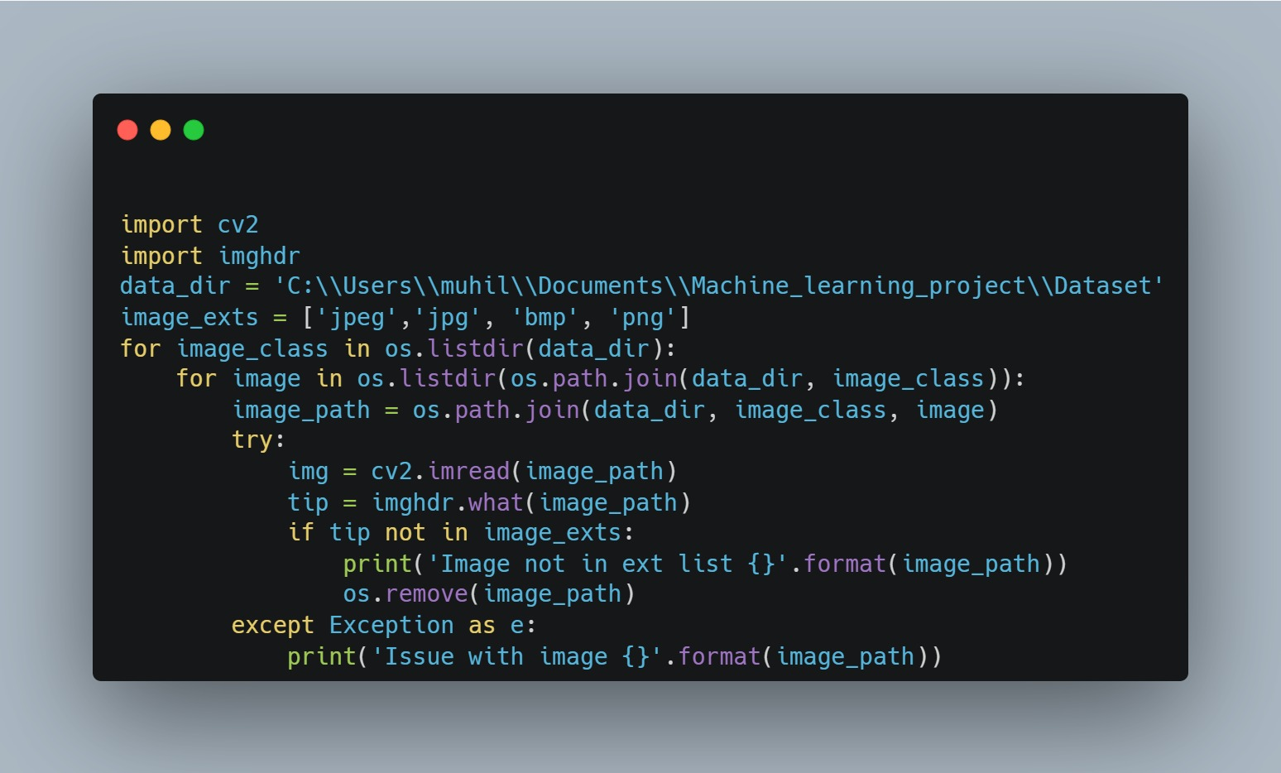
Preprocessing of data:

Slide 8
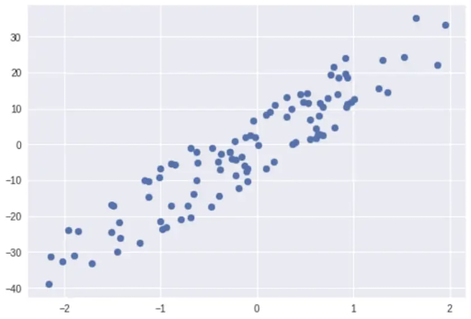
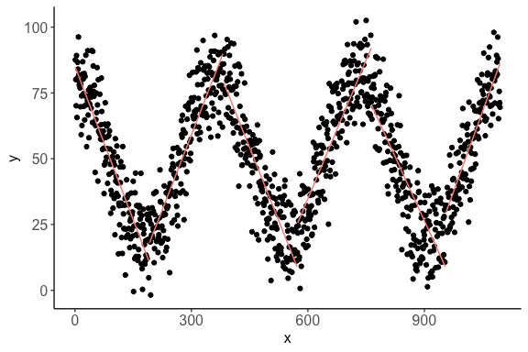
Activation Functions
Why do we need Activation Functions?
Activation Function is a non-linear transformation function that is used to transform data into a particular range and it is used to decide if a neuron in a neural network should be activated or not.
It is basically used to solve complex problems and analyze and transmit data.
Various activation functions are being used for both hidden and output layers.

Slide 9
Popular Activation Functions which are used:
Sigmoid Activation Function
Tanh Activation Function
Relu Activation Function
Softmax Activation Function
Leaky Relu Activation Function
Elu Activation Function

Slide 10
Activation Function comparison in our Model:
Relu Activation Function – 99.74% Accuracy
Tanh Activation Function – 99.14% Accuracy
Elu Activation Function – 99.02% Accuracy

Slide 11
THANK YOU

