Slide 1
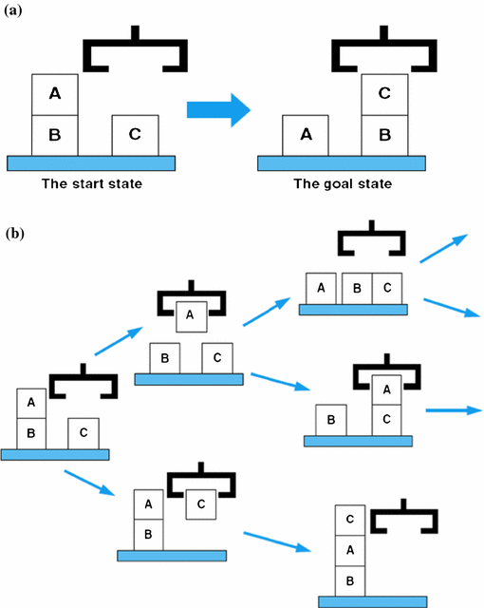
CSC – 570 Practical - IIII
Group No. 13
Blocks World Problem
Implementation using BFS and DFS
GROUP NO. 13
Abhishek Jaiswar (256201)
Mangesh Mate (256214)
Yogiraj Bhilare (256228)

Slide 2
Introduction and Problem Statement
What is the Blocks World?
Classic AI planning and search benchmark
A set of lettered blocks arranged on pegs/stacks
Agent must rearrange blocks from an initial state to a goal state
Only the top block of any peg can be moved at a time
Originated in 1960s robotics and planning research
Problem Statement
Given:
· An initial configuration of blocks across 3 pegs
· A desired goal configuration
Find:
· A sequence of valid moves to reach the goal
· Each move transfers the top block of one peg to another
Compare:
· BFS (optimal, finds shortest path)
· DFS (fast, not always optimal)
Blocks World Problem — BFS & DFS · Group No. 13

Slide 3
Methodology — BFS & DFS Algorithms
BFS — Breadth-First Search
Data Structure: Queue (FIFO)
Explores all nodes at current depth before going deeper
Guaranteed to find the shortest (optimal) path
Complete — always finds a solution if one exists
Time & Space complexity: O(bᵈ)
Higher memory usage — stores entire frontier
DFS — Depth-First Search
Data Structure: Stack (LIFO)
Explores one path fully before backtracking
Not guaranteed to find the optimal path
Incomplete — may get stuck in infinite loops
Time: O(bᵐ), Space: O(b x m)
Lower memory usage — stores only current path
Theoretical algorithm properties (b = branching factor, d = depth of optimal solution, m = maximum depth).
Blocks World Problem — BFS & DFS · Group No. 13

Slide 4
Implementation Overview
Frontend — React.js
Interactive UI built with React + Tailwind CSS. Components: Interaction (block/peg configuration), SplitScreen (BFS vs DFS panels), PlaybackControls (step-by-step animation), TreeView (ReactFlow search tree), ComparisonTable (metrics dashboard).
Backend — Node.js + Express
REST API server handles /api/solve and /api/example. solverController.js validates inputs and invokes the Python engine via child_process. Optional MongoDB storage for solve history. Runs on port 5000.
Algorithm Engine — Python
solver.py implements BFS (deque-based) and DFS (stack-based). Returns full step trace: state, move description, data structure snapshot, tree node. Linked into Node.js via runPython.js using stdin/stdout JSON piping.
Blocks World Problem — BFS & DFS · Group No. 13

Slide 5
Key Features & Visualization
Step-by-Step Playback
Animated playback with Slow / Medium / Fast speed controls and step-forward/back navigation.
Live Block Visualization
BlockStack component renders each peg with color-coded blocks in real time as the algorithm progresses.
Search Tree (ReactFlow)
Interactive tree diagram highlights the currently explored node at every step for both BFS and DFS.
Input Validation
Frontend + backend both validate block parity, peg count (2–5), block count (≤6), and duplicate detection.
Execution Log
LogsPanel shows the full move history, highlighting the current step and fading past/future entries.
Metrics Dashboard
ComparisonTable shows theoretical properties alongside measured step counts and tree node totals.
Blocks World Problem — BFS & DFS · Group No. 13

Slide 6
Results and Algorithm Comparison
Metric | BFS | DFS
Data Structure | Queue (FIFO) | Stack (LIFO)
Time Complexity | O(bᵈ) | O(bᵐ)
Space Complexity | O(bᵈ) | O(b x m)
Completeness | ✓ Yes | ✗ No
Optimality | ✓ Yes | ✗ No
Memory Usage | High (full frontier) | Low (current path)
Demo Steps (A,B,C) | 41 | 9
Theoretical algorithm properties (b = branching factor, d = depth of optimal solution, m = maximum depth).
Blocks World Problem — BFS & DFS · Group No. 13

Slide 7
Key Features & Visualization
BFS for Optimal Solutions
BFS guarantees the shortest path and is complete. Ideal when solution quality and correctness matter more than memory.
DFS for Memory Efficiency
DFS uses significantly less memory and is faster in practice when the goal is deep in the tree. Suitable for large state spaces.
01
02
Visual Learning Tool
The interactive visualizer makes search algorithms tangible — students can observe state changes, data structures, and tree growth in real time.
Full-Stack AI Application
Demonstrates a complete AI pipeline: React frontend, Node.js API layer, and Python algorithm engine communicating via JSON over stdio.
03
04
Thank You · Blocks World Problem — BFS & DFS · Group No. 13

