Slide 1
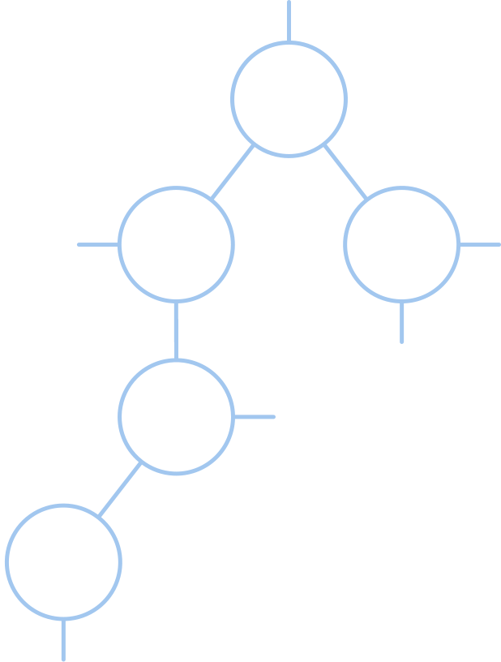
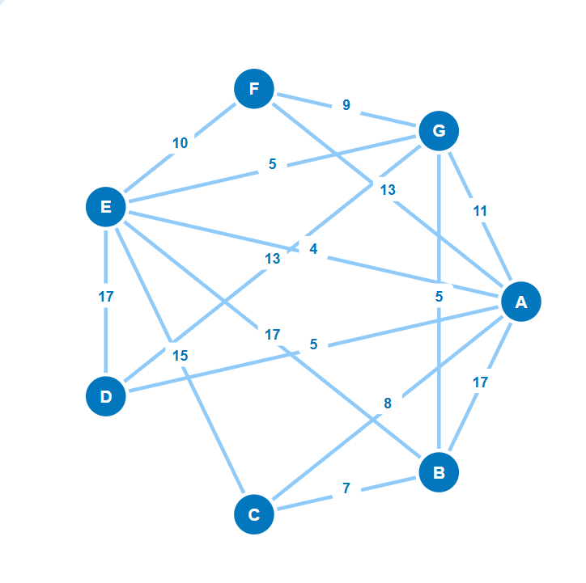


CSC-520 : Practical 1
MST Visualizer
Interactive Minimum Spanning Tree Algorithm Visualizer
Kruskal's & Prim's Algorithms
Group No. 7
Abhishek Jaiswar - 256201
Yogiraj Bhilare - 256228
Tejas Patare - 256259
Notes:
1

Slide 2
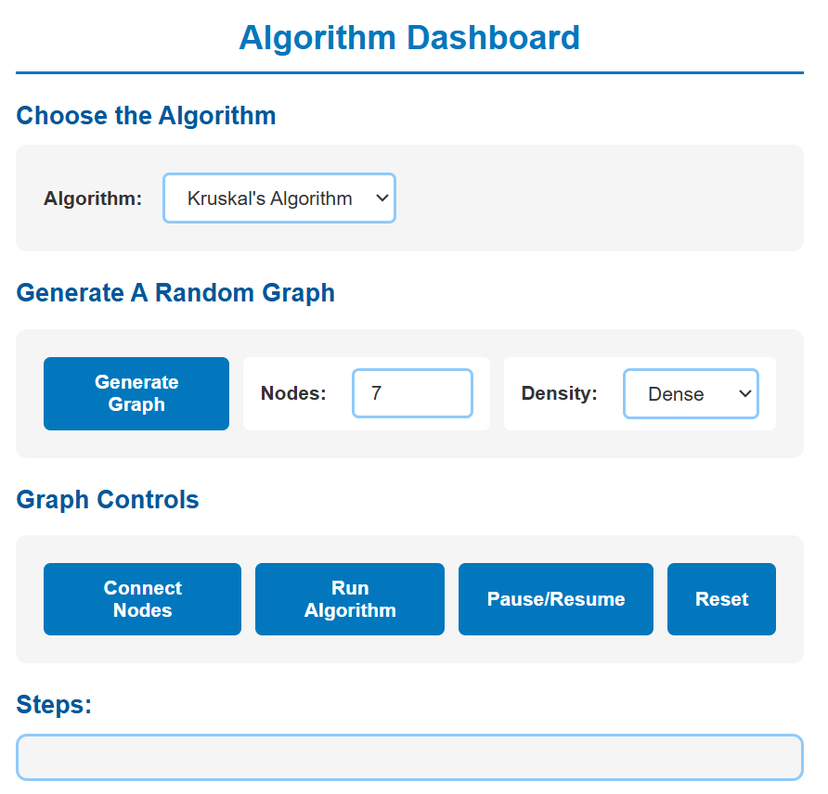
What is MST Visualizer?
Purpose
An interactive web application that visualizes Minimum Spanning Tree algorithms with step-by-step execution, helping students understand complex graph algorithms through real-time visual demonstration.
Key Features
  Interactive drag-and-drop graph creation
  Random graph generation with configurable density
  Step-by-step algorithm visualization
  Support for both Kruskal's and Prim's algorithms
  Pause/Resume control and real-time metrics
Notes:
2

Slide 3
Modular Project Structure
Clean separation of concerns across three architectural layers ensures maintainability, scalability, and efficient code organization.
UI Layer
Logic Layer
Algorithm Layer
  index.html
  style.css
  dom.js
  graphDrawing.js
  modal.js
  state.js
  interactions.js
  graphGeneration.js
  utils.js
  algorithms.js
  uiControls.js
Separation of Concerns
Maintainable Code
Scalable Design
Notes:
3

Slide 4

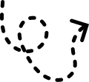
User Interaction Flow
01
02
Create Graph
Select Algorithm
Choose between random generation (select node count and density) or interactive mode (drag nodes to connect and set edge weights).
Pick Kruskal's or Prim's algorithm. For Prim's, specify your source vertex to begin tree construction.
03
Visualize Execution
Run the algorithm step-by-step with pause/resume control. Monitor real-time metrics, edge selections, and tree growth as the algorithm progresses.
Notes:
4

Slide 5
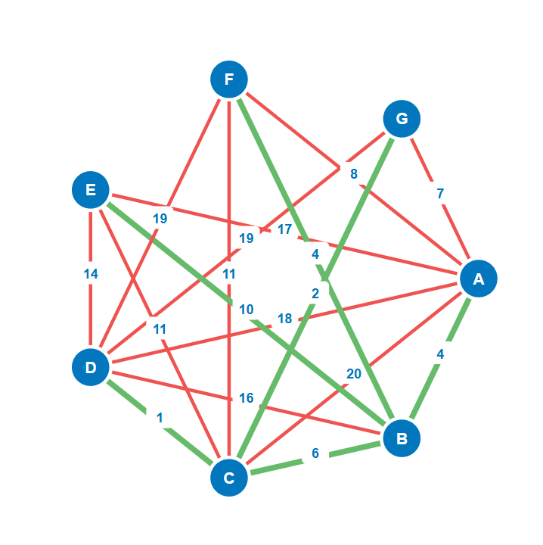
Kruskal's Algorithm
Edge-Based Greedy Approach
Union-Find Data Structure
Kruskal's algorithm processes edges in ascending order by weight, building the MST by selectively adding edges that don't create cycles.
  find(x): Locates set with path compression
  union(a,b): Connects two disjoint sets
Algorithm Steps
  Sort all edges by weight (ascending order)
  Examine each edge sequentially
Complexity Analysis
  Use Union-Find to detect cycles
  Time: O(E log E)
  Add edge to MST if no cycle (GREEN)
  Space: O(V)
  Skip edge if cycle detected (RED)
  Best For: Sparse graphs with fewer edges
  Continue until all vertices are connected
Notes:
5

Slide 6
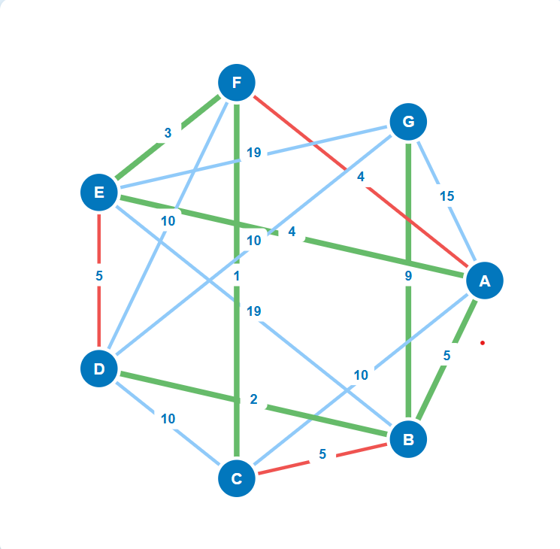
Prim's Algorithm
Vertex-Based Greedy Approach
Priority Queue Structure
Prim's algorithm grows the MST from a source vertex, continuously adding minimum-weight edges connecting visited and unvisited vertices.
  Maintains available edges efficiently
  Sorted by edge weight
  Enables quick minimum selection
Algorithm Steps
  Start from designated source vertex
  Add source to visited set
  Examine all edges from visited vertices
Complexity Analysis
  Time: O(E log V)
  Select minimum weight edge to unvisited vertex
  Space: O(V)
  Add edge to MST (GREEN) and mark vertex as visited
  Best For: Dense graphs with many edges
  Repeat until all vertices are visited
Notes:
6

Slide 7
Thank you
Group No. 7
Notes:
8

