Slide 1
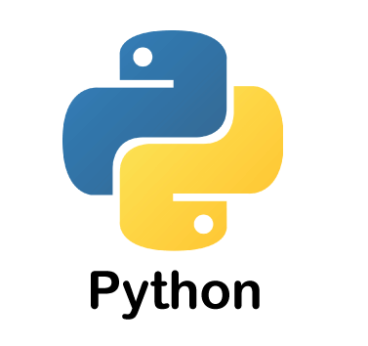

Slide 2
W01D01
Environment Setup | Python Basics
What is Python
Python Installation
Jupyter setup

Slide 3
A programming language is a computer language that is used by programmers (developers) to communicate with computers.
Python is an object-oriented, high-level programming language.
First developed in the late 1980s by Guido van Rossum

Slide 4
Advantages
Python is easy to read, easy to understand, and easy to write.
It integrates with other programming languages like C, C++, and Java.
Python executes code line-by-line, so it is easy for the programmer to find the error that occurred in the code.
Python is platform-independent means you can write code once and run it anywhere.
Disadvantages
Python is not suitable for developing mobile applications and games.
Python works with the interpreter. That's why it is slower than other programming languages like C and C++.

Slide 5
Why Python
It’s Flexible
It’s Easy to Learn
It’s Open Source
It’s Well-Supported
Script writing and automation
Back-end development
Data science and machine learning
Internet of Things (IoT)
Robotics

Slide 6
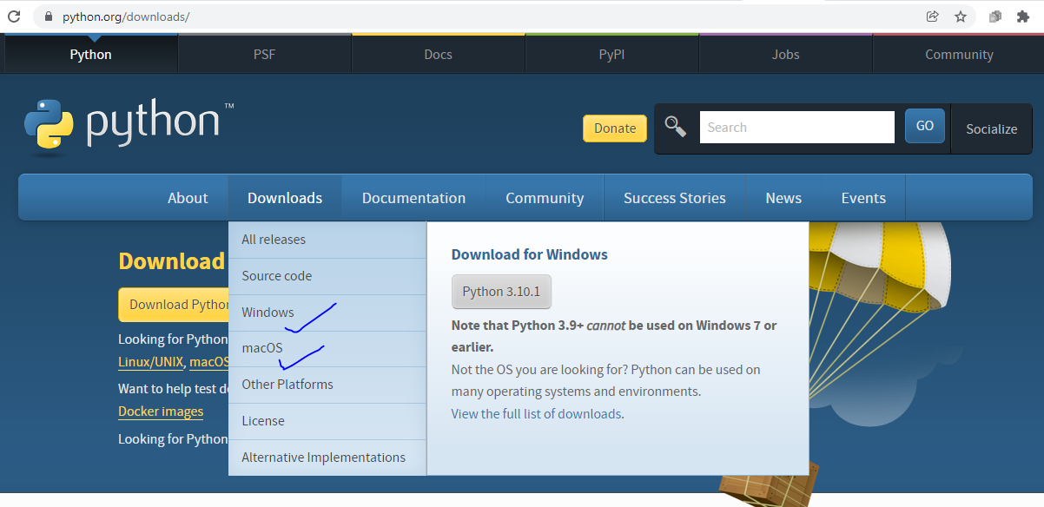
Python Installation

Slide 7
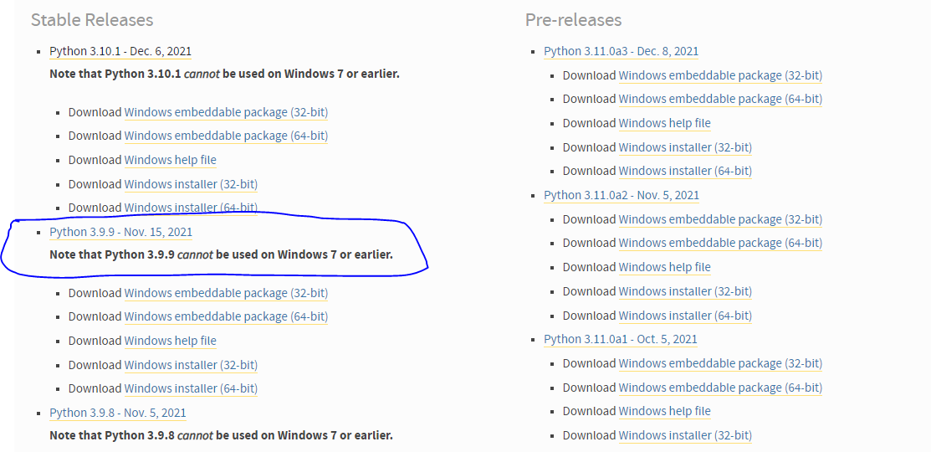

Slide 8
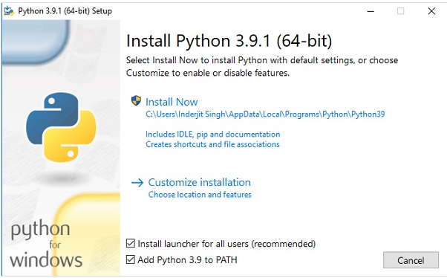

Slide 9
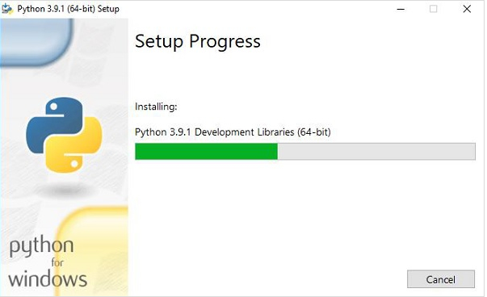

Slide 10
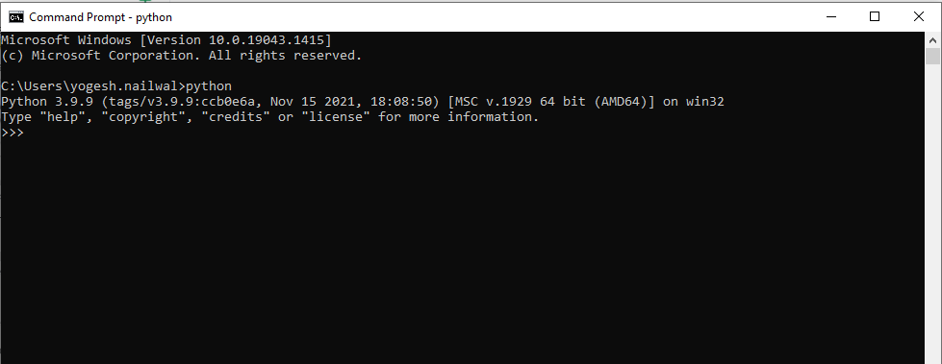

Slide 11
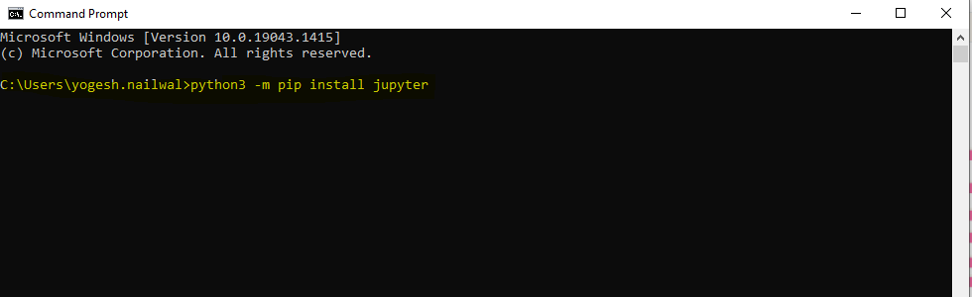
Alternatively of you want to install Anaconda and access jupyter
https://www.youtube.com/watch?v=kbTSj5xTgNc

Slide 12
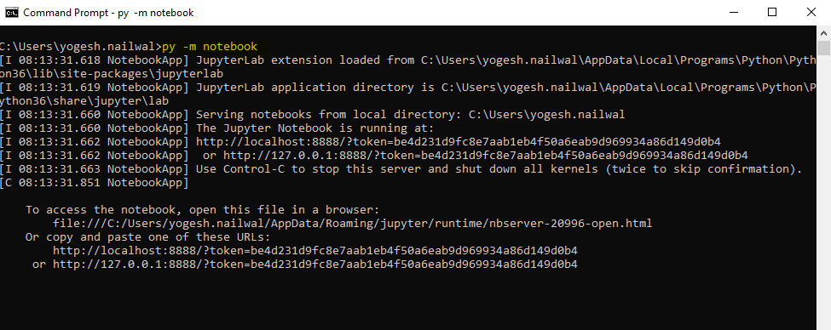

Slide 13
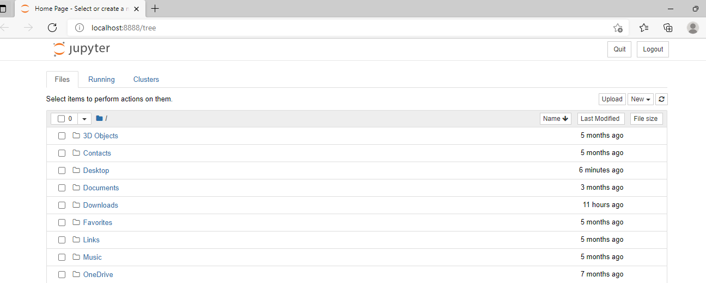

Slide 14
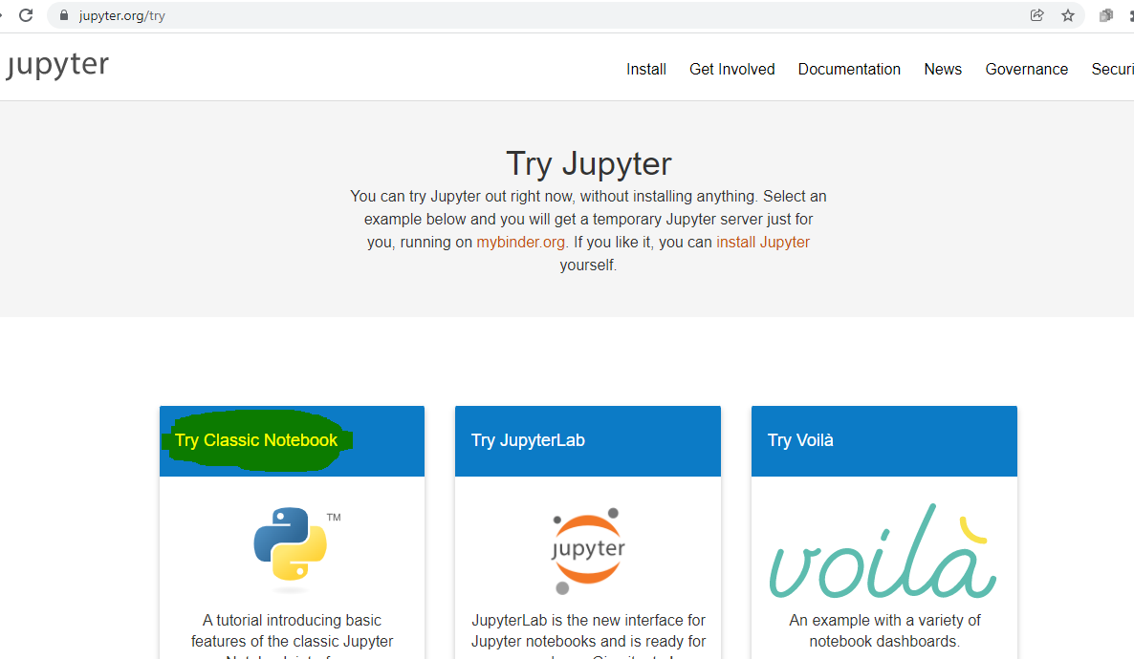

Slide 15
What is a jupyter notebook
Notebook documents are documents produced by the Jupyter Notebook App, which contain both computer code (e.g. python) and rich text elements (paragraph, equations, figures, links, etc…).
Notebook documents are both human-readable documents containing the analysis description and the results (figures, tables, etc..) as well as executable documents which can be run to perform data analysis.
The Jupyter Notebook App is a server-client application that allows editing and running notebook documents via a web browser.

Slide 16
kernel
A notebook kernel is a “computational engine” that executes the code contained in a Notebook document.
When you open a Notebook document, the associated kernel is automatically launched. When the notebook is executed (either cell-by-cell or with menu Cell -> Run All), the kernel performs the computation and produces the results.

