Slide 1

BEWAKOOF

Slide 2
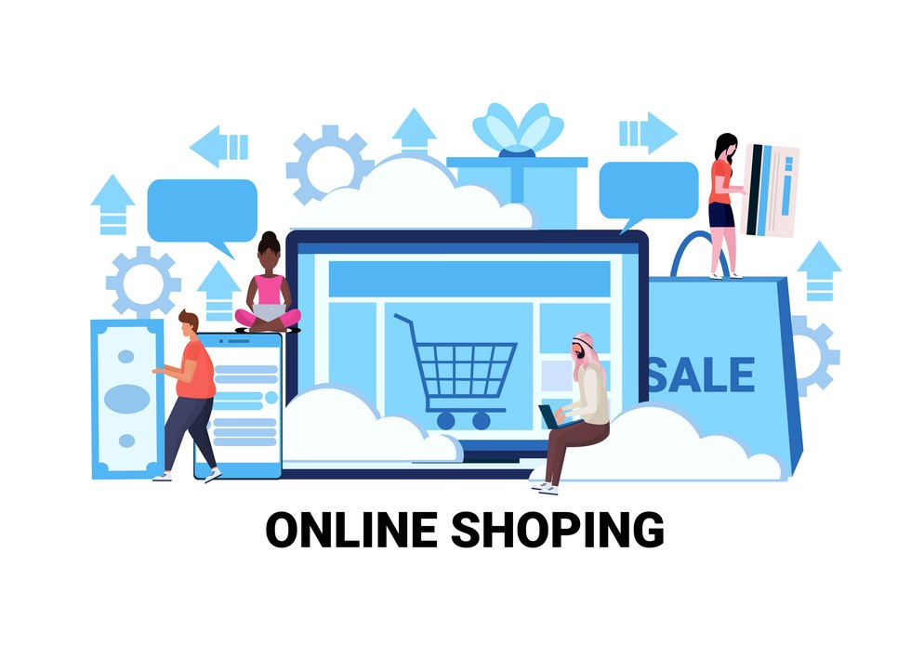

Slide 3
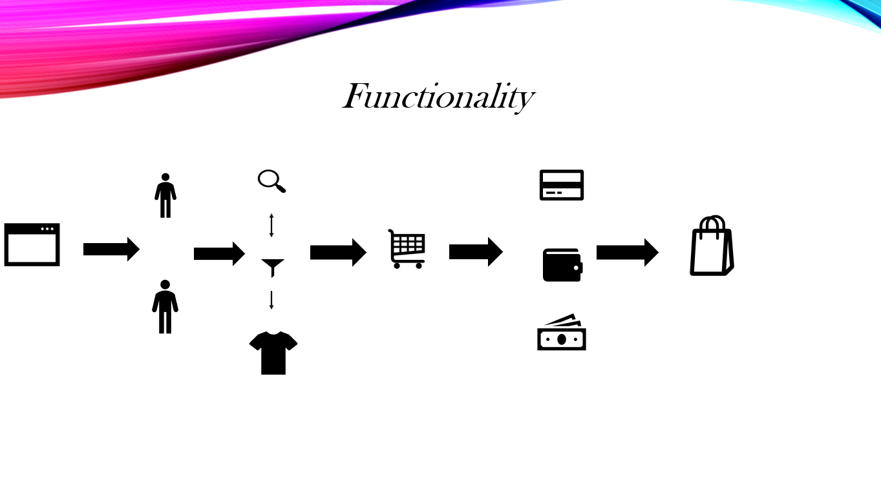










Functionality

Slide 4
Operating Users
Admin User
Login Control Panel
Orders List
Home Page Product Display – featured product
Product Category Details
Items Details, Image & Price under a Category.
Buying User
Display Of Items with Details under Categories
Search Products by input & Category
Add To Cart
Select Quantity
Price Calculated
Proceed To Checkout at Payment Gateway

Slide 5
Functional Requirements
The main page consists of Logo of Application, Login/signup page, offers page, product page, profile page and helpline details under the bottom of Home page.
The page consists of options such as product size, color, and type. There is a sorting feature to filter out products based on price, model, size, etc. There is also the “Add to Cart” or “Add to Wishlist” feature present in the category pages.
The page Consists of the product title, description, product images, related products, Add to Cart feature, Product comparison, additional product information.
The Page consist of list view, removing the product from the list, cash on delivery option, Select delivery option, card payment, pay now option.

Slide 6
Non Functional Requirements
Capturing the behavior when a large number of people are using the software at the same time. Most of the time it is experienced that the servers are busy or unavailable due to heavy load.
Validates that the system meets the expected response time. Evaluates that the significant elements of the application meet the desired response time.
Whether the Application easy to use.

Slide 7
Modules
1. User Phase
2. Application overview
3. Add to cart
4. Payment method

Slide 8
User Module
User registration
Existing user login
Profile Creation– Name, billing, shipping address
Forget Password Retrieval

Slide 9
Application Overview
Product photos
Inter linking with Product Category
Related Product list & links
Product Name & Pricing.
Home Page Product Display

Slide 10
Add To Cart Page
Shopping Cart functionality – Add more product, Update cart, Remove product, checkout
Billing Address > Shipping Address (same or separate)
Number of items
Price for Total number of products

Slide 11
Payment Page
Payment method – Instant pay/ Pay Later
Card details for card payment
Net banking- username and password
UPI ID

Slide 12
TASKS & RESPONSIBILITIES
Sl. No | Team Member | Task assigned | Responsibility
1 | Nandhana | Login Phase | QA
2 | Yogiramu | Application overview | QA
3 | Konani joshna | Add to cart | QA
4 | Jagadeesh | Payment method | QA

Slide 13

Types Of Testing
Smoke Testing
Sanity Testing
Unit Testing
Integration Testing
Performance testing
System Testing
Regression Testing

Slide 14
Documents
Business Requirement Document
Functional Specification Document
Test Cases Execution
Test Scenarios
Requirement Traceability Matrix
Test Strategy
Test Exit Closure Report

Slide 15
Conclusion
Technology has made significant progress over the years to provide consumers a better online shopping experience and will continue to do so for years to come. With the rapid growth of products and brands, people have speculated that online shopping will overtake in-store shopping. While this has been the case in some areas, there is still demand for clothing in market areas where the consumer feels more comfortable seeing and touching the product being bought. However, the availability of online shopping has produced a more educated consumer that can shop around with relative ease without having to spend a large amount of time.

