Slide 1

An open source IDS/IPS

Slide 2

Shameless plug
Ronald van Dorp
’75
Kennis en ervaring (Functioneel):
Requirement Engineering
Prince2, Agile Procesmatig/functioneel ontwerp
ITIL, TOGAF, CEH, CISSP
Trots op: - Kids - Avond HTS - Alpe d’Huez beklommen met 1x MTB en 1x Racefiets
Kennis en ervaring (Technisch):
Netwerk: (KPN, ADSL, Glasvezel, IPTV, VoIP, Cisco 12k, CRS, Redback SE, Huawei, Juniper) Databases: MySQL, Oracle DevOps: (KPN TCL, Solaris, Perl, Ansible, Jenkins, GIT, CVS, Azure DevOp, Python, YAML, JSON, NodeRed)
Unix: Solaris, Debian, RHEL, CentOS Security: Splunk, ArcSight, Qualys, McAfee VM, OpenVAS, Nessus, FirePower, Suricata, Azure Sentinel, Symantec DLP (Data Loss Prevention / Information Security). Cookoo, Symantec/Bluecoat MCAS Ontwerp: ArchiMate

Slide 3

Suricata content
Functioneel Overzicht (Decoder, Rules etc)
Installeren/Configureren van Suricata (15 slides)
Ophalen van gratis Snort/Suricata Rules
Manipuleren van Rules (bijv. Severity aanpassen)
Uitzetten van Rules
Starten van Suricata
EVE events in Splunk
PCAPs extraheren uit EVE events in Splunk
TCPreplay
Publieke PCAP repos met malicious verkeer
Tunen van rules
Elephant flows
Performance / Tunen OS (Suricata.yaml)
Additional features (o.a. DNS, Anomalies)

Slide 4
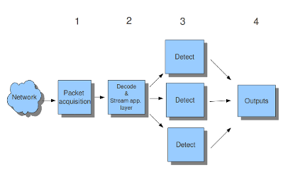
Functioneel overzicht
Suricata:
Er zijn 4 hoofdfuncties:
Packet acquisition
Decode and stream application layer
Detection (Signatures/Rules)
Outputs
Stream application layer:
Stream tracking, make sure all steps will be taken to make the network connection
TCP traffic comes in as packets. Stream Assembly engine reconstructs the original stream
Final step, the Stream Application layer will be inspected. E,g HTTP will be analyzed

Slide 5
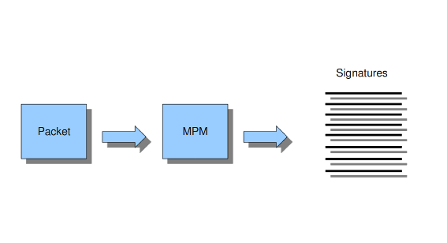
Functioneel overzicht
Suricata Detection Engine:
MPM: Multi-Pattern-Matcher is part of the detection engine Of each signature, one pattern is used by the multi-pattern-matcher. -> Exclude many signatures, because a signature only match when all its patterns match.
MPM algorithms (in order of best implementation by Suricata):
hs, Hyperscan is a high-performance multiple regex matching library: https://www.hyperscan.io
ac-ks, Aho-Corasick, "Ken Steele" variant
ac, Aho-Corasick, default implementation
ac-bs, Aho-Corasick, reduced memory implementation
auto, (let Suricata/OS decide)
Hyperscan wordt aangeraden als je een x86-64-bits CPU gebruikt. Maar ac-ks kan beter performen (zie PDF aan het einde)

Slide 6
Functioneel overzicht
Suricata thread modules:
Management (flow.managers, flow.recyclers)
Receive/capture (receive and decode)
Worker (streamtcp, detect, output(logging), reject
IPS Verdict (respond/reject)

Slide 7
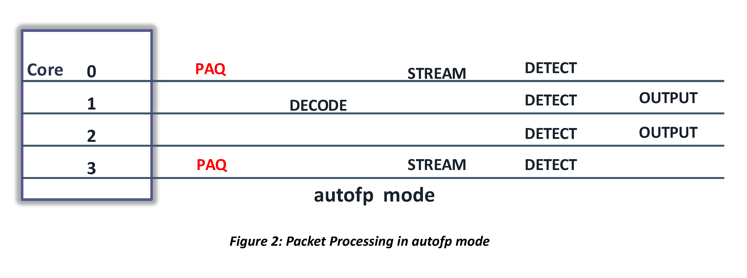
Functioneel overzicht
Suricata Run Modes: https://suricata.readthedocs.io/en/suricata-6.0.0/performance/runmodes.html https://xbu.me/article/performance-characterization-of-suricata-thread-models/ AutoFP: (Auto Flow Pinning) All packets belonging to a flow are processed by the same stream, detection and output thread
One or more capture threads (PCAP processing / IPS ) -> packet capture + decoding, passed to flow worker thread
management-cpu-set is used for flow timeout handling, counters
worker-cpu-set is used for 'worker' threads
receive-cpu-set is used for capture threads
verdict-cpu-set is used for IPS verdict threads

Slide 8
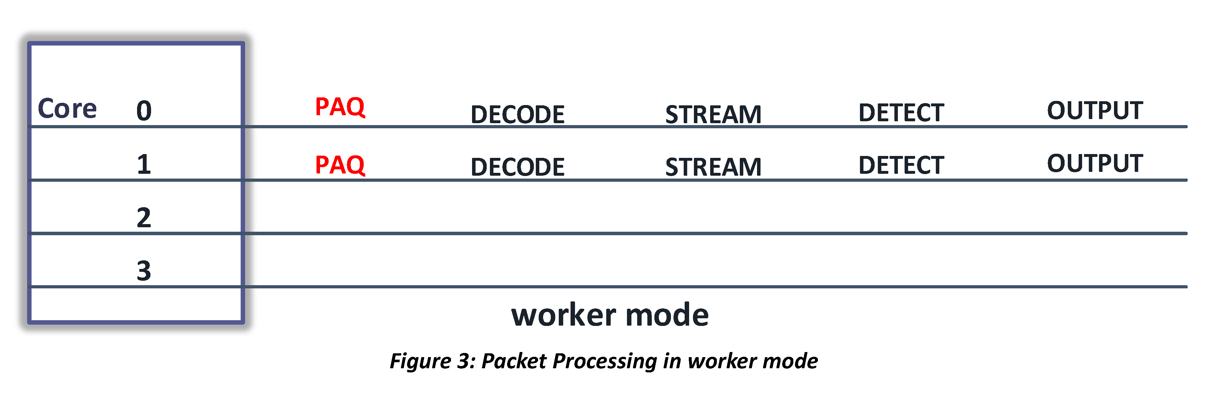
Functioneel overzicht
Suricata Run Modes: Workers: NIC/Driver -> Suricata processing threat. Each packet processing thread then contains the full packet pipeline. Each thread runs all thread modules. management-cpu-set is used for flow timeout handling, counters
worker-cpu-set is used for 'worker' threads
Single: Same as worker only 1 single processing threat. E.g., for troubleshooting signatures/development.

Slide 9
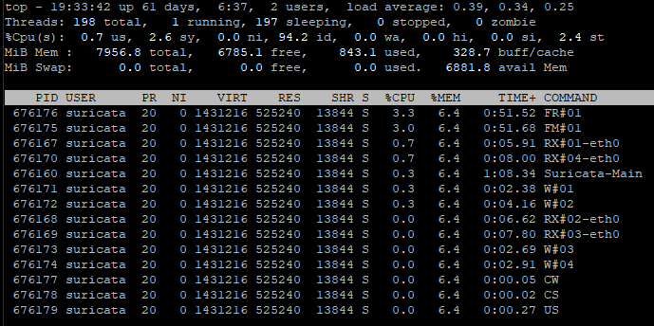
Functioneel overzicht
Suricata Run Modes: Example output, alle threads in AutoFP mode (IDS mode)
https://github.com/OISF/suricata/blob/master/src/runmodes.c
Management: FM#01: Flow Manager
FR#01: Flow Recycler
CS: Counter Stats
CW: Counter Wakeup US: Unix Socket Receive/Capture:
RX#01-04: AutoFP mode only Worker: W#01-04: Detection+Output

Slide 10
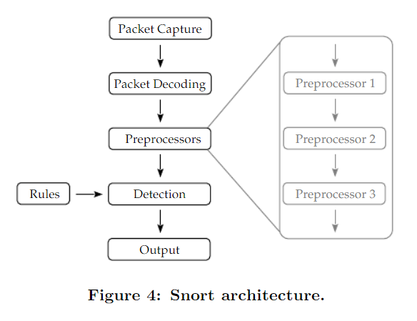
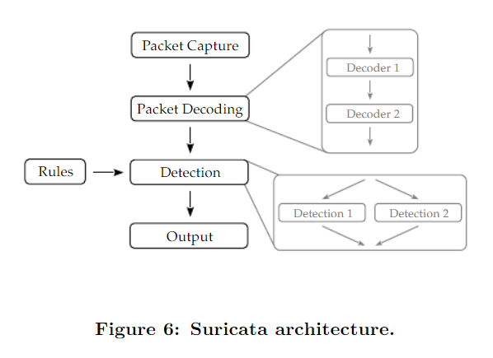
Functioneel overzicht
Suricata vs Snort: Automatic protocol detection -> Rules matchen onafhankelijk van TCP/UDP poorten alert http maar niet $HTTP_PORTS!!! Let op die rules alert tcp $HOME_NET any -> $EXTERNAL_NET $HTTP_PORTS ... Wordt dan: alert http $HOME_NET -> $EXTERNAL_NET any ...
Figures source: https://www.researchgate.net/publication/309229246_A_Survey_on_Network_Security_Monitoring_Systems

Slide 11

Suricata
Installeren / configureren van Suricata
15 slides

Slide 12
Installeren/configureren van Suricata
Debian: sudo apt-get install suricata Run as non-root user: sudo systemctl stop suricata sudo groupadd -g 2002 suricata
sudo useradd -m -k /etc/skel/ -u 2002 -g 2002 suricata sudo chown -R suricata: /etc/suricata/ sudo chown -R suricata: /var/log/suricata/ sudo chown -R suricata: /var/lib/suricata/ sudo mkdir /var/run/suricata sudo chown –R suricata: /var/run/suricata (suricata-command.socket will be created within that folder) Cron: /etc/cron.d/suricata-update
# minute hour day-of-month month day-of-week (0,7=Sunday, 1=Monday)
0 0 * * 0,3 suricata test -x /usr/bin/suricata-update || /usr/bin/suricata-update update-sources > /dev/null 2>&1
0 1 * * * suricata test -x /usr/bin/suricata-update || /usr/bin/suricata-update > /dev/null 2>&1 # Reload rules only (USR2 signal)
5 1 * * * suricata kill -usr2 $(pidof suricata)

Slide 13
Installeren/configureren van Suricata
suricata.yaml
Run Suricata met specifieke user-id en group-id:
run-as:
user: suricata
group: suricata
unix-command:
enabled: yes
filename: /var/run/suricata/suricata-command.socket
Specificeer je eigen HOME_NET, IP-subnet(s), dit is noodzakelijk: vars:
address-groups:
HOME_NET: "[192.168.0.0/16,10.0.0.0/8,172.16.0.0/12]"
In een Enterprise omgeving geldt: Hoe meer je weet over web servers, DNS server etc. Des te beter werken je signatures en dit heeft impact op je performance
Ports tbv applicatie herkenning: Als je rules herschrijft naar Suricata is dit niet nodig, dat kan de decoder van Suricata uitvoeren op iedere port.

Slide 14
Configureren van Suricata
suricata.yaml Run mode (scheelt echt in load):
runmode: autofp AF-Packet mode: Linux + IDS mode: af-packet v3: ONLY in ‘workers’ mode! af-packet:
- interface: eth0
....
use-mmap: yes
tpacket-v3: yes|no (depending on runmode) PF_RING mode (heb je speciale NIC + drivers nodig!): suricata -vvv --pfring -k none -c /etc/suricata/suricata.yaml
AF Packet (Address Families)
PF Packet is renamed to AF Packet PF Ring (Protocol Families) mmap()-ed memory ring for accelerating packet capture (specific, custom drivers)

Slide 15
Configureren van Suricata
suricata.yaml Define threads for autoFP: threading: (Voor 4 CPU cores)
set-cpu-affinity: yes
cpu-affinity:
- management-cpu-set:
cpu: [ 0 ] # include only these CPUs in affinity settings
- receive-cpu-set:
cpu: [ "0-1" ] # include only these CPUs in affinity settings
- worker-cpu-set:
cpu: [ "2-3" ]
mode: "exclusive"
# Use explicitly 3 threads and don't compute number by using
# detect-thread-ratio variable:
#threads: 3
prio:
low: [ "0-1" ]
medium: [ "2-3" ]
high: [ ]
default: "medium“
#- verdict-cpu-set:
# cpu: [ 0 ]
# prio:
# default: "high“
detect-thread-ratio: 1.0

Slide 16
Configureren van Suricata
suricata.yaml On x86_64 use Hyperscan: mpm-algo: hs
Statistics:
Let op update iedere 60 secondes, neem ook decoder en stream events mee
stats:
enabled: yes
interval: 60
decoder-events: true
stream-events: true
Outputs:
Disable fast output als je je events naar Splunk/ELK stuurt -> EVE naar Splunk outputs:
- fast:
enabled: no

Slide 17
Configureren van Suricata
suricata.yaml eve output.
Settings die aan gezet moeten worden / niet default zijn
outputs:
- eve-log:
enabled: yes
filetype: regular
filename: eve.json
community-id: true
xff:
enabled: yes
mode: extra-data
deployment: reverse
Eve-log types op de volgende pagina.

Slide 18
Configureren van Suricata
suricata.yaml Eve-log types:
types:
- alert:
payload: yes
payload-printable: yes
packet: yes
tagged-packets: yes
- anomaly:
enabled: yes
types:
decode: yes
stream: no
applayer: yes
packethdr: no

Slide 19
Configureren van Suricata
suricata.yaml Eve-log types:
types:
- http:
extended: yes
- dns:
enabled: yes
requests: yes
responses: yes
formats: [grouped, detailed]
types: [a, aaaa, cname, mx, ns, ptr, txt]
- tls:
extended: yes
- drop:
alerts: yes
flows: all

Slide 20
Configureren van Suricata
suricata.yaml Eve-log types:
types:
- smtp:
Wanneer je node in een gesharede / publieke omgeving zit:
- dhcp:
enabled: yes
extended: no
Protocol specifieke logging (uitzetten als dit niet gebruikt wordt in je omgeving, scheelt performance) #- dnp3 (SCADA, is niet echt gebruikelijk)

Slide 21
Configureren van Suricata
suricata.yaml Eve-log types:
Als het gebruikt wordt wil ik het wel zien: types:
- ftp
- rdp
- nfs - smb
- tftp
- ikev2
- dcerpc
- krb5
- snmp
- rfb
- sip
- ssh
- mqtt
- http2

Slide 22
Configureren van Suricata
suricata.yaml Eve-log types:
Suricata statistieken: types:
- stats:
totals: yes
threads: no
deltas: no
Network flows: types:
- flow (bi-directional flows)
#- netflow (uni-directional flows, teveel logs)
#- metadata (pktvars, flowvars,flowbits, flowints)

Slide 23
Configureren van Suricata
suricata.yaml Andere line-based log types uitzetten (enabled: no), EVE logging bevat de meeste al:
outputs:
- https-log
- tls-log
- tls-store
- pcap-log (ligt aan de use-case, maar kan snel heel veel data worden)
- alert-debug
- alert-prelude
- stats (wordt al gelogged in EVE)
- syslog
- file-store
- tcp-data
- http-body-data
- lua

Slide 24
Configureren van Suricata
suricata.yaml Logging van Suricata zelf:
logging:
outputs:
- console:
enabled: no
- file:
enabled: yes
- syslog:
enabled: no

Slide 25
Configureren van Suricata
suricata.yaml Application layer detection (hou alles op default, tenzij custom ports gebruikt worden):
app-layer:
protocols:
Zet Core dumps uit, tenzij je een support contract hebt met Suricata ☺ coredump:
max-dump: 0
Wanneer je niet de default packet size hebt, andere MTU + header vanwege LACP, VLAN tagging etc, dan aanpassen:
default-packet-size: 1514
GeoIP2 database file (Land wordt soms in rules/signatures gebruikt. Tegenwoordig een API key nodig): https://dev.maxmind.com/geoip/geolite2-free-geolocation-data?lang=en geoip-database: /opt/GeoLite2/GeoLite2-Country.mmdb

Slide 26
Configureren van Suricata
suricata.yaml Flow settings:
flow:
memcap: 128mb (32mb is te weinig)
managers: 1
recyclers: 1
VLAN ondersteuning:
vlan:
use-for-tracking: true
Stream settings:
stream:
memcap: 64mb (32mb is te weinig)
reassembly:
memcap: 256mb (64mb is te weinig)

Slide 27
Configureren van Suricata
suricata.yaml Reload rules en blijf draaien (gebruik kill –usr2 $(pidof suricata) in cronjob):
detect-engine:
- rule-reload: true

Slide 28
Suricata
Ophalen van up2date signatures/rules

Slide 29
Ophalen van gratis Snort rules
Met de laatste versies van Suricata is dit enorm verbeterd.
Als user suricata: suricata-update update-sources Alle rules updaten, automatisch disable, modify: suricata-update BUG: run-as -> suricata-update –-no-test
Alle sources listen: suricata-update list-sources /var/lib/suricata/update/cache/index.yaml
Alle enabled sources:
suricata-update list-enabled-sources
/var/lib/suricata/update/sources/*.yaml
Voorstel: Enabled sources:
- sslbl/ja3-fingerprints
- oisf/trafficid
- tgreen/hunting
- et/open
- sslbl/ssl-fp-blacklist

Slide 30
Suricata
Manipuleren van signatures / rules

Slide 31
Manipuleren van rules
Aanpassen van de signatures / rules
/etc/suricata/modify.conf
# Syntax:
# re:"<Regular Expression>" "<Search>" "<Replace with>"
Change priority to informational for bad reputation lists
re:"ET CINS Active Threat Intelligence Poor Reputation IP group" "classtype:misc-attack" "classtype:misc-attack; priority:4"
N.B.
Make sure lookup table for Suricata TA Splunk contains info for priority 4 in alerts.severity
Use classtype (first lookup in rule) to add the priority, as per default classtype is used to determine severity
Default classification.config
config classification: command-and-control,Malware Command and Control Activity Detected,1

Slide 32
Suricata
Uitzetten van signatures / rules

Slide 33
Uitzetten van Rules
Uitzetten van rules / signatures:
disable.conf
# Disable SURICATA TCPv4 invalid checksum
2200074
# Disable SURICATA STREAM Packet with invalid timestamp
2210044
# Disable ET SCAN Potential SSH Scan, already covered with fail2ban
2001219

Slide 34
Suricata
Starten van Suricata

Slide 35
Starten van Suricata
Nu de meeste zaken geconfigureerd zijn kan Suricata gestart worden:
sudo systemctl start suricata
Verifieer of Suricata gestart is en als user suricata draait:

Slide 36
Suricata
EVE events in Splunk

Slide 37
EVE events in Splunk
Outputs die Suricata kan genereren anders dan EVE (extensible event format):
Alerts (op basis van signatures/rules):
fast (leesbare logging van de alerts, ASCii)
syslog (leesbare logging van de alerts naar Syslog)
eve (Extensible Event Format –JSON van de alerts)
Protocol specifiek (geen alerts):
http-log (HTTP requests)
tls-log (TLS handshake parameters)
tls-store (Store certificates)
pcap-log (Logs to pcap files)
file-store (Store files found in streams, name SHA256)
tcp-data (Store tcp data na stream normalisatie)
http-body-data
lua (Execute LUA script)
Suricata zelf:
alert-debug (Debug rules, signature writers, false positives)
stats (Statistics about Suricata and the engines/layers/processes)

Slide 38
EVE events in Splunk
EVE events in Splunk
Suricata TA ophalen van Splunk base: https://splunkbase.splunk.com/app/2760
Aanpassingen van de TA:
TA-Suricata/default/inputs.conf:
# commentarieer alles
TA-Suricata/default/inputs.conf:
[monitor:///var/log/suricata/eve.json]
disabled = 0
sourcetype = suricata
index = suricata
# Set time-zone in SourceType
TZ = UTC

Slide 39
EVE events in Splunk
EVE events in Splunk
Suricata TA ophalen van Splunk base: https://splunkbase.splunk.com/app/2760
Aanpassingen van de TA:
TA-Suricata/default/props.conf:
stats.decoder.icmpv6 AS decoder_icmpv6
TA-Suricata/lookups# cat suricata_severity.csv
severity_id,severity
0,N/A
1,high
2,medium
3,low
4,info <<< deze staat er standard niet in

Slide 40
Suricata
Base64 PCAPs extraheren uit EVE events in Splunk

Slide 41
PCAPs extraheren uit EVE events
Download de eStreamer TA van SplunkBase
https://splunkbase.splunk.com/app/1629
Packet is base64 encoded bevat niet de PCAP header tools.py is aangepast zodat deze werkt met Suricata.
Nieuwe tools.py:
HWSE3_Suricata/appserver/controllers/tools.py
Aangepaste eventtypes.conf:
HWSE3_Suricata/default/eventtypes.conf
[suricata-pcap]
search = index=suricata sourcetype=suricata packet!=""

Slide 42
PCAPs extraheren uit EVE events
Updated workflow_actions.conf:
/HWSE3_Suricata/default/workflow_actions.conf
[suricata_save_pcap]
display_location = event_menu
eventtypes = suricata-pcap
fields = flow_id, packet, payload
label = Suricata: Save PCAP
link.method = get
link.target = blank
link.uri = /custom/HWSE3_Suricata/tools/savepcap?flow_id=$flow_id$&packet=$packet$&payload=$payload$
type = link
Updated web.conf:
HWSE3_Suricata/default/web.conf
# Tools endpoint
#
# custom cherrypy endpoints
#
#[endpoint:<python_module_name>]
#* Registers a custom python CherryPy endpoint.
#* The expected file must be located at:
# $SPLUNK_HOME/etc/apps/<APP_NAME>/appserver/controllers/<PYTHON_NODULE_NAME>.py
#* This module's methods will be exposed at
# /custom/<APP_NAME>/<PYTHON_NODULE_NAME>/<METHOD_NAME>
[endpoint:tools]

Slide 43
Suricata
TCPreplay

Slide 44
TCPreplay
TCPreplay - Replay a captured PCAP file
tcpreplay -i eth0 –v –d0 –K –pps 1000 2022-09-29-Qakbot-with-Cobalt-Strike.pcap tcpreplay -i eth0 –v –d0 –K –pps 1000 2022-10-06-IcedID-with-Cobalt-Strike-santized-and-carved.pcap | less (to find the host under attack, for the rewrite)
TCPrewrite
- Rewrite certain fields, e.g. Source and Destination MAC address, Source and Destination IP to it can be routed to/through a firewall / IPS / IDS tcprewrite -S 10.9.29.201/32:38.242.142.237/32 -D 10.9.29.201/32:38.242.142.237/32 -i 2022-09-29-Qakbot-with-Cobalt-Strike.pcap
-o 2022-09-29-Qakbot-with-Cobalt-Strike_Edited.pcap tcprewrite -S 10.10.6.101/32:38.242.142.237/32 -D 10.10.6.101/32:38.242.142.237/32 -i 2022-10-06-IcedID-with-Cobalt-Strike-santized-and-carved.pcap -o 2022-10-06-IcedID-with-Cobalt-Strike-santized-and-carved_Edited.pcap TCPreplay: tcpreplay -i eth0 -t -v –d0 2022-09-29-Qakbot-with-Cobalt-Strike_Edited.pcap (Max speed, leads to packet drops) tcpreplay -i eth0 -v -d0 -K --pps 1000 2022-09-29-Qakbot-with-Cobalt-Strike_Edited.pcap (Packets/sec) Because now the Src+Dest IP match the host on which the IDS / IPS is running -> Triggers alerts
If you really want to trigger another device/IPS/Firewall then you need to manipulate the source and destination MAC addresses too.

Slide 45
Suricata
Publieke repositories met malicious verkeer opgeslagen in PCAP files

Slide 46
Publieke PCAP repos met malicious verkeer
Samples / PCAPs met laatste malware IOCs gebaseerd op network verkeer
https://www.malware-traffic-analysis.net/ (based on recent attacks)
https://www.netresec.com/?page=PcapFiles
Ransomware:
http://dataset.tlm.unavarra.es/ransomware/
Mitre Att&ck matched:
https://github.com/sbousseaden/PCAP-ATTACK
DEMO!
Notes:
/opt/malwaretraffic

Slide 47
Suricata
Tunen van signatures / rules

Slide 48
Tunen van Rules
Tunen van Rules of zelf rules maken
Dit is een hoofdstuk apart. Suricata rules lijken op die van Snort rules, daar is zat over te vinden. Let op application/protocol decoders ipv TCP/UDP ports
https://redmine.openinfosecfoundation.org/projects/suricata/wiki/Suricata_Rules
https://alparslanakyildiz.medium.com/creating-custom-suricata-signitures-260fc049b56a
https://coralogix.com/blog/writing-effective-suricata-rules-for-the-sta/

Slide 49
Suricata
Elephant flows

Slide 50
Elephant flows
Large flows/streams which will take memory out of your stream assembly process/engine. Bijvoorbeeld Backups, kopiëren van grote bestanden / ISOs One CPU/Thread is 100% bezet voor een langere tijd.
Stream.reassembly.depth protects agains tracking these large data transfers stream:
reassembly:
depth: 1mb # reassemble max of 1mb into a stream

Slide 51
Suricata
Performance tuning OS

Slide 52
Performance / Tunen van OS
Interessante performance tests waarin verschillende configuratie settings worden vergeleken:
https://suricon.net/wp-content/uploads/2021/04/SuriCon17-Woodberg.pdf Disable IRQ balancing:
systemctl stop irqbalance
systemctl disable irqbalance
Uitzetten van Transparant Huge Pages 4 KB vs 2 MB:
echo madvise > /sys/kernel/mm/transparent_hugepage/enabled
echo madvise > /sys/kernel/mm/transparent_hugepage/defrag
Wanneer je fysieke hardware NICs gebruikt: G/LRO: Generic/Large Receive Offload G/T/LSO: Generic/TCP/Large Segmentation Offload # sudo ethtool -K eth0 gro off lro off gso off tso off lso off Huidige NIC driver/module parameters: # sudo ethtool -k eth0

Slide 53
Performance / Tunen van OS
Minder snel swap gebruiken / sneller leegmaken:
/etc/sysctl.d/20-swap.conf
#
# Less use of Swap
#
vm.swappiness = 1
vm.vfs_cache_pressure = 50
vm.dirty_ratio = 8
vm.dirty_background_ratio = 4
Max shared memory definiëren:
/etc/sysctl.d# cat 21-max-shared-mem.conf
#
# Max Shared Memory # 8GB = 8 * 1024 * 1024 * 1024
# 4GB = 4 * 1024 * 1024 * 1024 # 4294967296 1048576
# 1073741824 262144
# SHMALL = SHMMAX / 4096 (PageSize)
# getconf PAGE_SIZE
#
kernel.shmmax = 8589934592
kernel.shmall = 2097152

Slide 54
Suricata
Additional Features

Slide 55
Additional features
Anomalies:
CPU en memory intensief voor grote/veel verkeersstromen
Flows:
Flow: Bidirectional
Netflow: Unidirectional (geeft veel events)
Statistics:
Aparte log file
In EVE (makkelijker voor Splunk)
DHCP (interessant als je een VM hebt in een gesharede omgeving)
DNS:
Queries
Answers
Let op: Root DNS, want je ziet Root DNS server verzoeken -> TLDs etc.
Communiceren via Unix socket:
suricatasc /var/run/suricata/suricata-command.socket
suricatasc /var/run/suricata/suricata-command.socket -c "iface-stat eth0"

Slide 56
Additional features
Anomaly -> event_type = anomaly -> Report
Flows -> event_type = flow
Stats -> Dashboard
DHCP -> event_type = dhcp
DNS -> Report (unbound actions)
DEMO
Notes:
Anomaly:
find corresponding flow -> e.g. flow_id=781118831517788 Flows: flow_id: 335662054952330

Slide 57
Vragen?

Slide 58
Suricata
Appendix

Slide 59
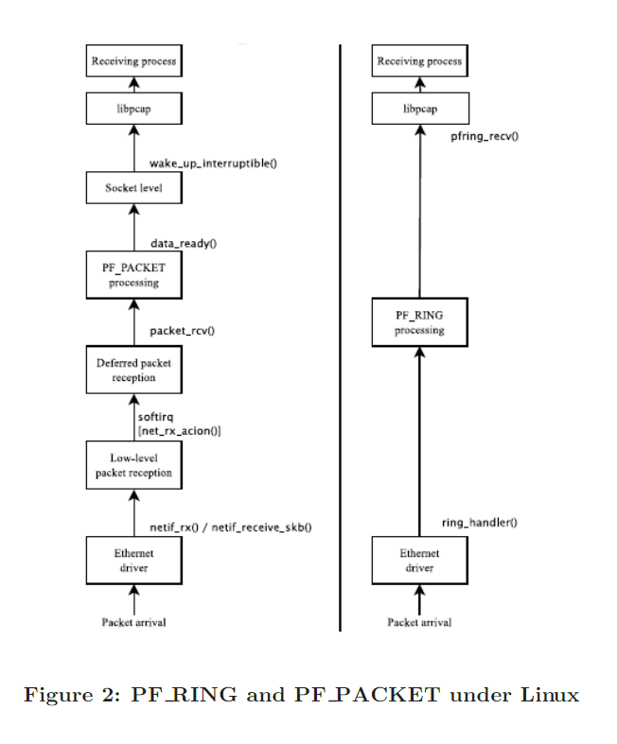
Appendix
Some interesting read about performance of AF/PF PACKET vs PF_RING -> Non-Promiscuous mode, only accept packets with its own MAC-address
Promiscuous mode, retrieve/accept all packets
Figures source: https://www.researchgate.net/publication/221611960_Comparing_and_improving_current_packet_capturing_solutions_based_on_commodity_hardware

