Slide 1

ILLUMINATING THE BLACK BOX:
An Explainable AI framwork for madical Trust on AI models using 3D MRI images on 3D CNNs and make it transparent.
SUPERVISOR : MAIMOONA MAQSOOD SHARIF
COURSE : DATA SCIENCE AND ARTIFICIAL INTELLIGENCE

Slide 2
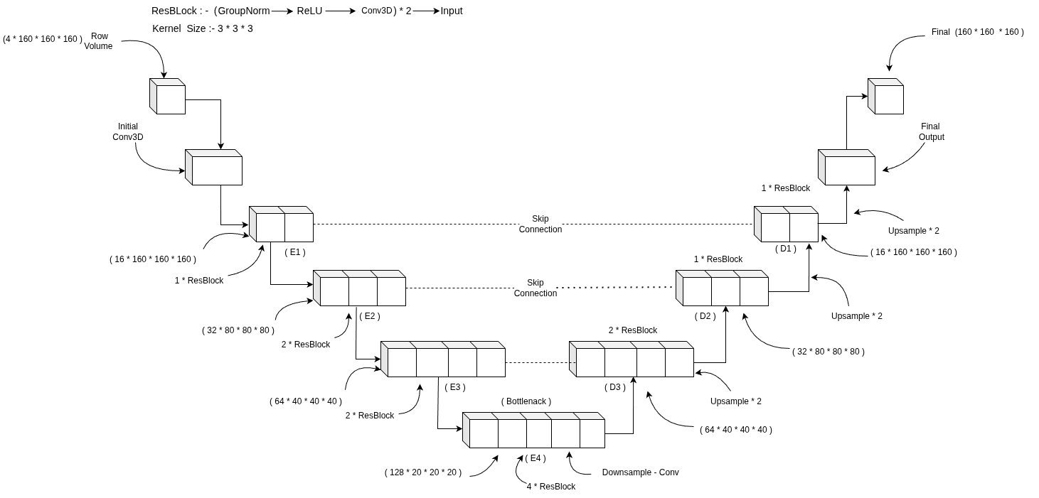
3D Residual-Net Model

Slide 3
