Slide 1
Employee Data Analysis using Excel
STUDENT NAME: IFRAN KHAN
REGISTER NO: 312213154
DEPARTMENT: B.com (ACCOUNTING & FINANCE)
COLLEGE: Tagore college of arts and science

Slide 2

Employee Performance Analysis
using Excel

Slide 3


Problem Statement
Project Overview
End Users
Our Solution and Proposition
Dataset Description
Modelling Approach
Results and Discussion
Conclusion

Slide 4

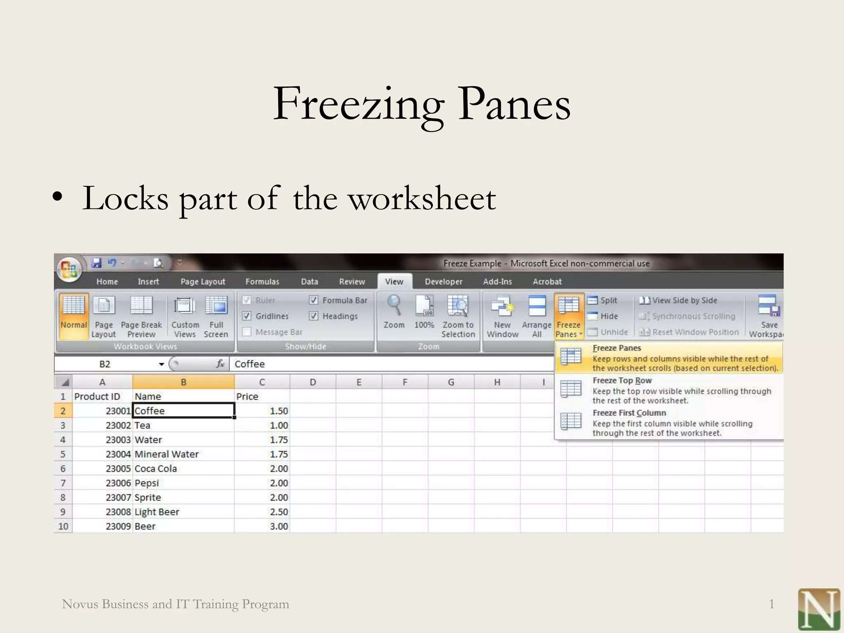

Slide 5

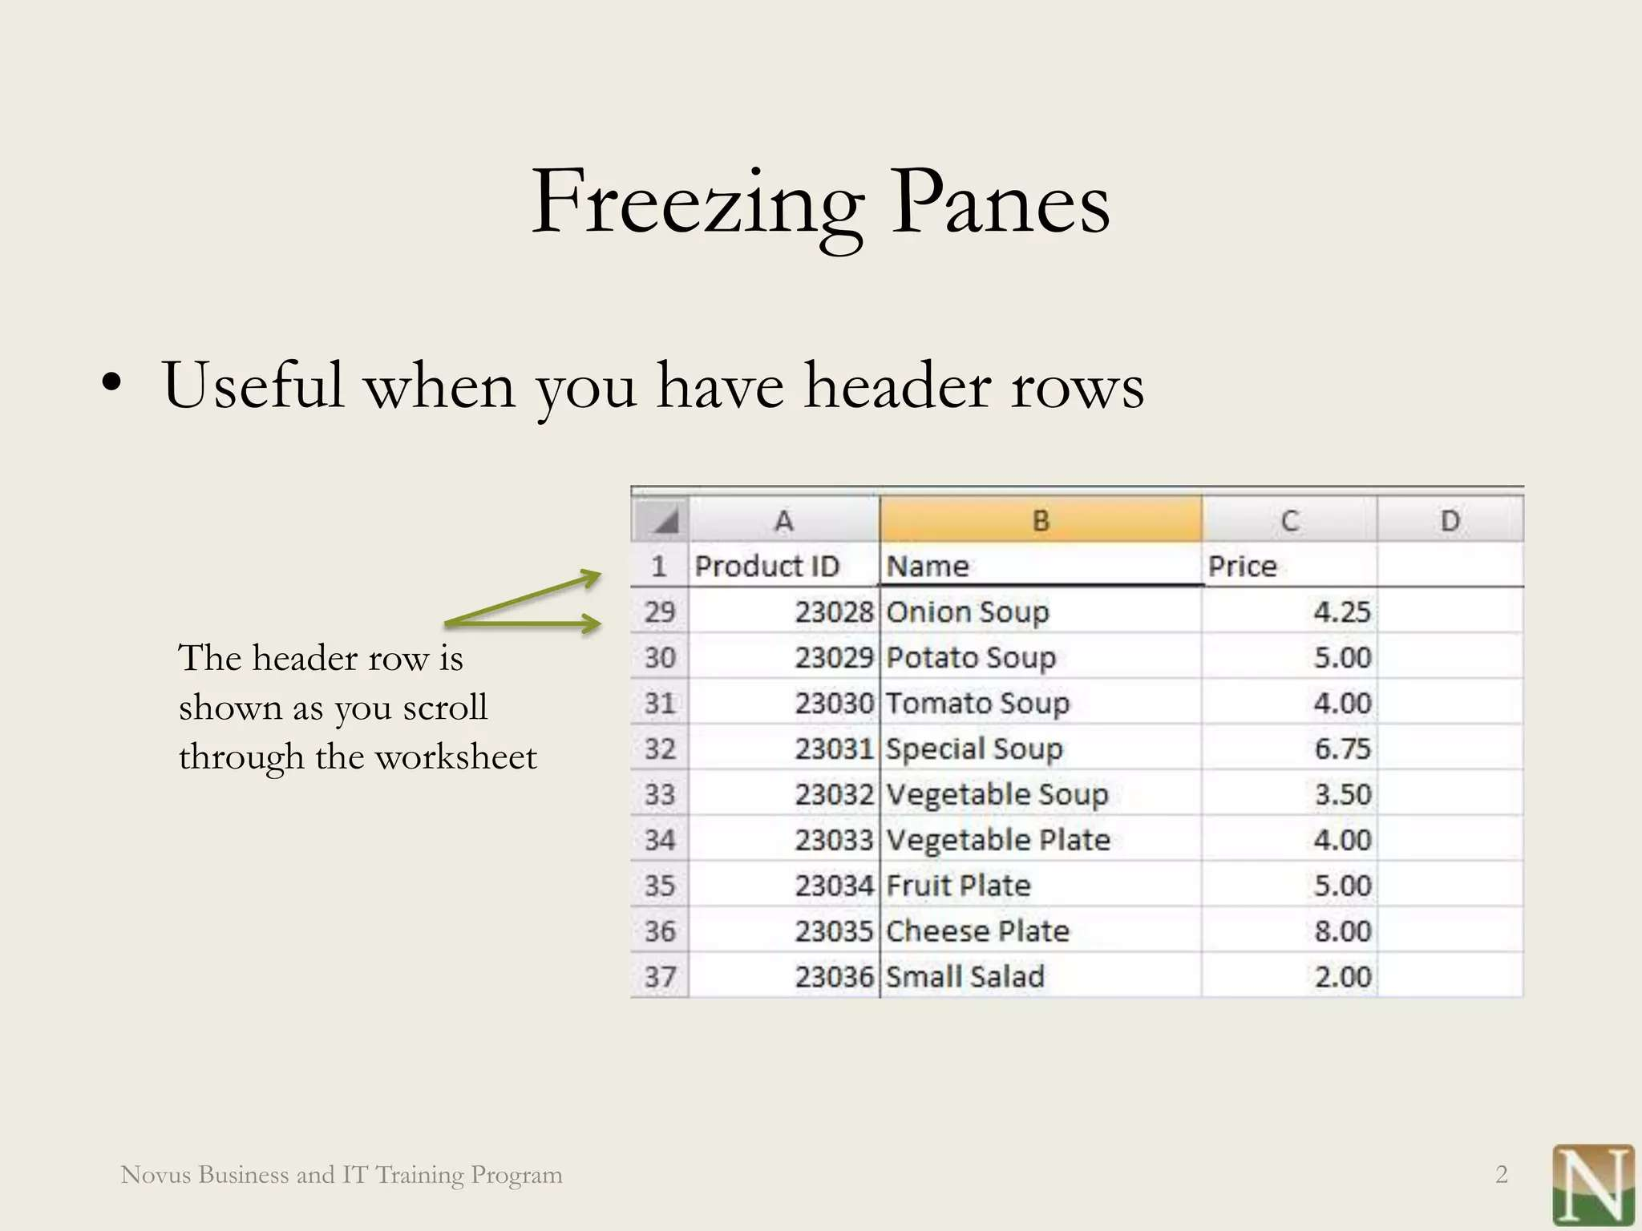

Slide 6

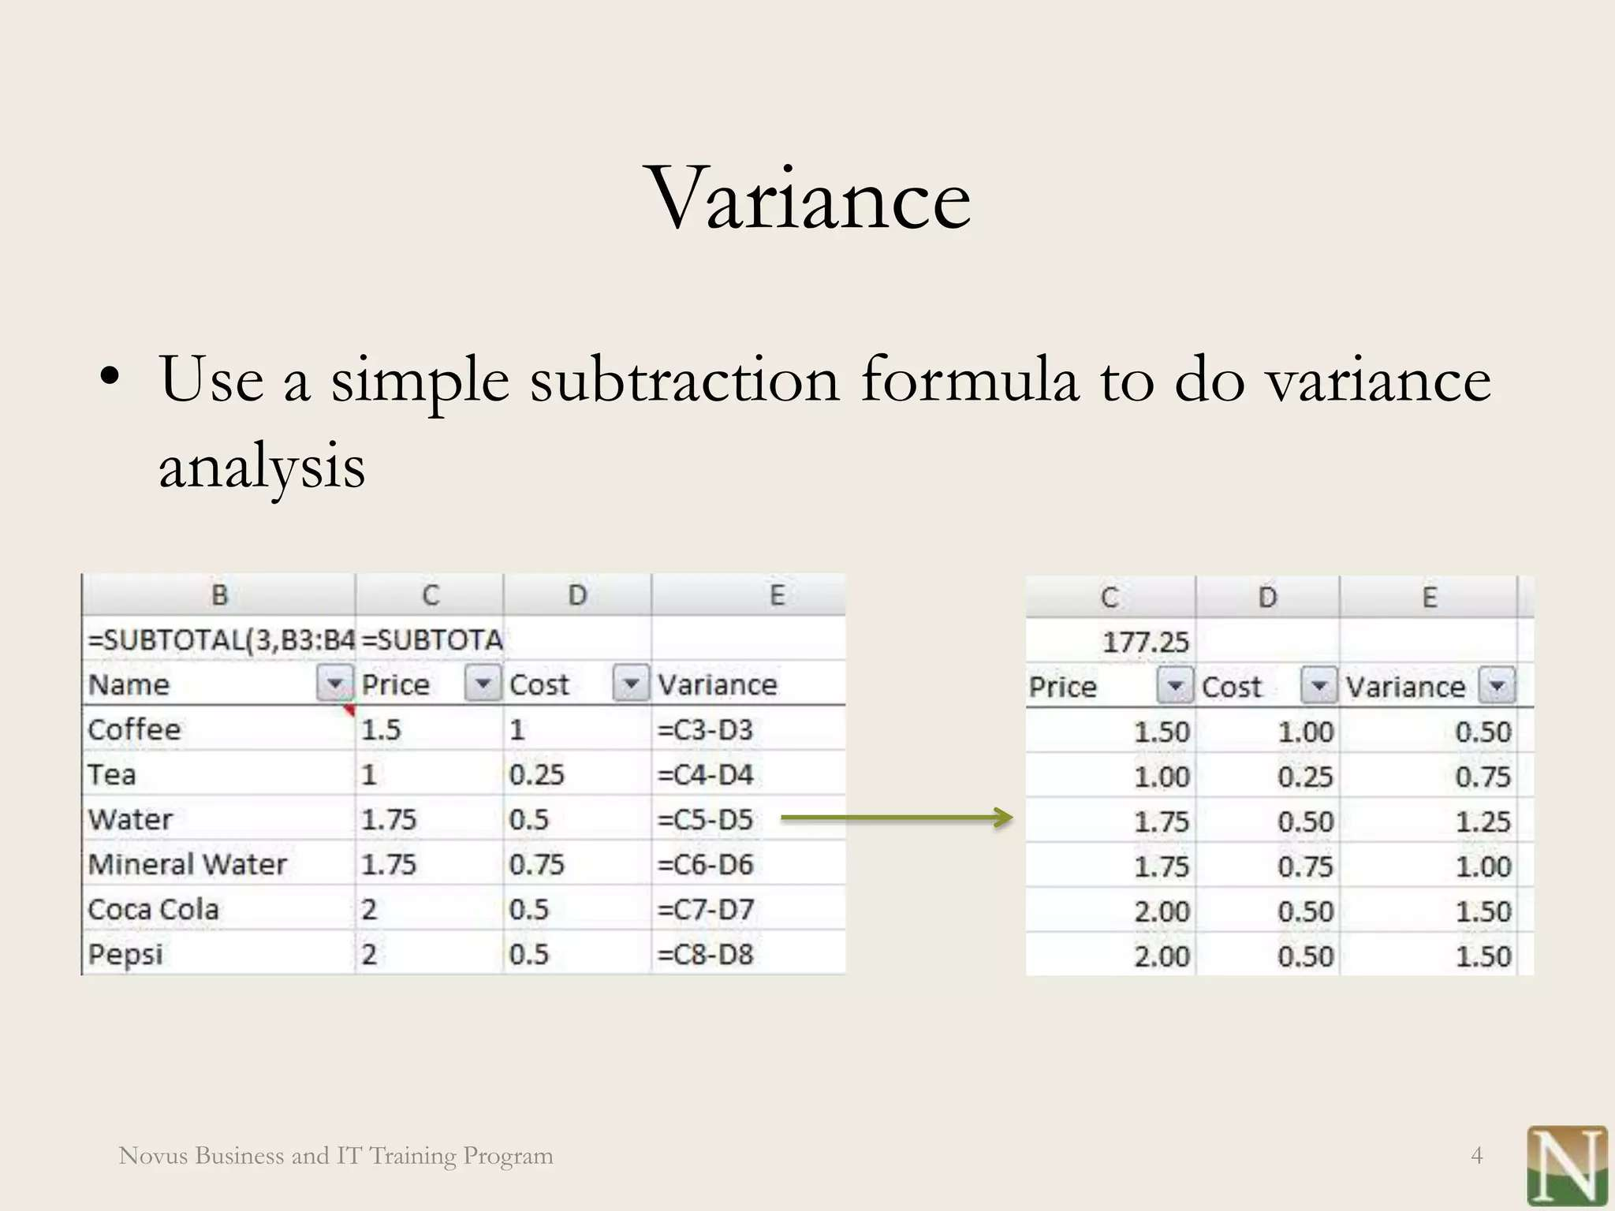


Slide 7
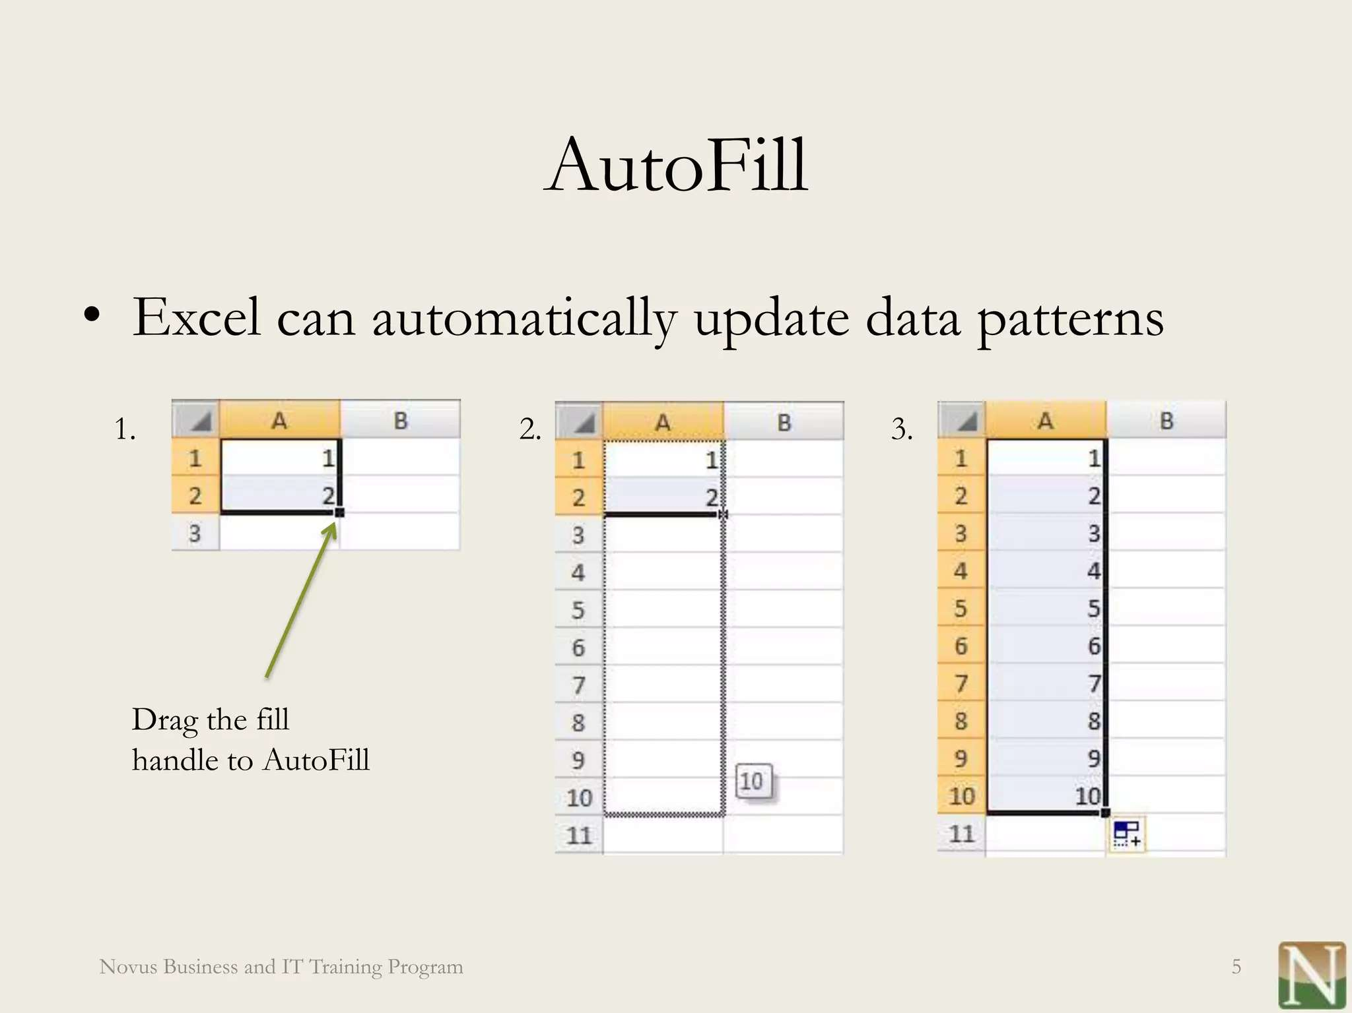
MODELLING

Slide 8
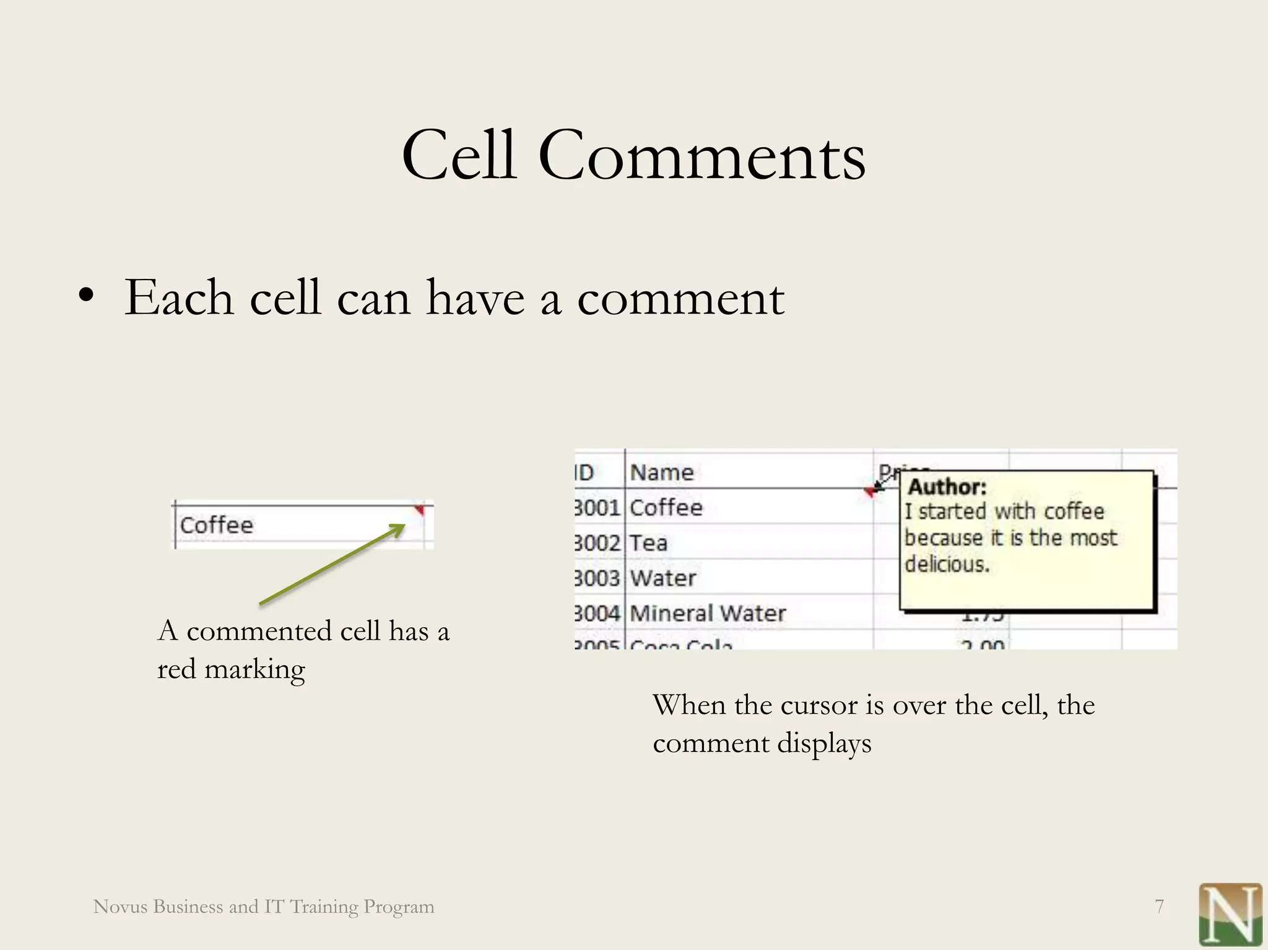

Slide 9
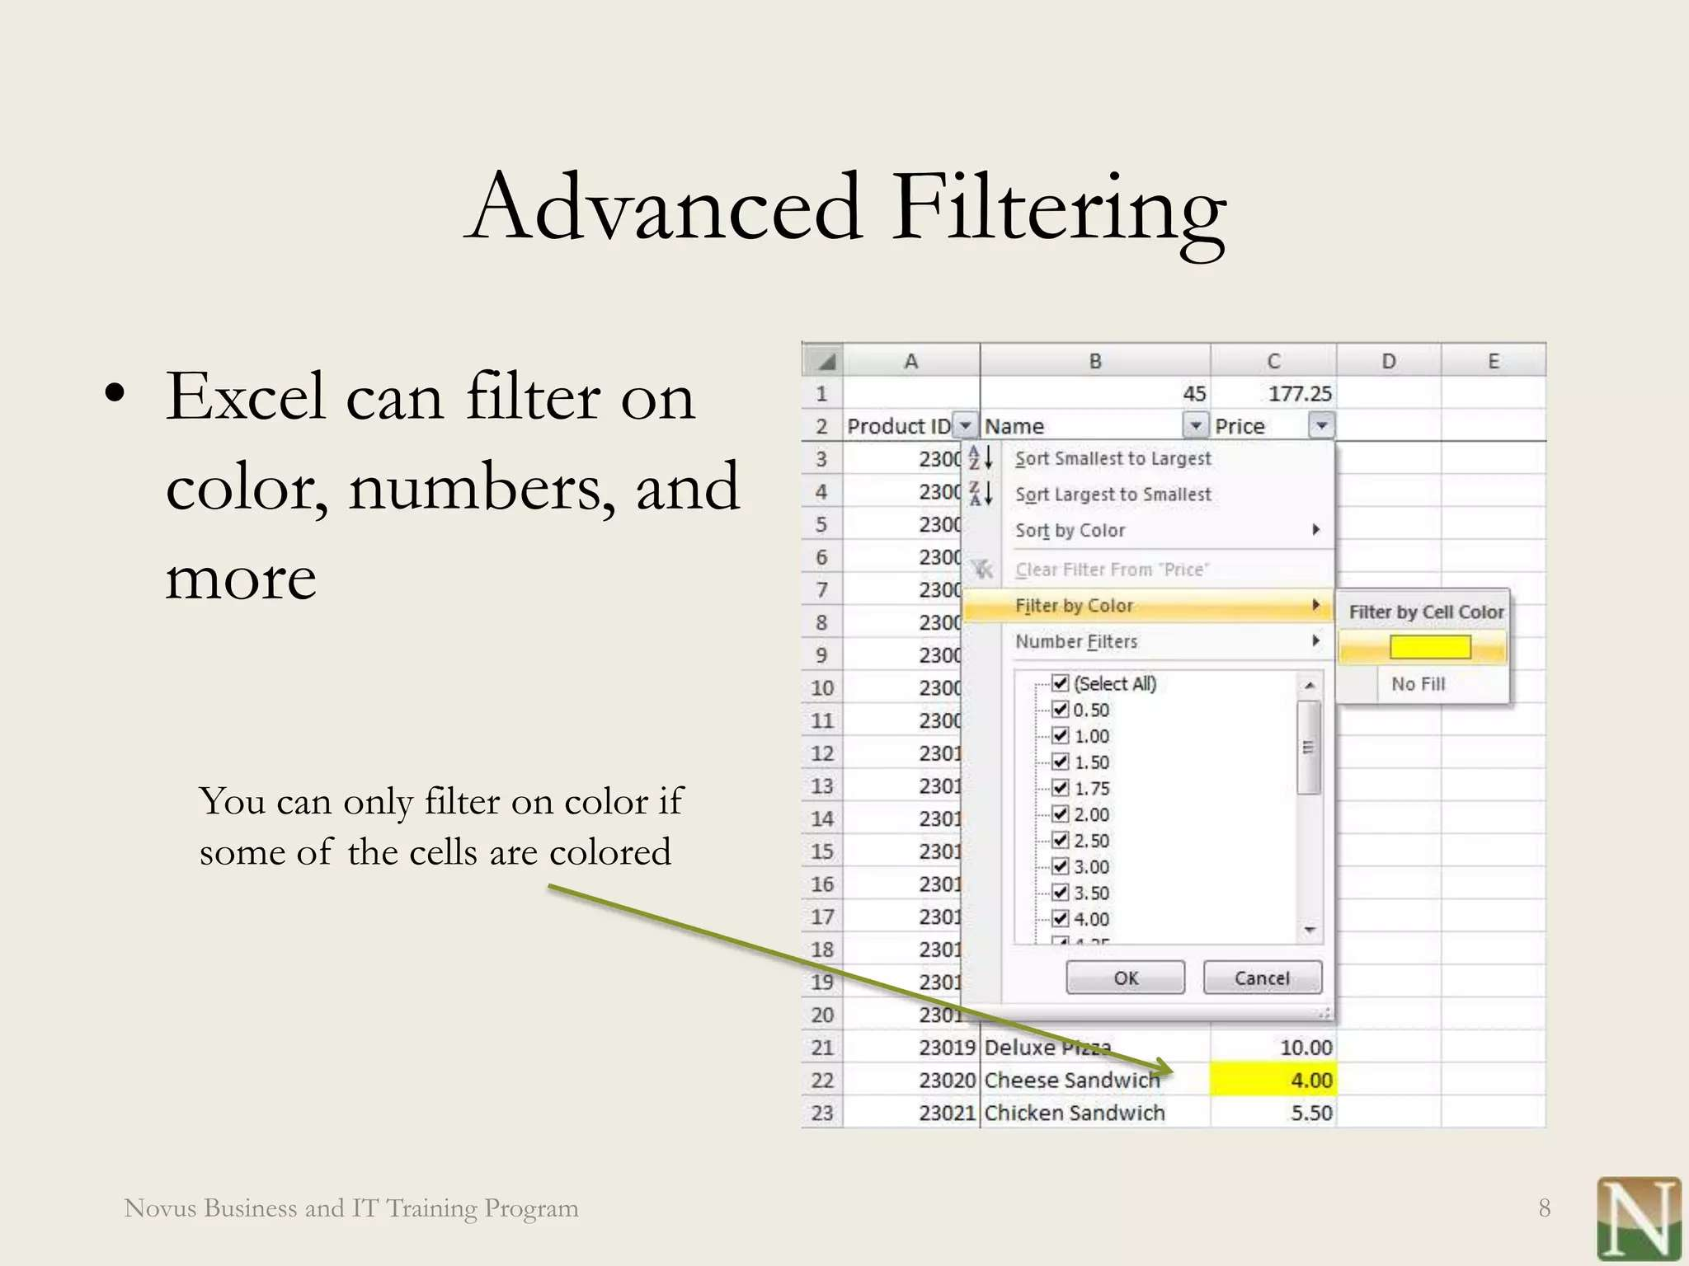

Slide 10

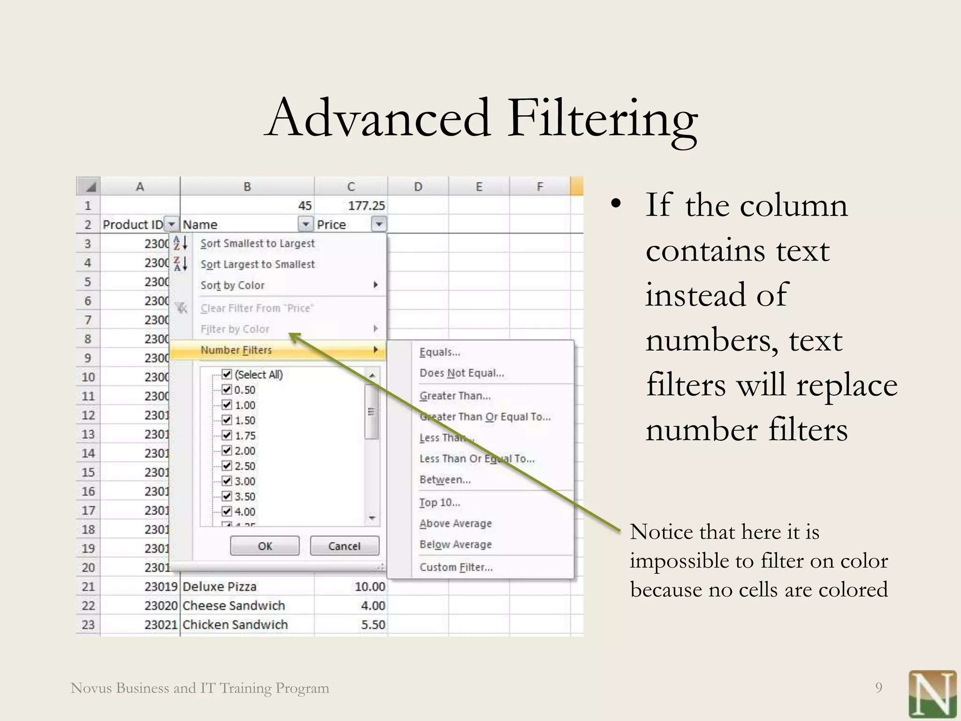

Slide 11
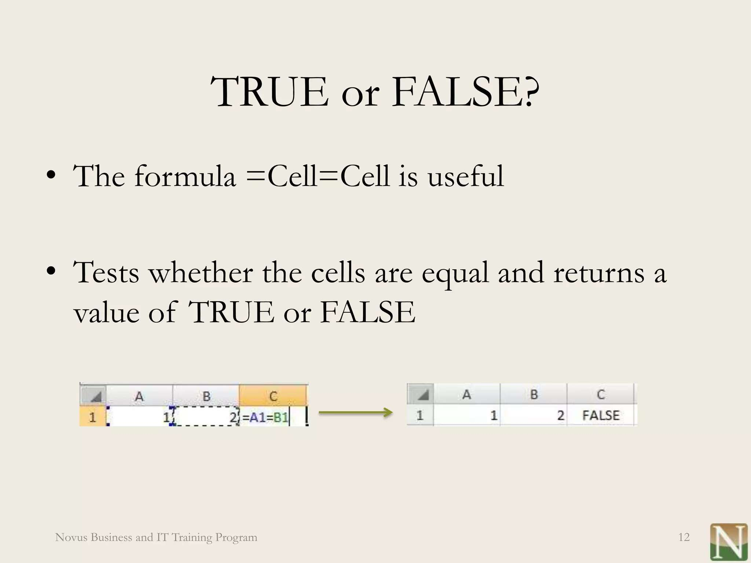

Slide 12
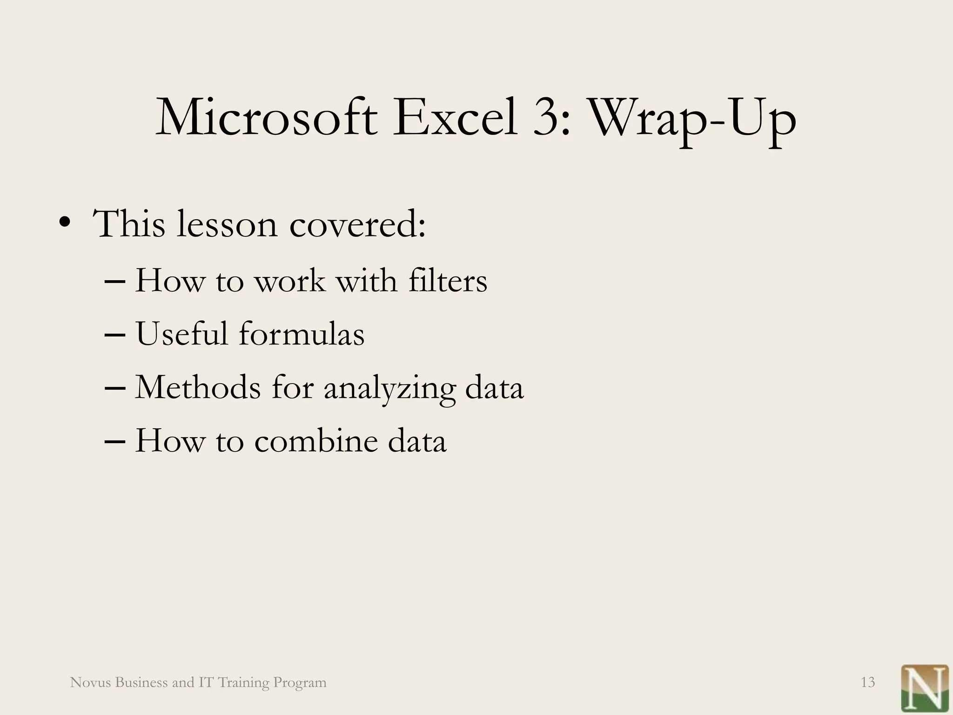

Slide 13


