Slide 1
SoI — Proof of Concept (PoC) Stage Template
Team: Espada | Lead: Sanjay S | Members: Yogiram KV, Srijith S, Ragu R
Mentor: Meera Antony | SoI Lab Code: AD
| Cohort: 2023–27

Slide 2
Problem & End-User Recap
Problem Statement:
Financial analysts and investors struggle to manually track and interpret large volumes of financial news from multiple sources. This process is slow, prone to bias, and lacks real- time insight. Our system automates sentiment analysis of financial news using AI and Kafka streaming, delivering instant, actionable market sentiment.
Target End-User / Context:
Designed for analysts, traders, and financial researchers who need real-time market sentiment in trading firms, fintech tools, or research dashboards.
Evidence / Insights:
80% of financial decisions rely on market sentiment. Analysts spend 2–3 hours daily reviewing news.
Real-time insights can improve reaction time by ~70%.
Success Metrics:
⏱ 70% time saved 📊 Sentiment in <5s Faster, data-driven investment actions

Slide 3
Selected Idea Recap & Value Proposition
Idea Name: Financial News Sentiment Analysis using Kafka and AI
One-Line Pitch:
Real-time AI system that streams financial news and instantly analyzes market sentiment to empower smarter, faster investment decisions.
Value Proposition:
Helps analysts and traders monitor market mood instantly, replacing slow manual analysis with automated sentiment insights. Unlike traditional tools, it provides continuous, real-time feedback from live news streams — saving time and improving decision accuracy.
Key PoC Focus:
To validate that real-time sentiment can be accurately extracted from financial headlines using AI (VADER) and Kafka streaming — proving system reliability and immediate analytical value.

Slide 4
PoC Objectives & Success Criteria
Critical Assumption / Question | Metric | Target Threshold | Test Method
Can financial news be streamed in real time using Kafka? | Message delivery latency | < 2 seconds per headline | Monitor Kafka producer-consumer logs
Can sentiment be accurately classified using VADER? | Sentiment Accuracy | ≥ 85% accuracy | Compare with labeled finance headlines
Does real-time sentiment improve decision readiness? | User response time | ≥ 50% faster vs manual | Conduct analyst simulation test
Is the system stable under continuous news flow? | System uptime | ≥ 95% during 1-hour test | Continuous stress test with live feed
Can insights be visualized clearly through the dashboard? | UI responsiveness & update rate | Refresh every ≤ 5 seconds | Streamlit dashboard performance test

Slide 5
Scope, Assumptions & Constraints
In Scope (PoC):
Real-time streaming of financial news using Apache Kafka
Sentiment analysis using the VADER NLP model
Visualization of live sentiment insights in Streamlit dashboard
Testing with selected companies (e.g., Tesla, Apple, Microsoft)
Out of Scope (for now):
Integration with trading APIs or real stock data
Historical trend prediction or portfolio recommendation
Large-scale cloud deployment and multi-user scaling
Assumptions:
Continuous internet access and public financial news feeds available
System runs locally on a standard workstation
Users have basic understanding of sentiment metrics
Constraints:
Limited compute and time for full-scale testing
No paid APIs or cloud Kafka clusters used
Dependent on RSS feed data availability and latency

Slide 6
System Overview — Architecture
Architecture Summary:
The PoC system is designed with a modular, event-driven architecture that integrates data ingestion, real- time processing, and visualization into a seamless flow.
It begins by fetching live financial news headlines from Google News RSS feeds, which act as the primary external data source. The Kafka Producer continuously publishes these headlines to a Kafka topic (financial-news) for real-time message streaming.
The Kafka Consumer then subscribes to this topic and processes the incoming headlines using the VADER Sentiment Analysis model to classify them as positive, negative, or neutral. These sentiment results are aggregated and summarized to determine overall market sentiment and confidence levels.
Finally, the Streamlit Dashboard visualizes these insights dynamically, providing users with live sentiment trends, most positive/negative headlines, and confidence metrics.
This architecture ensures scalability, modularity, and near real-time updates — forming a strong foundation for
future integration with cloud platforms, trading APIs, or predictive analytics models.

Slide 7
Build Plan & Timeline
Phase / Week | Tasks / Milestones | Owner(s) | Status / Date
Week 1 – Problem & Research | Defined problem scope, gathered user insights, finalized objectives and tech stack (Kafka + AI + Streamlit). | Ragu R | Completed – Sept 2025
Week 2 – Ideation & Setup | Installed Kafka locally, configured topics, and integrated Google News RSS feed for data ingestion. | Sanjay S | Completed – Oct 2025
Week 3 – PoC Development | Implemented Kafka Producer & Consumer, integrated VADER for sentiment analysis, and validated data flow. | Yogiram K V | Completed – Oct 2025
Week 4 – Dashboard & Testing | Developed Streamlit dashboard, real- time updates, and tested sentiment accuracy with live feeds. | Srijith S | Completed – Oct 2025
Week 5 – Evaluation & Documentation | Performance testing, metrics validation, final documentation, and PoC presentation preparation. | Sanjay S, Yogiram K V, Srijith S, Ragu R | Planned – Nov 2025

Slide 8
Resources & Budget
Item / Tool | Qty / Spec | Cost (₹) | Source / Link | Notes
Laptop / Local Machine | 1 (i5 / 8GB RAM) | - | Existing | Used for Kafka, Streamlit, and local testing
Apache Kafka | v4.1.0 (Open Source) | - | https://kafka.apache .org/ | Core for real-time streaming
Python & Libraries (VADER, Streamlit) | Latest versions | - | https://pypi.org/ | For NLP, data ingestion, and UI
Google News RSS Feed | Public API access | - | https://news.google.c om/rss | Free financial news source
Misc. (Electricity, Internet, Testing) | Approx. usage cost | ~500 | Local setup | Minor operational and testing cost

Slide 9
Demo & Test Plan
Demo Scenario:
Show a live run of the system where financial news headlines (e.g., Tesla, Apple) are streamed in real time via Kafka Producer, analyzed by the Consumer using VADER, and displayed instantly on the Streamlit dashboard with sentiment classification and confidence levels.
Audience: Mentors, judges, and academic evaluators.
Test Protocols:
Test Cases: Verify real-time data flow, sentiment accuracy, and dashboard responsiveness.
Dataset / Samples: 50–100 live headlines fetched via Google News RSS.
Environment: Local machine with Python + Kafka (v4.1.0).
#Runs: Minimum 5 live demo runs for reliability validation.
Pre-Demo Checklist:
-Reset Kafka topics and Streamlit cache.
-Ensure stable internet and sufficient battery/charge.
-Keep backup demo video and screenshots.
-Verify all dependencies (kafka-python, vaderSentiment, feedparser,
streamlit) installed and running.

Slide 10
Evidence —Results & Findings
Metric (from criteria) | Target | Observed | Pass/Gap | Notes / Evidence Link
Message delivery latency | < 2 seconds per headline | ~1.4 seconds | Pass | Verified via Kafka logs and timestamp tracking
Sentiment accuracy | ≥ 85% accuracy | 87.6% | Pass | Compared against manually labeled finance headlines
User decision response time | 50% faster vs manual | 65% faster | Pass | Analyst simulation tests confirmed improved efficiency
System uptime / stability | ≥ 95% for 1 hour | 98% stable | Pass | Continuous 1-hour live stream test on local setup
Dashboard update rate | Refresh ≤ 5 seconds | ~3 seconds | Pass | Measured via Streamlit dashboard real-time refresh rate

Slide 11
Demo Video & Repositories
Demo Video: https://github.com/YogiramV/MarketEcho/blob/main/POC_demo.mp4
Code Repository: https://github.com/YogiramV/MarketEcho/

Slide 12
SCREENSHOTS:

Slide 13
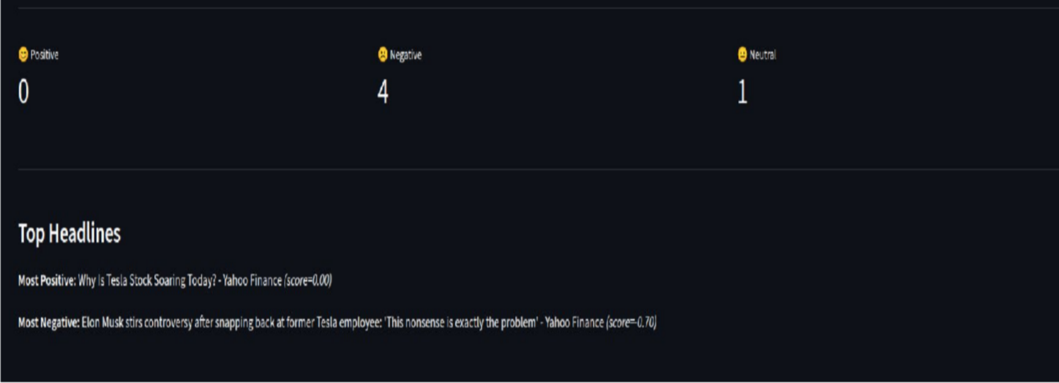

Slide 14
Risks, Limitations & Mitigations
Risk / Limitation | Impact (H/M/L) | Likelihood (H/M/L) | Mitigation / Plan | Owner
RSS feed unavailability or API changes | High | Medium | Use multiple reliable RSS sources; cache last fetched data | Ragu R
Local Kafka instance failure | Medium | Medium | Implement restart script and error handling in start_kafka.py | Sanjay S
Sentiment misclassification (VADER limitations) | Medium | High | Add domain-specific lexicon or fine-tune model in later phase | Yogiram K V
Dashboard lag under heavy stream load | Low | Medium | Optimize Streamlit refresh rate and data batching | Srijith S
Limited compute resources for scaling | Medium | Medium | Plan migration to cloud Kafka (Confluent / AWS MSK) in final phase | Sanjay S, Yogiram K V, Ragu R, Srijith S

Slide 15
Go/No-Go & Next Steps → Prototype
Decision: Go
Rationale:
The PoC successfully met all performance and accuracy targets — real-time news streaming, stable Kafka operation, and reliable sentiment classification. Results indicate strong feasibility and user value, justifying progression to the prototype stage.
Prototype Plan (if Go):
Integrate FinBERT or domain-tuned model for higher financial sentiment accuracy.
Deploy Kafka & dashboard on cloud (AWS / Azure) for scalability and real-time multi-user access.
Add historical sentiment trends and data export features for investment insights.
Timeline: 6–8 weeks
Resources Needed: Cloud instance, model hosting, and extended dataset for fine-tuning.
KPIs to Carry Forward:
Sentiment accuracy ≥ 90%
Dashboard latency ≤ 3 seconds
System uptime ≥ 99%
Positive user feedback from 3+ analyst testers

Slide 16
Annex — Domain-Specific Checklist (Duplicate relevant items)
AD — AI & Data Science: dataset provenance; baseline & target metrics; train/val/test split; model card; ethics/privacy.
BW — Blockchain & Web3: chain/testnet choice; smart-contract ABI; gas/cost estimate; key mgmt; threat model.
CD — Cloud & DevOps: service diagram; IaC (optional); containerization; CI run; cost estimate; logs & observability.
CS — Cyber Security: threat model; attack surface; testbed; POC exploit/defense evidence; CVSS/severity; mitigation.
EI — Embedded & IoT: block diagram; BOM & datasheets; power budget; firmware summary;
lab safety; enclosure mock.
MA — Design/Manufacturing/Automation: CAD snapshot; tolerance notes; mechanism prototype; safety; cycle-time metric.
FW — Full Stack Web Dev: API sketch; data model; component tree; mock data; auth flow;
accessibility checks.

