Slide 1
ACCO-MATCH
GROUP 4
Discover Your Ideal Accommodation

Slide 2
Need An Accomodation
We have developed a website called “ACCOMATCH”, an innovative accommodation finder platform designed to connect applicants seeking accommodation with providers who have available spaces

Slide 3



01
ROLES
02
03
ADMIN
Can post new lease and verify Applicants
APPLICANT
Can apply to be a lease owner
LEASE OWNER
Can post availability

Slide 4



FEATURES
PROVIDE THE HOUSE
RENT/FIND EASILY
ADVANCED SEARCH &
PREFERENCES

Slide 5



FEATURES
USER VERIFICATION
RATING SYSTEM
CHAT SYSTEM

Slide 6
TARGET AUDIENCE
Travelers
Tourists
Business Professionals
Students
Relocators

Slide 7
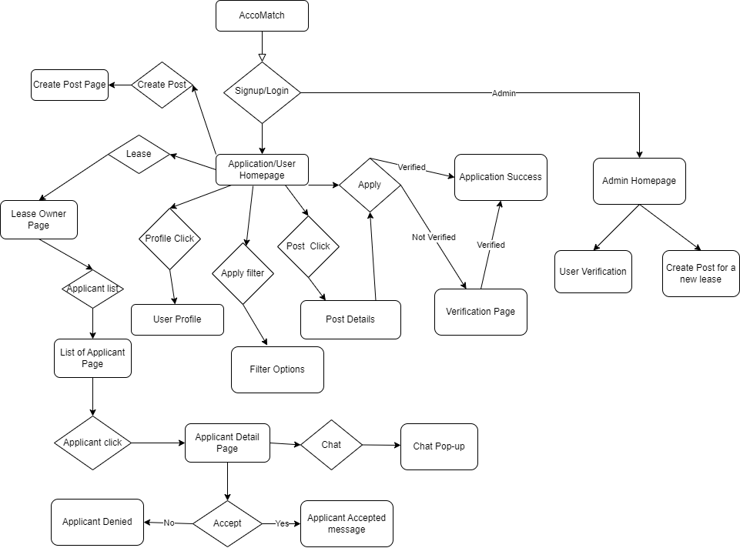
WORKFLOW

Slide 8
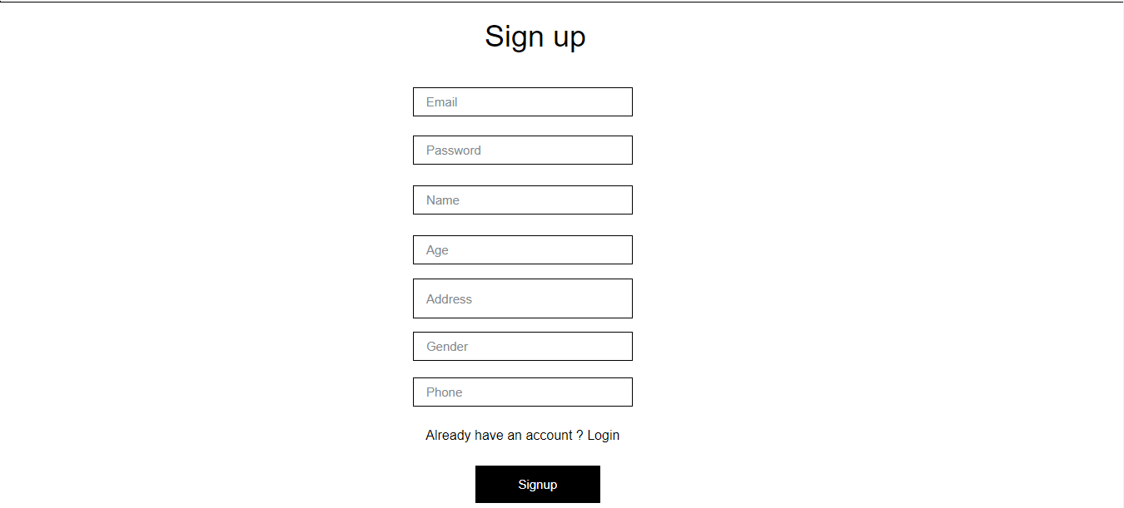
Sign up page

Slide 9
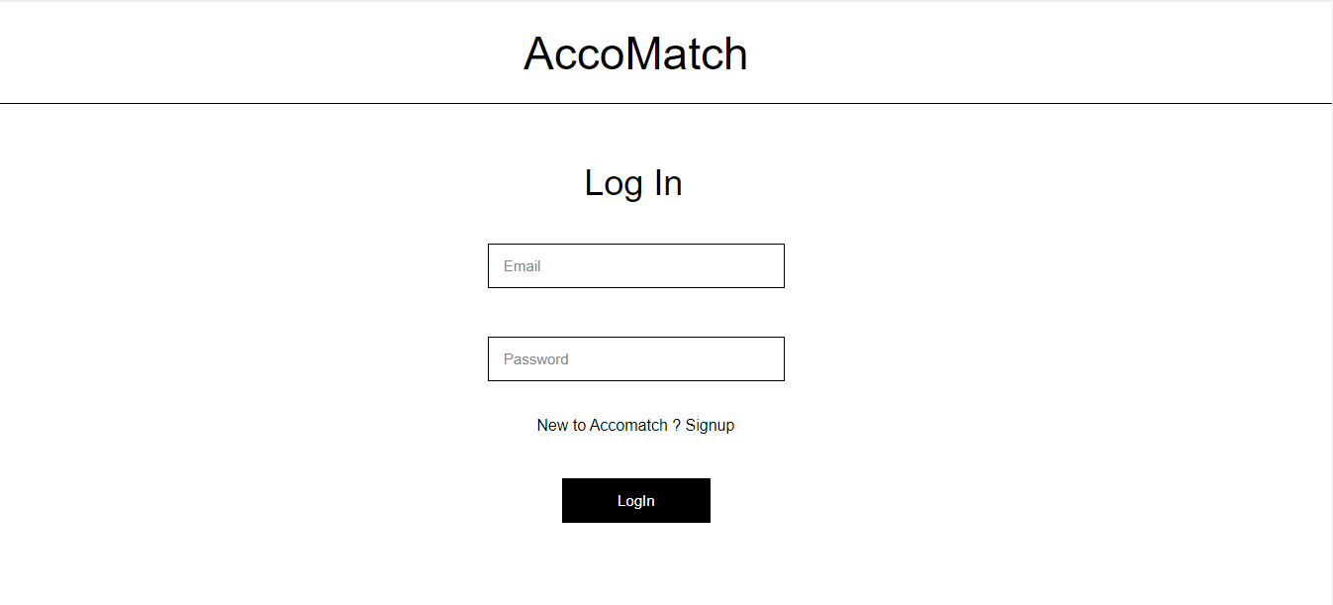
Login Page

Slide 10
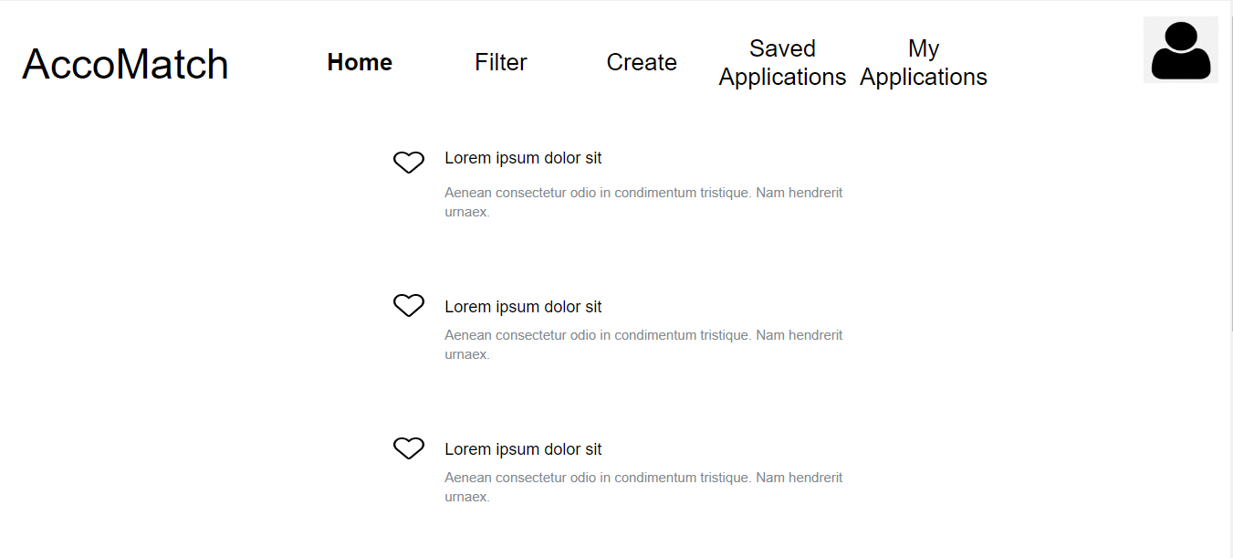
Home Page

Slide 11
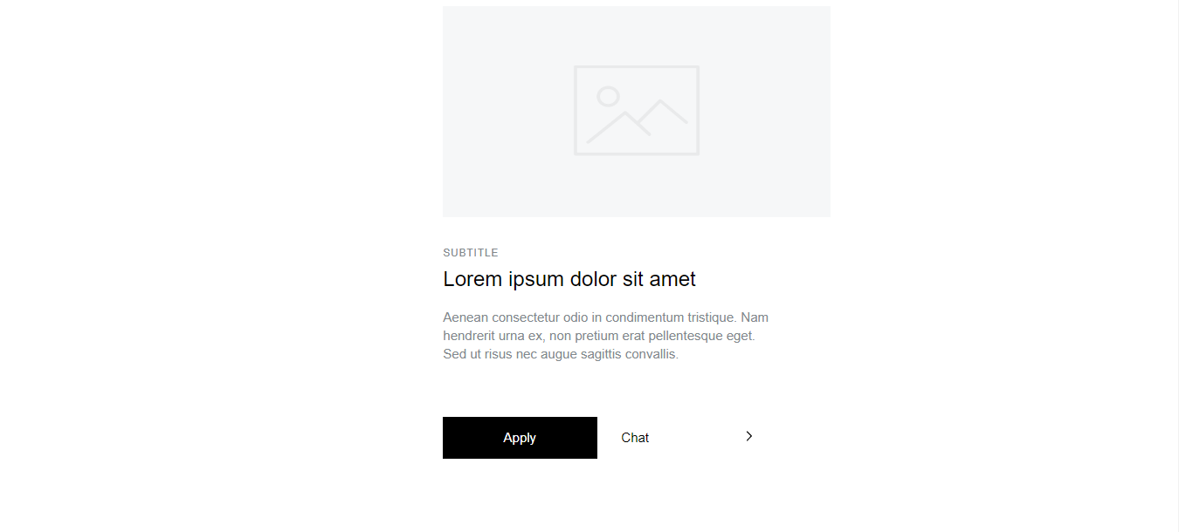
Application Detailed Page

Slide 12
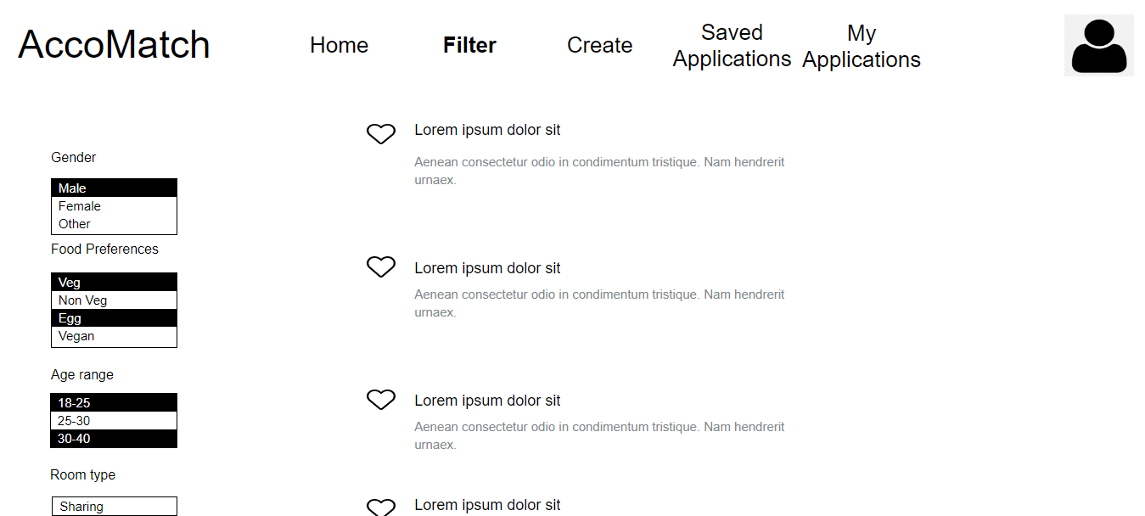
Advanced Search & Preference Page

Slide 13
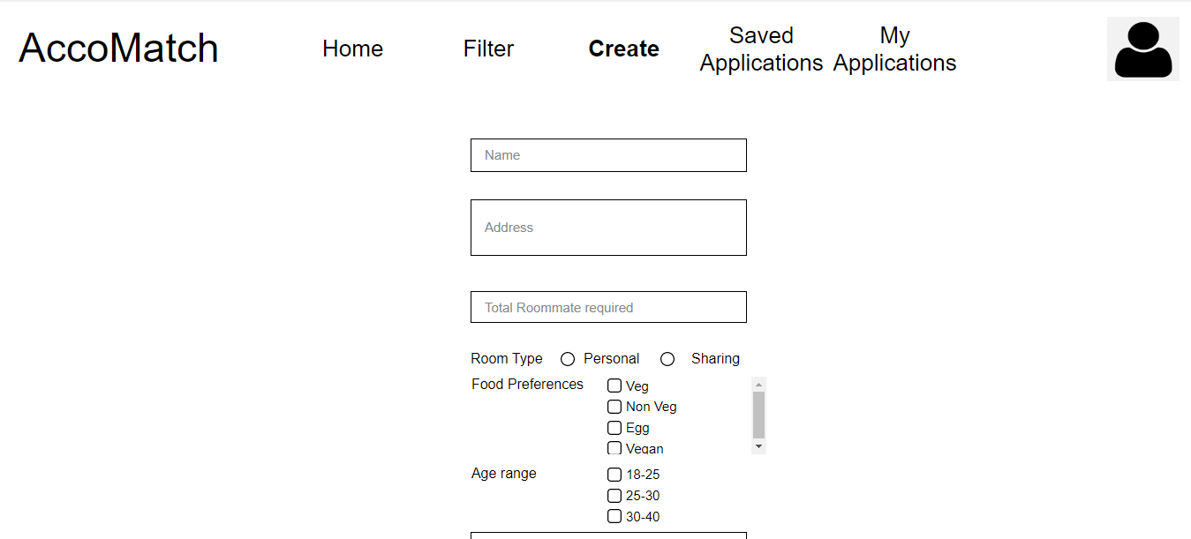
Create Post Page

Slide 14
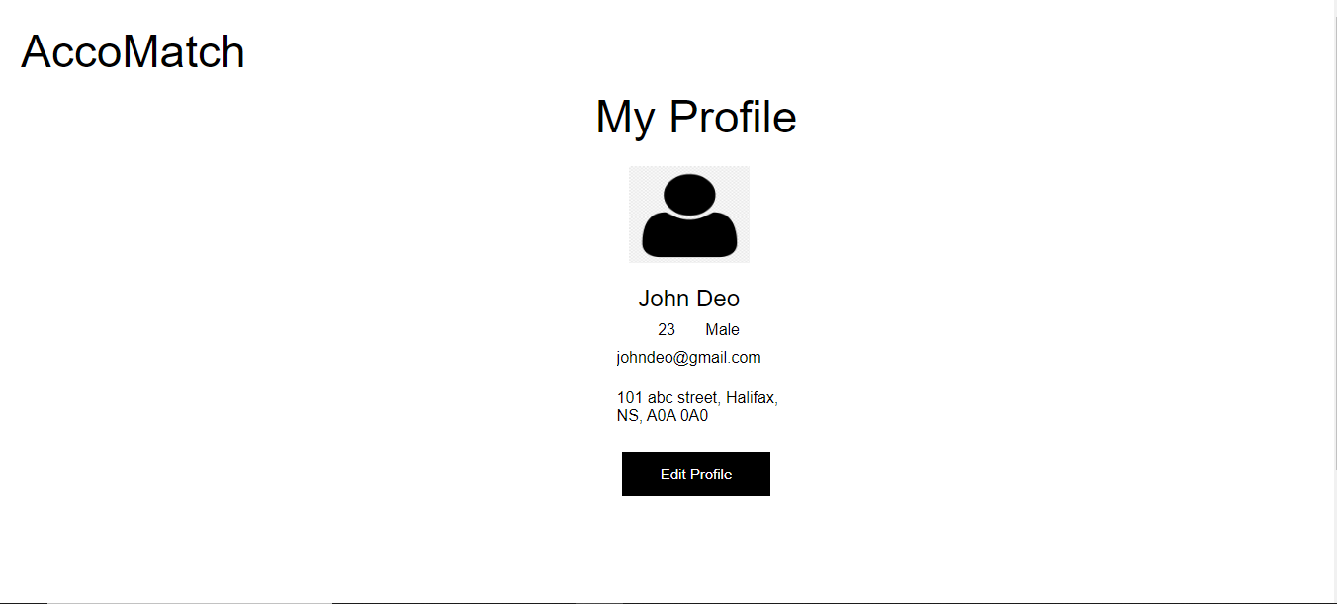
User Profile Page

Slide 15
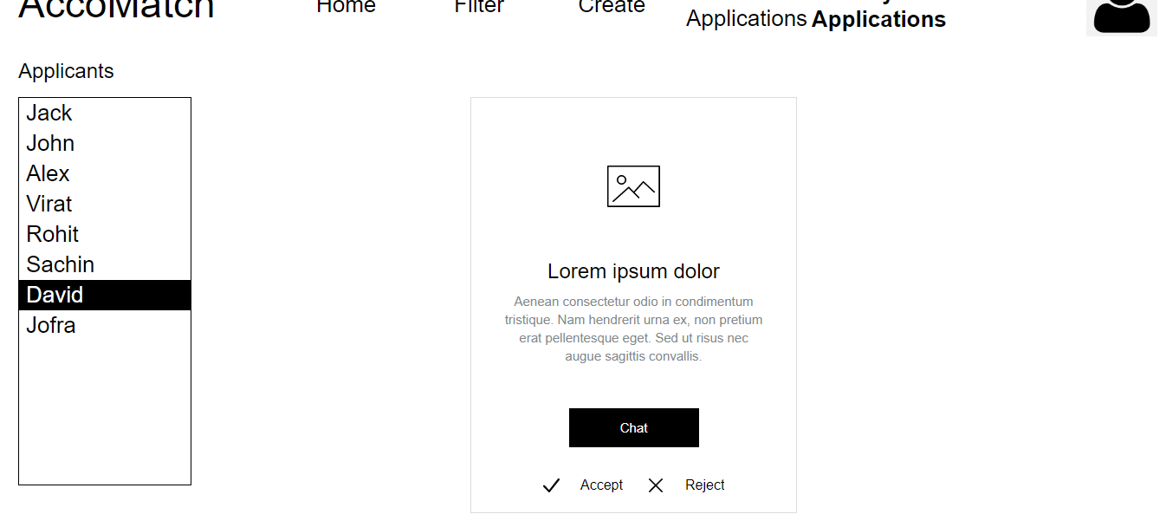
Application Page

Slide 16
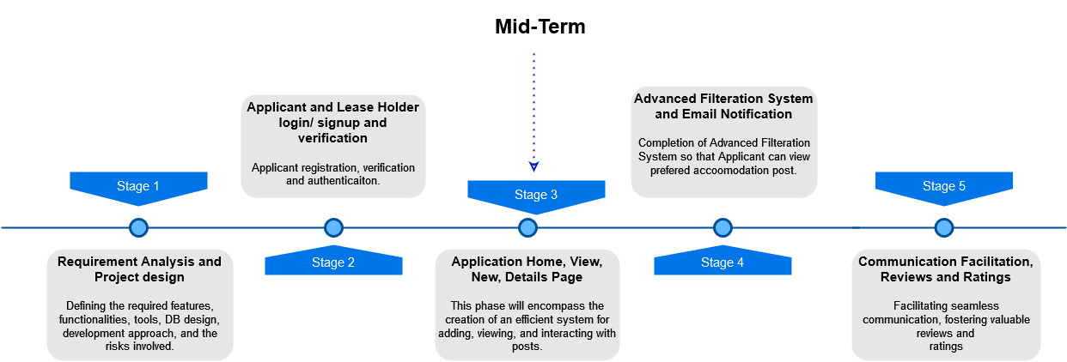
PROJECT TIMELINE

Slide 17
TOOLS & TECHNOLOGY
Framework
Database
Front-end: React
Back-end: Spring Boot
MySQL
UI/UX
Testing
BootStrap, CSS, JavaScript
Junit5, Mockito, Postman

Slide 18
REFERENCES
[1] "Profile png images", Pngwing [Online]. Available:
https://www.pngwing.com/en/search?q=profile. [Accessed: May 17, 2023].
[2] “Material Symbols and icons,” Google Fonts [Online]. Available:
https://fonts.google.com/icons. [Accessed: May 17, 2023].
[3] “Flowchart maker & online diagram software”, app.diagrams [Online]. Available:
https://app.diagrams.net/. [Accessed: May 19, 2023].
[4] “Free prototyping tool for web & mobile appS,” Justinmind [Online]. Available:
https://www.justinmind.com/. [Accessed: May 20, 2023].

Slide 19
PROJECT TEAM
DHRUMIL VIMALBHAI GOSALIYA (B00929836)
GOWRI PRASHANTH KANAGARAJ (B00942544)
BHARGAV KANODIYA (B00938588)
RAMANDEEP KAUR (B00943241)
YOGISH HONNADEVIPURA GOPALAKRISHNA (B00928029)

Slide 20
THANKS!
Does anyone have any questions?

