Slide 1
Randomized Algorithms CS648
Lecture 9
Approximate Distance Oracles [Contd.]
Expected duration of random experiment

Slide 2
Approximate Distance oracles

Slide 3
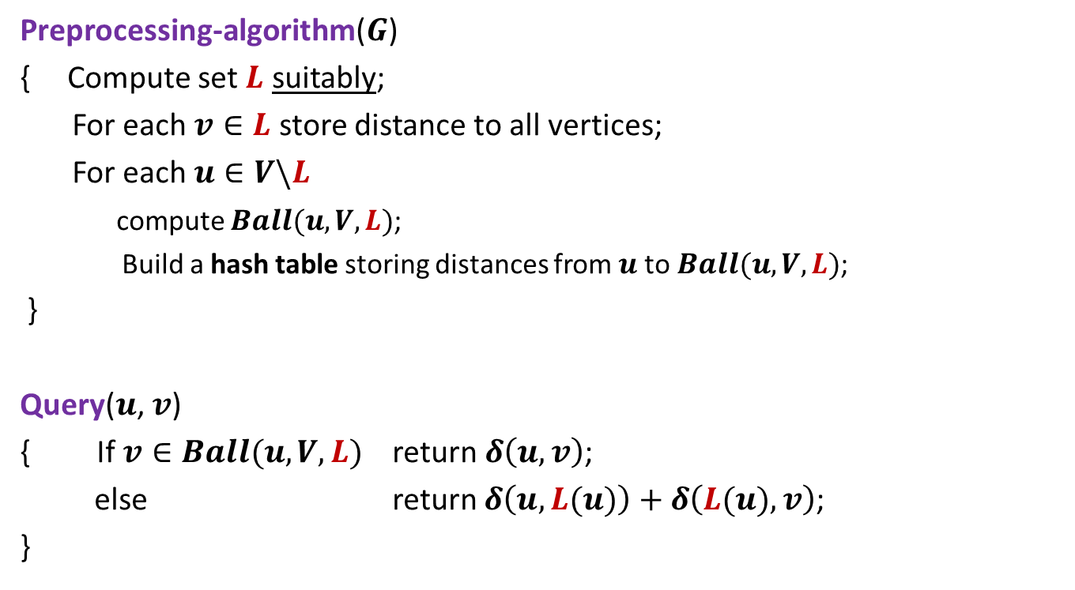
3-approximate distance oracle
Preprocessing-algorithm($G$)
{ Compute set $L$ suitably;
For each $v∈L$ store distance to all vertices;
For each $u∈V\backslash L$
compute $Ball(u,V,L)$;
Build a hash table storing distances from $u$to $Ball(u,V,L)$;
}
Query($u$, $v$)
{ If $v∈Ball(u,V,L)$ return $δ\left(u,v\right)$;
else return $δ\left(u,L(u)\right)+δ\left(L(u),v\right)$;
}
Global distance info.
Local distance info.

Slide 4

The real challenge left
How to compute set $L$ such that
$L$ is small.
$Ball(u,V,L)$ is small for each $u∈V\backslash L$.

Slide 5



The real challenge left
$$L(u)$$
$$u$$
$$Ball(u,V,L)$$

Slide 6


A deterministic approach to the challenge
$$u$$
$$u$$
$$<\sqrt{n}$$

Slide 7
A deterministic approach to the challenge
$$u$$
$$<\sqrt{n}$$

Slide 8





A deterministic approach to the challenge
There is no guarantee that $L(u)$ will ensure ‘small ball’ for other vertices like $v$ or $w$.
$$w$$
$$v$$
$$L(u)$$
$$u$$
$$=\sqrt{n}$$

Slide 9
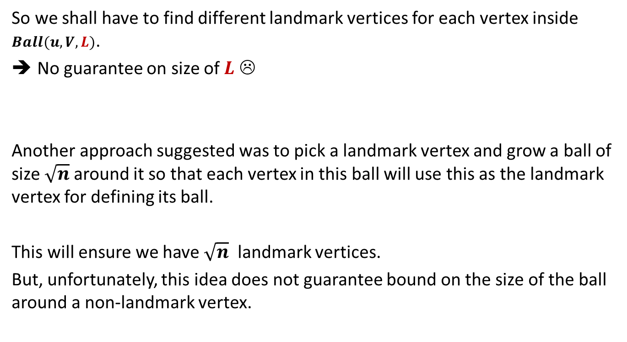
So we shall have to find different landmark vertices for each vertex inside $Ball(u,V,L)$.
No guarantee on size of $L$ ☹
Another approach suggested was to pick a landmark vertex and grow a ball of size $\sqrt{n}$ around it so that each vertex in this ball will use this as the landmark vertex for defining its ball.
This will ensure we have $\sqrt{n}$ landmark vertices.
But, unfortunately, this idea does not guarantee bound on the size of the ball around a non-landmark vertex.

Slide 10
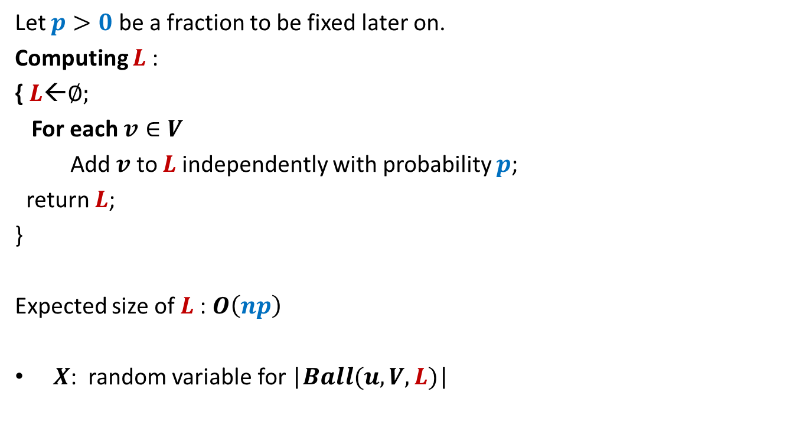
Conquering the challenge
Let $p>0$ be a fraction to be fixed later on.
Computing $L$:
{ $L$←∅;
For each $v∈V$
Add $v$ to $L$independently with probability $p$;
return $L$;
}
Expected size of $L$: $O\left(np\right)$
$X$: random variable for |$Ball(u,V,L)$|

Slide 11

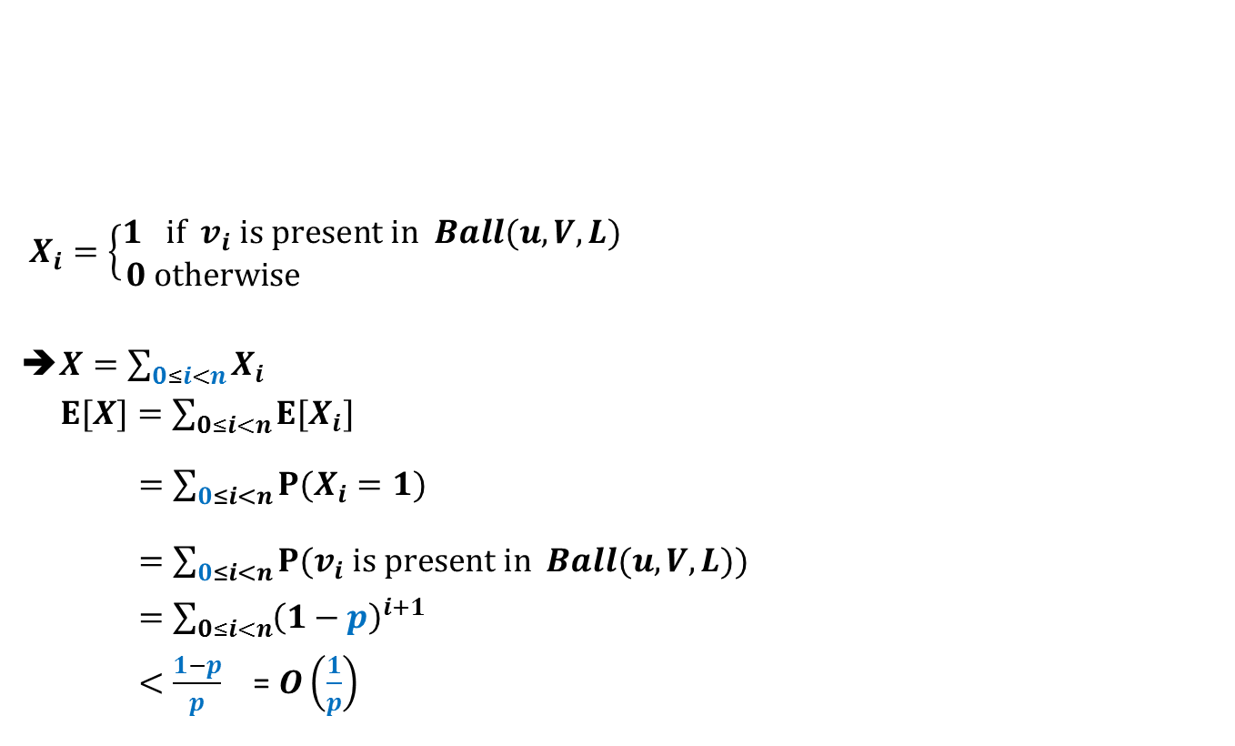
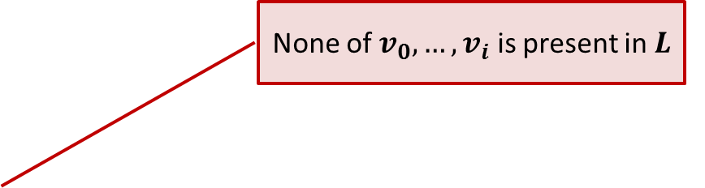



Expected size of $Ball(u,V,L)$
$$Ball(u,V,L)$$
$X_{i}=\left\{\begin{aligned}1 if v_{i} is present in Ball(u,V,L) \\ 0 otherwise \end{aligned}\right.$
➔$X=\sum_{0≤i<n}{X_{i}}$
$E[X]=\sum_{0≤i<n}{E[X_{i}]}$
$=\sum_{0≤i<n}{P(X_{i}=1)}$
$=\sum_{0≤i<n}{P(v_{i} is present in Ball(u,V,L))}$
$=\sum_{0≤i<n}{{\left(1−p\right)}^{i+1}}$
$<\frac{1−p}{p}$ = $O\left(\frac{1}{p}\right)$
$$u$$
$v_{1} v_{2}$ … $v_{i}$ … $v_{n−1}$
Increasing order of distance from $u$
None of $v_{0}, …,v_{i}$ is present in $L$

Slide 12

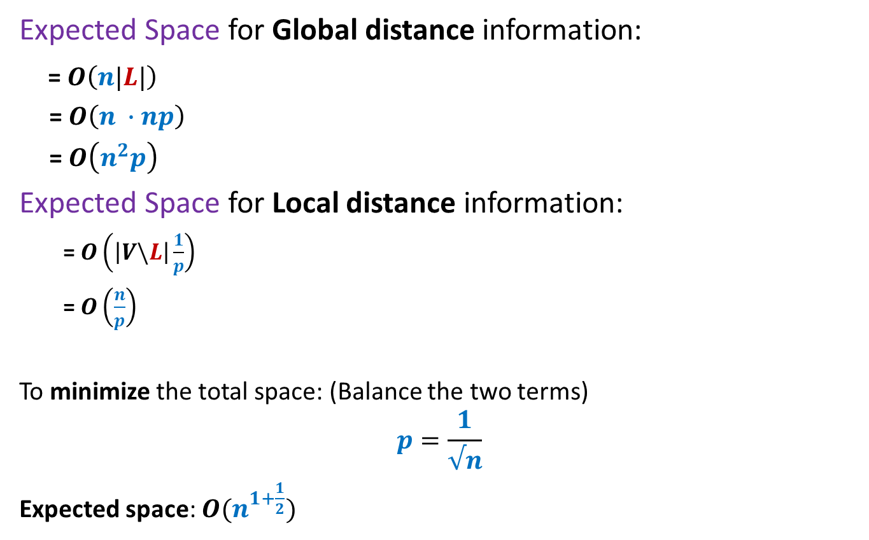
Expected space of 3-approximate distance oracle
Expected Space for Global distance information:
= $O\left(n|L|\right)$
= $O\left(n ∙np\right)$
= $O\left(n^{2}p\right)$
Expected Space for Local distance information:
= $O\left(\left|V\backslash L\right|\frac{1}{p}\right)$
= $O\left(\frac{n}{p}\right)$
To minimize the total space: (Balance the two terms)
$$p=\frac{1}{√n}$$
Expected space: $O(n^{1+\frac{1}{2}})$
Each vertex in $V\backslash L$ keeps a Ball)

Slide 13
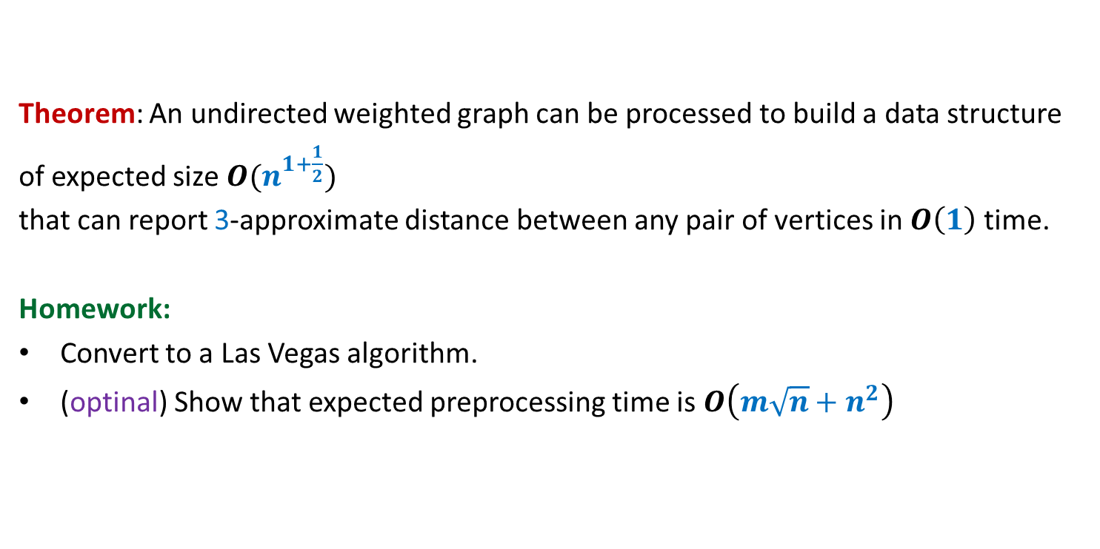
Theorem: An undirected weighted graph can be processed to build a data structure
of expected size $O(n^{1+\frac{1}{2}})$
that can report 3-approximate distance between any pair of vertices in $O\left(1\right)$ time.
Homework:
Convert to a Las Vegas algorithm.
(optinal) Show that expected preprocessing time is $O\left(m\sqrt{n}+n^{2}\right)$

Slide 14





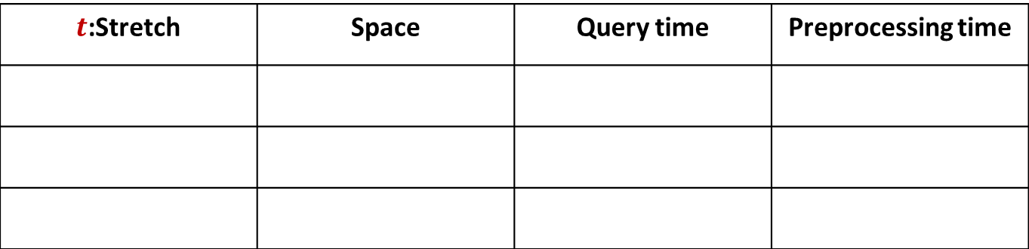







A truly magical result
Approximate Distance Oracles
$t$:Stretch | Space | Query time | Preprocessing time
$$3$$
$$O(n^{1+\frac{1}{2}})$$
$$O(1)$$
$$O({mn}^{\frac{1}{2}})$$
$$5$$
$$O(n^{1+\frac{1}{3}})$$
$$O(1)$$
$$O({mn}^{\frac{1}{3}})$$
$$2k−1$$
$$O(n^{1+\frac{1}{k}})$$
$$O(k)$$
$$O({k mn}^{\frac{1}{k}})$$
Mikkel Thorup and Uri Zwick:
Approximate Distance Oracles for graphs,
Journal of ACM (4), 2005

Slide 15
5-approximate distance oracle
?

Slide 16



3-approximate distance oracle
If we wish to decrease the space occupied for global distance information to less than$n^{1+\frac{1}{2}}$
We need to reduce $L$
➔ We need to reduce sampling probability to less than $\frac{1}{√n}$
➔ Expected size of all Balls together increase beyond $n^{1+\frac{1}{2}}$ ☹
$$L$$
$$V$$

Slide 17

3-approximate distance oracle
If we wish to decrease the space occupied for all Balls together to less than$n^{1+\frac{1}{2}}$
we need to increase sampling probability to more than $\frac{1}{√n}$
➔ Expected number of $L$ increases.
➔ Expected size of space occupied for global distance information to less than$n^{1+\frac{1}{2}}$ ☹
$$L$$
$$V$$
What to do ?

Slide 18


5-approximate distance oracle
$$L_{2}$$
$$L_{1}$$
$$V$$

Slide 19




5-approximate distance oracle
What will you store ?
$$L_{2}(u)$$
$$L_{1}(u)$$
$$u$$
$$Ball(u,V,L_{1})$$
$$Ball(u,L_{1}, L_{2})$$

Slide 20
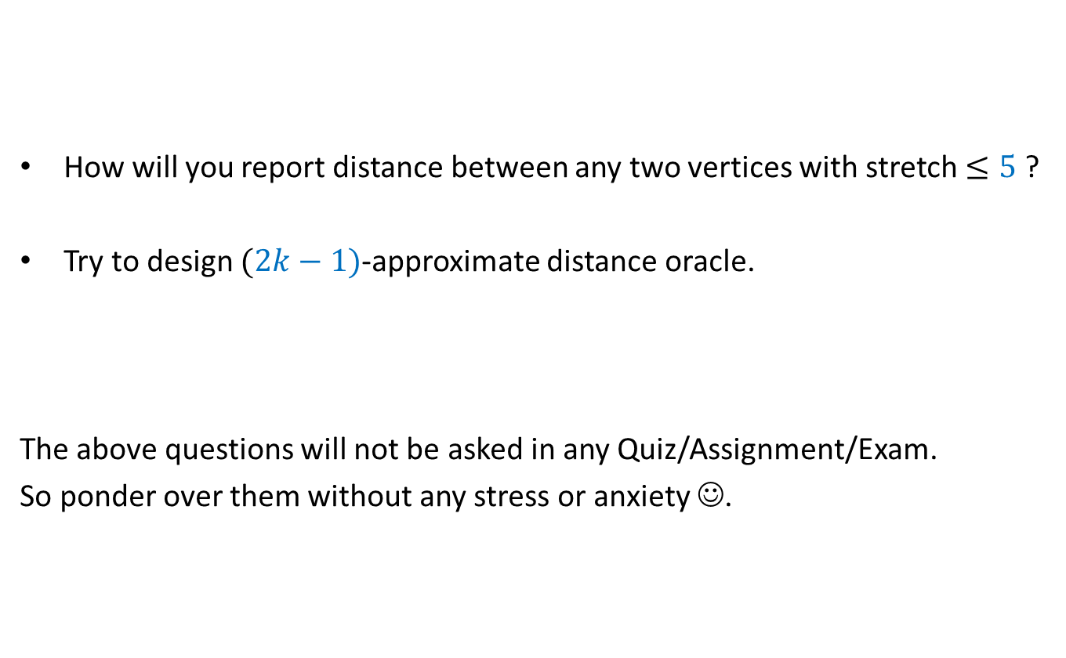
This slide is only for those whose aim is more than getting A*.
How will you report distance between any two vertices with stretch $≤5$ ?
Try to design $(2k−1)$-approximate distance oracle.
The above questions will not be asked in any Quiz/Assignment/Exam.
So ponder over them without any stress or anxiety ☺.

Slide 21
Expected duration of a random experiment

Slide 22
coupon Collector Problem

Slide 23
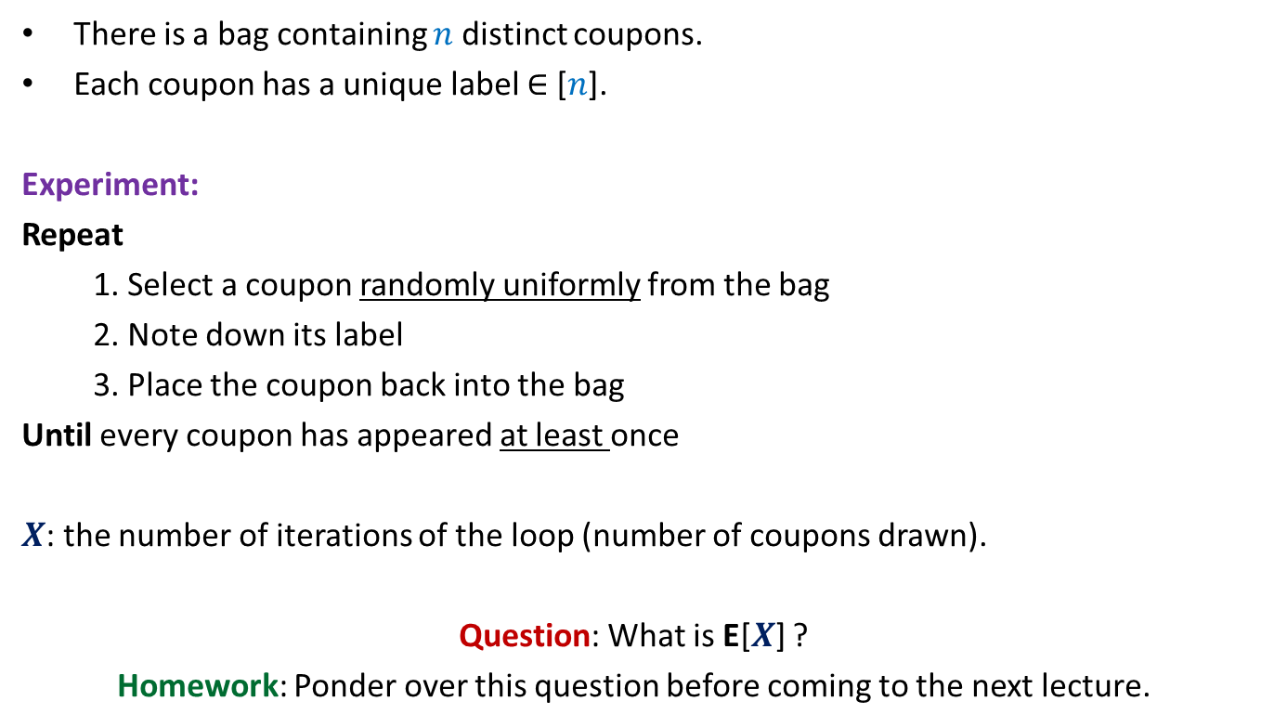
Coupon Collector Problem
There is a bag containing $n$ distinct coupons.
Each coupon has a unique label $∈$ [$n$].
Experiment:
Repeat
1. Select a coupon randomly uniformly from the bag
2. Note down its label
3. Place the coupon back into the bag
Until every coupon has appeared at least once
$X$: the number of iterations of the loop (number of coupons drawn).
Question: What is E[$X$] ?
Homework: Ponder over this question before coming to the next lecture.

Slide 24
Discrete Random Walk on a LINE

Slide 25
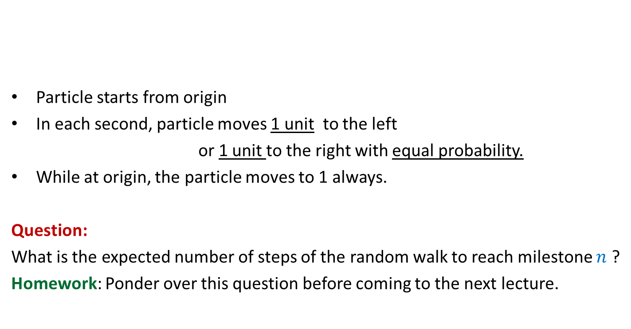
Discrete Random Walk
Particle starts from origin
In each second, particle moves 1 unit to the left
or 1 unit to the right with equal probability.
While at origin, the particle moves to 1 always.
Question:
What is the expected number of steps of the random walk to reach milestone $n$ ?
Homework: Ponder over this question before coming to the next lecture.
0 1 2 3 4 5 6 7 8 … n n+1

Slide 26
Distributed Client-serveR Problem

Slide 27
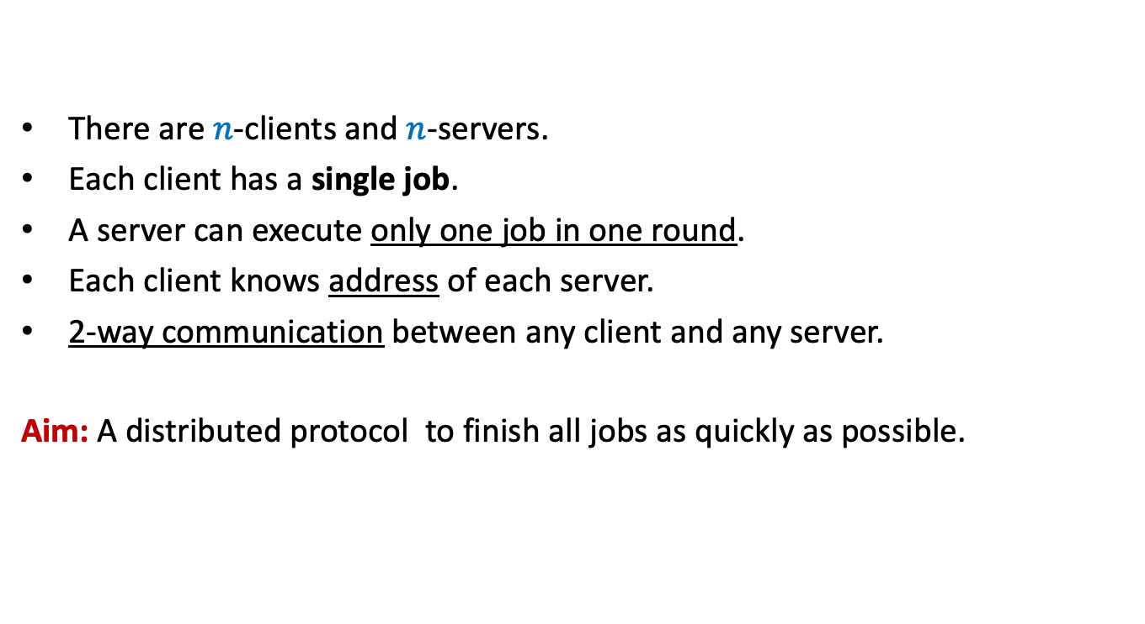
Distributed Client-Server Problem
There are $n$-clients and $n$-servers.
Each client has a single job.
A server can execute only one job in one round.
Each client knows address of each server.
2-way communication between any client and any server.
Aim: A distributed protocol to finish all jobs as quickly as possible.

Slide 28
Distributed Client-Server problem
Observation: If there were a central authority,
it would have been trivial to assign each client to a distinct server.
1
2
3
4
5
6
7
8
Clients
The problem arises in distributed setting
since each client has to take its own decision
without the knowledge of the decision taken by fellow clients.
Servers
1 2 3 4 5 6 7 8
Think of a simple protocol to address this problem.

Slide 29
Distributed Client-Server Problem
Randomized protocol (one round)
Each client sends a request to a server selected r.u.i.
Each server which receives one or more requests,
accepts only one request and finishes the corresponding job.
Each client, whose job is finished, leaves the system.
The remaining clients repeat the same procedure in next round.
Question: what is the expected number of rounds to finish all jobs?

Slide 30
Distributed Client-Server problem
1
2
3
4
5
6
7
8
Clients
It can be framed as our familiar
ball-bin problem.
☺
Servers
1 2 3 4 5 6 7 8

Slide 31
Distributed Client-Server problem
1
2
3
4
5
6
7
8
Balls
Bins
1 2 3 4 5 6 7 8

Slide 32
Distributed Client-Server problem Randomized protocol
Round 1
1
2
3
4
5
6
7
8
1 2 3 4 5 6 7 8

Slide 33
Distributed Client-Server problem Randomized protocol
3
4
7
8
1 2 3 4 5 6 7 8

Slide 34
Distributed Client-Server problem Randomized protocol
Round 2
3
4
7
8
1 2 3 4 5 6 7 8

Slide 35
Distributed Client-Server problem Randomized protocol
Round 3
8
1 2 3 4 5 6 7 8

Slide 36
Distributed Client-Server Problem
Randomized protocol (one round)
Each client sends a request to a server selected r.u.i.
Each server which receives one or more requests,
accepts only one request and finishes the corresponding job.
Each client, whose job is finished, leaves the system.
The remaining clients repeat the same procedure in next round.
Question: what is the expected number of rounds to finish all jobs?
Homework: Ponder over this question before coming to the next lecture.

Slide 37
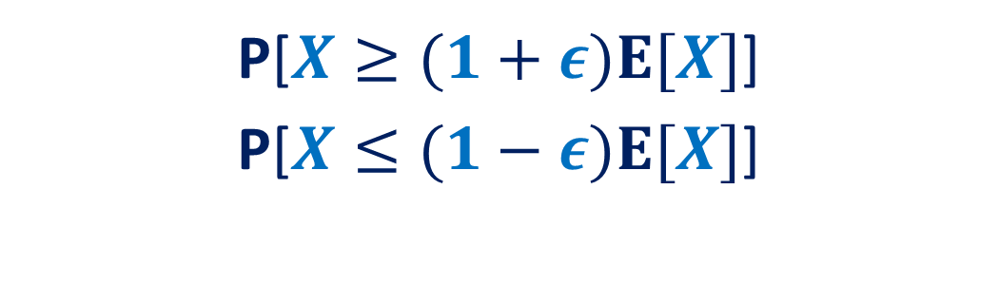
How to show
P[$X≥(1+ε)E[X]$]
P[$X≤(1−ε)E[X]$]

Slide 38
Tools
Markov’s Inequality
Chebyshev’s Inequality
Chernoff bound
We shall have an optional online lecture to discuss these tools.
I shall also post the slides on the website.

