Slide 1
Randomized Algorithms CS648
Lecture 16
Randomized Algorithm for Min-cut (part I)
Number of random bits

Slide 2
Recap of the last lecture

Slide 3
Min-cut
A Randomized Algorithm

Slide 4



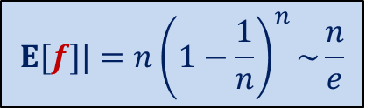


Graph and Multi-graph
A multi-graph may have:
More than one edge between a pair of vertices
No self loop
$$u$$
$$a$$
$$l$$
$$v$$
$$x$$
$$b$$
$$h$$
$$w$$

Slide 5

Min-Cut
$G=(V,E)$: undirected connected graph
Definition (cut):
A subset $C⊆E$whose removal disconnects the graph.
Definition (min-cut): A cut of smallest size.
Problem Definition: Design algorithm to compute min-cut of a given graph.

Slide 6

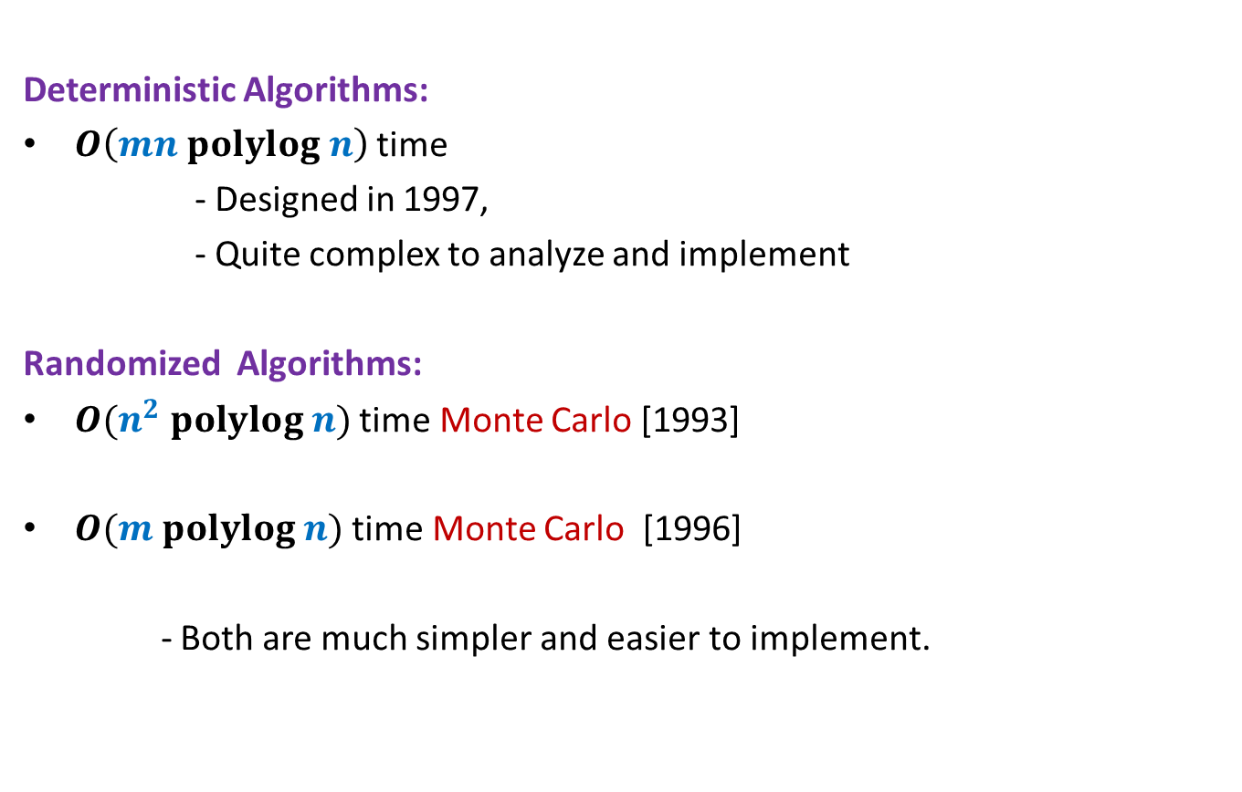
Min-Cut
Deterministic Algorithms:
$O\left(mn polylog n\right)$ time
- Designed in 1997,
- Quite complex to analyze and implement
Randomized Algorithms:
$O(n^{2} polylog n)$ time Monte Carlo [1993]
$O(m polylog n)$ time Monte Carlo [1996]
- Both are much simpler and easier to implement.
$O(m polylog n)$ time [2015]

Slide 7
some basic facts

Slide 8
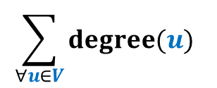





Min-Cut
Question: How many cuts ?
Answer: $\frac{2^{n}−2}{2}$
Question : what is relation between degree($u$) and size of min-cut ?
Answer: size of min-cut $≤$ degree($u$)
Question : If size of min-cut is $k$, what can be minimum value of $m$ ?
Answer: $\frac{nk}{2}$
$$v$$
$$u$$
These answers are correct there as well.
How about cuts in multi-graph ?
$$\sum_{∀u∈V}{degree(u)}$$
$$nk≤$$
$$=2m$$

Slide 9



Min-Cut
Question: How many cuts ?
Answer: $\frac{2^{n}−2}{2}$
Question : what is relation between degree($u$) and size of min-cut ?
Answer: size of min-cut $≤$ degree($u$)
$$v$$
$$u$$
These answers are correct there as well.
How about cuts in multi-graph ?
$$k$$
$$\frac{nk}{2}≤m$$
$$\sum_{∀u∈V}{degree(u)}$$
$$nk≤$$
$$=2m$$

Slide 10








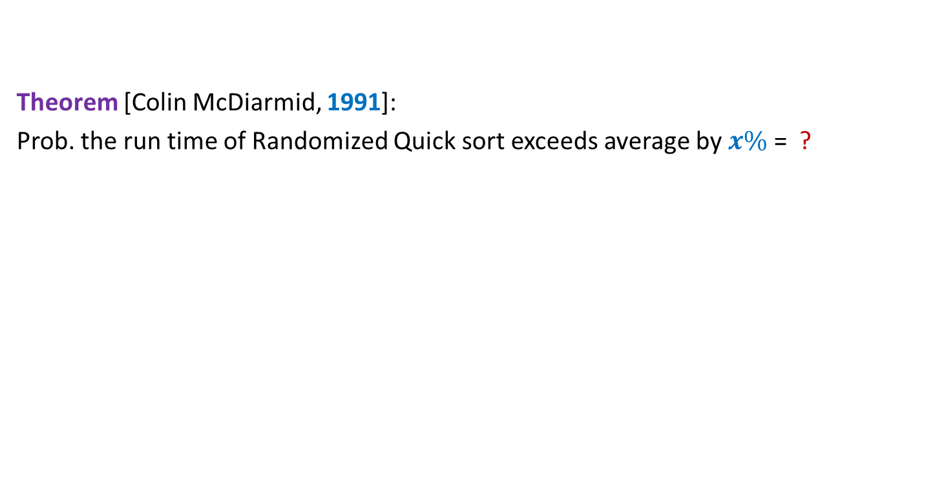










Contract($G,e$)
$$u$$
$$x$$
$$a$$
$$l$$
$$v$$
$$y$$
$$b$$
$$h$$
$$w$$
Contract($G,(x,y))$
$$u$$
$$a$$
$$l$$
$$v$$
$$xy$$
$$b$$
$$h$$
$$w$$

Slide 11
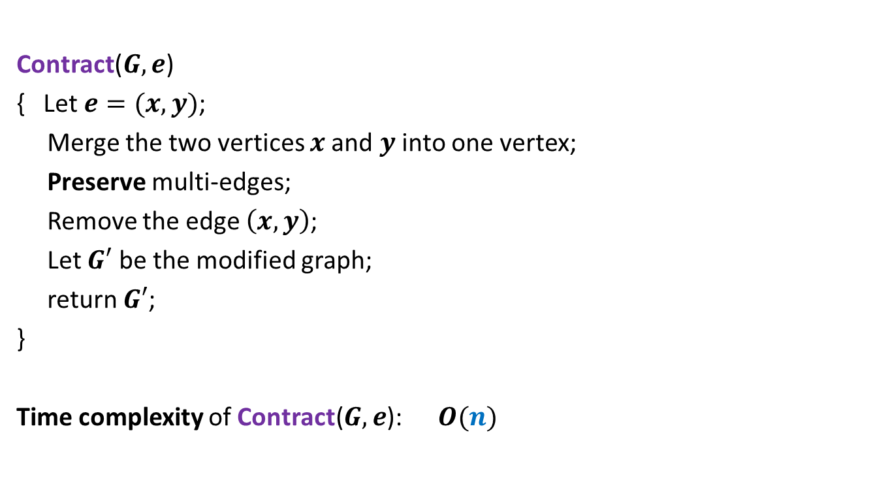

Contract($G,e$)
Contract($G,e$)
{ Let $e=(x,y)$;
Merge the two vertices $x$and $y$ into one vertex;
Preserve multi-edges;
Remove the edge $\left(x,y\right)$;
Let $G′$ be the modified graph;
return $G′$;
}
Time complexity of Contract($G,e$): $O(n)$

Slide 12

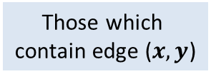


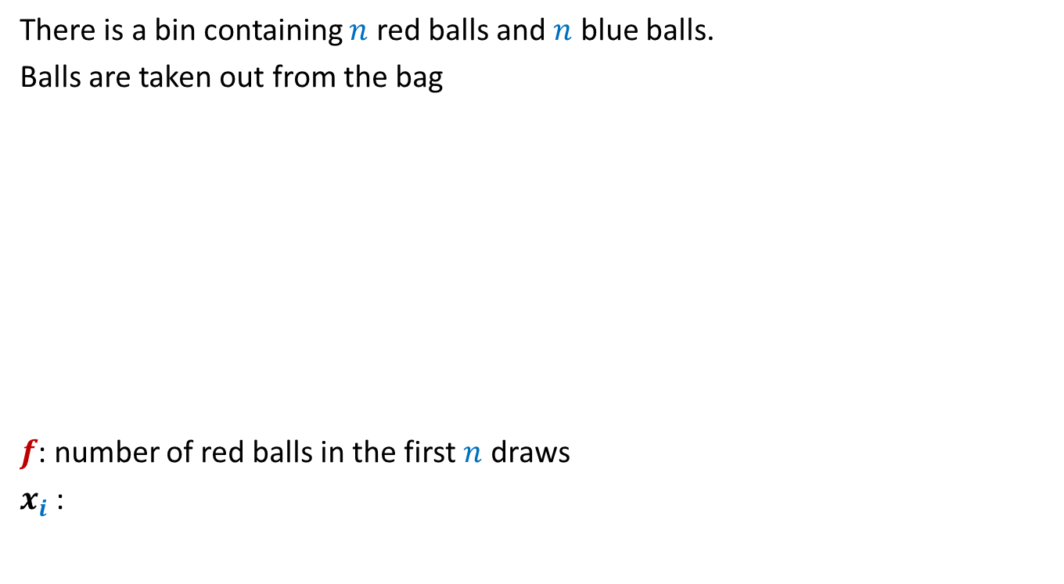
Contract($G,e$)
$$u$$
No
$$x$$
$$a$$
$$l$$
$$v$$
$$y$$
$$b$$
$$h$$
$$w$$
Contract($G,(x,y))$
$$u$$
$$a$$
$$l$$
$$v$$
$$xy$$
$$b$$
$$h$$
$$w$$
Which cuts of $G$ are absent from $G′$ ?
Is a cut of $G$ also a cut of $G′$ ?
Observation:
Every cut of $G′$ is also a cut of $G$.
$$G′$$
Those which
contain edge ($x,y$)
Yes
Yes

Slide 13

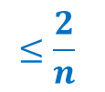
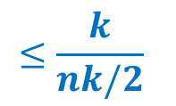
Contract($G,e$)
Let $k$ be the size of min-cut of $G$.
Let $C$ be any min-cut of $G$.
Let $G′$ be the graph after Contract($G,e$).
Question: Under what circumstance will $C$ be a cut of $G′$ ?
Answer: if $e∉C$.
Question: If $e$ is selected randomly uniformly,
what is the probability that $C$ is absent from $G′$ ?
Answer: $\frac{k}{m}$
$$≤\frac{k}{nk/2}$$
$$≤\frac{2}{n}$$

Slide 14

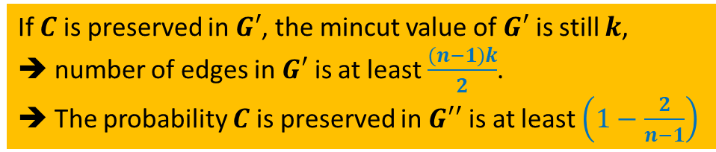
Contract($G,e$)
Let $k$ be the size of min-cut of $G$.
Let $C$ be any min-cut of $G$.
Lemma: If edge $e$ to be contracted is selected randomly uniformly,
$C$ is preserved with probability at least $1−\frac{2}{n}$.
Let $e∈_{r}G$;
$G′$ ← Contract($G,e$).
Let $e′∈_{r}G′$;
$G′′$ ← Contract($G′,e$).
Question: What is probability that $C$ is preserved in $G′′$ ?
Answer:$\left(1−\frac{2}{n}\right).\left(1−\frac{2}{n−1}\right)$
If $C$ is preserved in $G′$, the mincut value of $G′$ is still $k$,
➔ number of edges in $G′$ is at least $\frac{(n−1)k}{2}$.
➔ The probability $C$ is preserved in $G′′$ is at least $\left(1−\frac{2}{n−1}\right)$
Let us apply one more contraction step.
Can you design the algorithm now ?

Slide 15


Algorithm for min-cut
Min-cut($G$):
{ Repeat ?? times
{
Let $e∈_{r}G$;
$G$ ← Contract($G,e$).
}
return the edges of multi-graph $G$;
}
Running time: $O(n^{2})$
$$n−2$$

Slide 16
3
1
3
1
5
5
2
2
4
4
1
1
3,4
3,4
Sample executions
5
5
2
2
1
3,4,5
1
,3,4
2
5
2
1,2,3,4
1
2,3,4,5
5
Success ☺
Failure ☹

Slide 17

Algorithm for min-cut
Question: What is probability that $C$ is preserved during the algorithm ?
Answer: $\left(1−\frac{2}{n}\right).\left(1−\frac{2}{n−1}\right).\left(1−\frac{2}{n−2}\right)…\frac{3}{5}.\frac{2}{4}.\frac{1}{3}$
= $\left(\frac{n−2}{n}\right).\left(\frac{n−3}{n−1}\right).\left(\frac{n−4}{n−2}\right)…\frac{3}{5}.\frac{2}{4}.\frac{1}{3}$
= $\frac{2}{n}.\frac{1}{n−1}$
>$\frac{1}{n^{2}}$
How to increase the success probability ?

Slide 18
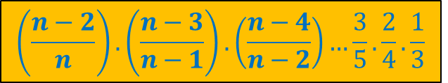
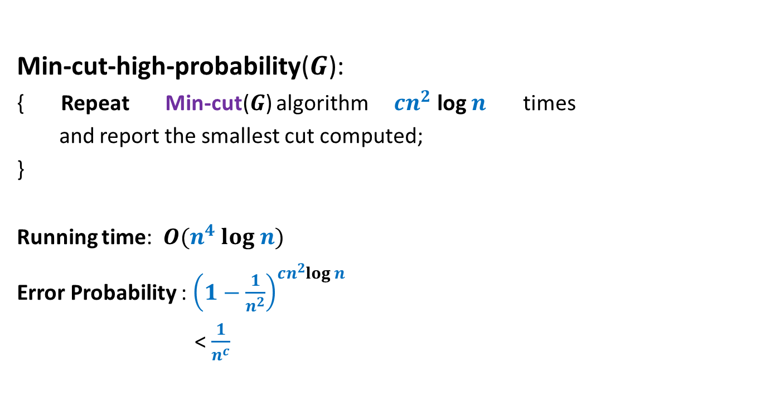
Algorithm for min-cut
Min-cut-high-probability($G$):
{ Repeat Min-cut($G$) algorithm $cn^{2}$ log $n$ times
and report the smallest cut computed;
}
Running time: $O(n^{4} log n)$
Error Probability : ${\left(1−\frac{1}{n^{2}}\right)}^{cn^{2}log n}$
< $\frac{1}{n^{c}}$
$$\left(\frac{n−2}{n}\right).\left(\frac{n−3}{n−1}\right).\left(\frac{n−4}{n−2}\right)…\frac{3}{5}.\frac{2}{4}.\frac{1}{3}$$

Slide 19
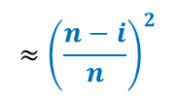
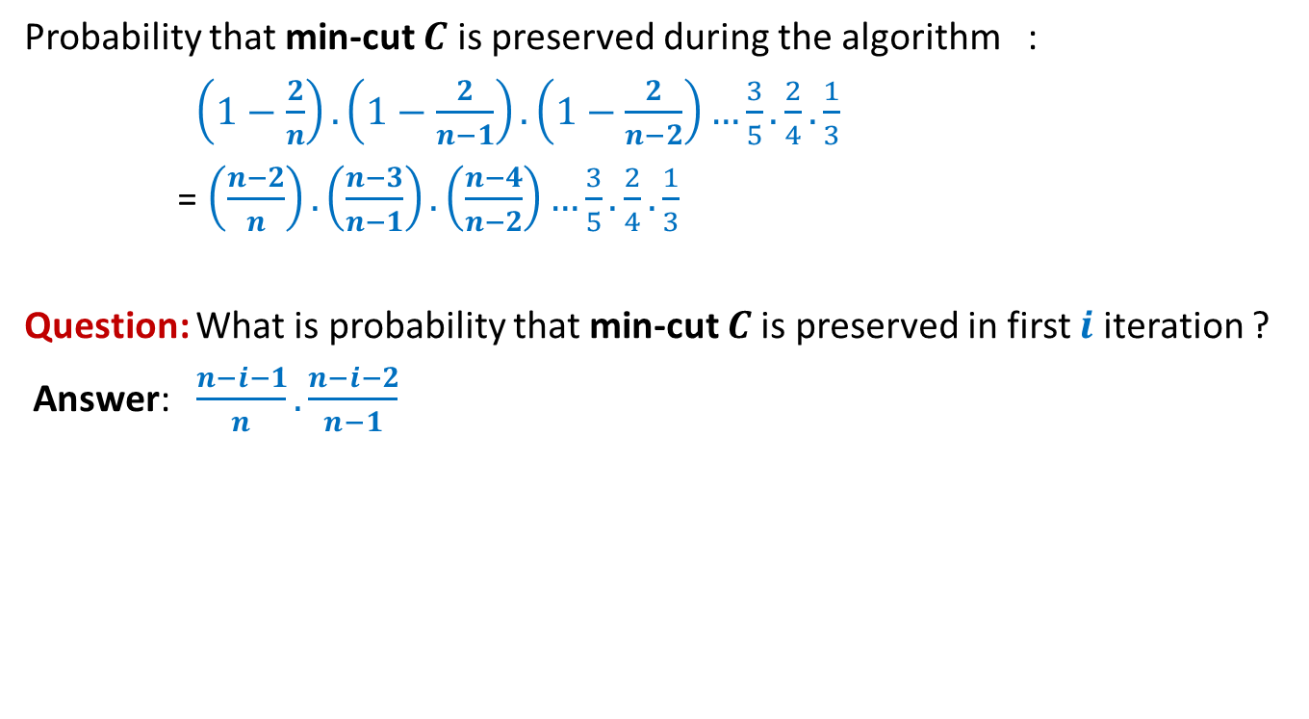
Algorithm for min-cut
Probability that min-cut $C$ is preserved during the algorithm :
$\left(1−\frac{2}{n}\right).\left(1−\frac{2}{n−1}\right).\left(1−\frac{2}{n−2}\right)…\frac{3}{5}.\frac{2}{4}.\frac{1}{3}$
= $\left(\frac{n−2}{n}\right).\left(\frac{n−3}{n−1}\right).\left(\frac{n−4}{n−2}\right)…\frac{3}{5}.\frac{2}{4}.\frac{1}{3}$
Question: What is probability that min-cut $C$is preserved in first $i$ iteration ?
Answer: $\frac{n−i−1}{n}.\frac{n−i−2}{n−1}$
$$≈{\left(\frac{n−i}{n}\right)}^{2}$$

Slide 20


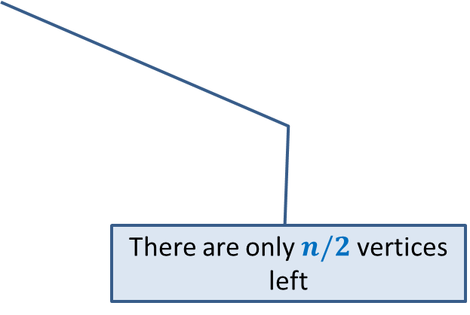
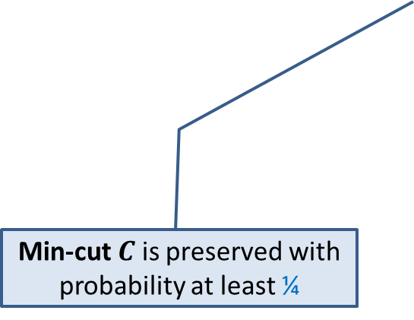
Key observations about Min-Cut algorithm
Algorithm performs $n−2$ contractions :
$$n/2$$
Min-cut $C$ is preserved with probability at least ¼
There are only $n/2$ vertices left
How to exploit these two observations ?
Ponder over this question before coming to next lecture.

Slide 21
Helping Ram distribute the apple among two friends
three
Using least no. of random bits.

Slide 22




How many random bits ?
2-bits Number
$$0 0$$
Shyam
$$0 1$$
Kabir
$$1 0$$
Michael
Repeat
$$1 1$$

Slide 23
Helping Ram distribute the apple among two friends
Using least no. of random bits.

Slide 24
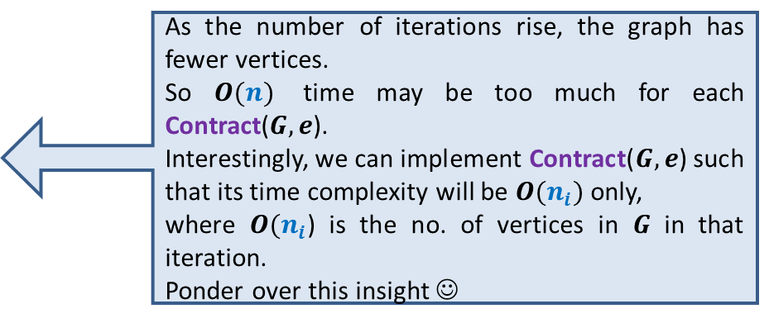
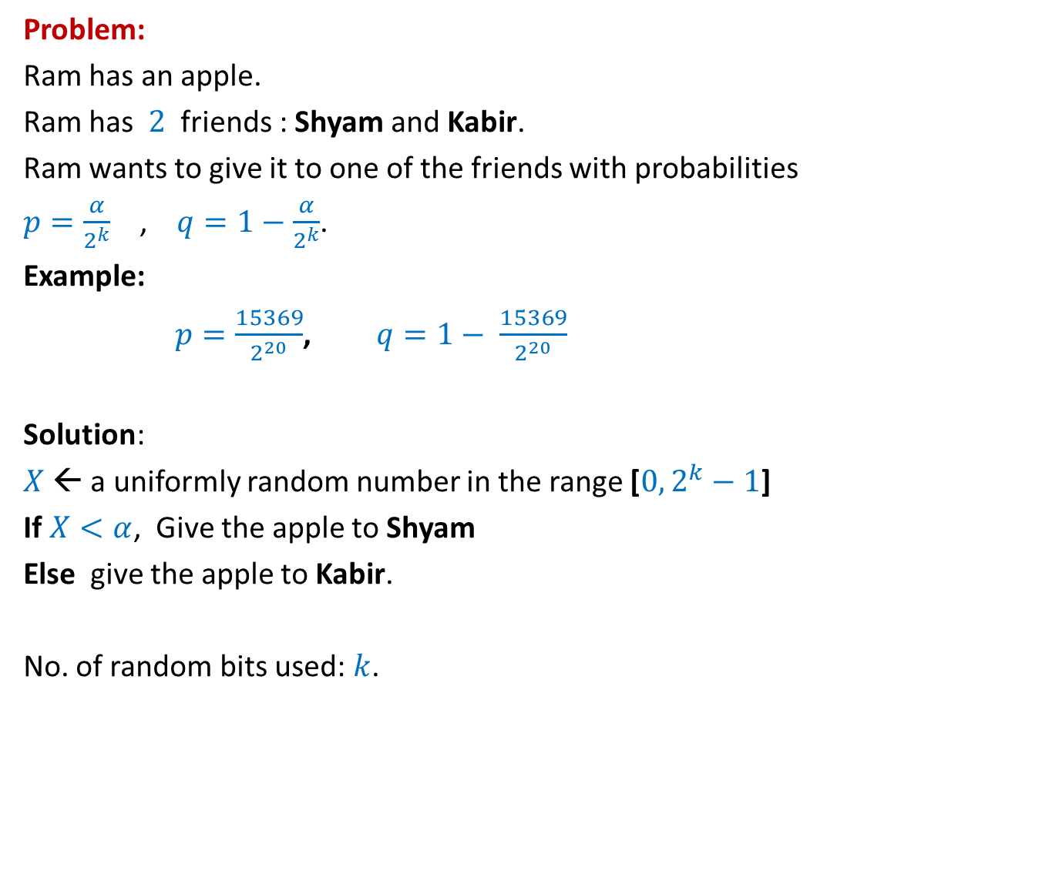
How many random bits ?
Problem:
Ram has an apple.
Ram has $2$ friends : Shyam and Kabir.
Ram wants to give it to one of the friends with probabilities
$p=\frac{α}{2^{k}}$ , $q=1−\frac{α}{2^{k}}$.
Example:
$p=\frac{15369}{2^{20}}$, $q=1− \frac{15369}{2^{20}}$
Solution:
$X$← a uniformly random number in the range [$0,2^{k}−1$]
If $X<α$, Give the apple to Shyam
Else give the apple to Kabir.
No. of random bits used: $k$.
$α$ : any given positive integer $≤2^{k}$
Can we do it in still fewer bits ?
Yes, in expectation ☺

Slide 25

An illustrative example
$$k=2$$
$p=\frac{1}{4}$, and
$1−p=\frac{3}{4}$

Slide 26
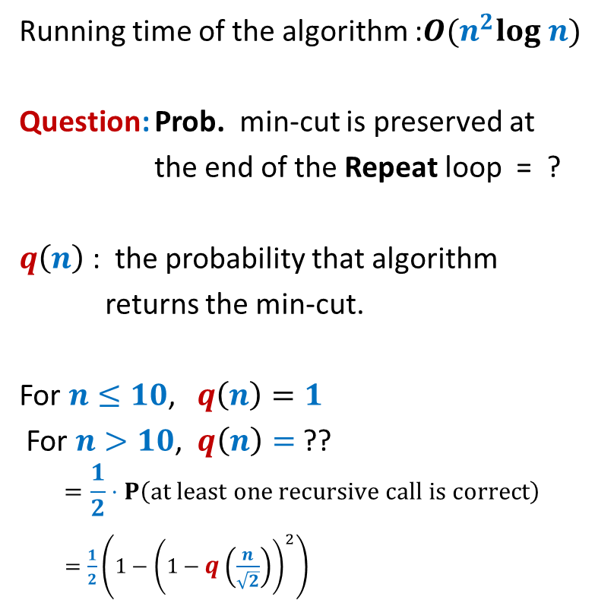
How many random bits ?
2-bits Number
$$0 0$$ | Shyam
$$0 1$$ | Kabir
$$1 0$$
$$1 1$$
Let us generate the random bits lazily
,i.e., only when it is absolutely necessary

Slide 27
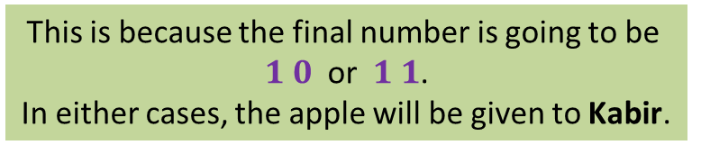


How many random bits ?
No.
2-bits Number
$$0 0$$ | Shyam
$$0 1$$ | Kabir
$$1 0$$
$$1 1$$
This is because the final number is going to be
$1 0$ or $1 1$.
In either cases, the apple will be given to Kabir.
$$1$$
Revealed
If the MSB is $1$,
do we need other bits of the number ?
Let us generate the MSB (Most Significant Bit) first.

Slide 28





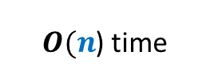
How many random bits ?
Yes.
2-bits Number
$$0 0$$ | Shyam
$$0 1$$
$$1 0$$
$$1 1$$
$X$ : the number of random bits needed.
E[$X$] = $\frac{1}{2}⋅$ E[$X$| MSB is $1$] + $\frac{1}{2}⋅$ E[$X$| MSB is $0$]
= $\frac{1}{2}⋅1+\frac{1}{2}⋅2$ = $\frac{3}{2}⋅$
This is because the final number is going to be
$0 0$ (Shyam)
or $0 1$ (Kabir).
Revealed
$$0$$
But now the problem becomes simpler. Can you see ?
Kabir
If the MSB is $0$,
do we need other bits of the number ?
It is now like the case of $k=1$ now.
$$1$$
$1+$ No. of bits to distribute with $p=\frac{1}{2}$
$$2$$
That is, distributing with $p=\frac{1}{2}$ .

Slide 29
An illustrative example
$$k=3$$
$p=\frac{5}{8}$, and
$1−p=\frac{3}{8}$
Homework: Show that the expected no. of random bits needed is less than 2.

Slide 30
The generic example
$p=\frac{α}{2^{k}}$ , $1−p=\frac{2^{k}−α}{2^{k}}$
Homework: Show that the expected no. of random bits needed is less than 2.

Slide 31

Computing a random sample of size $k$from [$0,n−1$]
In an efficient manner.

Slide 32


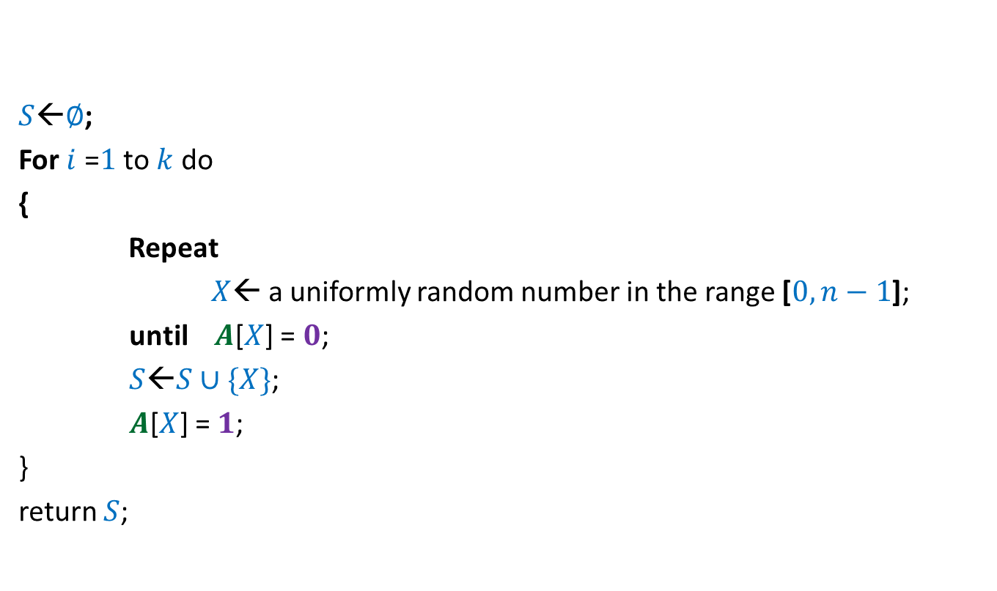



$$0$$ | $$0$$ | $$0$$ | $$0$$ | $$0$$ | $$0$$ | $$0$$ | $$0$$
$$A$$
$$1$$
$$1$$
$$1$$
$$1$$
$S$←$∅$;
For $i$ =$1$ to $k$ do
{
Repeat
$X$← a uniformly random number in the range [$0,n−1$];
until $A$[$X$] = $0$;
$S$←$S∪\{X\}$;
$A$[$X$] = $1$;
}
return $S$;
$$0 1 … n−1$$
Homework: What is the expected no. of random bits needed ?

Slide 33

Computing a random permutation of [$0,n−1$]
In an efficient manner.

Slide 34

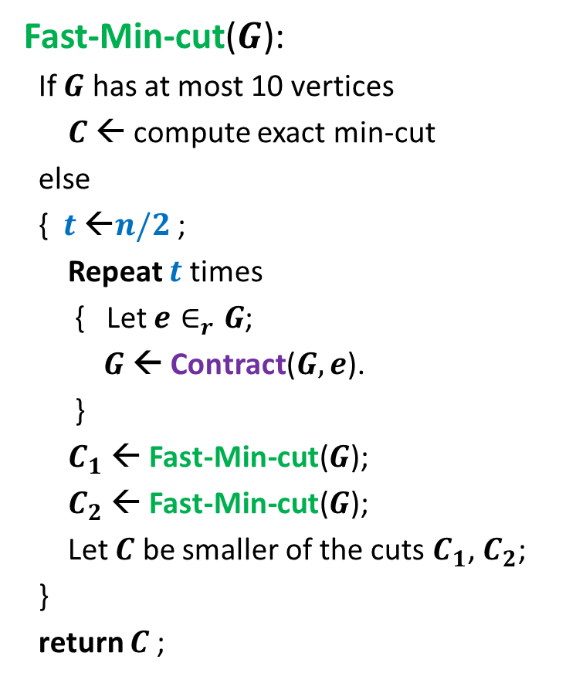

$$0$$ | $$0$$ | $$0$$ | $$0$$ | $$0$$ | $$0$$ | $$0$$ | $$0$$
$$A$$
$$1$$
$$1$$
$$1$$
$$1$$
$$1$$
$$1$$
$S$←empty string;
For $i$ =$1$ to $n$ do
{
Repeat
$X$← a uniformly random number in the range [$0,n−1$];
until $A$[$X$] = $0$;
$S$←$S∷X$;
$A$[$X$] = $1$;
}
return $S$;
$$0 1 … n−1$$
Homework: What is the expected no. of random bits used ?
Homework: Can you reduce the number random bits used ?

