Slide 1
Randomized Algorithms CS648
Lecture 2
Approximate Median (from last class)
Algebraic Techniques
Fingerprinting Techniques
Frievald’s Technique

Slide 2
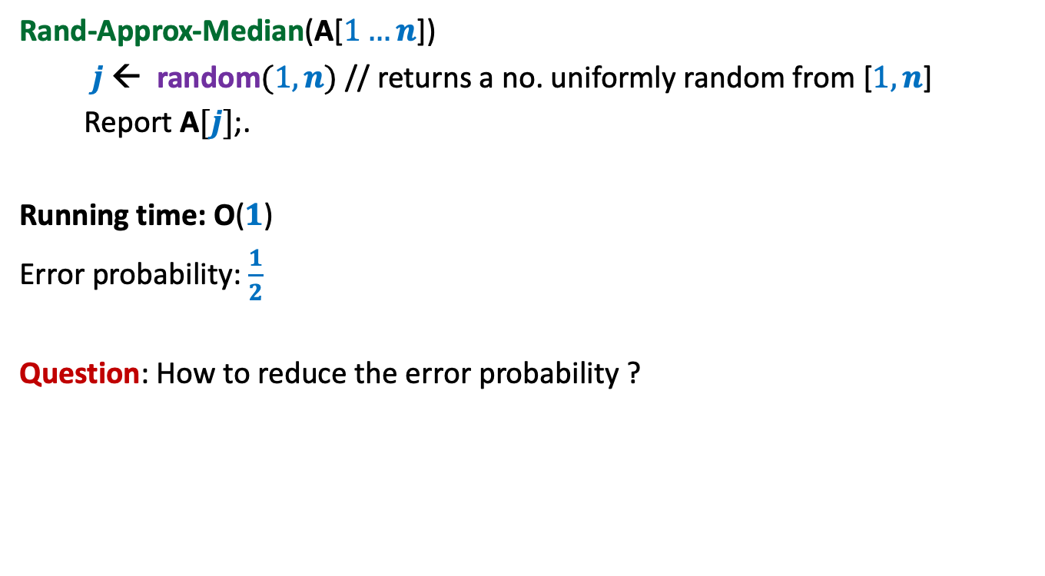
½ - Approximate median A Randomized Algorithm
Rand-Approx-Median(A[$1…n$])
$j$ ← random$(1,n)$ // returns a no. uniformly random from [$1,n$]
Report A$[j]$;.
Running time: O($1$)
Error probability: $\frac{1}{2}$
Question: How to reduce the error probability ?

Slide 3
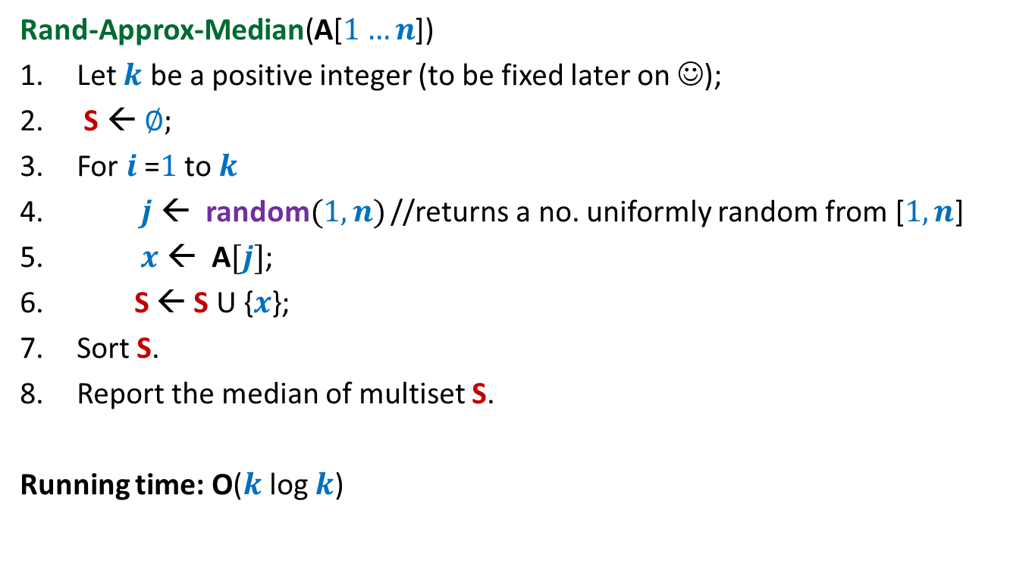
½ - Approximate median A Randomized Algorithm
Rand-Approx-Median(A[$1…n$])
Let $k$ be a positive integer (to be fixed later on ☺);
S ← ∅;
For $i$=$1$ to $k$
$j$ ← random$(1,n)$ //returns a no. uniformly random from [$1,n$]
$x$ ← A$[j]$;
S ← S U {$x$};
Sort S.
Report the median of multiset S.
Running time: O($k$ log $k$)

Slide 4




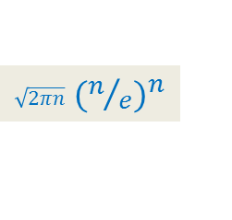
A simple probability exercise
P[HEADS] = ¼
P[TAILS] = ¾
The coin is tossed $k$ times.
[Stirling’s approximation for Factorial: $n! ≈$ ? ]
What is the probability that we get at least $k/2$ HEADS ?
$${ ≤\left(1/2\right)}^{k/5}$$
Last class
$\sqrt{2πn}$ ${(n/e)}^{n}$

Slide 5


Analyzing the error probability of Rand-approx-median
$$n/4$$
Elements of A arranged in Increasing order of values
$$3n/4$$
Left Quarter
Right Quarter
Lets us consider an instance of sample set S

Slide 6
Analyzing the error probability of Rand-approx-median
$$n/4$$
Elements of A arranged in Increasing order of values
$$3n/4$$
Median of S
Left Quarter
Right Quarter
Answer is correct
When does Rand-approx-median make an error ?

Slide 7
Analyzing the error probability of Rand-approx-median
$$n/4$$
Elements of A arranged in Increasing order of values
$$3n/4$$
Median of S
Left Quarter
Right Quarter
Answer is incorrect
What might have gone wrong with S ?

Slide 8
Analyzing the error probability of Rand-approx-median
Observation:
Rand-approx-median makes an error if and only if
……………………………………………?.......................................
$$n/4$$
Elements of A arranged in Increasing order of values
$$3n/4$$
Median of S
Left Quarter
Right Quarter
More than $k/2$ elements got sampled from the Right Quarter
(or Left Quarter).

Slide 9

Analyzing the error probability of Rand-approx-median
Pr[ An element selected randomly from A is from Right quarter] = ??
Pr[ Out of $k$ elements sampled from A, at least $k/2$ are from Right quarter] = ??
$≤{ (1/2)}^{k/5}$
$={ (1/2)}^{2 log{ n}}$ for $k=10\log{n}$
$={ n}^{−2}$
$$n/4$$
Elements of A arranged in Increasing order of values
$$3n/4$$
Left Quarter
Right Quarter
¼
Exactly the same as the coin tossing exercise we did ☺ !

Slide 10

Theorem:
The Rand-approx-median algorithm fails to report ½ -approximate median
from array A[1.. $n$] with probability at most${ 2 n}^{−2}$.

Slide 11
Fingerprinting technique
Application
Checking equality of files

Slide 12



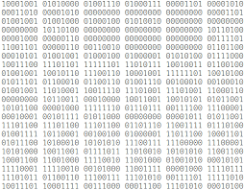

Fingerprinting
Fingerprints don’t capture the complete information of a person. Still fingerprinting is used and it works well in practice. What is the reason ?
Reason: The aim is to be able to distinguish two different persons. For this purpose finger prints suffice since every two human beings (even twins) have distinct finger prints.
Applications : Cryptography

Slide 13

A motivating example from real world
Queries or updates
Database

Slide 14
A motivating example from real world
New Delhi
New York
Synchronize at regular intervals

Slide 15





The Problem
Aim: To determine if File A is identical to File B by communicating fewest bits ?
Network
File A
File B
size(A) = $n$ bits
size(B) = $n$ bits
 | No. of bits to be sent
Deterministic algorithm
$$n$$
Randomized algorithm
O(log($n$))

Slide 16






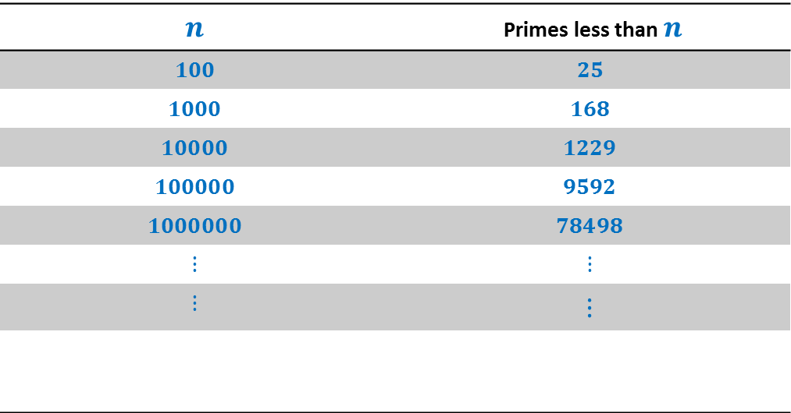
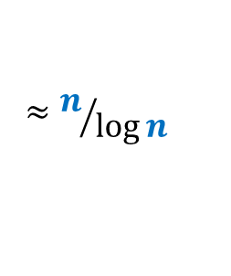




How many primes less than $n$ ?
$$n$$ | Primes less than $n$
$$100$$ | $$25$$
$$1000$$ | $$168$$
$$10000$$ | $$1229$$
$$100000$$ | $$9592$$
$$1000000$$ | $$78498$$
$$⋮$$ | $$⋮$$
$$⋮$$ | $$⋮$$
$π\left(n\right)$:
$$π\left(n\right)$$
$$≈n/{\log{n}}$$
Huge gap
Interestingly this simple fact alone will be used in devising the algorithm.
How many prime factors of $n$ ?
$$<\log{n}$$
$$=$$
$$2^{2}∙5^{3}∙7$$
$$3500$$
$$2^{2}∙5^{3}∙7$$
$$\{2,5,7\}$$
Notes:
Randomization will exploit this huge difference to achieve a very simple and elegant algorithm.

Slide 17
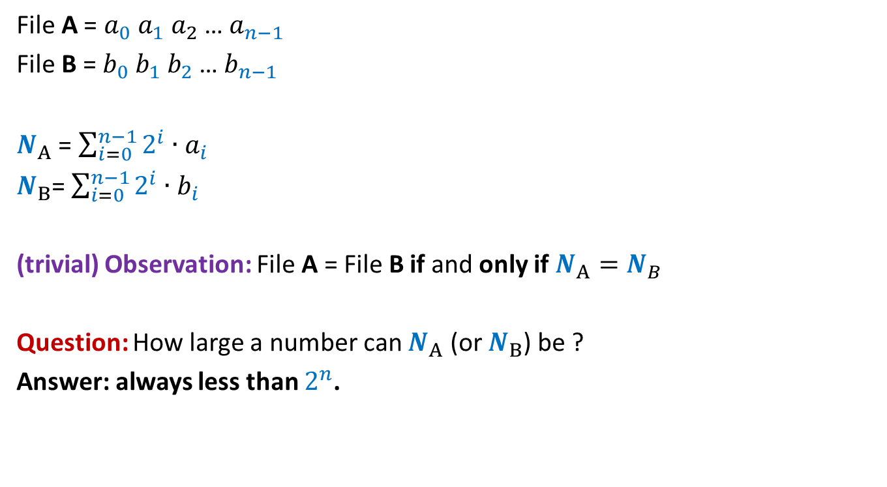
Key idea: Visualize a file as a binary number
File A = $a_{0} a_{1} a_{2}$… $a_{n−1}$
File B = $b_{0} b_{1} b_{2}$… $b_{n−1}$
$N_{A}$ = $\sum_{i=0}^{n−1}{2^{i}∙a_{i}}$
$N_{B}$= $\sum_{i=0}^{n−1}{2^{i}∙b_{i}}$
(trivial) Observation: File A = File B if and only if $N_{A}=N_{B}$
Question: How large a number can $N_{A}$ (or $N_{B}$) be ?
Answer: always less than $2^{n}$.

Slide 18

Network
File A
File B
size(A) = $n$ bits
size(B) = $n$ bits
What should be ?

Slide 19
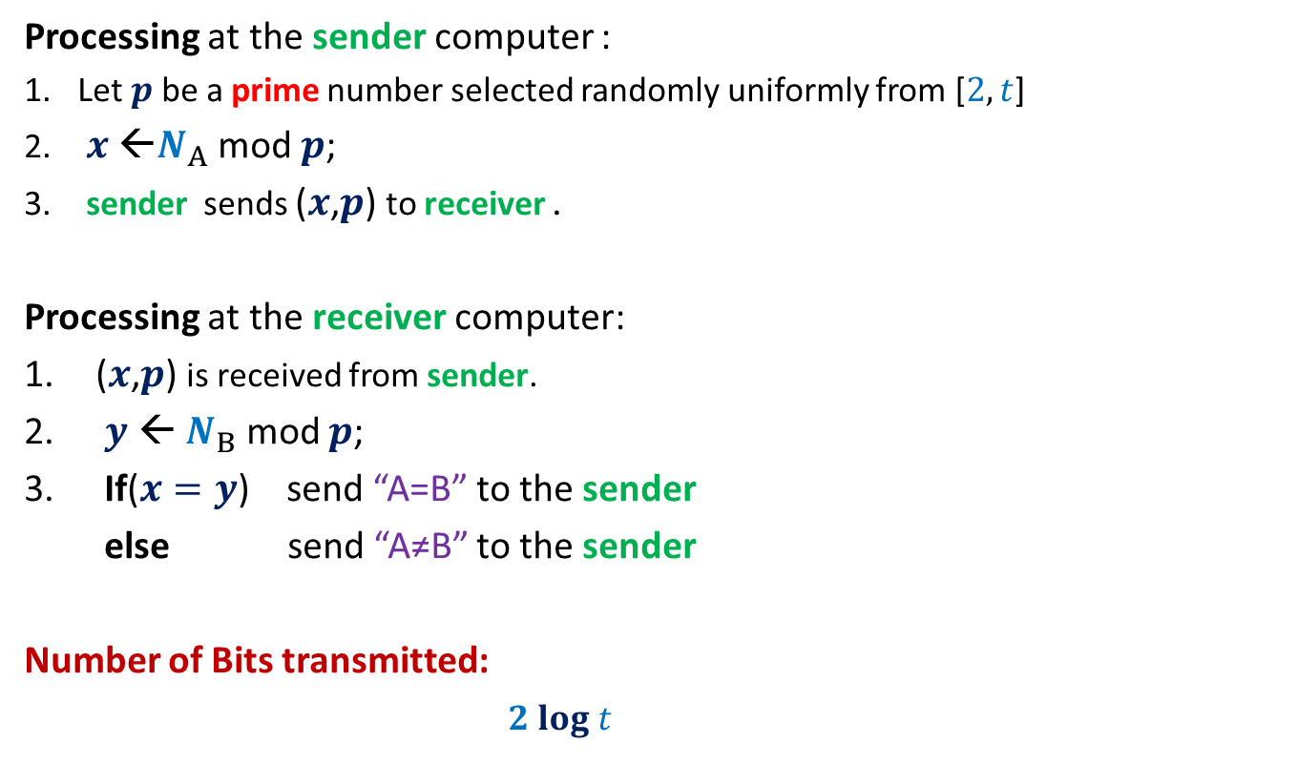
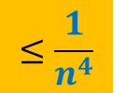
RandomEqualityChecking-Protocol($A$,$B$)
Processing at the sender computer :
Let $p$be a prime number selected randomly uniformly from [$2,t$]
$x$ ←$N_{A}$ mod $p$;
sender sends ($x$,$p$) to receiver .
Processing at the receiver computer:
($x$,$p$) is received from sender.
$y$ ← $N_{B}$ mod $p$;
If($x=y$) send “A=B” to the sender
else send “A≠B” to the sender
Number of Bits transmitted:
$2 log t$

Slide 20





Error Analysis
Cases
$$N_{A}=N_{B}$$
No error
$N_{A}mod p=N_{B} mod p$
$$N_{A}mod p=N_{B} mod p$$
$$N_{A}≠N_{B}$$
?
$$with some probability$$

Slide 21






Error Analysis
Cases
Let $d$ = $|N_{A}− N_{B}|$
Observation: If $N_{A}≠N_{B}$, then surely $d>0$.
The protocol makes an error if and only if
$N_{A} mod p=N_{B} mod p$
$N_{A} mod p−N_{B} mod p=0$
($N_{A} −N_{B}$) $mod p$ $=0$
$p$divides $d$
$$N_{A}=N_{B}$$
No error
$N_{A}mod p=N_{B} mod p$
$$N_{A}mod p=N_{B} mod p$$
$$N_{A}≠N_{B}$$
?
$$with some probability$$

Slide 22











Error Analysis
Cases
$$N_{A}=N_{B}$$
No error
$N_{A}mod p=N_{B} mod p$
$$N_{A}mod p=N_{B} mod p$$
$$N_{A}≠N_{B}$$
$$≤\frac{n}{π(t)}$$
$$with some probability$$
$$1$$
$$d$$
$$2^{n}$$
The prime factors of $d$
$$≤n$$
$$1$$
$$t$$
prime numbers in the range [$2,t$].
$$≈\frac{t}{log t }$$
$$π(t)$$

Slide 23

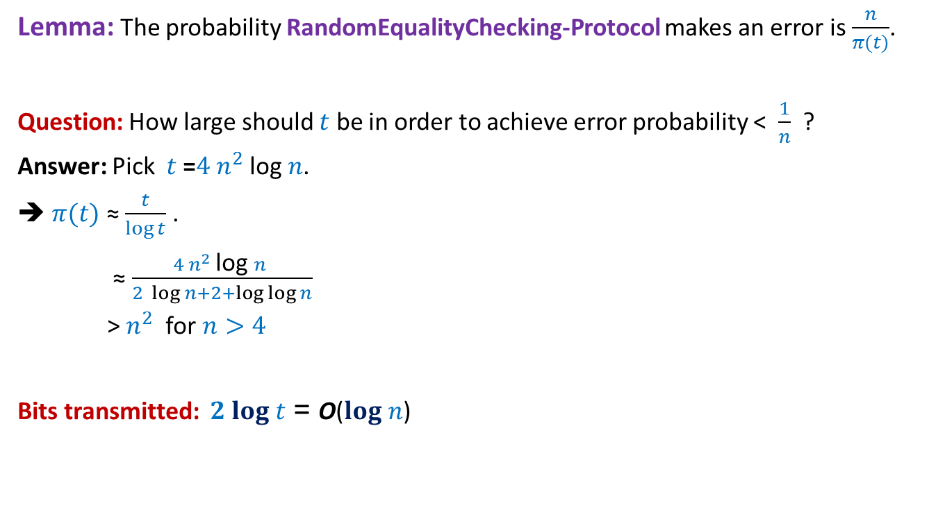
Error Analysis
Lemma: The probability RandomEqualityChecking-Protocol makes an error is $\frac{n}{π(t)}$.
Question: How large should $t$ be in order to achieve error probability < $\frac{1}{n}$ ?
Answer: Pick $t$ =$4 n^{2}$log $n$.
➔ $π(t)$ ≈ $\frac{t}{\log{t}}$ .
≈ $\frac{4 n^{2} \text{log} n }{2 \log{n}+2+\log{\log{n}}}$
> $n^{2}$ for $n>4$
Bits transmitted: $2 log t$ = O($log n$)
$$≈\frac{t}{log t }$$
$$π(t)$$

Slide 24
Frievald’s technique
Application : Matrix Product verification

Slide 25

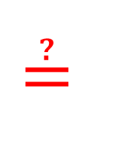




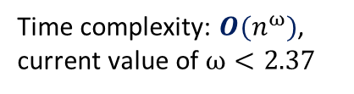


Frievald’s Algorithm (Rusins Frievald, 1977)
Problem: Given three $n$-by-$n$matrices $A$, $B$, and $C$, determine if $C≟A⨯B$.
Best deterministic algorithm:
$D$ ← $A⨯B$;
Verify if $C=D$ ?
$$1 2 … n$$
$$1$$
2
$$⋮$$
$$n$$
$$≟$$
$$⨯$$
$$C$$
$$A$$
$$B$$
Time complexity: $O(n^{ω})$,
current value of $ω<2.37$
STOC 2012

Slide 26













Frievald’s Algorithm (Rusins Frievald, 1977)
$$1$$
0
$$⋮$$
$$1$$
$$1$$
0
$$⨯$$
$$⨯$$
$$A$$
$$B$$
$$x$$
$$y$$
$$≟$$
$$1$$
0
$$⋮$$
$$1$$
$$1$$
0
$$⨯$$
$$C$$
$$x$$
$$z$$

Slide 27

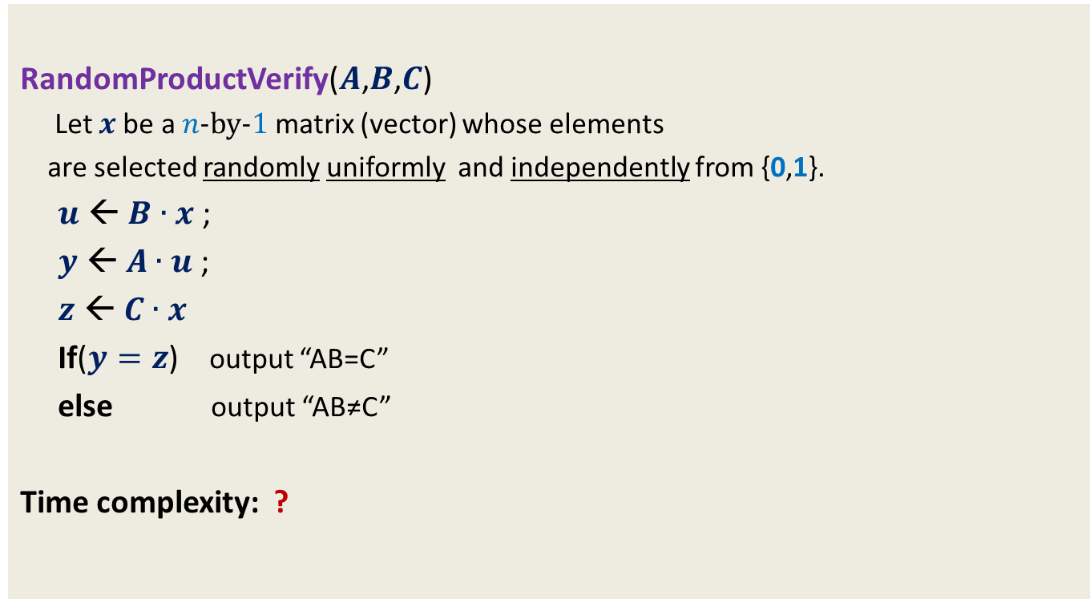
Frievald’s Algorithm (Rusins Frievald, 1977)
RandomProductVerify($A$,$B$,$C$)
Let $x$be a $n$-by-$1$matrix (vector) whose elements
are selected randomly uniformly and independently from {0,1}.
$u$ ← $B∙x$ ;
$y$ ← $A∙u$ ;
$z$ ← $C∙x$
If($y=z$) output “AB=C”
else output “AB≠C”
Time complexity: ?
$$O(n^{2})$$

Slide 28




Error Analysis
Cases
$$A∙B=C$$
No error
$$A∙B∙x=C∙x$$
$$A∙B∙x=C∙x$$
$$A∙B≠C$$
?
$$with some probability$$

Slide 29

Error Analysis
Cases
Let $D$= $A∙B−C$
Observation: If $A∙B≠C$ ➔ $D$ is not a null matrix.
Error Probability of the algorithm = P( $A∙B∙x=C∙x$ )
$A∙B∙x=C∙x$
$A∙B∙x −C∙x=0$
($A∙B −C$) $∙x$ $=0$
$D∙x=0$
$$A∙B=C$$
No error
$$A∙B∙x=C∙x$$
$$A∙B∙x=C∙x$$
$$A∙B≠C$$
?
$$with some probability$$
null vector

Slide 30



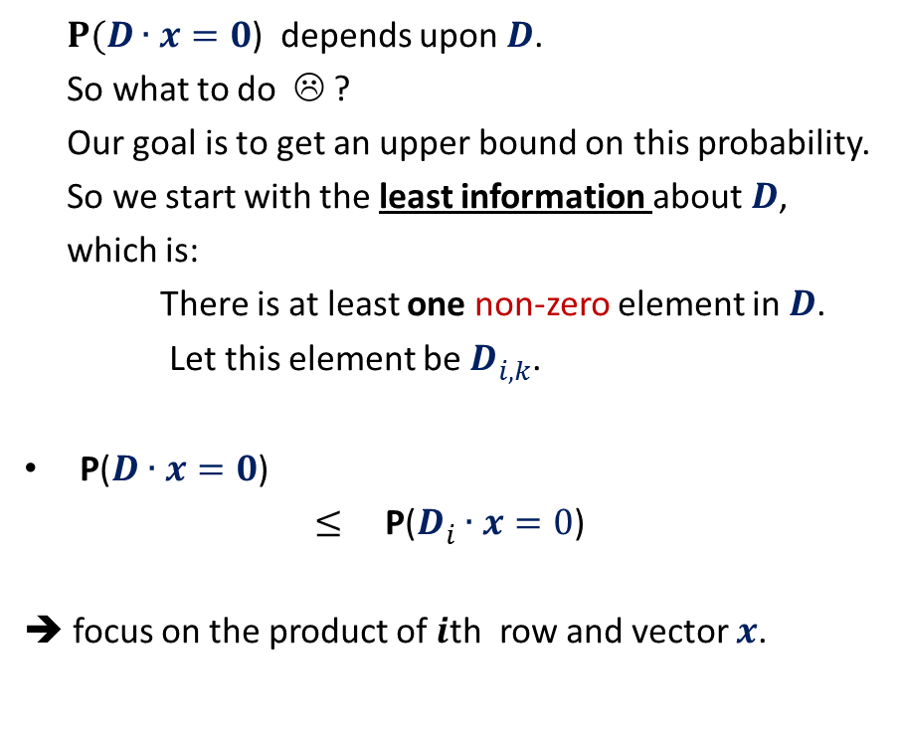

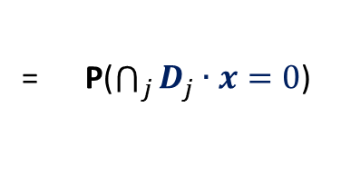

Frievald’s Algorithm (Analyzing error probability)
$$k$$
$P(D∙x=0$) depends upon $D$.
So what to do ☹ ?
Our goal is to get an upper bound on this probability.
So we start with the least information about $D$,
which is:
There is at least one non-zero element in $D$.
Let this element be $D_{i,k}^{}$.
P($D∙x=0$)
$≤$ P($D_{i}^{}∙x=0$)
➔ focus on the product of $i$th row and vector $x$.
$$1 2 … n$$
$$1$$
2
$$⋮$$
$$n$$
$$⨯$$
$$i$$
= P($\bigcap_{j}{D_{j}^{}∙x=0}$)
$$D$$
$$x$$
What is the relation between the two ?

Slide 31


Frievald’s Algorithm (Analyzing error probability)
$$k$$
P($D_{i}^{}∙x=0$) = P($D_{i1}^{}$ $∙x_{1}$ + … + $D_{in}^{}$ $∙x_{n}$ = 0)
The underlying sample space has $2^{n}$ elementary events.
Convince yourself that it is indeed difficult to calculate this probability from standard tools which you know.
Here we shall use a simple but powerful probability tool…
$$1 2 … n$$
$$1$$
2
$$⋮$$
$$n$$
$$⨯$$
$$i$$
$$D$$
$$x$$

Slide 32



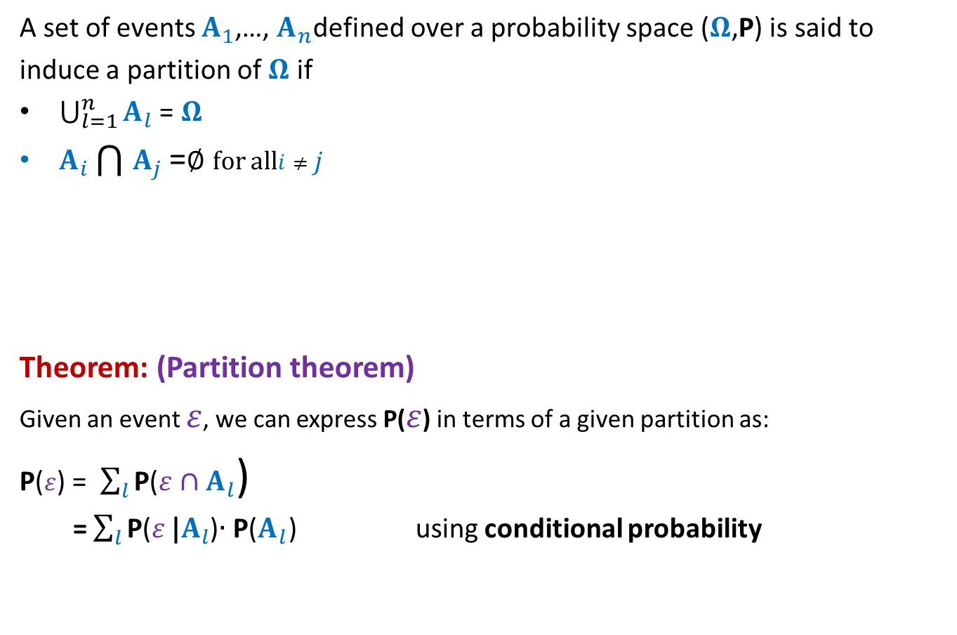




Probability tool: Partition of sample space
A set of events $A_{1}$,…, $A_{n}$defined over a probability space ($Ω$,P) is said to
induce a partition of $Ω$ if
$\bigcup_{l=1}^{n}{A_{l}}$ = $Ω$
$A_{i}\bigcap{A_{j}}$ =∅ for all$i≠j$
Theorem: (Partition theorem)
Given an event $ε$, we can express P($ε$) in terms of a given partition as:
P($ε$) = $\sum_{l}{\text{P}\text{(}ε}∩A_{l}$)
= $\sum_{l}{\text{P}\text{(}ε}\text{|}A_{l}$)∙ $\text{P}\text{(}A_{l}\text{)}$ using conditional probability
$$A_{2}$$
$$A_{3}$$
$$A_{4}$$
$$ε$$
$$A_{5}$$
$$A_{1}$$
Ω
$$A_{6}$$

Slide 33
Question: When to use the Partition theorem ?
Let be $ε$an event defined over a probability space ($Ω$,P).
Suppose it turns out that it is not easy to calculate or get a good bound on P($ε$) directly using the standard tools. In such situation, one may explore the following possibility:
Try to design a partition {$A_{1}$,…, $A_{n}$} of the sample space such that $\text{P}\text{(}ε|A_{l}$) is easy to calculate. This may be used to calculate $\text{P}\text{(}ε$).
IMPORTANT: Most of the times, $\text{P}\text{(}ε|A_{l}$) turns out to be independent of $l$. In this case, $\text{P}\text{(}ε$) can be bounded directly as follows.
If $\text{P}\text{(}ε$|$A_{l}$) $≤α$ for every possible value of $l$, then
P($ε$) = $\sum_{l}{\text{P}\text{(}ε}\text{|}A_{l}$)∙ $\text{P}\text{(}A_{l}\text{)}$
$≤\sum_{l}{α}$∙ $\text{P}\text{(}A_{l}\text{)}$
$=α\sum_{l}{\text{P}\text{(}A_{l}\text{) }}$
$=α$

Slide 34


Frievald’s Algorithm (Analyzing error probability)
$$ε$$
P( $D_{i1}^{}$ $∙x_{1}$ + … + $D_{in}^{}$ $∙x_{n}$ = 0 ) = ??
Question:
What can be the suitable partition of $Ω$?
Homework:
Make sincere attempt to complete the analysis.

