Slide 1
Randomized Algorithms CS648
Lecture 25
Random bit complexity
Derandomization

Slide 2
Random bit complexity
Definition : The total number of random bits taken from the Random Bit Generator by the algorithm is called its Random bit complexity.
Input
A Randomized Algorithm
(Min-Cut, QuickSort, RIC,…)
Random Bit generator

Slide 3
Recall the notion of independence

Slide 4

Types of independences
Definition: $ε_{1},…,ε_{n}$ are said to be mutually independent if
$P\left(\bigcap_{i}{ε_{i}}\right)=\prod_{i}{P(ε_{i})}$
Definition: $ε_{1},…,ε_{n}$ are said to be pairwise independent if
for every $1≤i<j≤n$
$P\left(ε_{i}∩ε_{j}\right)=P(ε_{i})$∙ $P(ε_{j})$

Slide 5
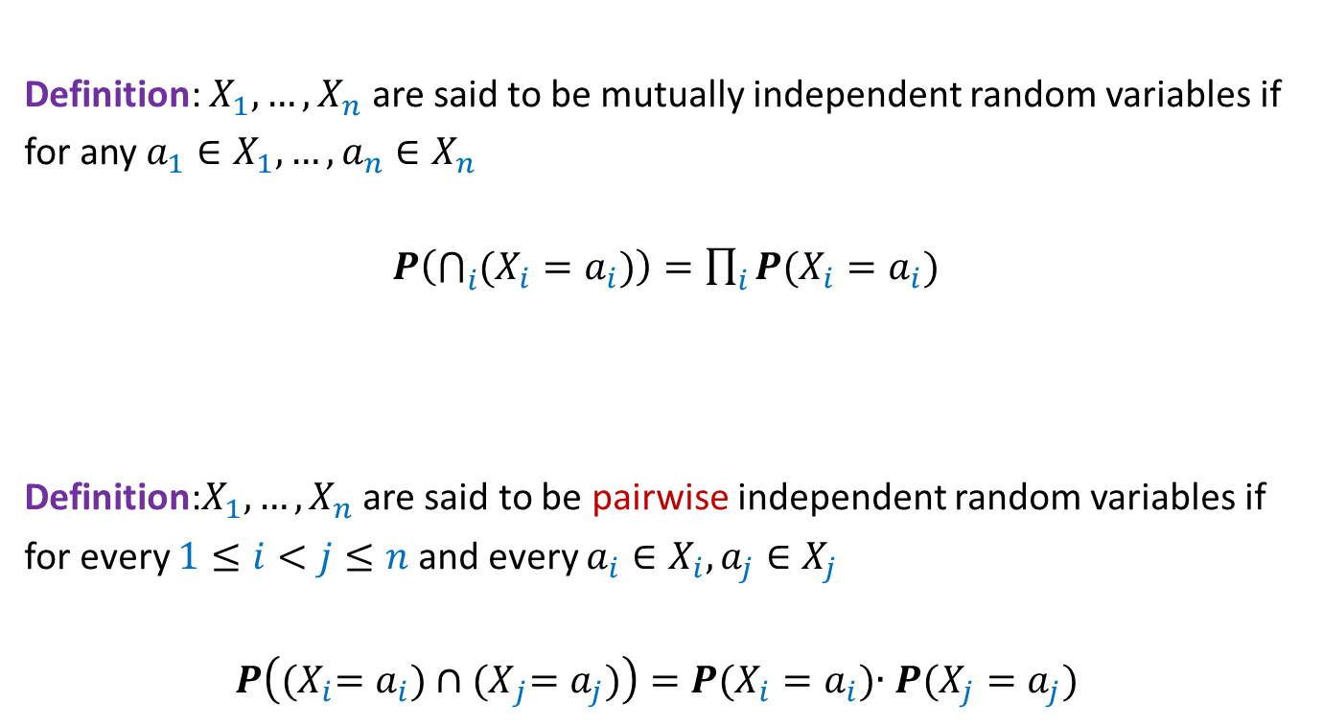
Types of independences
Definition: $X_{1},…,X_{n}$ are said to be mutually independent random variables if
for any $a_{1}∈X_{1},…,a_{n}∈X_{n}$
$P\left(\bigcap_{i}{(X_{i}=a_{i})}\right)=\prod_{i}{P(X_{i}=a_{i})}$
Definition:$X_{1},…,X_{n}$ are said to be pairwise independent random variables if
for every $1≤i<j≤n$ and every $a_{i}∈X_{i},a_{j}∈X_{j}$
$P\left({(X}_{i}=a_{i})∩{(X}_{j}=a_{j})\right)=P(X_{i}=a_{i})$∙ $P(X_{j}=a_{j})$

Slide 6
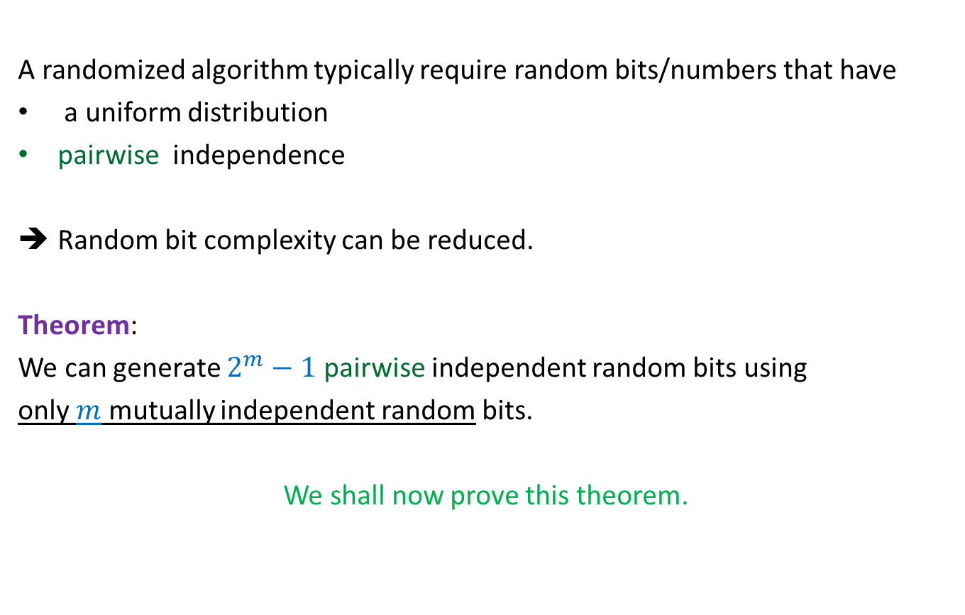
Important facts
A randomized algorithm typically require random bits/numbers that have
a uniform distribution
pairwise independence
Random bit complexity can be reduced.
Theorem:
We can generate $2^{m}−1$ pairwise independent random bits using
only $m$ mutually independent random bits.
We shall now prove this theorem.

Slide 7
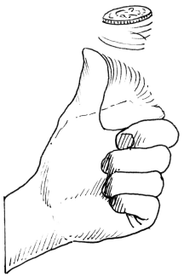

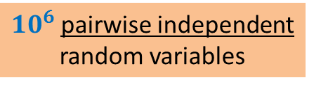

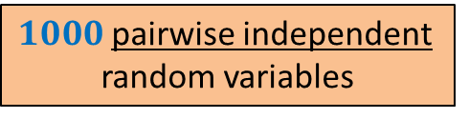
$1000$pairwise independent
random variables
$10^{6}$pairwise independent
random variables
$10$ tosses of a fair coin
$20$tosses of a fair coin

Slide 8
Generating Uniformly Random and pairwise independent Bits
using few truly random bits

Slide 9

















Generating Uniformly Random and pairwise independent Bits
Let $X_{0},…,X_{m−1}$ be $m$ mutually independent random bits.
Aim: To generate $2^{m}−1$ pairwise independent random bits $\{Y_{i}\}$
Key idea: Generate all non-empty subsets of {$X_{0},…,X_{m−1}$}
Ex:$m=3$
Why the XOR operation $⊕$ ? You should get its answer yourself after a few slides…
2 1 0
0 | 0 | 0
0 | 0 | 1
0 | 1 | 0
0 | 1 | 1
1 | 0 | 0
1 | 0 | 1
1 | 1 | 0
1 | 1 | 1
{ $X_{0}$ }
$$Y_{1}$$
$$Y_{2}$$
$$Y_{3}$$
$$Y_{4}$$
$$Y_{5}$$
$$Y_{6}$$
$$Y_{7}$$
$$X_{0}$$
{ $X_{1}$ }
$$X_{1}$$
{ ${X_{1},X}_{0}$ }
$$X_{1}⊕X_{0}$$
{ $X_{2}$ }
$$X_{2}$$
{ $X_{2}$, $X_{0}$ }
$$X_{2}⊕X_{0}$$
{ $X_{2}$, $X_{1}$ }
$$X_{2}⊕X_{1}$$
{ $X_{2}$, $X_{1}$, $X_{0}$ }
$$X_{2}⊕X_{1}⊕X_{0}$$

Slide 10
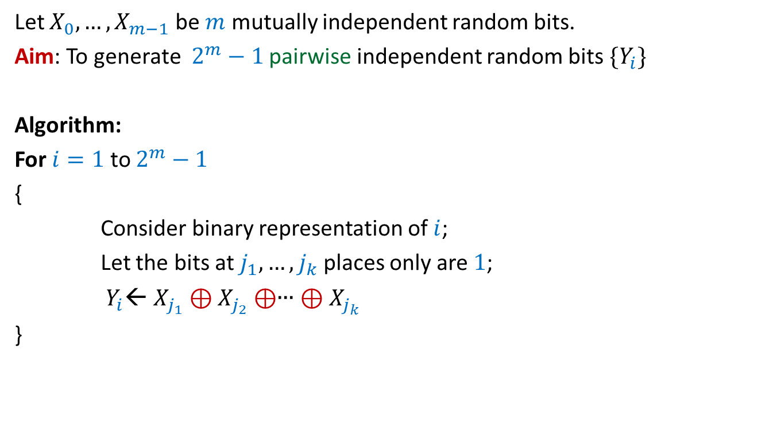
Generating Uniformly Random and pairwise independent Bits
Let $X_{0},…,X_{m−1}$ be $m$ mutually independent random bits.
Aim: To generate $2^{m}−1$ pairwise independent random bits $\{Y_{i}\}$
Algorithm:
For $i=1$ to $2^{m}−1$
{
Consider binary representation of $i$;
Let the bits at $j_{1},…,j_{k}$ places only are $1$;
$Y_{i}$← $X_{j_{1}}⊕X_{j_{2}}⊕$∙∙∙ $⊕X_{j_{k}}$
}

Slide 11
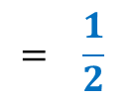
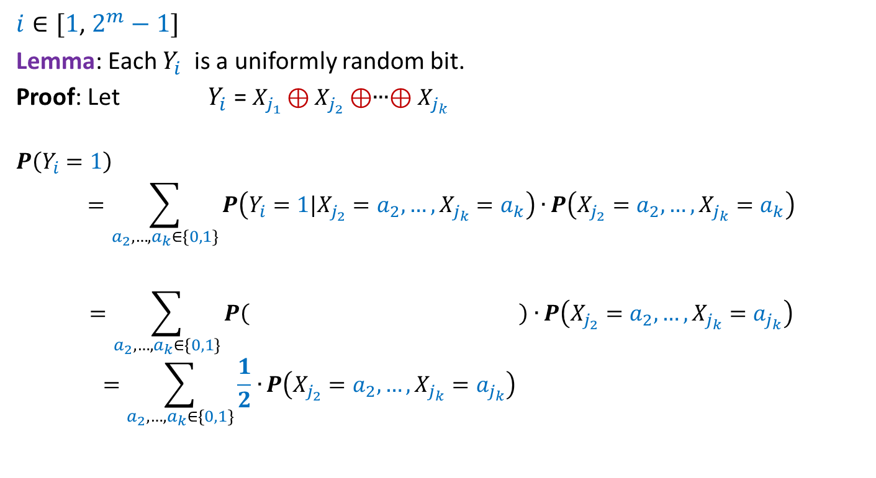

Generating Uniformly Random and pairwise independent Bits
$i∈[1$, $2^{m}−1]$
Lemma: Each $Y_{i}$ is a uniformly random bit.
Proof: Let $Y_{i}$ = $X_{j_{1}}⊕X_{j_{2}}⊕$∙∙∙$⊕X_{j_{k}}$
$$P\left(Y_{i}=1\right)$$
$$=\sum_{a_{2},…,a_{k}∈\{0,1\}}{P\left(Y_{i}=1|X_{j_{2}}=a_{2},…,X_{j_{k}}=a_{k}\right)∙}P\left(X_{j_{2}}=a_{2},…,X_{j_{k}}=a_{k}\right)$$
$$=\sum_{a_{2},…,a_{k}∈\{0,1\}}{P\left( \right)∙}P\left(X_{j_{2}}=a_{2},…,X_{j_{k}}=a_{j_{k}}\right)$$
$$=\sum_{a_{2},…,a_{k}∈\{0,1\}}{\frac{1}{2}∙}P\left(X_{j_{2}}=a_{2},…,X_{j_{k}}=a_{j_{k}}\right)$$
$$X_{j_{1}}⊕a_{2}⊕\text{∙∙∙}⊕a_{k}=1$$
$$= \frac{1}{2}$$

Slide 12



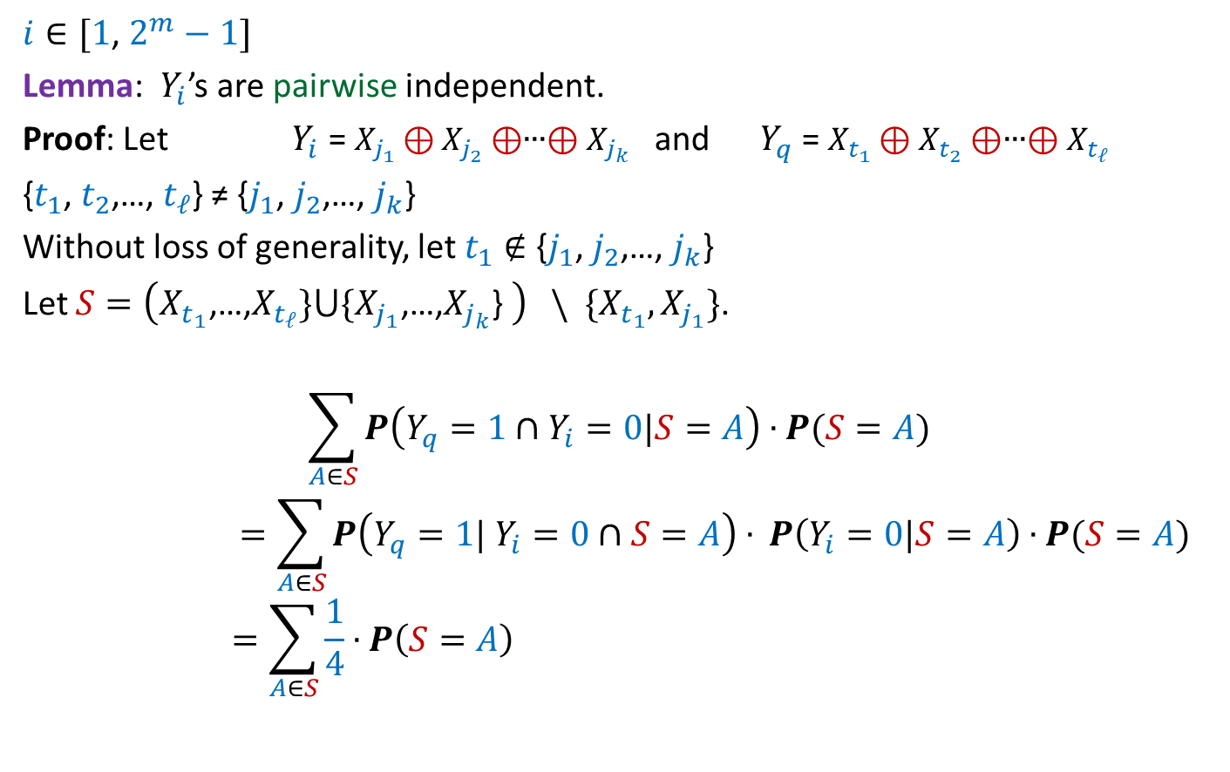

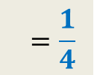


Generating Uniformly Random and pairwise independent Bits
$i∈[1$, $2^{m}−1]$
Lemma: $Y_{i}$’s are pairwise independent.
Proof: Let $Y_{i}$ = $X_{j_{1}}⊕X_{j_{2}}⊕$∙∙∙$⊕X_{j_{k}}$ and $Y_{q}$ = $X_{t_{1}}⊕X_{t_{2}}⊕$∙∙∙$⊕X_{t_{ℓ}}$
{$t_{1}$, $t_{2}$,…, $t_{ℓ}$} ≠ {$j_{1}$, $j_{2}$,…, $j_{k}$}
Without loss of generality, let $t_{1}∉$ {$j_{1}$, $j_{2}$,…, $j_{k}$}
Let $S=\left(X_{t_{1}}\text{,…,}X_{t_{ℓ}}\}⋃\{X_{j_{1}}\text{,…,}X_{j_{k}}\text{\} }\right) \backslash \{X_{t_{1}},X_{j_{1}}\}$.
$$\sum_{A∈S}{P\left(Y_{q}=1∩Y_{i}=0|S=A\right)}∙P(S=A)$$
$$=\sum_{A∈S}{P\left(Y_{q}=1| Y_{i}=0∩S=A\right)}∙ P\left(Y_{i}=0|S=A\right)∙P(S=A)$$
$$=\sum_{A∈S}{\frac{1}{4}}∙P\left(S=A\right)$$
$$P\left(Y_{q}=1∩Y_{i}=0\right)=$$
$$\frac{1}{2}$$
$$\frac{1}{2}$$
$$P\left(D|B\right)$$
$$P\left(C∩D|B\right) = ? ⋅ ?$$
$$P\left(C|D∩B\right)$$
$$=\frac{1}{4}$$

Slide 13
derandomization
a randomized algorithm ➔ a deterministic algorithm

Slide 14

Large cut in a graph
Theorem: (Probabilistic Methods - I)
Let $G$be an undirected graph on $n$vertices and $m$ edges.
There exists a cut of size at least $m/2$.

Slide 15
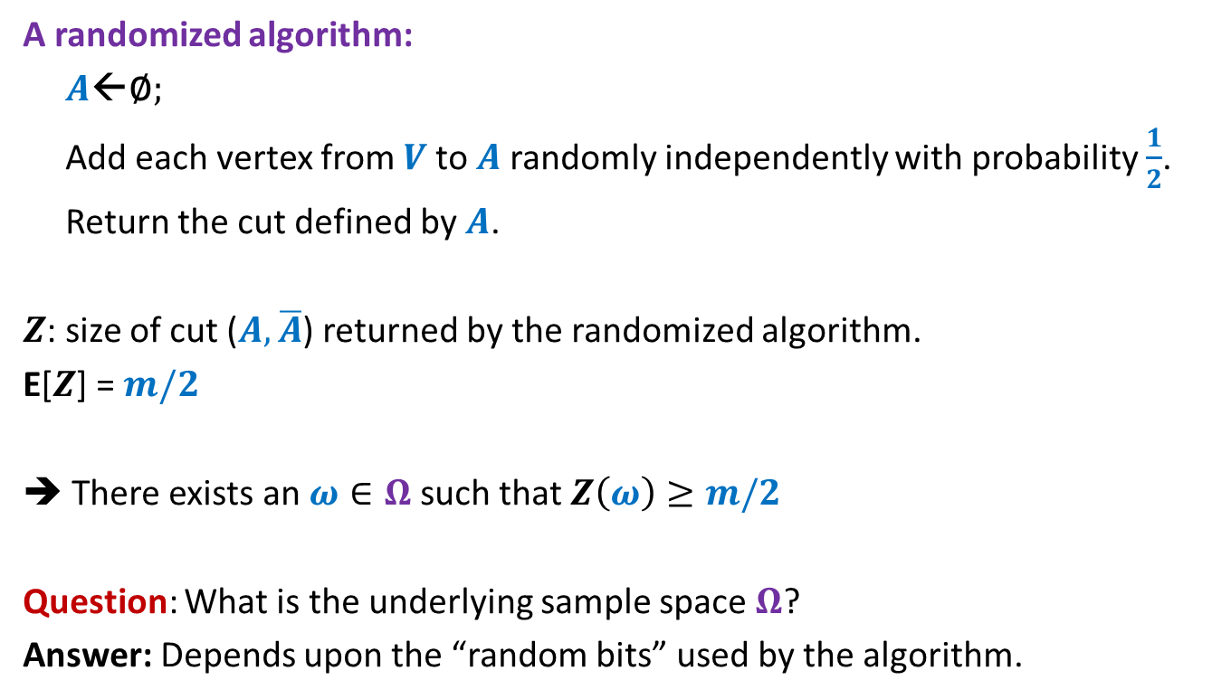
Large cut in a graph
A randomized algorithm:
$A$←∅;
Add each vertex from $V$to $A$randomly independently with probability $\frac{1}{2}$.
Return the cut defined by $A$.
$Z$: size of cut ($A,\overline{A}$) returned by the randomized algorithm.
E[$Z$] = $m/2$
➔ There exists an $ω∈Ω$ such that $Z\left(ω\right)≥m/2$
Question: What is the underlying sample space $Ω$?
Answer: Depends upon the “random bits” used by the algorithm.

Slide 16
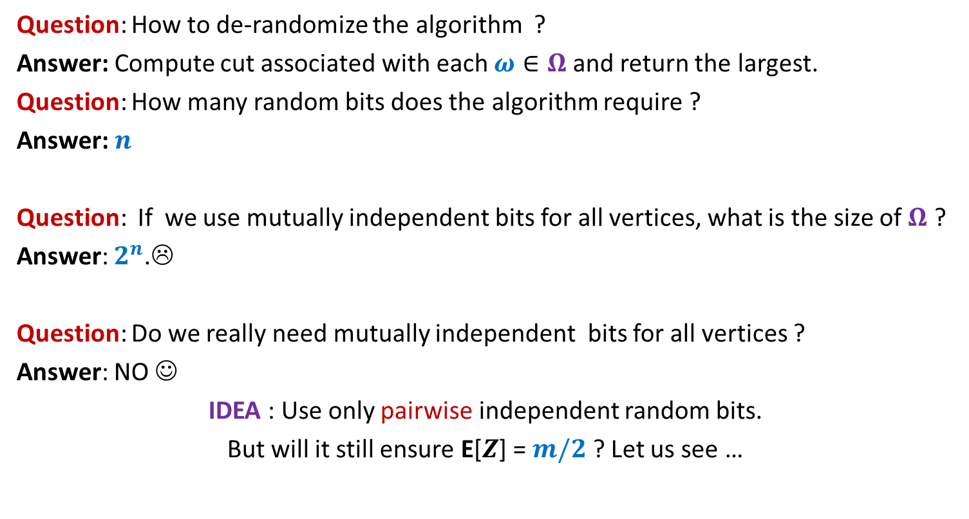
Large cut in a graph
Question: How to de-randomize the algorithm ?
Answer: Compute cut associated with each $ω∈Ω$ and return the largest.
Question: How many random bits does the algorithm require ?
Answer: $n$
Question: If we use mutually independent bits for all vertices, what is the size of $Ω$ ?
Answer: $2^{n}$.☹
Question: Do we really need mutually independent bits for all vertices ?
Answer: NO ☺
IDEA : Use only pairwise independent random bits.
But will it still ensure E[$Z$] = $m/2$ ? Let us see …

Slide 17

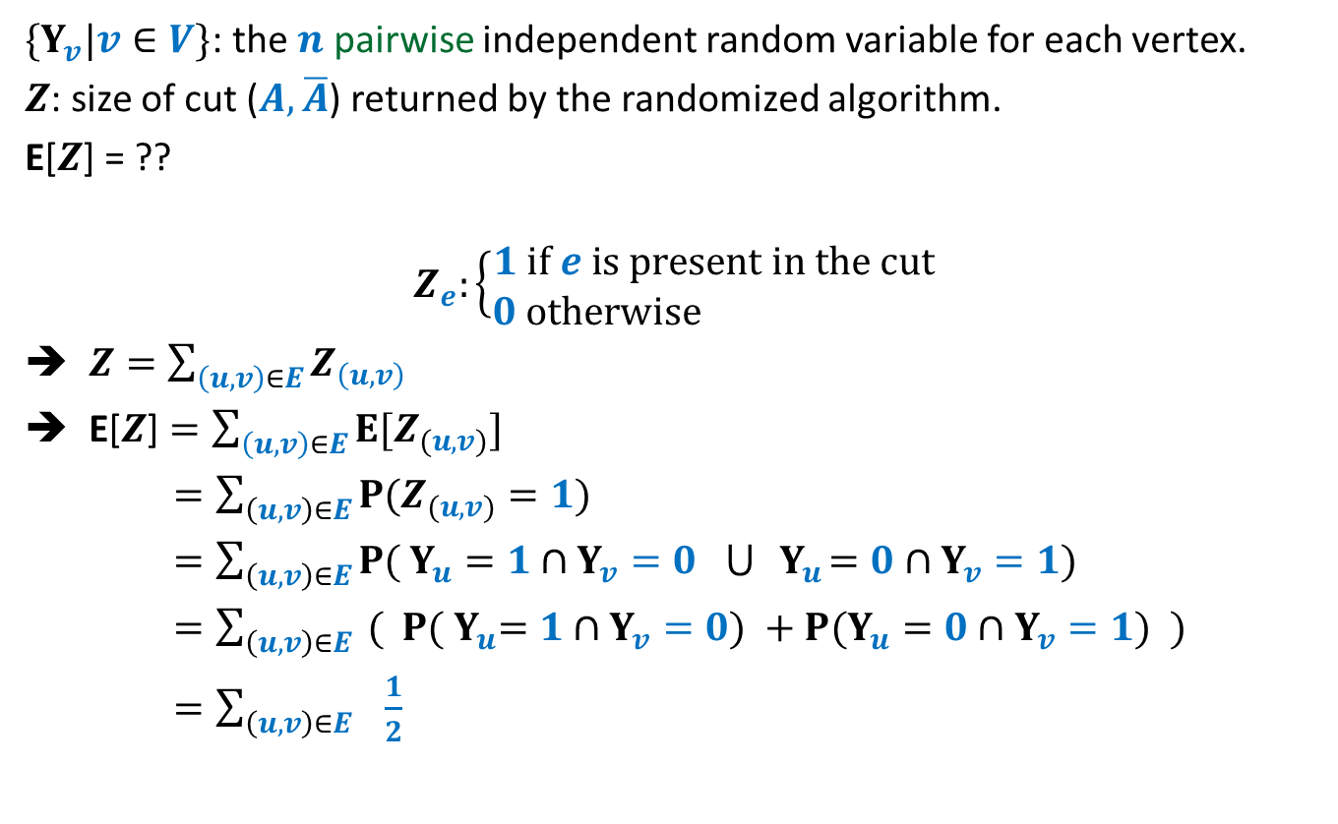


Large cut in a graph
$\{Y_{v}|v∈V\}$: the $n$ pairwise independent random variable for each vertex.
$Z$: size of cut ($A,\overline{A}$) returned by the randomized algorithm.
E[$Z$] = ??
$$Z_{e}:\left\{\begin{aligned}1 if e is present in the cut \\ 0 otherwise \end{aligned}\right.$$
$Z=\sum_{\left(u,v\right)∈E}{Z_{\left(u,v\right)}}$
E[$Z$] $=\sum_{\left(u,v\right)∈E}{{E[Z}_{(u,v)}]}$
$=\sum_{\left(u,v\right)∈E}{{P(Z}_{(u,v)}=1)}$
$=\sum_{\left(u,v\right)∈E}{{P( Y}_{u}=1{ ∩Y}_{v}=0 ⋃{ Y}_{u}=0{ ∩Y}_{v}=1)}$
$=\sum_{\left(u,v\right)∈E}{{ ( P( Y}_{u}=1{ ∩Y}_{v}=0) +{P(Y}_{u}=0{ ∩Y}_{v}=1)} )$
$=\sum_{\left(u,v\right)∈E}{ \frac{1}{2}}$
$$\frac{1}{4}$$
$$\frac{1}{4}$$
$$=\frac{m}{2}$$

Slide 18
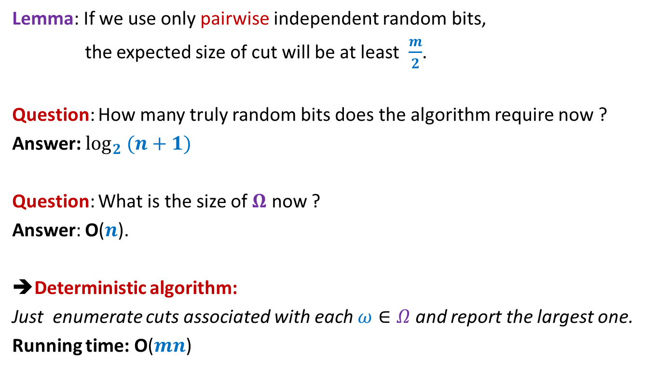
Large cut in a graph
Lemma: If we use only pairwise independent random bits,
the expected size of cut will be at least $\frac{m}{2}$.
Question: How many truly random bits does the algorithm require now ?
Answer: $\log_{2} (n+1)$
Question: What is the size of $Ω$ now ?
Answer: O($n$).
➔Deterministic algorithm:
Just enumerate cuts associated with each $ω∈Ω$ and report the largest one.
Running time: O($mn$)

Slide 19

Large cut in a graph
Theroem: There is an O($mn$) time deterministic algorithm
that computes a cut of size at least $m/2$
in a graph having $m$ edges and $n$ vertices.

Slide 20
Derandomization
using conditional expectation

Slide 21
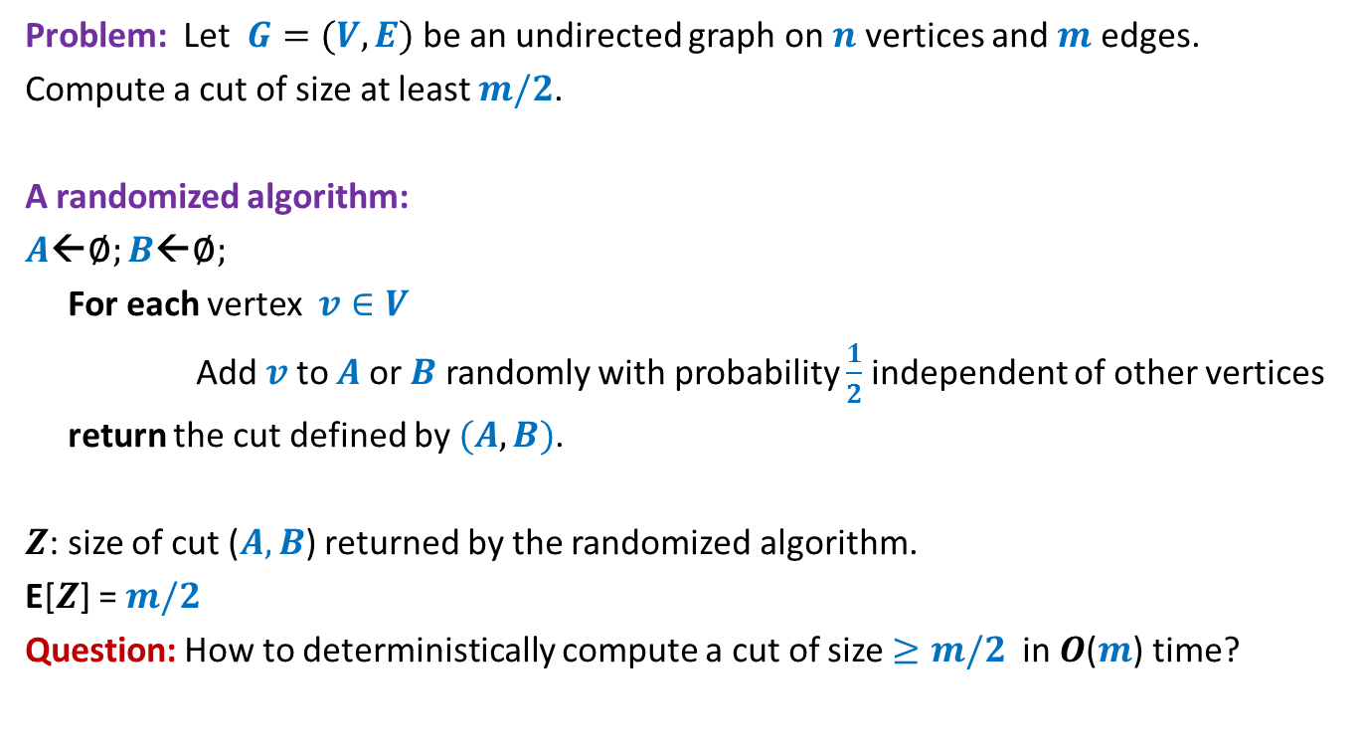
Problem 1: Large cut in a graph
Problem: Let $G=(V,E)$ be an undirected graph on $n$vertices and $m$ edges.
Compute a cut of size at least $m/2$.
A randomized algorithm:
$A$←∅; $B$←∅;
For each vertex $v∈V$
Add $v$ to $A$or $B$ randomly with probability $\frac{1}{2}$ independent of other vertices
return the cut defined by $(A,B)$.
$Z$: size of cut ($A,B$) returned by the randomized algorithm.
E[$Z$] = $m/2$
Question: How to deterministically compute a cut of size $≥m/2$ in $O$($m$) time?
A simple application of conditional expectation ☺

Slide 22
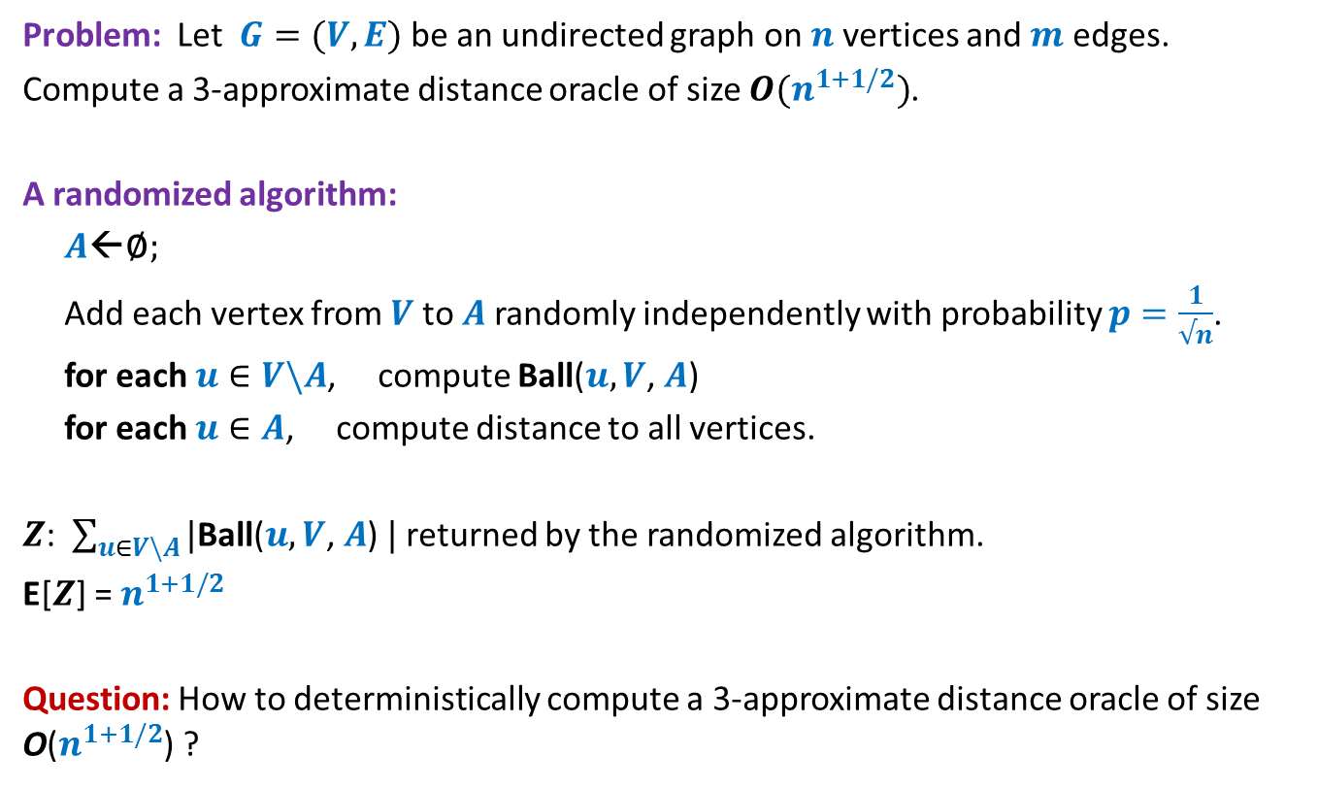
Problem 2: Approximate Distance Oracles
Problem: Let $G=(V,E)$ be an undirected graph on $n$vertices and $m$ edges.
Compute a 3-approximate distance oracle of size $O(n^{1+1/2})$.
A randomized algorithm:
$A$←∅;
Add each vertex from $V$to $A$randomly independently with probability $p=\frac{1}{√n}$.
for each $u∈V\backslash A$, compute Ball($u, V$, $A$)
for each $u∈A$, compute distance to all vertices.
$Z$: $\sum_{u∈V\backslash A}{|\text{Ball}\text{(}u, V\text{,} A\text{) }|}$ returned by the randomized algorithm.
E[$Z$] = $n^{1+1/2}$
Question: How to deterministically compute a 3-approximate distance oracle of size O($n^{1+1/2}$) ?
A non-trivial application of conditional expectation (published in ICALP 2005)

Slide 23
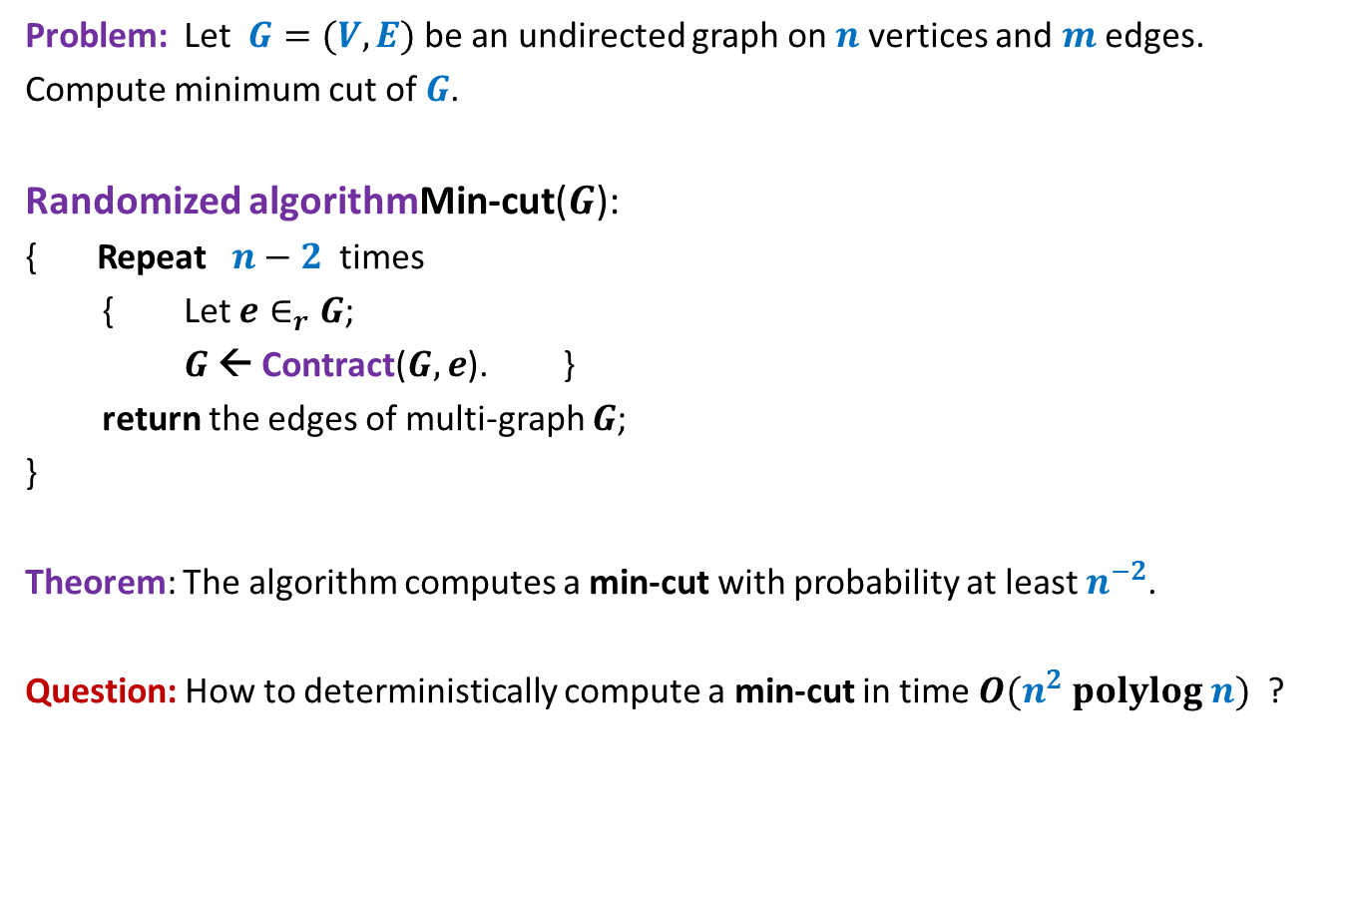
Problem 3: Min-Cut
Problem: Let $G=(V,E)$be an undirected graph on $n$vertices and $m$ edges.
Compute minimum cut of $G$.
Randomized algorithmMin-cut($G$):
{ Repeat $n−2$ times
{ Let $e∈_{r}G$;
$G$ ← Contract($G,e$). }
return the edges of multi-graph $G$;
}
Theorem: The algorithm computes a min-cut with probability at least $n^{−2}$.
Question: How to deterministically compute a min-cut in time $O(n^{2} polylog n)$ ?
No idea whether we can use conditional expectation ?☹

Slide 24
Large cut in a graph
A randomized algorithm:
$A$←∅; $B$←∅;
For each vertex $v∈V$
Add $v$ to $A$or $B$ randomly with probability $\frac{1}{2}$ independent of other vertices
return the cut defined by $(A,B)$.
$$v_{1} v_{2} v_{3} … { v}_{i} v_{i+1} v_{n}$$

Slide 25
Notations:
For a given graph $G=(V,E)$, $U,W⊆V$ and $v∈V$,
$E(v)$:
set of all edges from $E$ that have $v$ as one of the endpoint.
$E(U)$:
set of all edges from $E$ that have at least one end point in $U$.
$E(U,W)$:
set of all edges from $E$ with one endpoint in $U$ and another in $W$.
$$E(U,W)\text{=}E∩(U⨯W)$$
$E(v,U)$:
set of all edges from $E$ with one endpoint $v$and another endpoint in $U$.
$$E(v,U)\text{=}E∩(v⨯U)$$

Slide 26


Notations:
$Z$ : random variable denoting the number of edges in a cut output by the algorithm.
$x_{i}$: random variable taking value 1 if $v_{i}∈A$ and 0 otherwise
$X_{i}$: {$x_{1}$, $x_{2}$, …, $x_{i}$}
$C_{i}$: {$c_{1}$, $c_{2}$, …, $c_{i}$} where $c_{j}∈\{0,1\}$ for $1≤j≤i$.
$X_{i}=C_{i}$ means
“$x_{1}=c_{1}\text{,}…,$ ${x_{i}=c}_{i}$”

Slide 27
conditional expectation
Make sure you understand “Conditional expectation” before using it.
So try to focus on the following slide.

Slide 28


$E\left[Z | X_{i}=C_{i}\right]=?$
$$V_{i}$$
$$v_{1} v_{2} v_{3} … { v}_{i} v_{i+1} v_{n}$$
$$A$$
$$B$$

Slide 29



$E\left[Z | X_{i}=C_{i}\right]=?$
$$V_{i}$$
|$E(V_{i}^{A},V_{i}^{B})$| +
$\text{|}E({V\backslash V}_{i})$|$/2$
$$v_{1} v_{2} v_{3} … { v}_{i} v_{i+1} v_{n}$$
$$V_{i}^{A}$$
$$V_{i}^{B}$$
…
…
$$A$$
$$B$$

Slide 30
Derandomization using conditional expectation

Slide 31
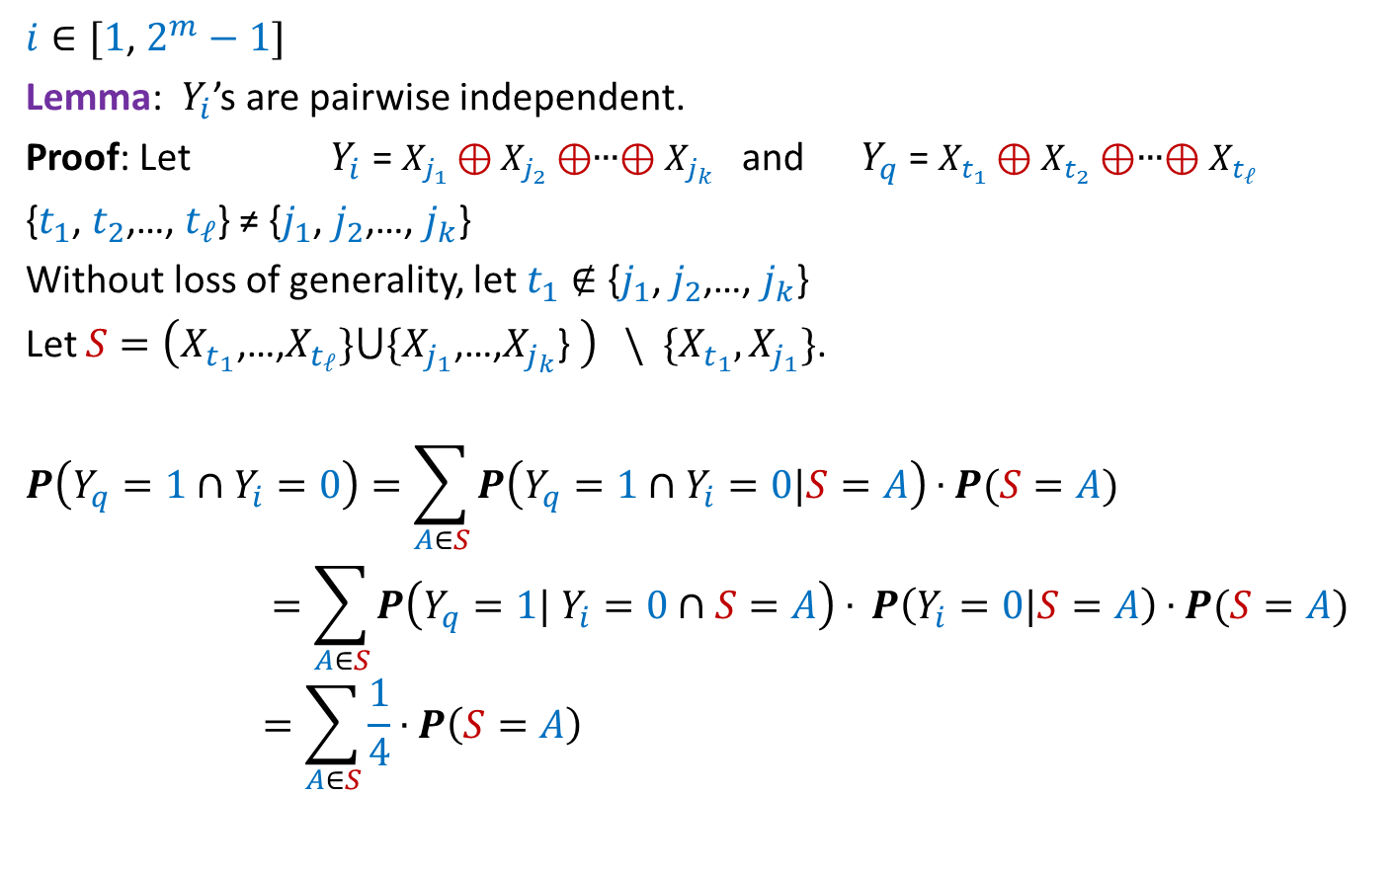


The Binary tree associated with the Randomized algorithm
$$E\left[Z\right]$$
$$x_{1}=1$$
$$x_{1}=0$$
$$E\left[Z | x_{1}=1\right]$$
$$E\left[Z | x_{1}=0\right]$$
$$x_{2}=1$$
$$x_{2}=0$$
$$x_{2}=1$$
$$x_{2}=0$$
$$E\left[Z | x_{2}=1,x_{1}=1\right]$$
$$n$$
…
A cut of value $≥m/2$

Slide 32

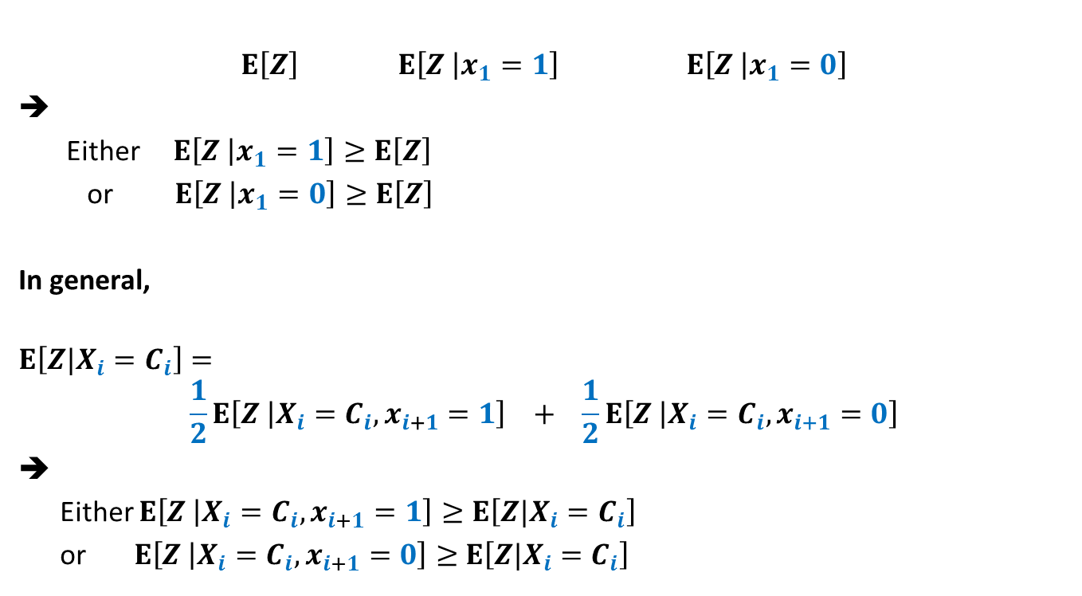
Role of conditional expectation
$$E\left[Z\right] E\left[Z | x_{1}=1\right] E\left[Z | x_{1}=0\right]$$
Either $E\left[Z | x_{1}=1\right]≥E\left[Z\right]$
or $E\left[Z | x_{1}=0\right]≥E\left[Z\right]$
In general,
$$E\left[Z|X_{i}=C_{i}\right]=$$
$$\frac{1}{2}E\left[Z | X_{i}=C_{i}, x_{i+1}=1\right] + \frac{1}{2}E\left[Z | X_{i}=C_{i}, x_{i+1}=0\right]$$
➔
Either $E\left[Z | X_{i}=C_{i}, x_{i+1}=1\right]≥E\left[Z|X_{i}=C_{i}\right]$
or $E\left[Z | X_{i}=C_{i}, x_{i+1}=0\right]≥$ $E\left[Z|X_{i}=C_{i}\right]$
= $\frac{1}{2}$ + $\frac{1}{2}$

Slide 33

Using Conditional expectation
$$\frac{m}{2}=E\left[Z\right]$$
We wish to make choices for $x_{j}$’s such that
$E\left[Z\right] ≤E\left[Z | x_{1}=c_{1}\right]$
$$≤E\left[Z | x_{2}=c_{2},x_{1}=c_{1}\right]$$
$≤E\left[Z|X_{n}=C_{n}\right]$
IDEA:
Given that $E\left[Z|X_{i}=C_{i}\right]$ $≥\frac{m}{2}$, choose that value for $x_{i+1}$ such that
$$E\left[Z|X_{i+1}=C_{i+1}\right]≥E\left[Z|X_{i}=C_{i}\right]$$
…

Slide 34
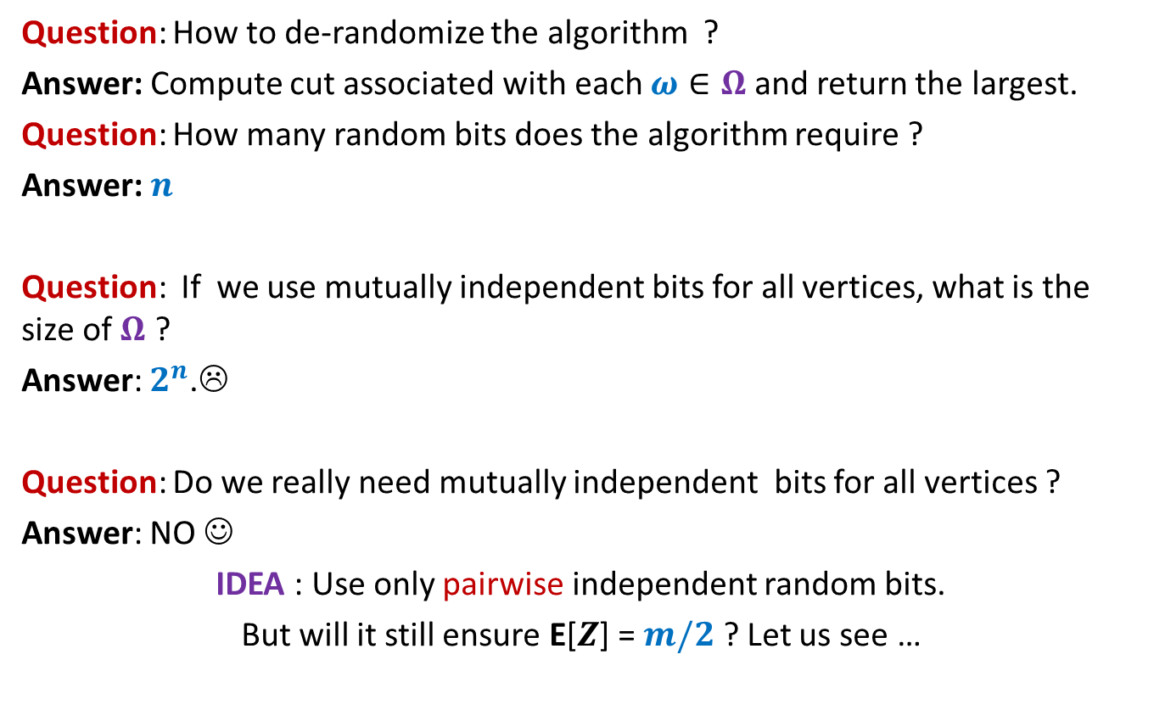

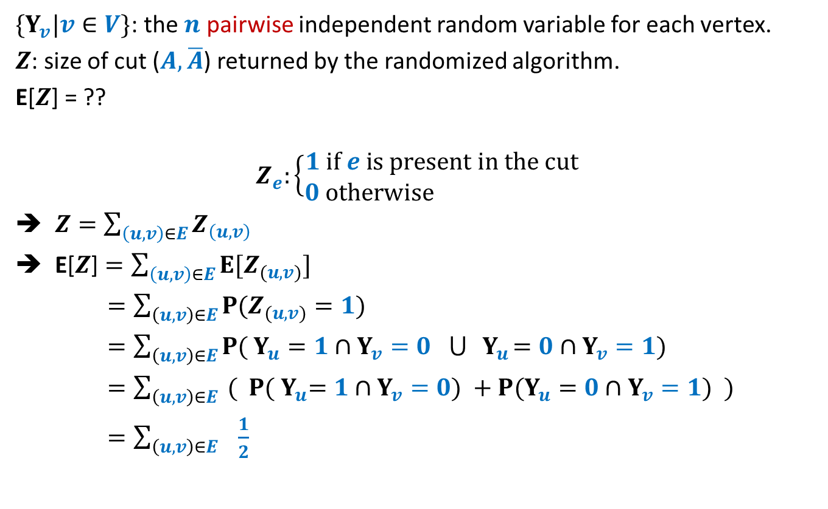
$E\left[Z | X_{i}=C_{i}\right]≥\frac{m}{2}$
$E\left[Z | X_{i}=C_{i}\right]$= |$E(V_{i}^{A},V_{i}^{B})$| + $\text{|}E({V\backslash V}_{i})$|$/2$
$$E\left[Z | X_{i}=C_{i}\right]=\frac{1}{2}E\left[Z | X_{i}=C_{i},x_{i+1}=1\right] + \frac{1}{2}E\left[Z | X_{i}=C_{i},x_{i+1 }=0\right]$$
$E\left[Z | X_{i}=C_{i},x_{i+1}=1\right]$= ??
$E\left[Z | X_{i}=C_{i},x_{i+1}=0\right]$= ??
Question: Should we assign $v_{i+1}$ to $A$ or to $B$ ?
➔ Assign $v_{i+1}$ to $A$ if |$E(v_{i+1},V_{i}^{B})$|$≥$ |$E(v_{i+1},V_{i}^{A})$|
|$E(V_{i}^{A},V_{i}^{B})$| + |$E(v_{i+1},V_{i}^{B})$| + $\text{|}E({V\backslash V}_{i+1})$|$/2$
|$E(V_{i}^{A},V_{i}^{B})$| + |$E(v_{i+1},V_{i}^{A})$| + $\text{|}E({V\backslash V}_{i+1})$|$/2$

Slide 35




Making Choice for $v_{i+1}$
$$V_{i}$$
$$v_{1} v_{2} v_{3} … { v}_{i} v_{i+1} v_{n}$$
$$V_{i}^{A}$$
$$V_{i}^{B}$$
…
…
$$v_{i+1}$$
$$v_{i+1}$$
$$A$$
$$B$$

Slide 36

Deterministic algorithm for Large cut
Input: $G$ = ($V,E$)
$A$←∅; $B$←∅;
For each vertex $v∈V$
{ if |$E(v,B)$|> |$E(v,A)$|
Add $v$ to $A$;
else
Add $v$ to $B$;
}
return the cut defined by $(A,B)$.
Time Complexity: O($m$).
Theorem: There is a deterministic O($m$) time algorithm to compute a cut of size at least $m/2$ in any given undirected graph.
This was a simple example of using conditional expectation to derandomize a randomized algorithm. But it conveys the crux of this powerful method. In order to use it to derandomize any other algorithm, all you might need is creative and analytical skills.
Also remember, we can not hope to derandomize every randomized algorithm. But if it is possible to derandomize an algorithm, conditional expectation may prove to be a very useful tool.

