Slide 1
Randomized Algorithms CS648A
Lecture 5
Linearity of expectation
An example of Partition Theorem
Pattern matching

Slide 2
Where did we reach in last lecture?

Slide 3
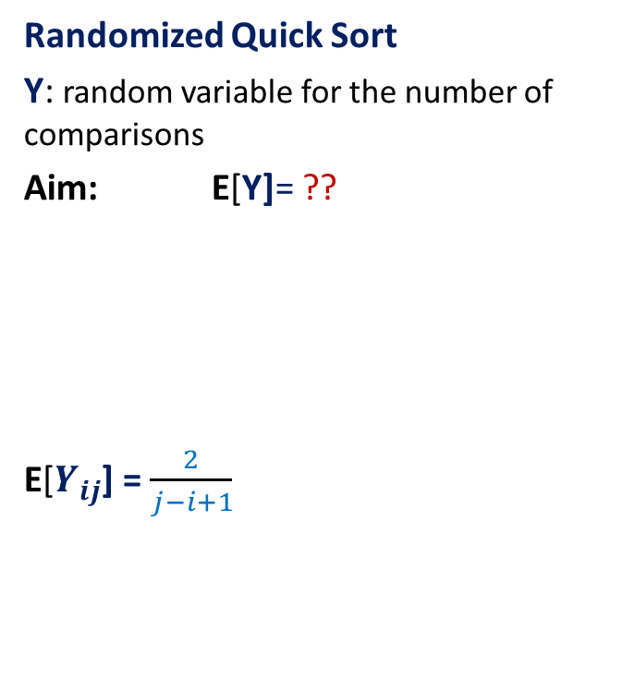

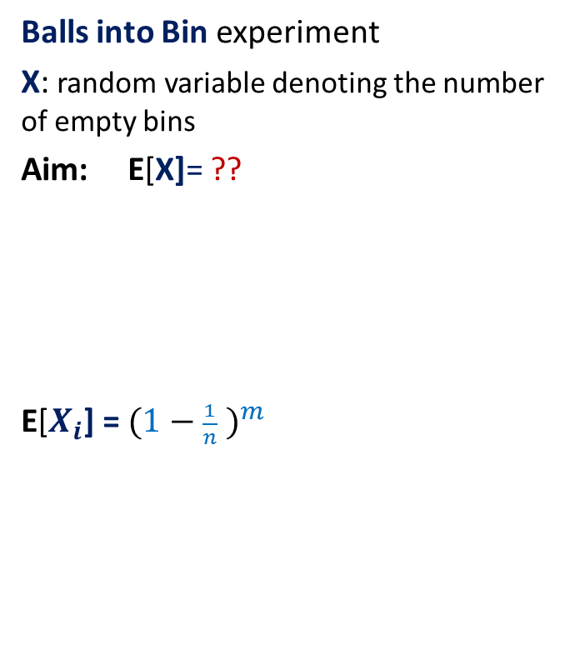
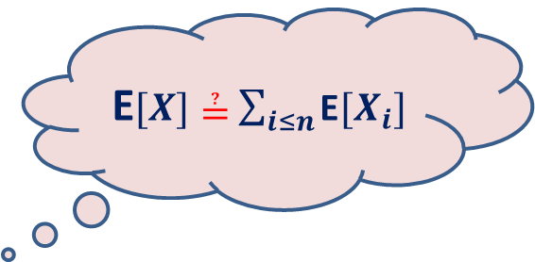
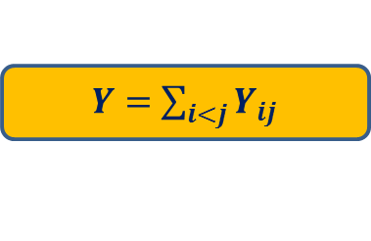
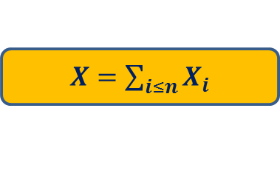
An interesting juncture
Balls into Bin experiment
X: random variable denoting the number of empty bins
Aim: E[X]= ??
E[$X_{i}$] = ${(1−\frac{1}{n} )}^{m}$
Randomized Quick Sort
Y: random variable for the number of comparisons
Aim: E[Y]= ??
E[$Y_{ij}$] = $\frac{2}{j−i+1}$
$X=$ $\sum_{i≤n}{X_{i}}$
$Y=$ $\sum_{i<j}{Y_{ij}}$
E$[X]≟$ $\sum_{i≤n}{\text{E}[X_{i}]}$
E$[Y]≟$ $\sum_{i<j}{\text{E}[Y_{ij}]}$

Slide 4
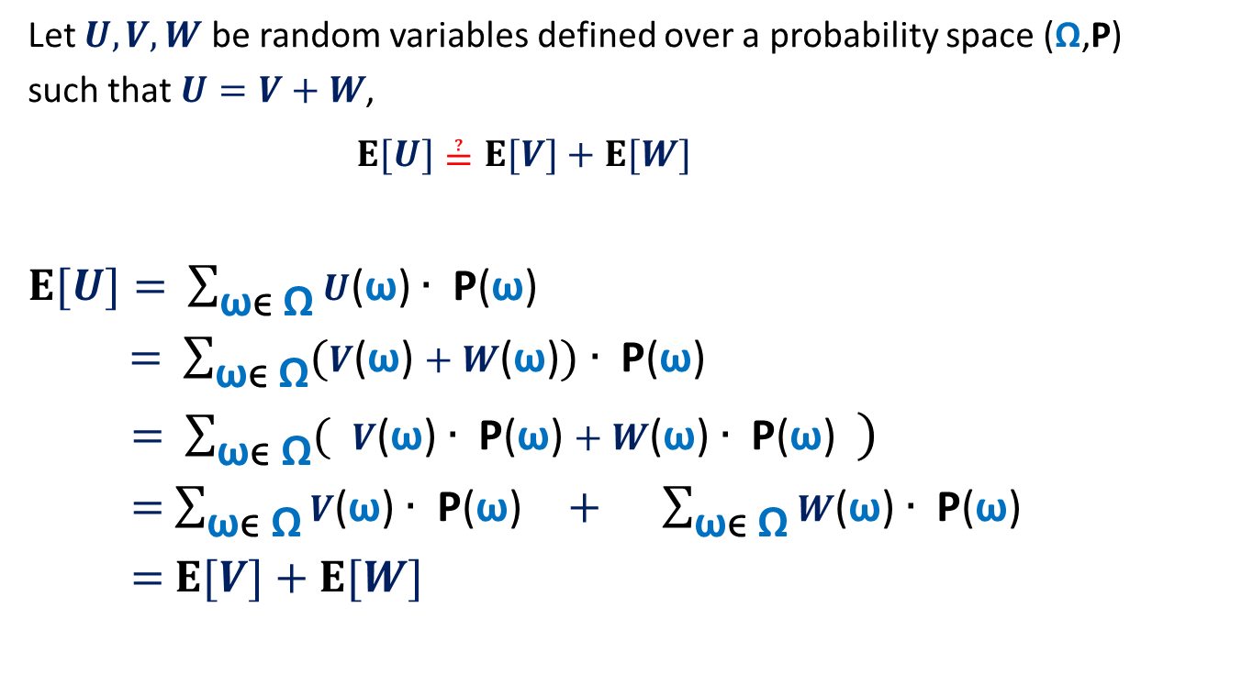
The main question ?
Let $U,V,W$ be random variables defined over a probability space (Ω,P)
such that $U=V+W$,
$E[U]≟E[V]+E[W]$
$E[U]=$ $\sum_{\text{ω}\text{ϵ} \text{Ω}}{U\text{(}\text{ω}\text{)}∙ \text{P}\text{(}\text{ω}\text{)}}$
$=$ $\sum_{\text{ω}\text{ϵ} \text{Ω}}{(V\text{(}\text{ω}\text{)}+W\text{(}\text{ω}\text{)})∙ \text{P}\text{(}\text{ω}\text{)}}$
$=$ $\sum_{\text{ω}\text{ϵ} \text{Ω}}{( V\text{(}\text{ω}\text{)}∙ \text{P}\text{(}\text{ω}\text{)}+W\text{(}\text{ω}\text{)}∙ \text{P}\text{(}\text{ω}\text{)} )}$
$=$ $\sum_{\text{ω}\text{ϵ} \text{Ω}}{V\text{(}\text{ω}\text{)}∙ \text{P}\text{(}\text{ω}\text{)}} + \sum_{\text{ω}\text{ϵ} \text{Ω}}{W\text{(}\text{ω}\text{)}∙ \text{P}\text{(}\text{ω}\text{) }}$
$=$ $E[V]+E[W]$

Slide 5

Balls into Bins (number of empty bins)
1 2 3 4 5 … m-1 m
$X$ : random variable denoting the number of empty bins.
$X=$ $\sum_{i≤n}{X_{i}}$
Using Linearity of Expectation
$E$[$X$] $=\sum_{i≤n}{E[X_{i}]}$
$=\sum_{i≤n}{{(1−\frac{1}{n} )}^{m}}$
$=$ $n{(1−\frac{1}{n} )}^{m}$
$=$ $n/e$ for $m=n$
1 2 3 … … n

Slide 6
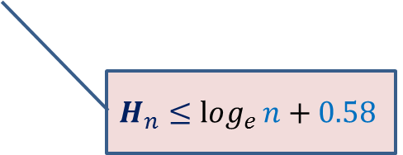
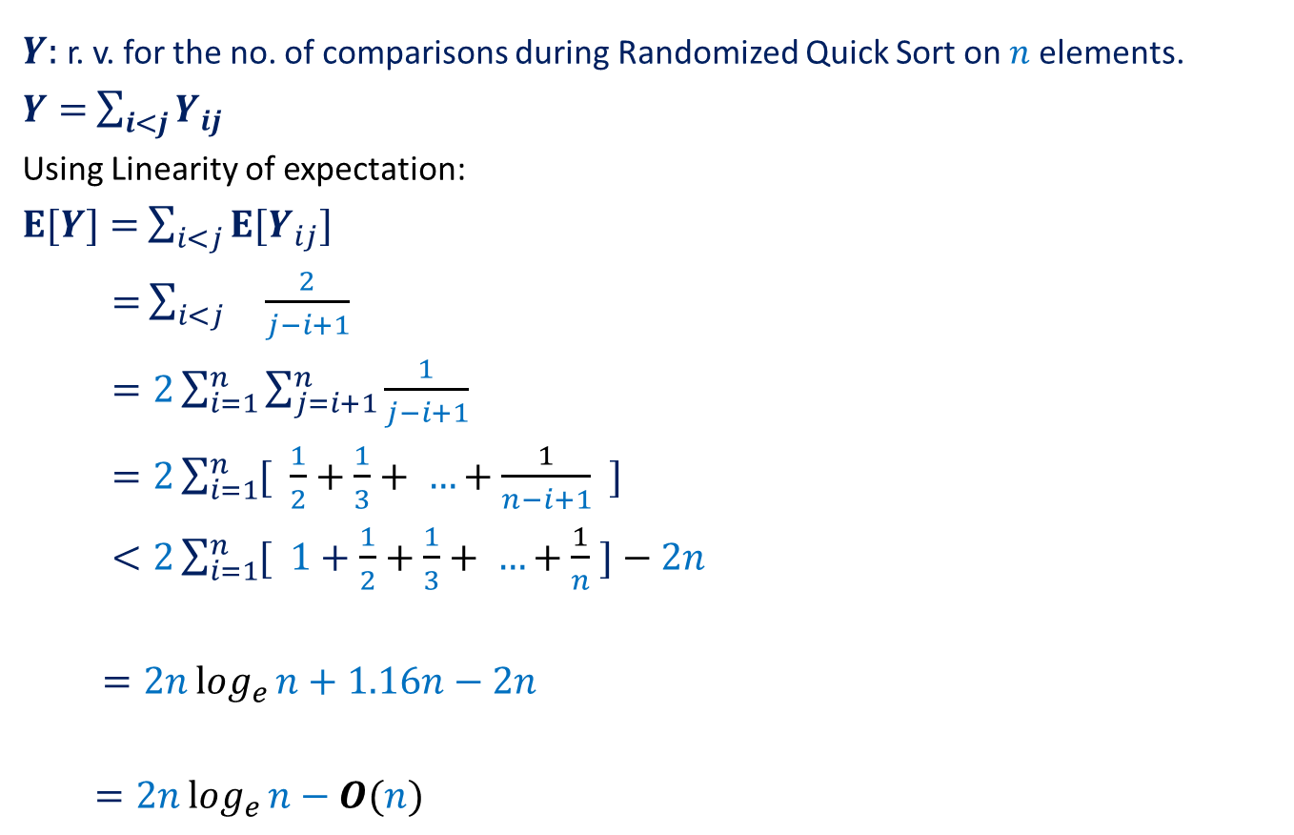
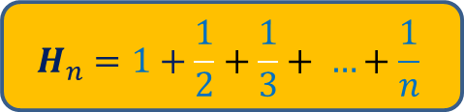
Randomized Quick Sort (number of comparisons)
$Y$: r. v. for the no. of comparisons during Randomized Quick Sort on $n$ elements.
$Y=$ $\sum_{i<j}{Y_{ij}}$
Using Linearity of expectation:
$E[Y]=$ $\sum_{i<j}{{E[Y}_{ij}]}$
$=$ $\sum_{i<j}{ \frac{2}{j−i+1}}$
$=2\sum_{i=1}^{n}{\sum_{j=i+1}^{n}{\frac{1}{j−i+1}}}$
$=2\sum_{i=1}^{n}{[ \frac{1}{2}+\frac{1}{3}+ …+\frac{1}{n−i+1} ]}$
$<2\sum_{i=1}^{n}{[ 1+\frac{1}{2}+\frac{1}{3}+ …+\frac{1}{n} ]}−2n$
$=2nlog_{e}{n}+1.16n−2n$
$=2nlog_{e}{n}−O(n)$
$$H_{n}=1+\frac{1}{2}+\frac{1}{3}+ …+\frac{1}{n}$$
$$H_{n}≤log_{e}{n}+0.58$$

Slide 7
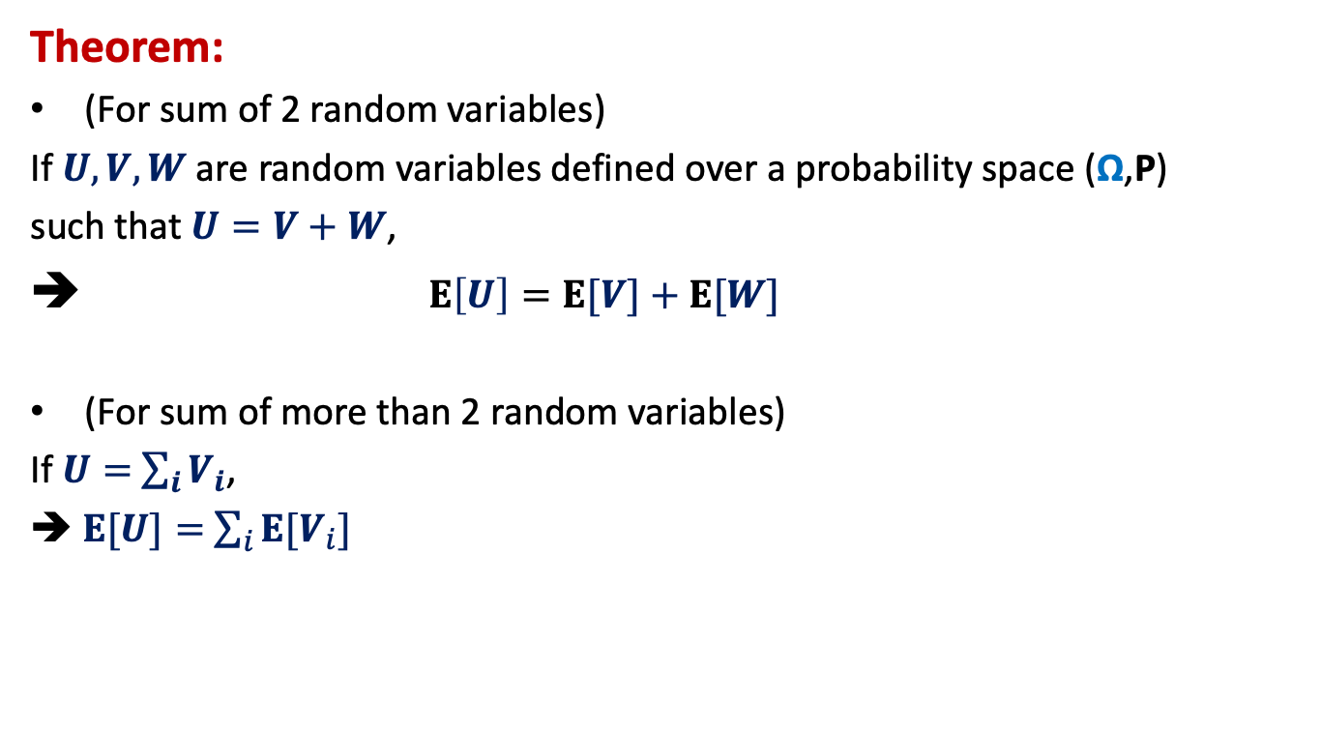
Linearity of Expectation
Theorem:
(For sum of 2 random variables)
If $U,V,W$ are random variables defined over a probability space (Ω,P)
such that $U=V+W$,
➔ $E\left[U\right]=E[V]+E[W]$
(For sum of more than 2 random variables)
If $U=$ $\sum_{i}{V_{i}}$,
➔$E[U]=$ $\sum_{i}{{E[V}_{i}]}$

Slide 8
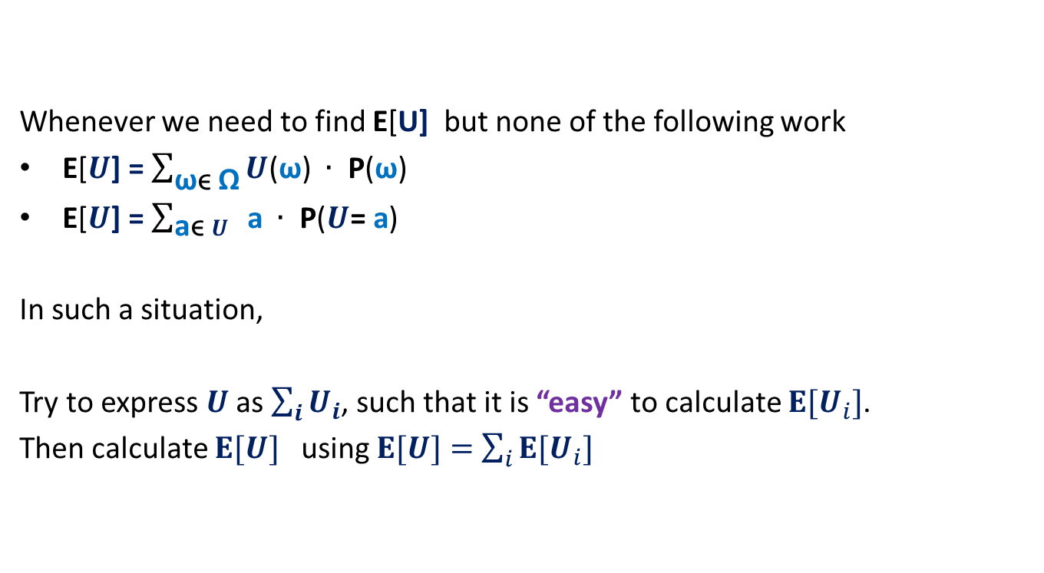
Where to use Linearity of expectation ?
Whenever we need to find E[U] but none of the following work
E[$U$] = $\sum_{\text{ω}\text{ϵ} \text{Ω}}{U\text{(}\text{ω}\text{)} ∙ \text{P}\text{(}\text{ω}\text{)}}$
E[$U$] = $\sum_{\text{a}\text{ϵ} U}{ \text{a} ∙ \text{P}\text{(}U\text{= }\text{a}\text{)}}$
In such a situation,
Try to express $U$ as $\sum_{i}{U_{i}}$, such that it is “easy” to calculate ${E[U}_{i}]$.
Then calculate $E[U]$ using $E[U]=$ $\sum_{i}{{E[U}_{i}]}$

Slide 9

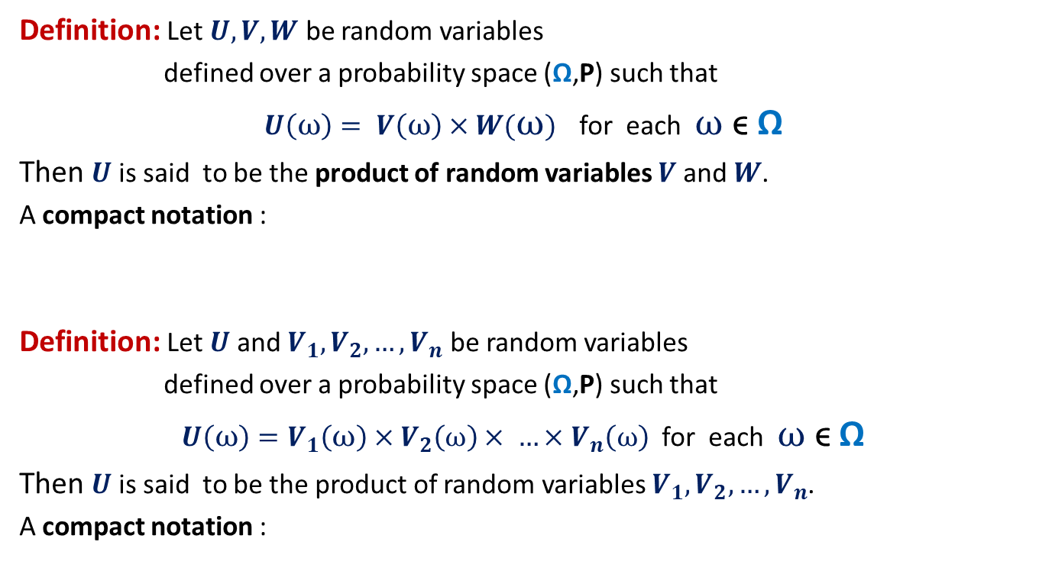

Product of Random Variables
Definition: Let $U,V,W$ be random variables
defined over a probability space (Ω,P) such that
$U\left(ω\right)= V\left(ω\right)×W(ω)$ for each $ω$ ϵ Ω
Then $U$ is said to be the product of random variables $V$ and $W$.
A compact notation :
Definition: Let $U$and $V_{1},V_{2},…,V_{n}$ be random variables
defined over a probability space (Ω,P) such that
$U\left(ω\right)=V_{1}\left(ω\right)×V_{2}\left(ω\right)× …×V_{n}\left(ω\right)$ for each $ω$ ϵ Ω
Then $U$ is said to be the product of random variables $V_{1},V_{2},…,V_{n}$.
A compact notation :
$$U=V×W$$
$$U=V_{1}×V_{2}×…×V_{n}$$

Slide 10



A question
➔ $E\left[U\right]=E[V]+E[W]$ $E\left[U\right] ? E\left[V\right]×E[W]$
$$U=V+W$$
$$U=V×W$$

Slide 11
Balls Out of BIN

Slide 12


Balls Out of Bin
There is a bin containing $r$ red balls and $b$ blue balls. There is one .
Balls are taken out from the bag
Question: What is the probability that appears ahead of all blue balls ?
Let $p(r,b)$ be the corresponding probability.
$p\left(1,b\right)=\frac{1}{b+1}$
$p\left(2,b\right)$ $=$ $\frac{1}{b+2}+\frac{1}{b+2} p\left(1,b\right) = \frac{1}{b+2}+\frac{1}{b+2}$ $(\frac{1}{b+1}) = \frac{1}{b+1}$
$$p\left(i+1,b\right)= \frac{1}{b+i+1}+\frac{i}{b+i+1} p\left(i,b\right)$$
uniformly randomly
and without replacement.
Induction on $r$

Slide 13

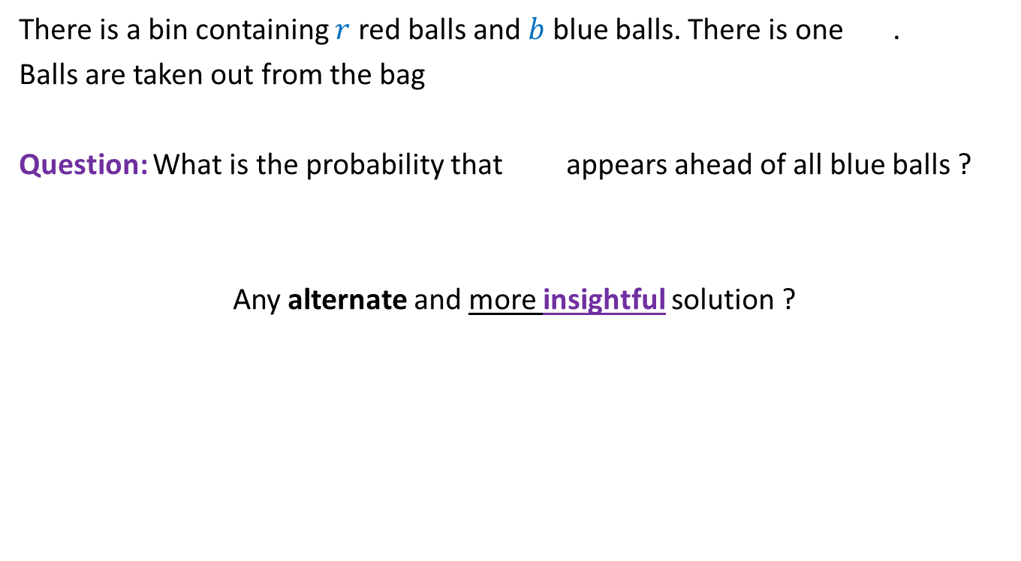
Balls Out of Bin
There is a bin containing $r$ red balls and $b$ blue balls. There is one .
Balls are taken out from the bag
Question: What is the probability that appears ahead of all blue balls ?
Any alternate and more insightful solution ?
uniformly randomly
and without replacement.
$$\frac{1}{b+1}$$
how to formalize the intuition :
“the presence of other red balls does not influence this probability”

Slide 14







Balls Out of Bin
any $2$ balls
$1$ … $r+b$
$4$ $7$
$$a$$
: any $2$positions from [$r+b$].
Event $Q_{a}$ :
the two balls are occupying positions specified by $a$
Given that event $Q_{a}$ has happened, what is the distribution of the $2$ balls ?
Try to generalize this claim ?
Uniform among the $2$ slots in $a$

Slide 15
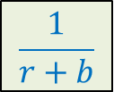










Balls Out of Bin
$$B$$
: any subset of $k$ balls
$1$ … $r+b$
$2$ $4$ $5$ $7$ $9$ $10$
$$a$$
: any subset of [$r+b$] of size $k$
Event $Q_{a}$ :
the balls of set $B$ are occupying positions specified by $a$
How might the balls of set $B$ have been distributed among the slots in $a$ given that $Q_{a}$ has happened ?
$$\frac{1}{r+b}$$
Uniformly among the slots in $a$
What is P[ ] ?
occupies position $7$
What is P[ | $Q_{a}$] ?
$$\frac{1}{k}$$
occupies position $7$
Does not depend on $a$ ☺

Slide 16


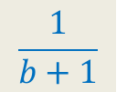



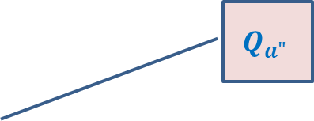

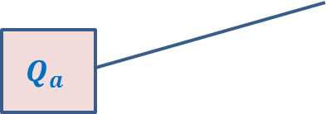
Balls Out of Bin
$E^{∗}$ :
$S$ :
For any $a∈S$, define event
$Q_{a}$ :
$P\left[E^{∗}|Q_{a}\right]$ = ?
$P\left[E^{∗}\right]$ = ?
appears ahead of all blue balls
set of all subsets of [$r+b$] of size $b+1$
all the blue balls and are occupying positions specified by $a$
$1$ $2$ $3$ … … $r+b$
$$\frac{1}{b+1}$$
$$a$$
What can we say about the events
{$Q_{a}$ | $a∈S$ } ?
Set {$Q_{a}$ | $a∈S$ } is a partition of $Ω$.
$$Q_{a"}$$
Ω
$$Q_{a}$$
$$Q_{a′}$$

Slide 17


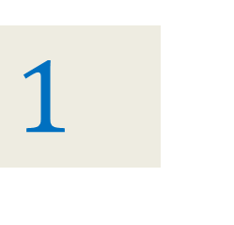
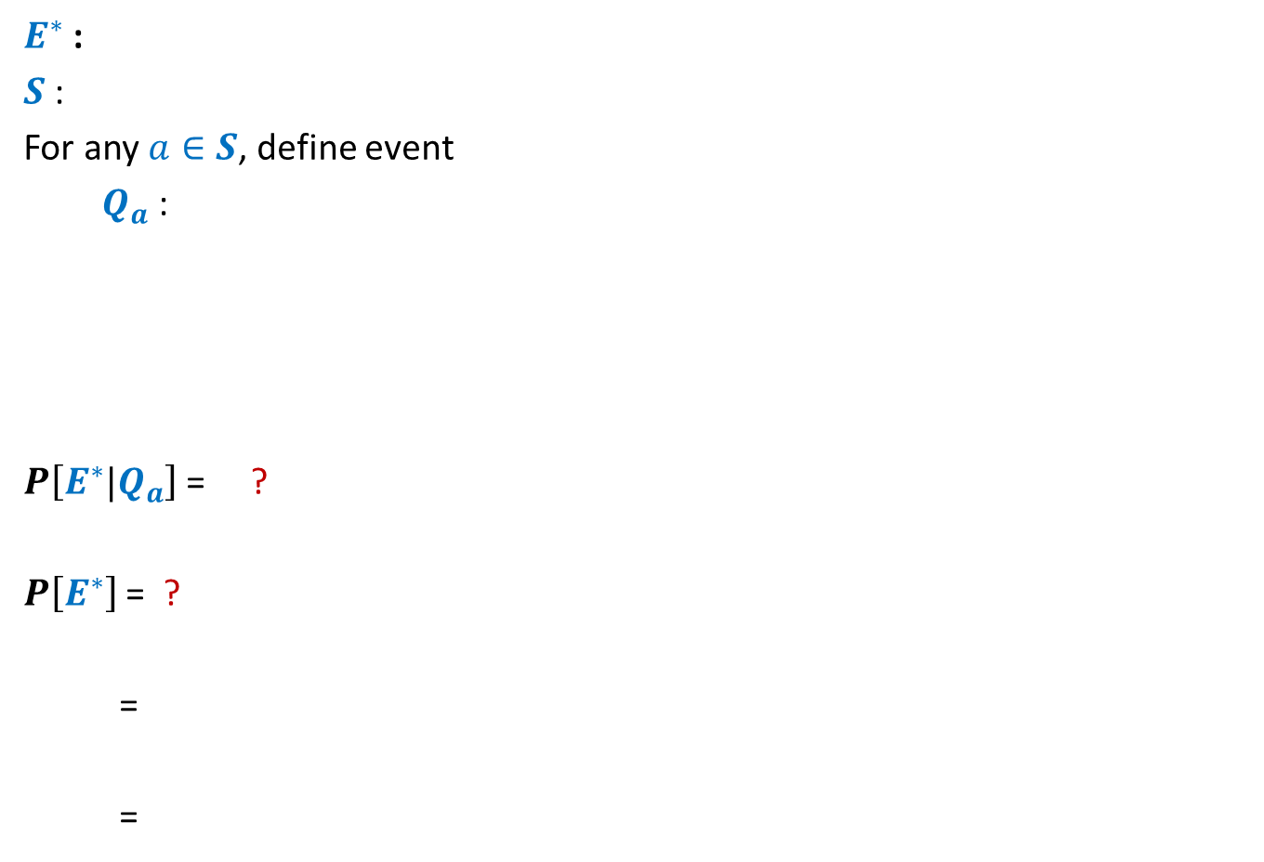
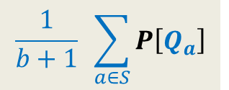
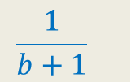
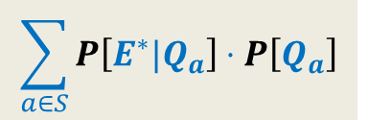
Balls Out of Bin
$E^{∗}$ :
$S$ :
For any $a∈S$, define event
$Q_{a}$ :
$P\left[E^{∗}|Q_{a}\right]$ = ?
$P\left[E^{∗}\right]$ = ?
=
=
appears ahead of all blue balls
set of all subsets of [$r+b$] of size $b+1$
all the blue balls and are occupying positions specified by $a$
$1$ $2$ $3$ … … $r+b$
$$\frac{1}{b+1}$$
$$a$$
$$\sum_{a∈S}{P\left[E^{∗}∩Q_{a}\right]}$$
Set {$Q_{a}$ | $a∈S$ } is a partition of $Ω$.
$$\sum_{a∈S}{P\left[E^{∗}|Q_{a}\right]}⋅P\left[Q_{a}\right]$$
The intuition “the other red balls have no influence” is materialized during one step in this proof. Can you spot the step ?
$$\frac{1}{b+1}$$
$1$
$$\frac{1}{b+1} \sum_{a∈S}{P\left[Q_{a}\right]}$$

Slide 18
Randomized algorithm for Primality

Slide 19

mod operation
$p$ : a prime number
$A$: {$1,2,…,p−1$}
Consider any $i∈A$.
Define set $A_{i}$ = { $ij mod p |$ $j∈A$} ?
Fact: $A_{i}$ = $A$ for all $i∈A$.
Homework: (Fermat’s little theorem)
Let$a∈A$,
{$1,2,…,p−1$} = {$aj mod p |$ $j∈A$}
$\left(p−1\right)!$ $mod p$= $(\prod_{j}{aj mod p} )$ $mod p$
= $(\prod_{j}{aj})$ $mod p$
= $(a^{p−1}\prod_{j}{j})$ $mod p$
= $(a^{p−1}\left(p−1\right)!)$ $mod p$
$p$ divides $(a^{p−1}−1)\left(p−1\right)!$
$p$ divides $(a^{p−1}−1)$

Slide 20


mod operation
$p$ : a prime number
$A$: {$1,2,…,p−1$}
Consider any $i∈A$.
Define set $A_{i}$ = { $ij mod p |$ $j∈A$} ?
Fact: $A_{i}$ = $A$ for all $i∈A$.
Homework: (Fermat’s little theorem)
If $p$is prime then for each $a<p$,
$a^{p−1}mod p=1$.
Question: What if $p$is composite ?
The answer to this question is in negation.
For each $a<p$, $a^{p−1}mod p≠ 1$.
Homework:
If this question has an affirmative answer, design a polynomial time algorithm
for primality.

Slide 21

A programming exercise
For each composite number $n$from $6$ to $600$,
determine the count of the numbers $a<n$ such that $a^{n−1}mod n≠ 1$
Draw useful inferences.

Slide 22
Fingerprinting Application 2
Pattern matching

Slide 23

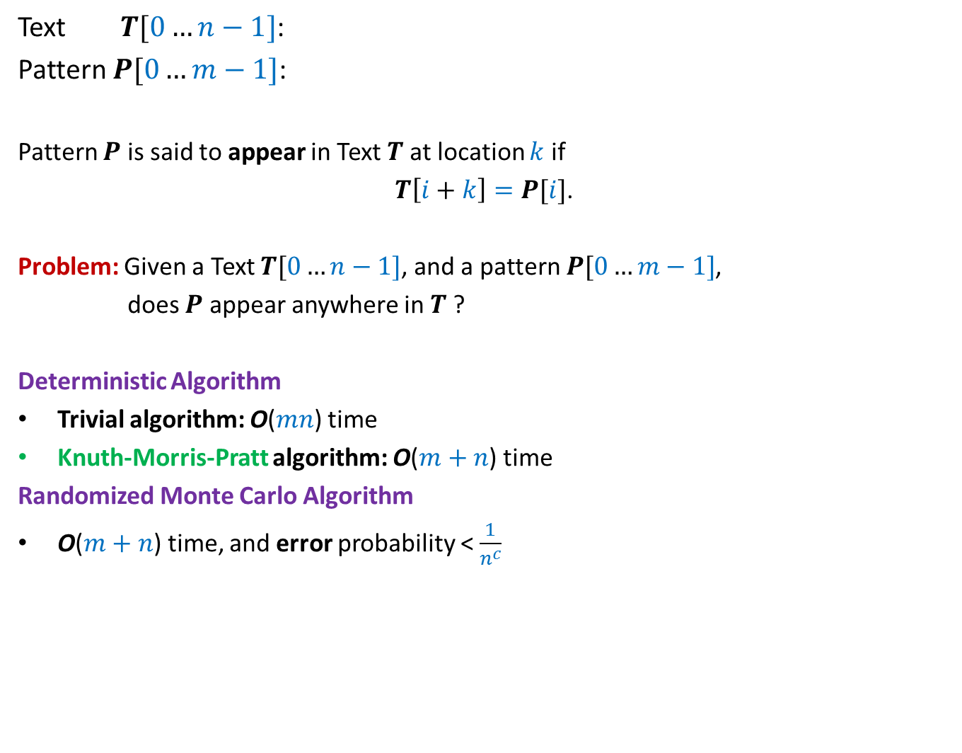
17
Text $T[0…n−1]$:
Pattern $P[0…m−1]$:
Pattern $P$ is said to appear in Text $T$at location $k$ if
$T\left[i+k\right]=P[i]$.
Problem: Given a Text $T[0…n−1]$, and a pattern $P[0…m−1]$,
does $P$ appear anywhere in $T$ ?
Deterministic Algorithm
Trivial algorithm: O($mn$) time
Knuth-Morris-Pratt algorithm: O($m+n$) time
Randomized Monte Carlo Algorithm
O($m+n$) time, and error probability < $\frac{1}{n^{c}}$
100101100110001101111010101110101010111010000101
011110101011101
for all $0≤i<m$,

Slide 24
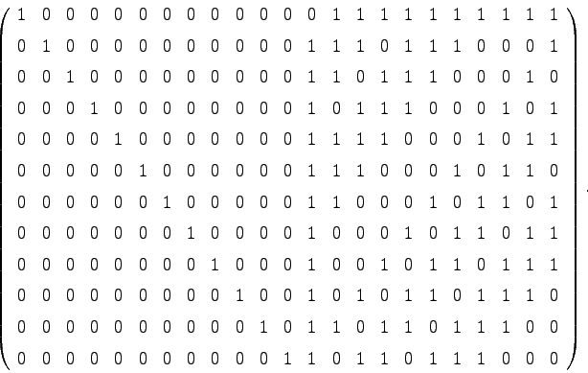

Motivation
Simplicity, real time implementation, streaming environment
Extension to 2-dimensions
Converting Monte Carlo to Las Vegas algorithm
1 1 0
1 1 0 1
1 0 1 1
1 1 1 1
m⨯m
n⨯n
O($n^{2}+m^{2}$) time algorithm

Slide 25
Randomized Algorithm for pattern Matching

Slide 26
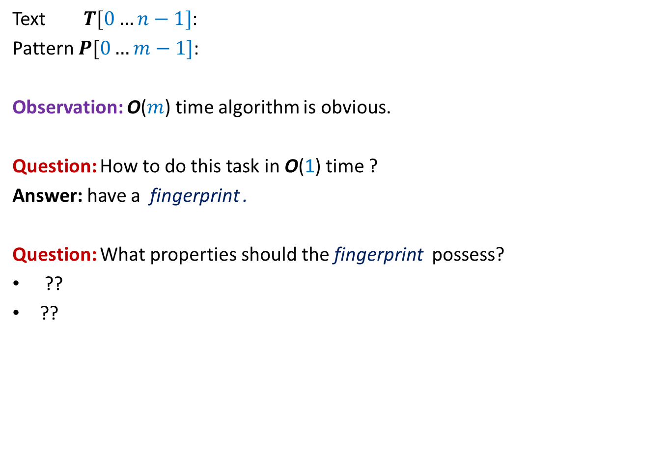


Checking if$P$appears in Text $T$at location $k$
$$k$$
Text $T[0…n−1]$:
Pattern $P[0…m−1]$:
Observation: O($m$) time algorithm is obvious.
Question: How to do this task in O(1) time ?
Answer: have a fingerprint .
Question: What properties should the fingerprint possess?
??
??
100101100110001101111010101010101010111010000101
0111101110110101
Small size
Efficiently computable

Slide 27

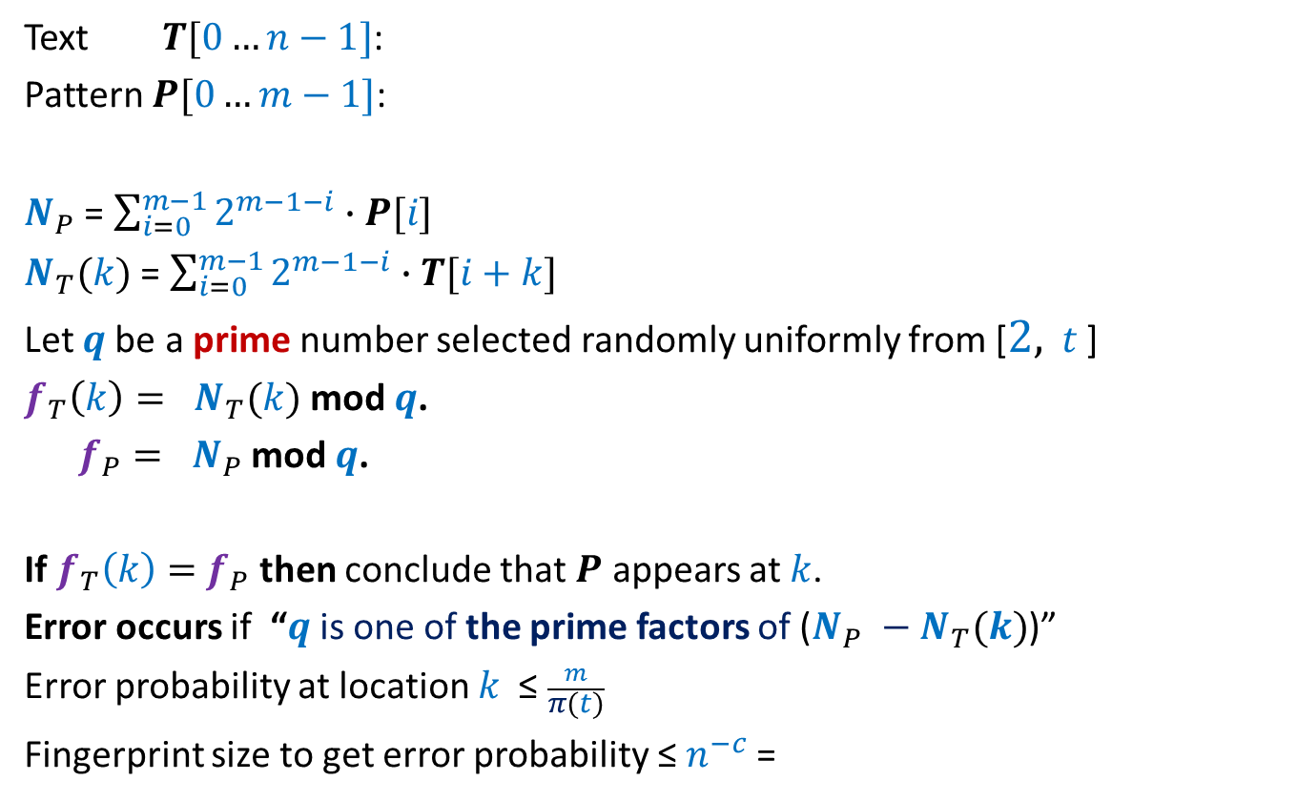


Checking if$P$appears in Text $T$at location $k$
$$k$$
Text $T[0…n−1]$:
Pattern $P[0…m−1]$:
$N_{P}$ = $\sum_{i=0}^{m−1}{2^{m−1−i}∙P[i]}$
$N_{T}(k)$ = $\sum_{i=0}^{m−1}{2^{m−1−i}∙T[i+k]}$
Let $q$be a prime number selected randomly uniformly from [$2,$ $t$ ]
$f_{T}\left(k\right)= N_{T}(k)$ mod $q$.
$f_{P}= N_{P}$ mod $q$.
If $f_{T}\left(k\right)=$ $f_{P}$ then conclude that $P$ appears at $k$.
Error occurs if “$q$is one of the prime factors of ($N_{P} −N_{T}(k)$)”
Error probability at location $k$ ≤ $\frac{m}{π(t)}$
Fingerprint size to get error probability ≤ $n^{−c}$=
100101100110001101111010101010101010111010000101
0111101110110101
<$\frac{1}{n^{c}}$
for $t$ = $4n^{c}m log nm$
O($\log{m}+\log{n}$) bits

Slide 28
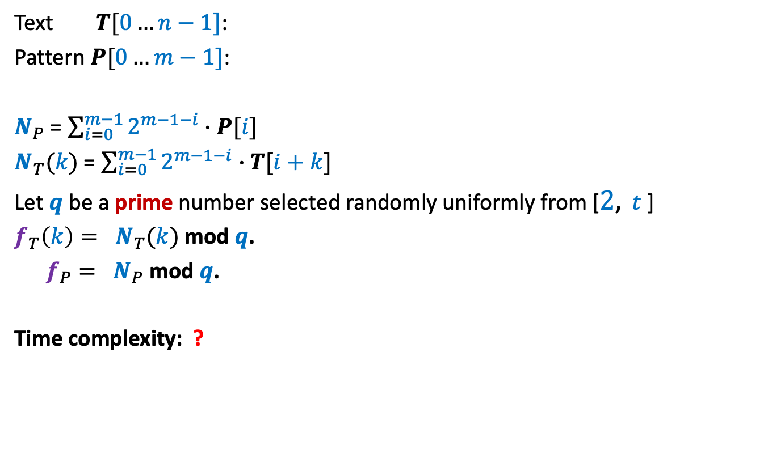
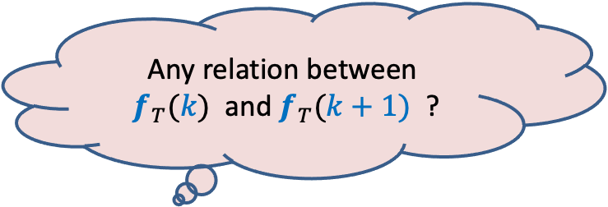

Checking if$P$appears in Text $T$at location $k$
$$k$$
Text $T[0…n−1]$:
Pattern $P[0…m−1]$:
$N_{P}$ = $\sum_{i=0}^{m−1}{2^{m−1−i}∙P[i]}$
$N_{T}(k)$ = $\sum_{i=0}^{m−1}{2^{m−1−i}∙T[i+k]}$
Let $q$be a prime number selected randomly uniformly from [$2,$ $t$ ]
$f_{T}\left(k\right)= N_{T}(k)$ mod $q$.
$f_{P}= N_{P}$ mod $q$.
Time complexity: ?
100101100110001101111010101010101010111010000101
0111101110110101
$Θ(m)$ since $N_{T}(k)$ has $m$ bits.
Any relation between
$f_{T}(k)$ and $f_{T}(k+1)$ ?
Homework

Slide 29
A problem in distributed environment

Slide 30
There is no centralized unit.
Each client only knows the address of each server.
A client has no way to communicate/coordinate with other clients.
Aim:
A distributed protocol to assign clients to servers
so that the maximum load is minimized.
n servers
A central unit to assign clients to servers
n clients

