Slide 1
Randomized Algorithms
G R O U P 1:
4 7 6 1 3 2 8 5 0 9
R I S H I P O O N I A
D H R U V
Y O G I T
GROUP PROJECT on
SMALLEST ENCLOSING CIRCLE

Slide 2
PROBLEM
Given n points in the plane, compute the smallest radius circle enclosing all n points.

Slide 3
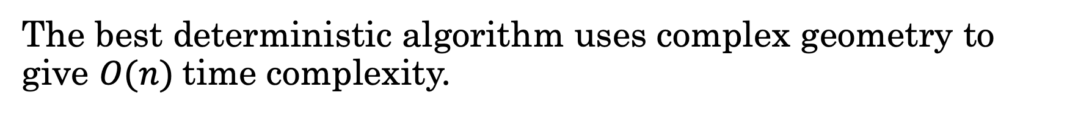
PROBLEM
Given n points in the plane, compute the smallest radius circle enclosing all n points.
The best deterministic algorithm uses complex geometry to give $O(n)$time complexity.

Slide 4
PROBLEM
Given n points in the plane, compute the smallest radius circle enclosing all n points.
The best deterministic algorithm uses complex geometry to give $O(n)$time complexity.
We present a simple randomized algorithm that matches this time complexity on expectation.

Slide 5
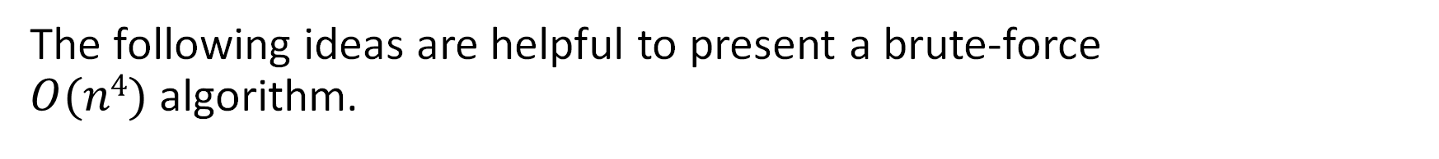
Towards an O(n⁴) algorithm
The following ideas are helpful to present a brute-force $O(n4)$algorithm.

Slide 6
Towards an O(n⁴) algorithm
The following ideas are helpful to present a brute-force $O(n4)$algorithm.
Uniqueness of the smallest enclosing circle.

Slide 7
Towards an O(n⁴) algorithm
The following ideas are helpful to present a brute-force $O(n4)$algorithm.
Uniqueness of the smallest enclosing circle.
Given n ≥ 2, the smallest enclosing circle contains at least two points on its circumference.

Slide 8
Uniqueness of the smallest enclosing circle

Slide 9
Consider two circles, C₁ (r, c₁) and C₂ (r, c₂) as the two smallest enclosing circle.

Slide 10
Consider another circle C passing through the intersection of two circles, centered at the midpoint of line joining C₁ and C₂ containing all points x ∊ C₁ ∩ C₂ .

Slide 11
The radius of C is $\sqrt{r^{2}−{\frac{(c1−c2)}{4}}^{2}}$ ≤ $\text{r}$.

Slide 12
The smallest enclosing circle contains at least two points on its circumference (for n ≥ 2)

Slide 13
Consider a circle with no points on its circumference.

Slide 14
This circle can be further shrunk to get a smaller circle that passes through one point while still enclosing all the points.

Slide 15
We can again move the center along the line joining center and the first point to get a smaller circle passing through two points.

Slide 16
We can again move the center along the line joining center and the first point to get a smaller circle passing through two points.

Slide 17
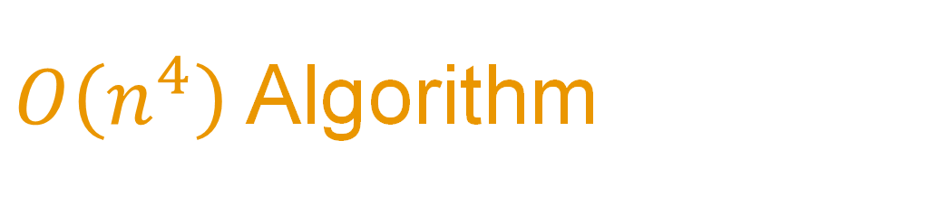
$O\left(n^{4}\right)$ Algorithm

Slide 18
Enclosing_Circle_N4([p₁,p₂,...p_{n}]){
C ← Circle with infinite radius
for i ← 1 to n do
for j ← i+1 to n do
C' ← Circle formed by taking p_{i}, p_{j} as ends of diameter
if C’.radius < C.radius and all_points_inside ( C') then
C ← C'
end
end
for i ← 1 to n do
for j ← i+1 to n do
for k ← j+1 to n do
C' = circumcircle ( p_{i} , p_{j} , p_{k} )
if C’.radius < C.radius and all_points_inside ( C' ) then
C ← C'
end
end
end
return C
}

Slide 19

Reducing the time complexity
We will now present lemmas that will help us to reduce the time complexity to $O\left(n^{3}\right)$.

Slide 20
Reducing the time complexity
We will now present lemmas that will help us to reduce the time complexity to $O\left(n^{3}\right)$.
The triangle formed by 3 defining points must be acute.

Slide 21
Reducing the time complexity
We will now present lemmas that will help us to reduce the time complexity to $O\left(n^{3}\right)$.
The triangle formed by 3 defining points must be acute.
The smallest enclosing circle for all points is the enclosing circle of any 3 points that form an acute angle triangle of maximum circumradius.

Slide 22
Defining Point of Smallest Enclosing Circle
A point that helps us “define” the smallest enclosing circle.

Slide 23
Defining Point of Smallest Enclosing Circle
A point that helps us “define” the smallest enclosing circle.
Defining points lie on the circumference of the smallest enclosing circle.

Slide 24
The triangle formed by 3 defining points must be acute.

Slide 25
Circle with three defining points.
Right Angled triangle

Slide 26
Circle with three defining points.
This is a case of two defining points.

Slide 27
Circle with three defining points.
Obtuse Angled triangle

Slide 28
Circle with three defining points.
Circle can be shrunk further to reduce the angle subtended.

Slide 29
Circle with three defining points.
Acute angle triangle

Slide 30
The smallest enclosing circle for all points is the enclosing circle of any 3 points that form an acute angle triangle of maximum circumradius.

Slide 31




Let D₁ and D₂ be two defining points at some stage of the algorithm.
$$P$$
$$α$$
$D$₂
$D$₁

Slide 32

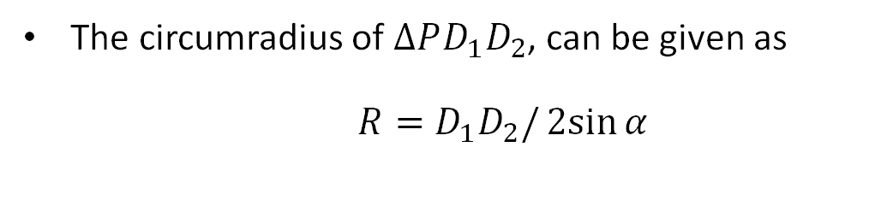


The circumradius of $∆PD_{1}D_{2}$, can be given as $R=D_{1}D_{2}/2sin{α}$
Let D₁ and D₂ be two defining points at some stage of the algorithm.
$$P$$
$$α$$
$D$₂
$D$₁

Slide 33
The circumradius of $∆PD_{1}D_{2}$, can be given as $R=D_{1}D_{2}/2sin{α}$
Let D₁ and D₂ be two defining points at some stage of the algorithm.
$$P$$
$$α$$
If the angle subtended by the chord on the boundary of the circle is least, then radius of the circumcircle is maximum as compared to all other points in the same sector.
$D$₂
$D$₁

Slide 34
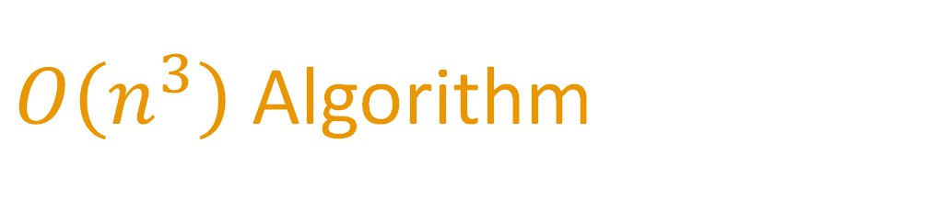
$O\left(n^{3}\right)$ Algorithm

Slide 35
Enclosing_Circle_N3([p₁,p₂,...p_{n}]){
C ← Circle with infinite radius
for i ← 1 to n do
for j ← i+1 to n do
C’ ← Circle(p_{i}, p_{j} )
if C’.radius < C.radius and C’ contains all points then
C ← C’
for i ← 1 to n do
for j ← i+1 to n do
C’ ← Circle(p_{i}, p_{j} )
for k ← j to n do
C” ← Circumcircle(p_{i}, p_{j} , p_{k})
if is_acute(C”) and C”.radius > C’.radius then
C’ ← C”
if C’.radius < C.radius and C’ contains all points then
C ← C’ return C
}

Slide 36
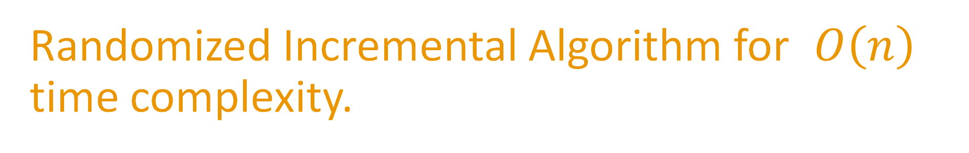
Randomized Incremental Algorithm for $O\left(n\right)$ time complexity.

Slide 37


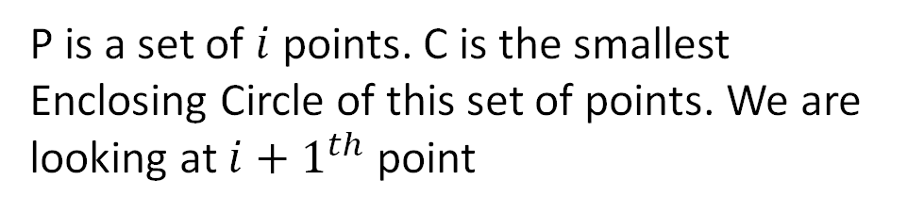
Randomized Incremental Construction
$$p$$
$$P$$
P is a set of $i$ points. C is the smallest Enclosing Circle of this set of points. We are looking at ${i+1}^{th}$ point

Slide 38
Randomized Incremental Construction
$$p$$
$$P$$
P is a set of $i$ points. C is the smallest Enclosing Circle of this set of points. We are looking at ${i+1}^{th}$ point
If the point lies inside. The smallest enclosing circle remains the same.

Slide 39
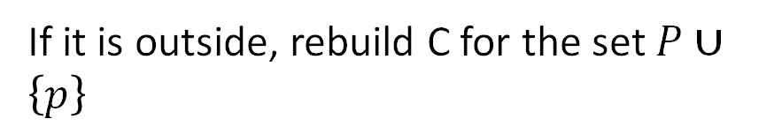
Randomized Incremental Construction
$$p$$
$$P$$
P is a set of $i$ points. C is the smallest Enclosing Circle of this set of points. We are looking at ${i+1}^{th}$ point
If the point lies inside. The smallest enclosing circle remains the same.
If it is outside, rebuild C for the set $P∪\left\{p\right\}$

Slide 40
Randomized Incremental Construction
Enclosing_Circle_N([p₁,p₂,...p_{n}]){
C ← Circle(p₁, p₂)
for i ← 3 to n do
if p_{i} lies outside C
Update C
return C
}

Slide 41

Updating the Circle
To update C, we need to make use of the ${(i+1)}^{th}$ point available to us. We will present the following idea that will help us to achieve this task.

Slide 42
Updating the Circle
To update C, we need to make use of the ${(i+1)}^{th}$ point available to us. We will present the following idea that will help us to achieve this task.
A new point that lies outside serves as a defining point. We will call this the first defining point.

Slide 43
Updating the Circle
To update C, we need to make use of the ${(i+1)}^{th}$ point available to us. We will present the following idea that will help us to achieve this task.
A new point that lies outside serves as a defining point. We will call this the first defining point.
With the help of this new defining point, we can search for another defining point in a similar manner.

Slide 44
Updating the Circle
To update C, we need to make use of the ${(i+1)}^{th}$ point available to us. We will present the following idea that will help us to achieve this task.
A new point that lies outside serves as a defining point. We will call this the first defining point.
With the help of this new defining point, we can search for another defining point in a similar manner.
Another iteration leads us to three defining points. Since three points that form an acute triangle are sufficient to determine minimum enclosing circle, we find the required circle.

Slide 45
First Defining Point.

Slide 46
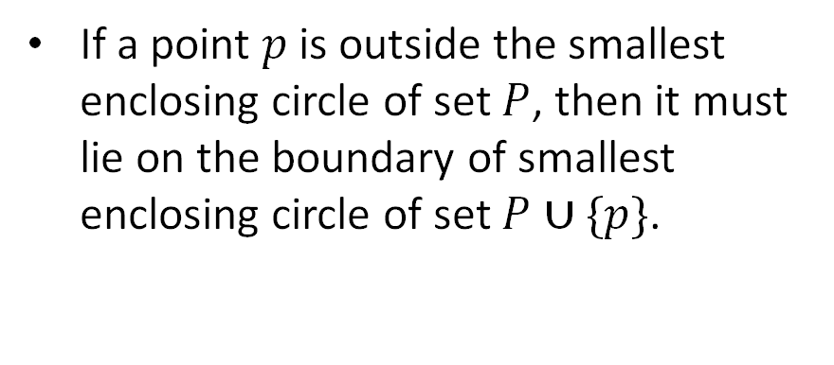
First Defining Point
$$p$$
$$P$$
If a point $p$ is outside the smallest enclosing circle of set $P$, then it must lie on the boundary of smallest enclosing circle of set $P∪\{p\}$.

Slide 47


Intuition
Let’s assume that the smallest enclosing circle contains the point p inside it. Hence, the defining points for this circle must be taken from set P.
$$P∪\{p\}$$
$$P$$
$$p$$

Slide 48



Intuition
Let’s assume that the smallest enclosing circle contains the point p inside it. Hence, the defining points for this circle must be taken from set P.
$$P∪\{p\}$$
$$P$$
We can move the center of the new circle towards the common chord along the perpendicular bisector, as the triangle formed by the new set of defining points is obtuse.
$$p$$

Slide 49
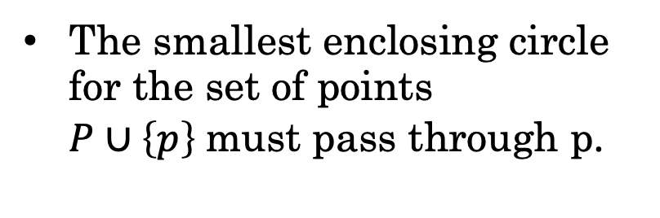

Intuition
Let’s assume that the smallest enclosing circle contains the point p inside it. Hence, the defining points for this circle must be taken from set P.
$$P∪\{p\}$$
$$P$$
We can move the center of the new circle towards the common chord along the perpendicular bisector, as the triangle formed by the new set of defining points is obtuse.
$$p$$
The smallest enclosing circle for the set of points $P∪\left\{p\right\}$must pass through p.

Slide 50

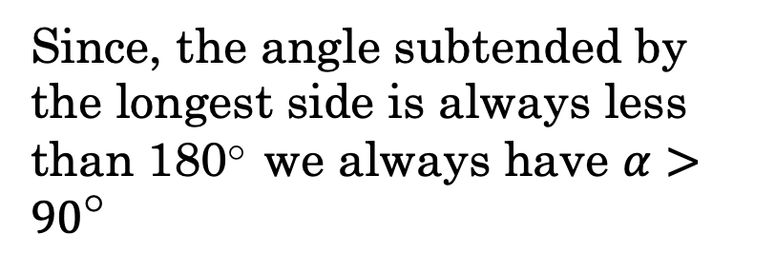

Key idea
Angle subtended at the center of the circle is twice that of the angle subtended by the triangle
$$P$$
Since, the angle subtended by the longest side is always less than 180○ we always have $α>{90}^{○}$
$$α$$
$$2α$$

Slide 51
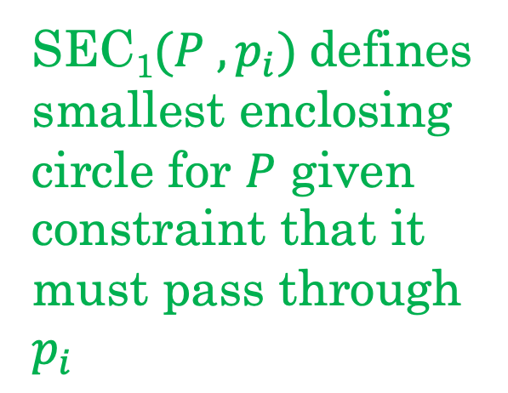
Randomized Incremental Construction
Enclosing_Circle_N([p₁,p₂,...p_{n}])
{
C ← Circle(p₁, p₂)
P ← A list of all the points
for i ← 3 to n do
if p_{i} lies outside C
C ← SEC₁(P, p_{i})
return C
}
SEC₁$(P ,p_{i})$definessmallest enclosing circle for $P$ given constraint that it must pass through $p_{i}$

Slide 52
Second Defining Point.

Slide 53



Second Defining Point
$$p_{i}$$
$$p_{j}$$
$$P$$
With a similar analysis as in the previous case, if $p_{j}$ is outside the smallest enclosing circle of set $P$, with constraint that it must pass through $p_{i}$then $p_{j}$ must lie on the boundary of the smallest enclosing circle of set $(P,{ p}_{i})∪\{p_{j}\}$.

Slide 54

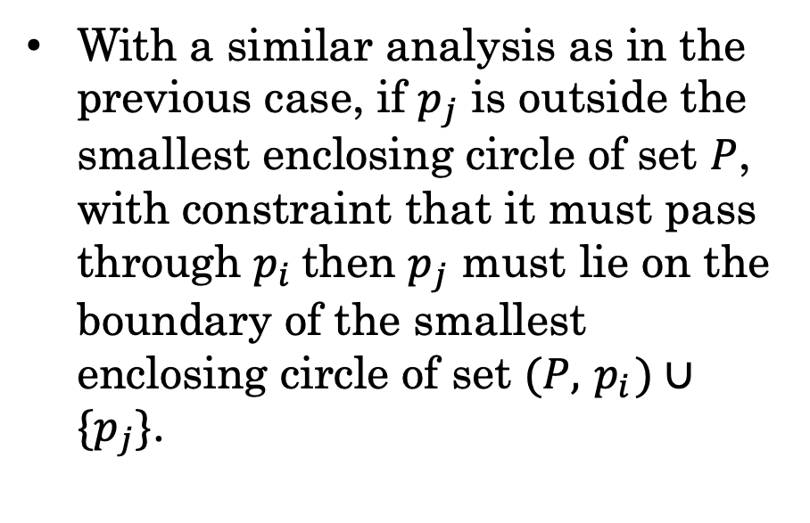
Second Defining Point
With a similar analysis as in the previous case, if $p_{j}$ is outside the smallest enclosing circle of set $P$, with constraint that it must pass through $p_{i}$then $p_{j}$ must lie on the boundary of the smallest enclosing circle of set $(P,{ p}_{i})∪\{p_{j}\}$.
$$p_{i}$$
$$P$$
$$p_{j}$$

Slide 55
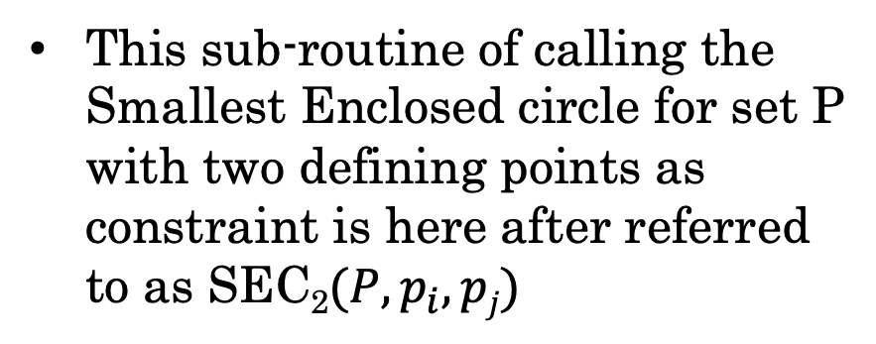

Second Defining Point
With a similar analysis as in the previous case, if $p_{j}$ is outside the smallest enclosing circle of set $P$, with constraint that it must pass through $p_{i}$then $p_{j}$ must lie on the boundary of the smallest enclosing circle of set $(P,{ p}_{i})∪\{p_{j}\}$.
$$p_{i}$$
$$P$$
$$p_{j}$$
This sub-routine of calling the Smallest Enclosed circle for set P with two defining points as constraint is here after referred to as SEC₂$(P,p_{i}, pj)$

Slide 56


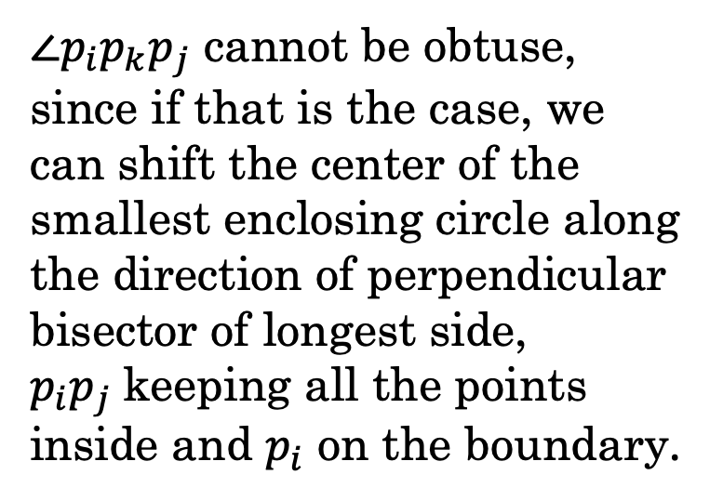

Key idea
$$p_{i}$$
$$P$$
$∠p_{i}p_{k}p_{j}$ cannot be obtuse, since if that is the case, we can shift the center of the smallest enclosing circle along the direction of perpendicular bisector of longest side, $p_{i}p_{j}$keeping all the points inside and $p_{i}$ on the boundary.
$$p_{k}$$
$$α$$
$$2α$$
$$p_{j}$$

Slide 57
Randomized Incremental Construction
SEC₁(P,p_{i})
{
C ← Circle(p_{i},p₁)
for j ← 1 to P.size do
if p_{j} lies outside C
C ← SEC₂(P, p_{i}, p_{j})
return C
}

Slide 58
Third Defining Point.

Slide 59

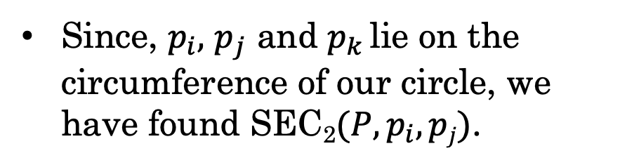
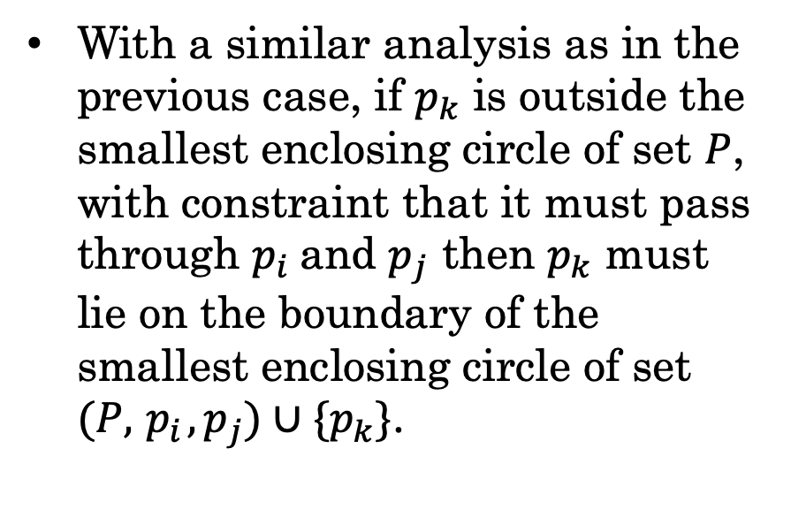


Third Defining Point
$$p_{i}$$
With a similar analysis as in the previous case, if $p_{k}$ is outside the smallest enclosing circle of set $P$, with constraint that it must pass through $p_{i}$and $p_{j}$ then $p_{k}$ must lie on the boundary of the smallest enclosing circle of set $(P,{ p}_{i},p_{j})∪\{p_{k}\}$.
$$P$$
$$p_{j}$$
Since, $p_{i},$ $p_{j}$ and $p_{k }$lie on the circumference of our circle, we have found SEC₂$(P,p_{i}, pj)$.

Slide 60


$$p_{i}$$
$$P$$
$$p_{j}$$

Slide 61

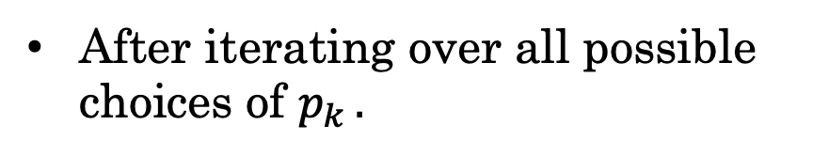

After iterating over all possible choices of $p_{k }.$
$$p_{i}$$
$$P$$
$$p_{j}$$
$$p_{k}$$

Slide 62
Randomized Incremental Construction
SEC₂(P, p_{i}, p_{j})
{
C ← Circle(p_{i},p₁)
for i ← 1 to P.size do
if p_{j} lies outside C
C ← Update(SEC₂(P, p_{i}, p_{j}))
return C
}

Slide 63
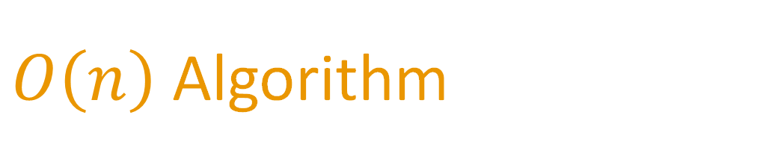
$O\left(n\right)$ Algorithm

Slide 64
Enclosing_Circle_N([p₁,p₂,...p_{n}]){
C ← Circle Passing through p₁, p₂
for i ← 3 to n do
if p_{i} lies outside C then
C ← Circle(p₁, p_{i})
for j ← 1 to i do
if p_{j} lies outside C’ then
C ← Circle(p_{j}, p_{i})
for k ← 1 to j do
if p_{k} lies outside C” then
C ← Circumcircle(p_{k}, p_{i}, p_{j})
return C
}

Slide 65
Enclosing_Circle_N([p₁,p₂,...p_{n}]){
C ← Circle Passing through p₁, p₂
for i ← 3 to n do
if p_{i} lies outside C then
C ← Circle(p₁, p_{i})
for j ← 1 to i do
if p_{j} lies outside C’ then
C ← Circle(p_{j}, p_{i})
SEC(P,p)
for k ← 1 to j do
if p_{k} lies outside C” then
C ← Circumcircle(p_{k}, p_{i}, p_{j})
return C
}

Slide 66
Enclosing_Circle_N([p₁,p₂,...p_{n}]){
C ← Circle Passing through p₁, p₂
for i ← 3 to n do
if p_{i} lies outside C then
C ← Circle(p₁, p_{i}) \
for j ← 1 to i do
if p_{j} lies outside C’ then
C ← Circle(p_{j}, p_{i})
for k ← 1 to j do
if p_{k} lies outside C” then
C ← Circumcircle(p_{k}, p_{i}, p_{j})
return C
}
SEC(P,p,q)

Slide 67
Proof of Correctness

Slide 68
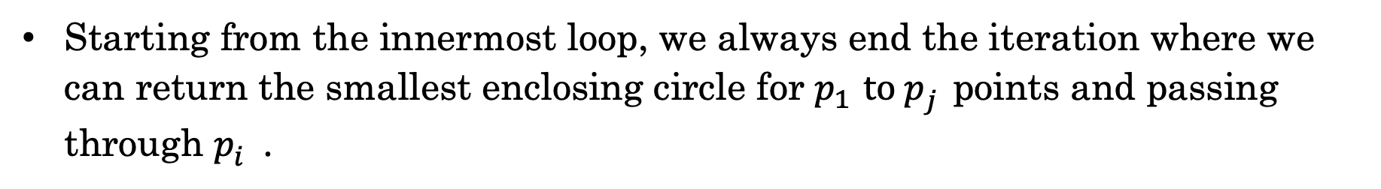
Proof of Correctness
Starting from the innermost loop, we always end the iteration where we can return the smallest enclosing circle for $p_{1}^{}to p_{j}^{}$points and passing through $p_{i}^{}$.

Slide 69
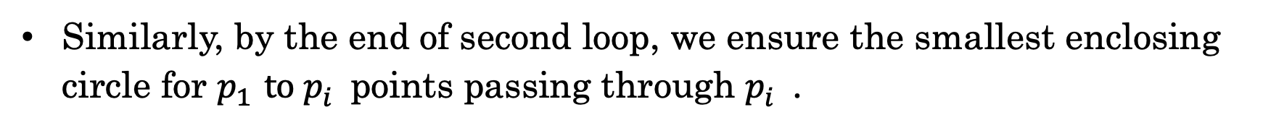
Proof of Correctness
Starting from the innermost loop, we always end the iteration where we can return the smallest enclosing circle for $p_{1}^{}to p_{j}^{}$points and passing through $p_{i}^{}$.
Similarly, by the end of second loop, we ensure the smallest enclosing circle for $p_{1}^{}to p_{i}^{}$points passing through $p_{i}^{}$.

Slide 70
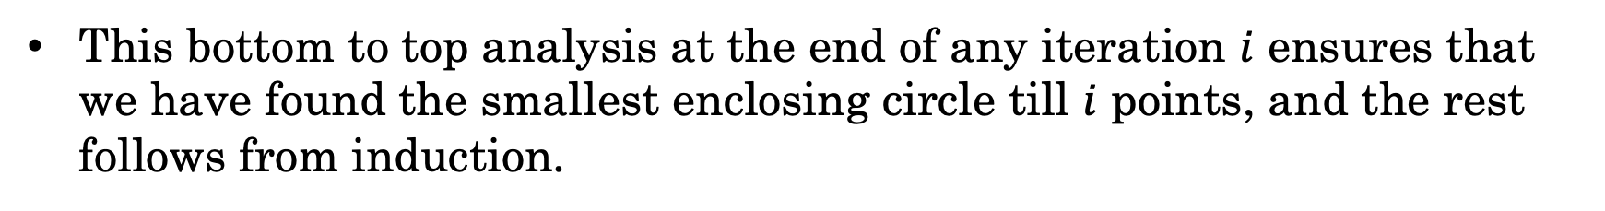
Proof of Correctness
Starting from the innermost loop, we always end the iteration where we can return the smallest enclosing circle for $p_{1}^{}to p_{j}^{}$points and passing through $p_{i}^{}$.
Similarly, by the end of second loop, we ensure the smallest enclosing circle for $p_{1}^{}to p_{i}^{}$points passing through $p_{i}^{}$.
This bottom to top analysis at the end of any iteration $i$ ensures that we have found the smallest enclosing circle till $i$ points, and the rest follows from induction.

Slide 71

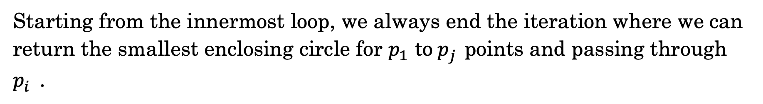

Starting from the innermost loop, we always end the iteration where we can return the smallest enclosing circle for $p_{1}^{}to p_{j}^{}$points and passing through $p_{i}^{}$.
$$D2$$
$$D1$$

Slide 72
Starting from the innermost loop, we always end the iteration where we can return the smallest enclosing circle for $p_{1}^{}to p_{j}^{}$points and passing through $p_{i}^{}$.
Our final loop fails to find the third defining point when it lies on the line formed by joining the two previous defining points.
$$D2$$
?
$$D1$$

Slide 73
Starting from the innermost loop, we always end the iteration where we can return the smallest enclosing circle for $p_{1}^{}to p_{j}^{}$points and passing through $p_{i}^{}$.
If a point lies on the line and is inside the circle defined by the first defining point and second defining point, then it will not be a defining point and we will iterate over other points that lie inside.
$$D2$$
$$D1$$

Slide 74


Starting from the innermost loop, we always end the iteration where we can return the smallest enclosing circle for $p_{1}^{}to p_{j}^{}$points and passing through $p_{i}^{}$.
If the point lies on the line, but is outside, then one of the inner defining points get replaced in further iterations.
$$D_{1}$$
$$D_{2}$$
?

Slide 75


Starting from the innermost loop, we always end the iteration where we can return the smallest enclosing circle for $p_{1}^{}to p_{j}^{}$points and passing through $p_{i}^{}$.
$$D_{1}$$
$$D_{2}$$
?
If the point lies on the line, but is outside, then one of the inner defining points get replaced in further iterations.

Slide 76


$$D_{1}$$
$$D_{2}$$

Slide 77
Time Complexity Analysis

Slide 78
Lemma
Probability that point $P_{i}$ lies outside the smallest enclosing circle of points is $P_{1}$ , $P_{2}$ , $P_{3}$ , … , $P_{i−1}$ is ≤ $\frac{3}{i}$

Slide 79
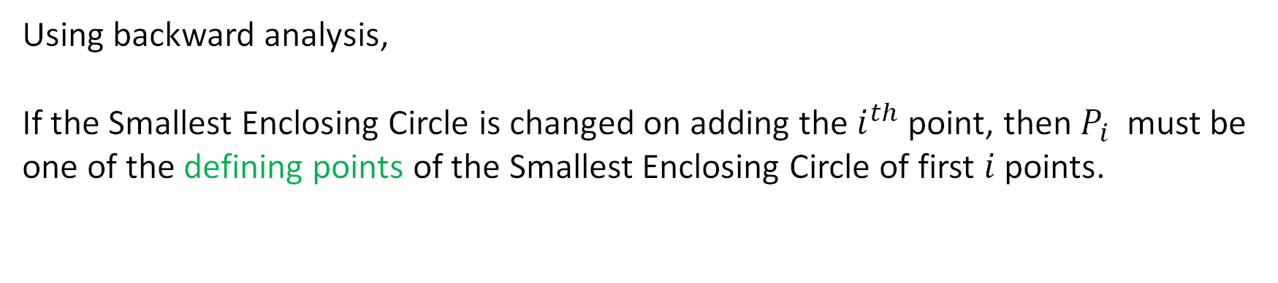
Lemma
Probability that point $P_{i}$ lies outside the smallest enclosing circle of points is $P_{1}$ , $P_{2}$ , $P_{3}$ , … , $P_{i−1}$ is ≤ $\frac{3}{i}$
Using backward analysis,
If the Smallest Enclosing Circle is changed on adding the $i^{th}$ point, then $P_{i}$ must be one of the defining points of the Smallest Enclosing Circle of first $i$ points.

Slide 80
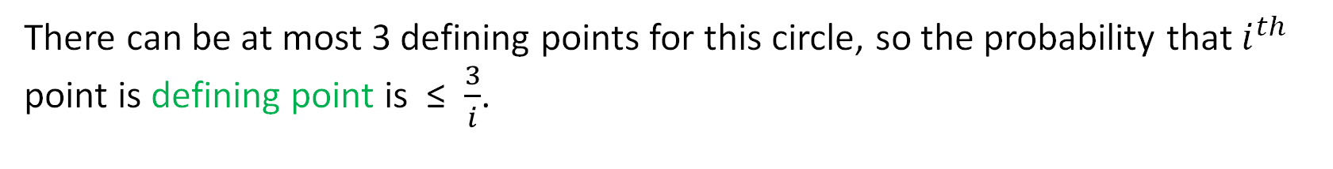
Lemma
Probability that point $P_{i}$ lies outside the smallest enclosing circle of points is $P_{1}$ , $P_{2}$ , $P_{3}$ , … , $P_{i−1}$ is ≤ $\frac{3}{i}$
Using backward analysis,
If the Smallest Enclosing Circle is changed on adding the $i^{th}$ point, then $P_{i}$ must be one of the defining points of the Smallest Enclosing Circle of first $i$ points.
There can be at most 3 defining points for this circle, so the probability that $i^{th}$ point is defining point is ≤ $\frac{3}{i}$.

Slide 81
Time Complexity Analysis
Expected time taken to find smallest enclosing circle with :

Slide 82
Time Complexity Analysis
Expected time taken to find smallest enclosing circle with :
$$O\left(1\right)+ \frac{3}{i}(time taken with one defining point known)$$
One defining point

Slide 83
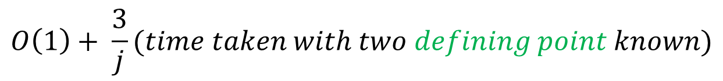
Time Complexity Analysis
Expected time taken to find smallest enclosing circle with :
$$O\left(1\right)+ \frac{3}{i}(time taken with one defining point known)$$
One defining point
$$O\left(1\right)+ \frac{3}{j}(time taken with two defining point known)$$
Two defining points

Slide 84
Time Complexity Analysis
Expected time taken to find smallest enclosing circle with :
$$O\left(1\right)+ \frac{3}{i}(time taken with one defining point known)$$
One defining point
$$O\left(1\right)+ \frac{3}{j}(time taken with two defining point known)$$
Two defining points
Three defining points
$$O\left(j\right)$$

Slide 85
Time Complexity Analysis
Expected time taken to find smallest enclosing circle with :
$$O\left(1\right)+ \frac{3}{i}(time taken with one defining point known)$$
One defining point
Two defining points
$$O\left(i\right)$$
Three defining points
$$O\left(j\right)$$

Slide 86
Time Complexity Analysis
Expected time taken to find smallest enclosing circle with :
One defining point
$$O\left(n\right)$$
Two defining points
$$O\left(i\right)$$
Three defining points
$$O\left(j\right)$$

Slide 87
Experimental Results

Slide 88
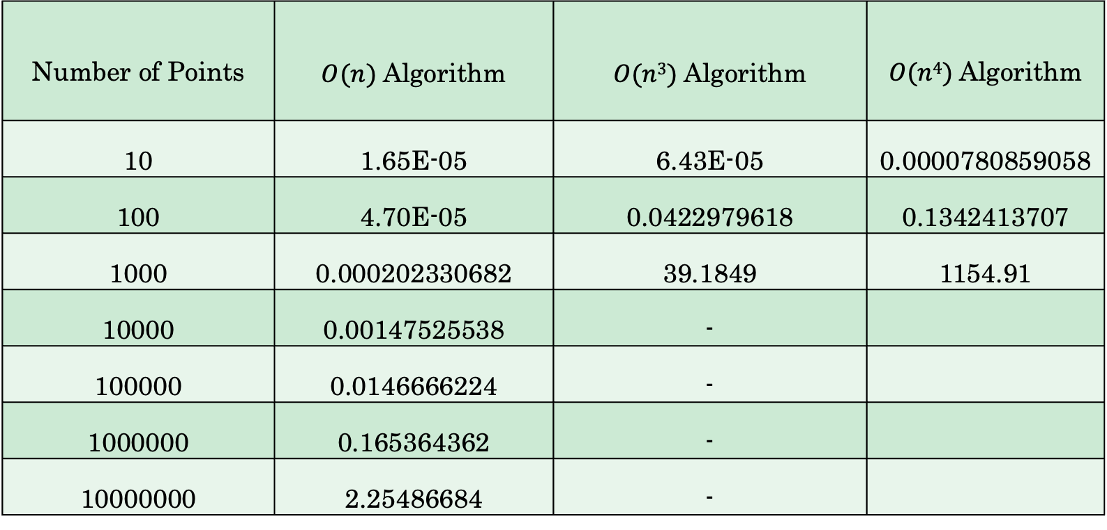

Time taken by $O(n)$ , $O\left(n3\right)$ and $O(n4)$ algorithms
Number of Points | $O(n)$ Algorithm | $O(n3)$Algorithm | $O(n4)$Algorithm
10 | 1.65E-05 | 6.43E-05 | 0.0000780859058
100 | 4.70E-05 | 0.0422979618 | 0.1342413707
1000 | 0.000202330682 | 39.1849 | 1154.91
10000 | 0.00147525538 | -
100000 | 0.0146666224 | -
1000000 | 0.165364362 | -
10000000 | 2.25486684 | -

Slide 89
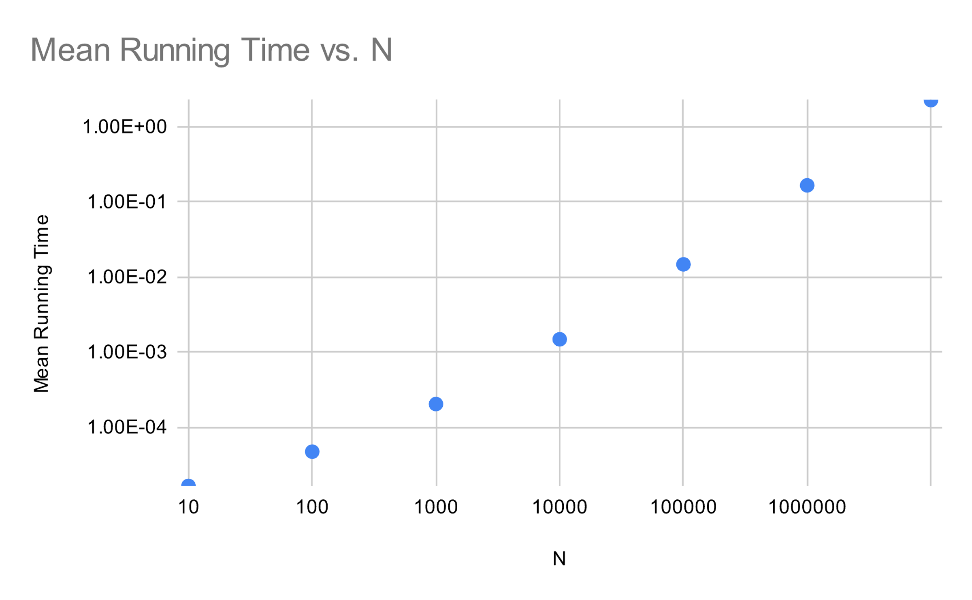
Time taken by O(n) algorithm
Number of Points | Mean Running time in Seconds
10 | 1.65E-05
100 | 4.70E-05
1000 | 0.000202330682
10000 | 0.00147525538
100000 | 0.0146666224
1000000 | 0.165364362
10000000 | 2.25486684

Slide 90
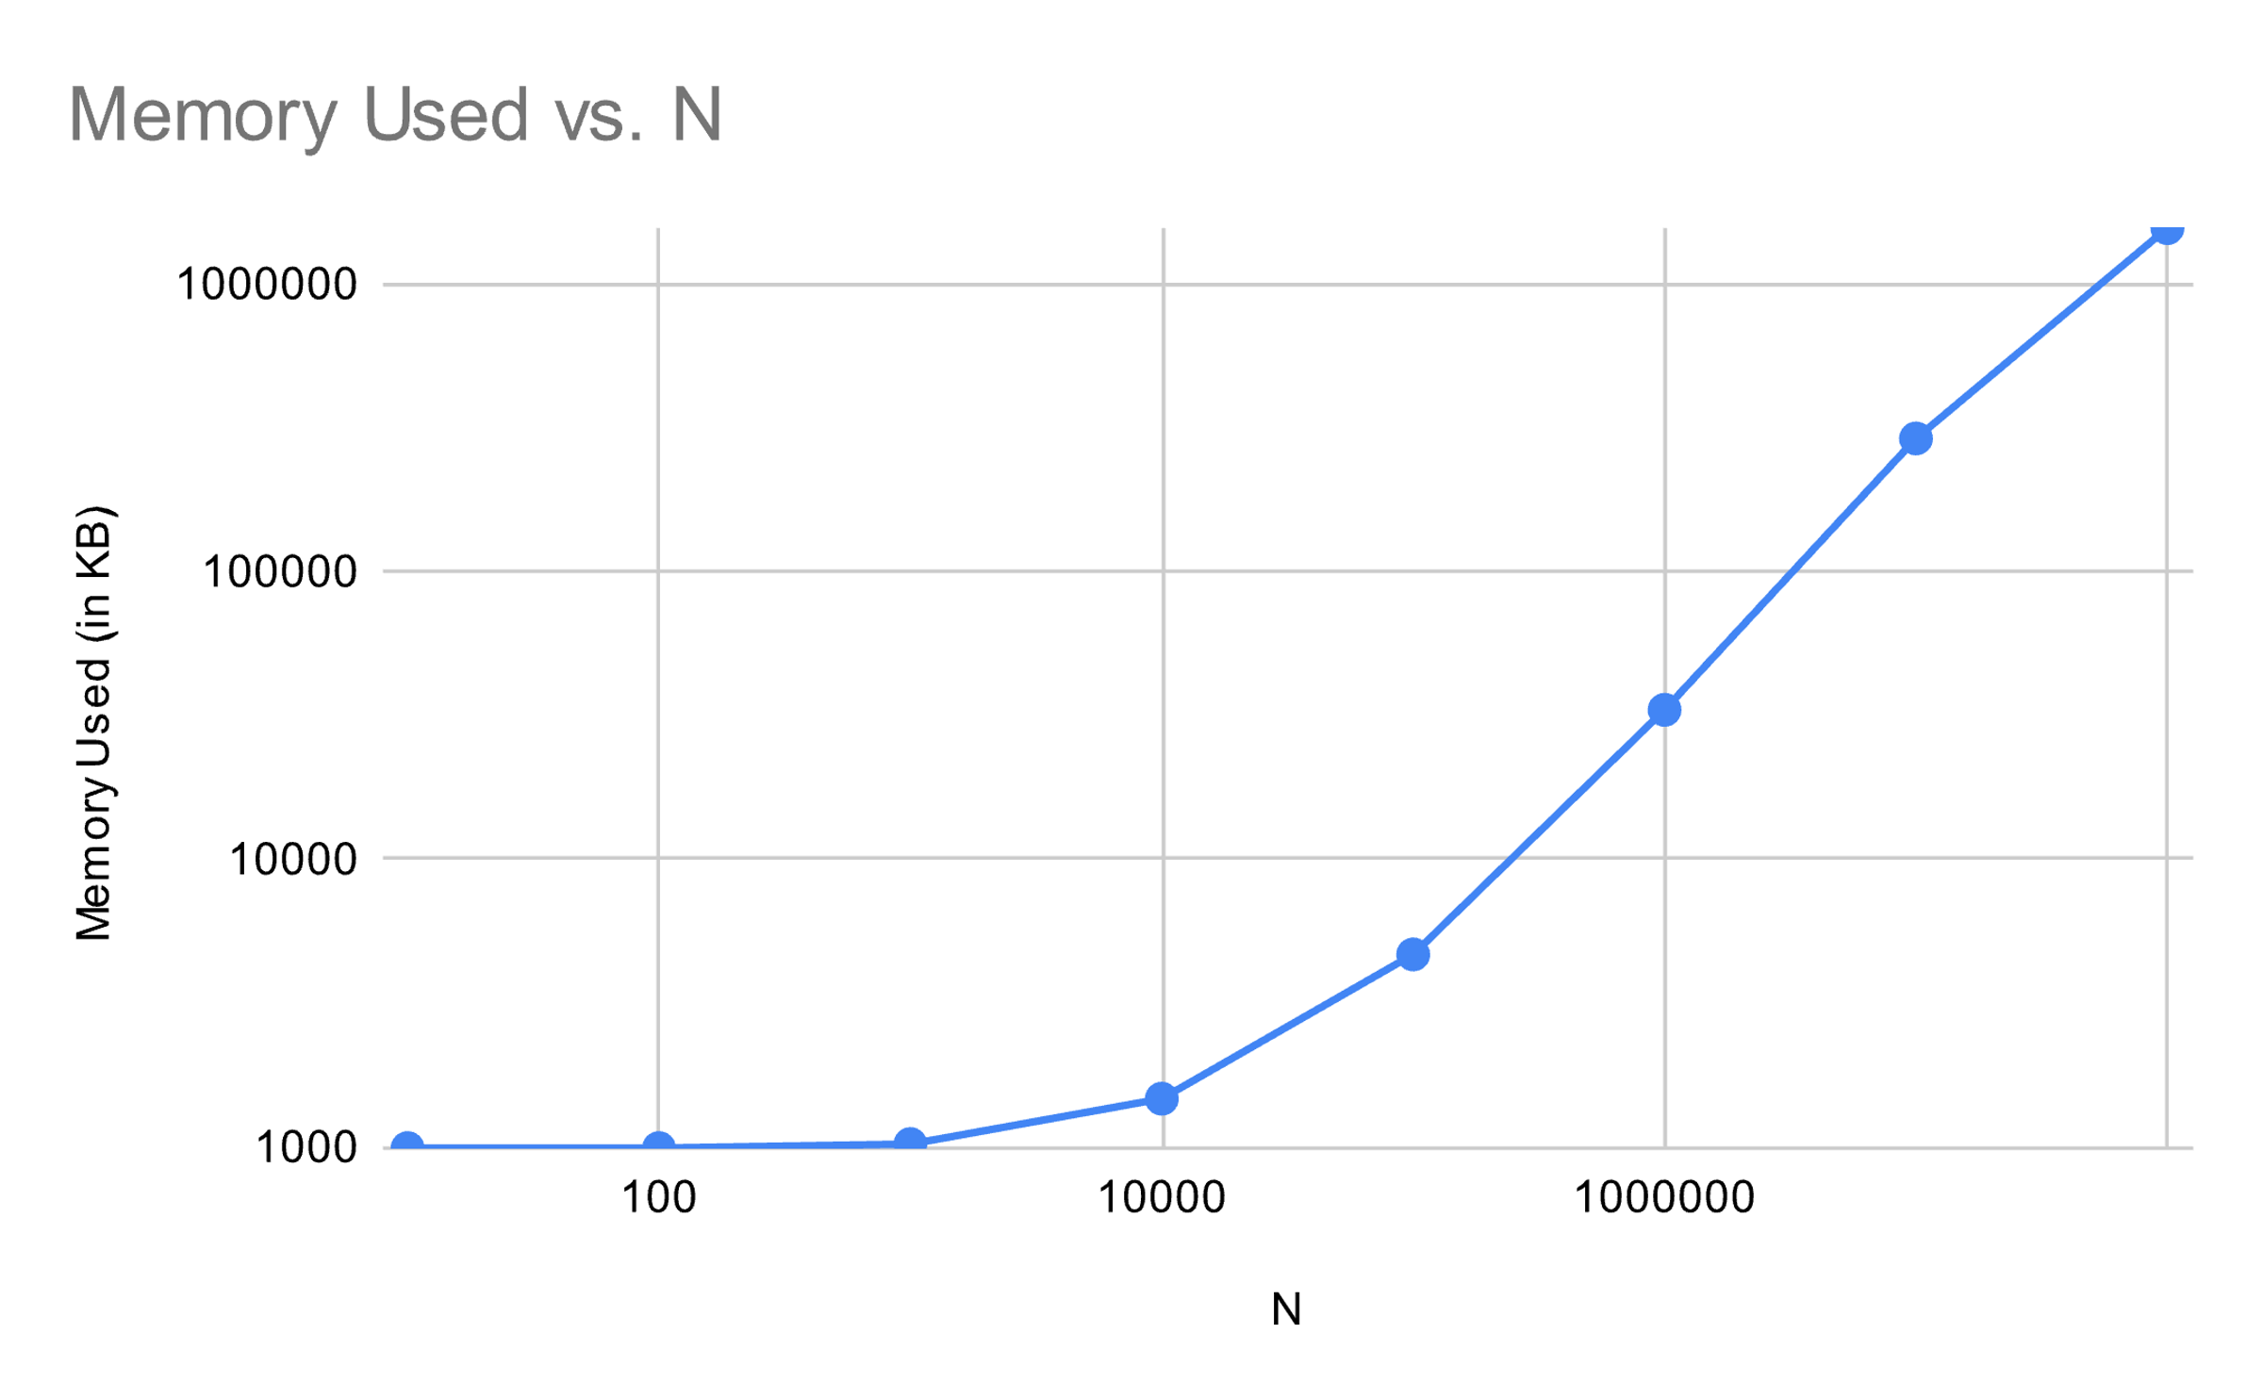
Memory used per iterations for linear time algorithm
Number of Points | Memory Used in Kilobytes
10 | 992
100 | 992
1000 | 1024
10000 | 1472
100000 | 4672
1000000 | 33088
10000000 | 290368

Slide 91
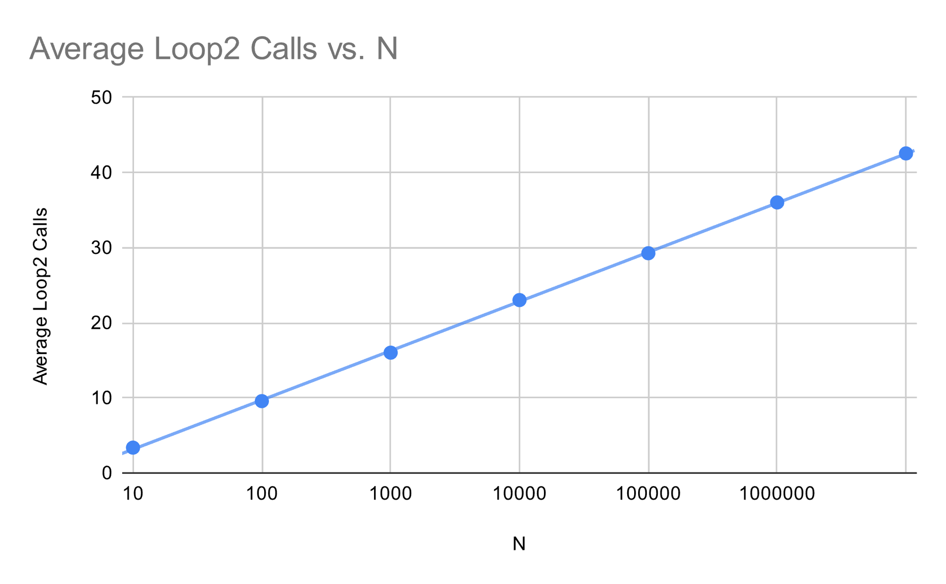
Number of times new point lies outside current circle
Number of Points | Average number of times point lies outside
10 | 3.37
100 | 9.57
1000 | 16.02
10000 | 23.02
100000 | 29.26
1000000 | 36.02
10000000 | 42.55

Slide 92
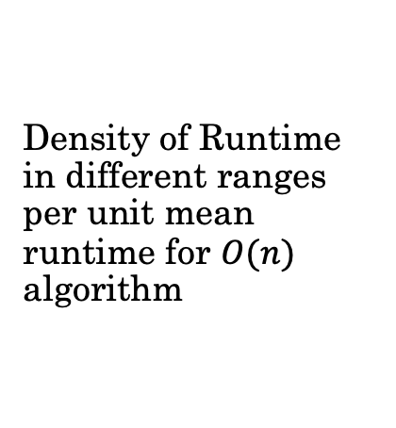
Density of Runtime in different ranges per unit mean runtime for $O(n)$ algorithm
 | 10 | 100 | 1000 | 10000 | 100000 | 1000000 | 10000000
0.25, 0.35 | 0 | 0 | 0 | 0 | 0 | 0 | 0
0.35, 0.45 | 0 | 0 | 0 | 0 | 0 | 0 | 0
0.45, 0.55 | 0 | 7 | 0 | 0 | 0 | 0 | 0
0.55, 0.65 | 12 | 34 | 36 | 0 | 0 | 0 | 0
0.65, 0.75 | 40 | 71 | 103 | 1 | 0 | 6 | 0
0.75, 0.85 | 65 | 74 | 96 | 73 | 69 | 75 | 6
0.85, 0.95 | 118 | 80 | 84 | 149 | 182 | 151 | 183
0.95, 1.05 | 87 | 55 | 48 | 141 | 132 | 133 | 190
1.05, 1.15 | 71 | 57 | 28 | 78 | 62 | 68 | 75
1.15, 1.25 | 54 | 29 | 19 | 30 | 26 | 37 | 30
N
n/N_{avg}
1.25, 1.35 | 20 | 27 | 13 | 15 | 9 | 9 | 9
1.35, 1.45 | 15 | 19 | 9 | 3 | 7 | 4 | 2
1.45, 1.55 | 8 | 16 | 11 | 2 | 3 | 4 | 3
1.55, 1.65 | 4 | 7 | 10 | 2 | 2 | 6 | 2
1.65, 1.75 | 1 | 10 | 11 | 1 | 2 | 3 | 0
>1.75 | 5 | 14 | 32 | 5 | 6 | 4 | 0

Slide 93
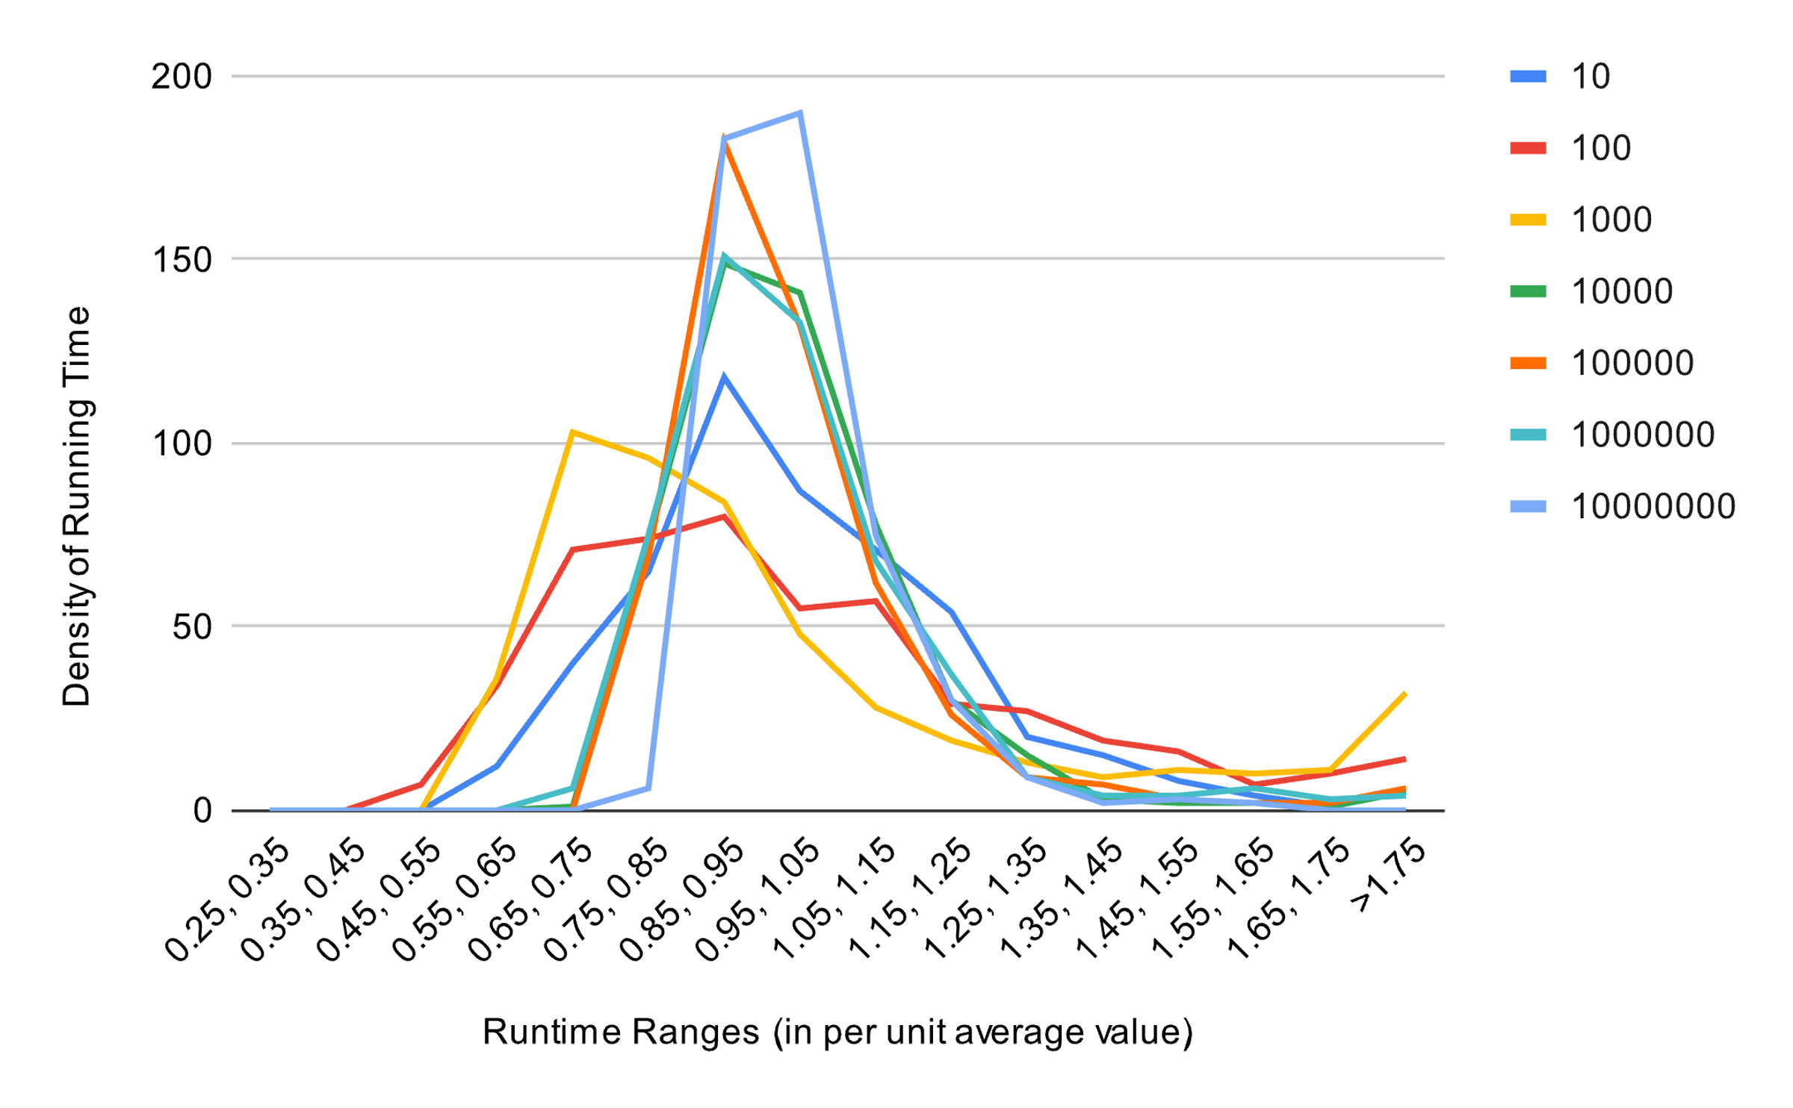

Slide 94
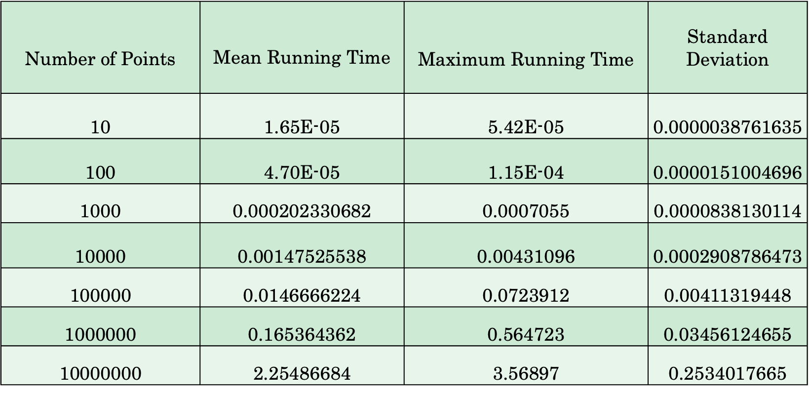
Comparison with worst case time for linear time algorithm
Number of Points | $$\text{Mean} \text{Running} \text{Time}$$ | Maximum Running Time | Standard Deviation
10 | 1.65E-05 | 5.42E-05 | 0.0000038761635
100 | 4.70E-05 | 1.15E-04 | 0.0000151004696
1000 | 0.000202330682 | 0.0007055 | 0.0000838130114
10000 | 0.00147525538 | 0.00431096 | 0.0002908786473
100000 | 0.0146666224 | 0.0723912 | 0.00411319448
1000000 | 0.165364362 | 0.564723 | 0.03456124655
10000000 | 2.25486684 | 3.56897 | 0.2534017665

Slide 95
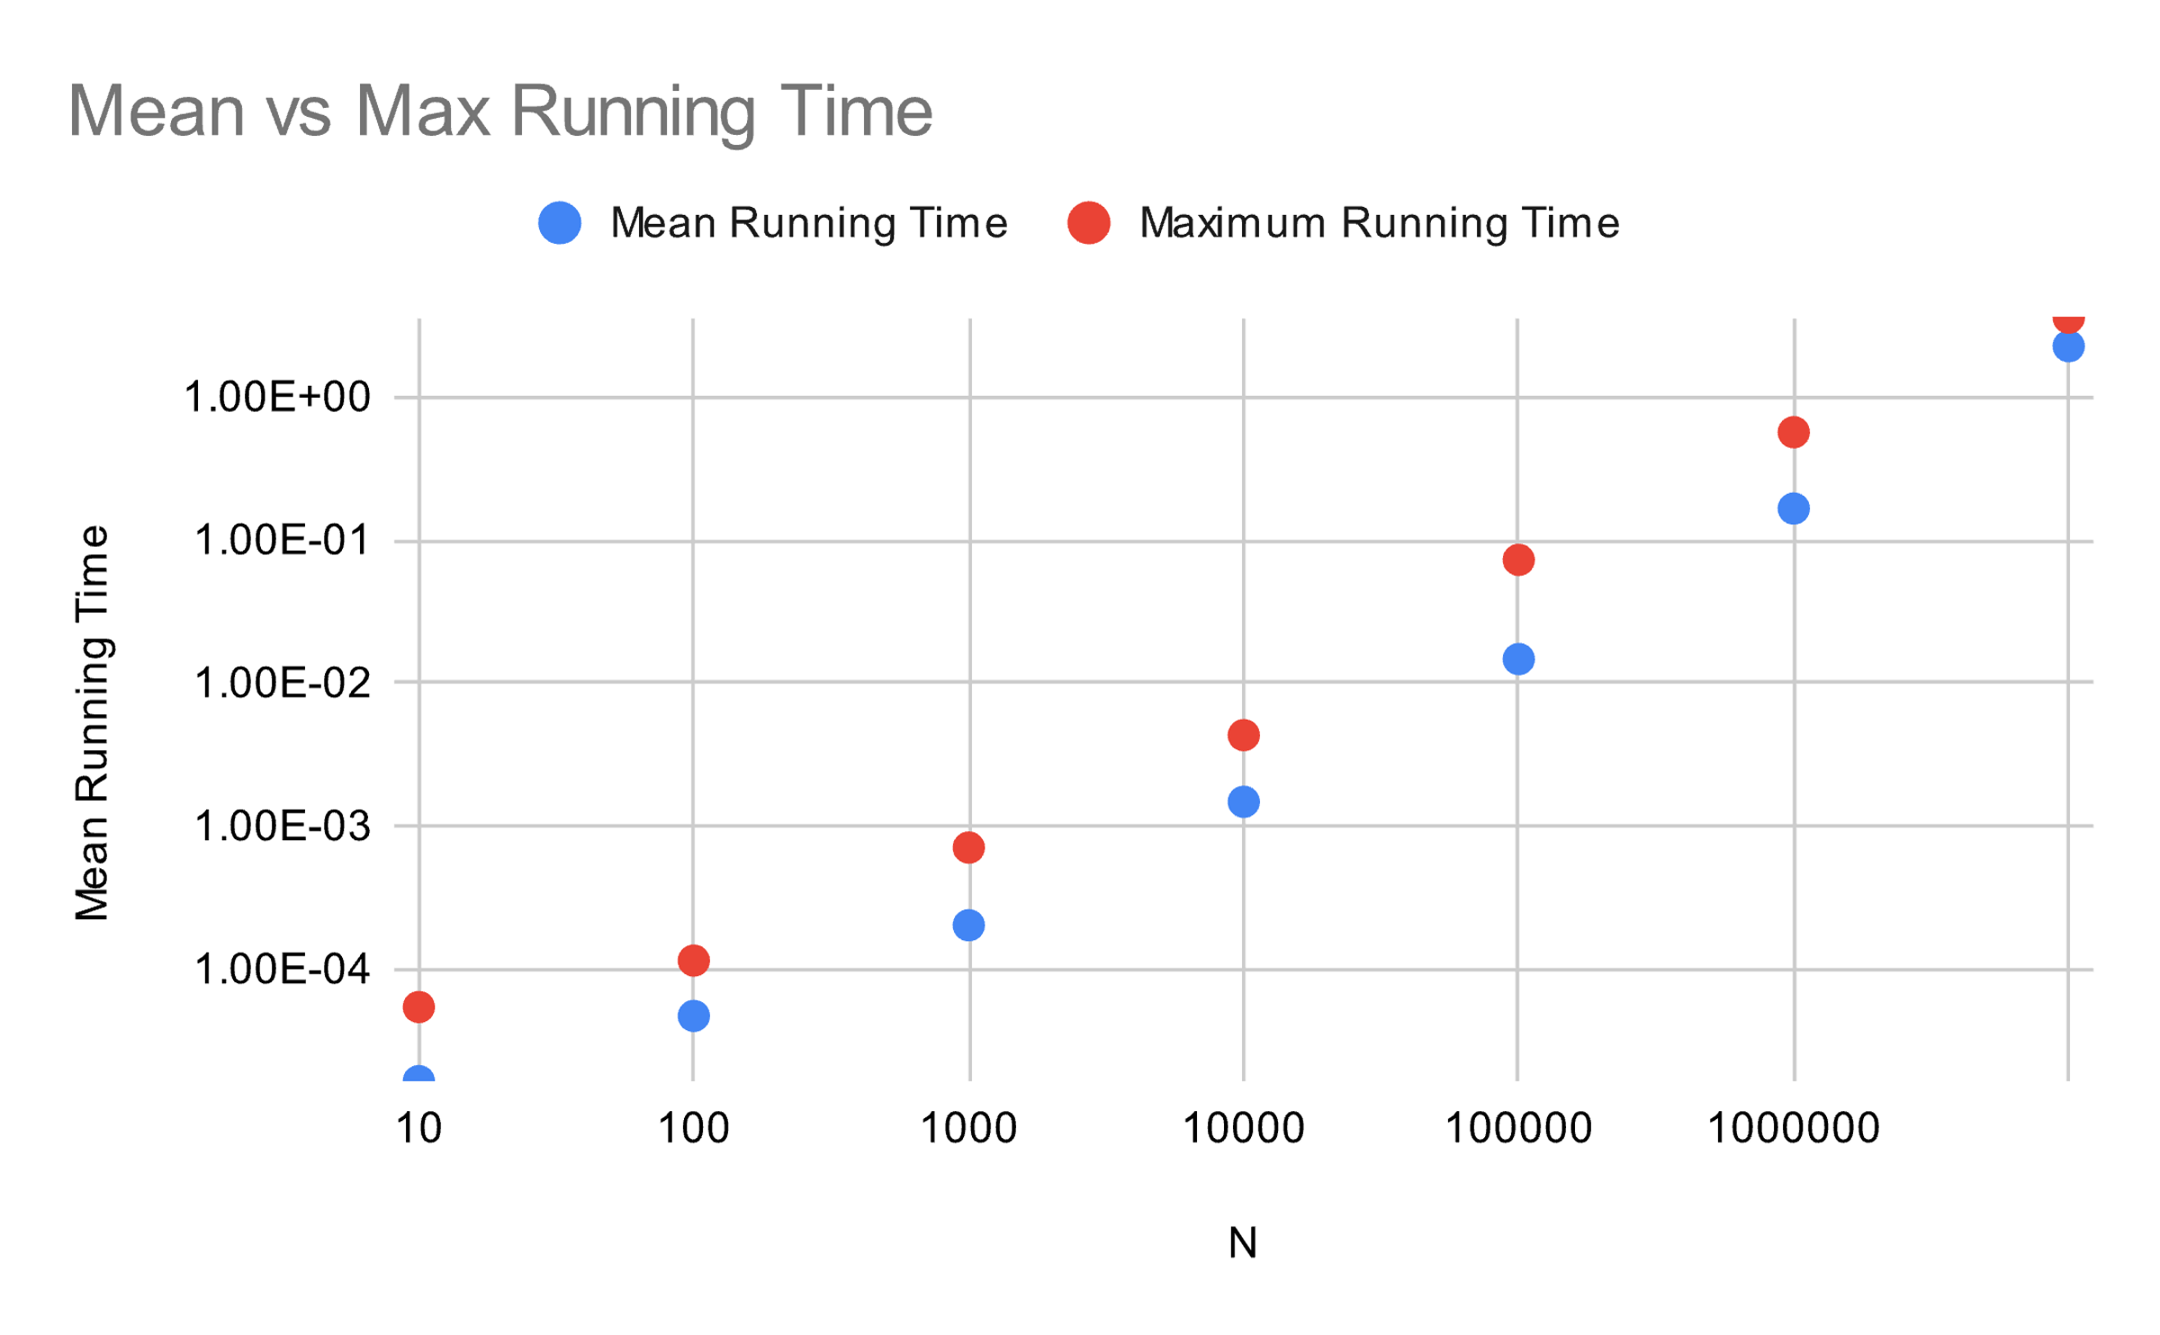

Slide 96
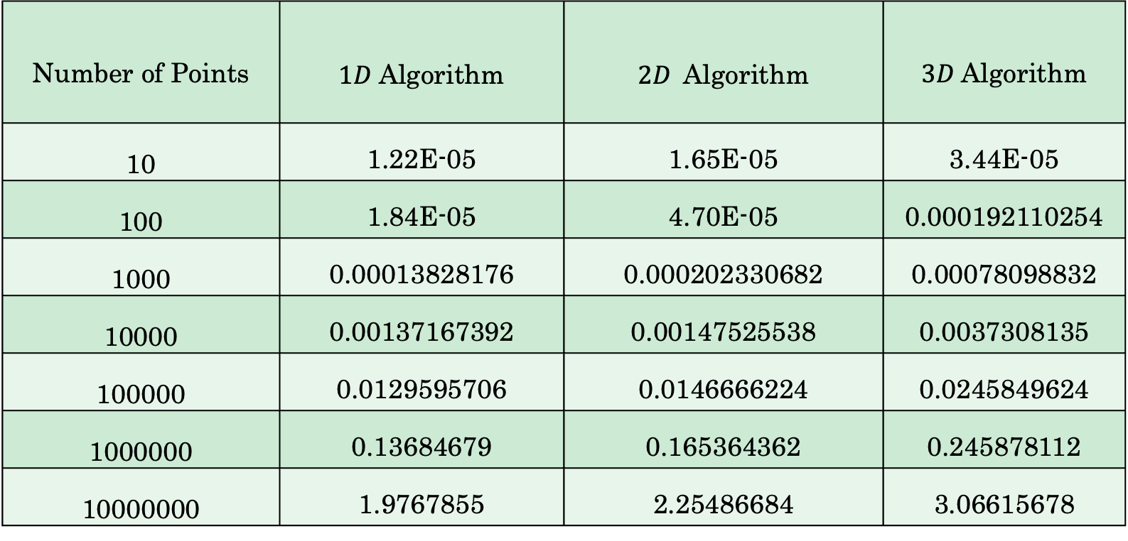
Extension to higher and lower dimensions.
Number of Points | $1D$Algorithm | $2D$Algorithm | $3D$Algorithm
10 | 1.22E-05​ | 1.65E-05​ | 3.44E-05​
100 | 1.84E-05​ | 4.70E-05​ | 0.000192110254​
1000 | 0.00013828176​ | 0.000202330682​ | 0.00078098832​
10000 | 0.00137167392​ | 0.00147525538​ | 0.0037308135​
100000 | 0.0129595706​ | 0.0146666224​ | 0.0245849624​
1000000 | 0.13684679​ | 0.165364362​ | 0.245878112​
10000000 | 1.9767855​ | 2.25486684​ | 3.06615678​

Slide 97
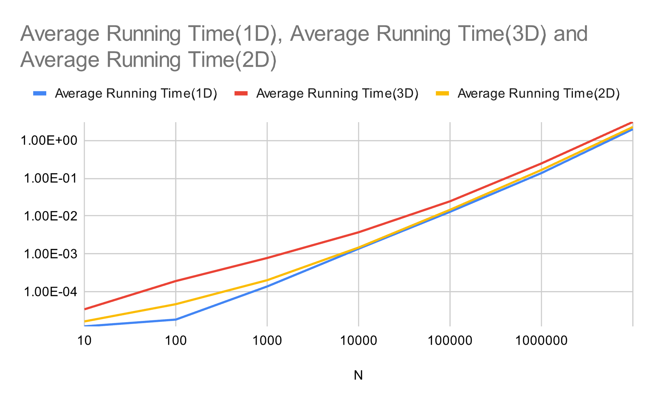

Slide 98
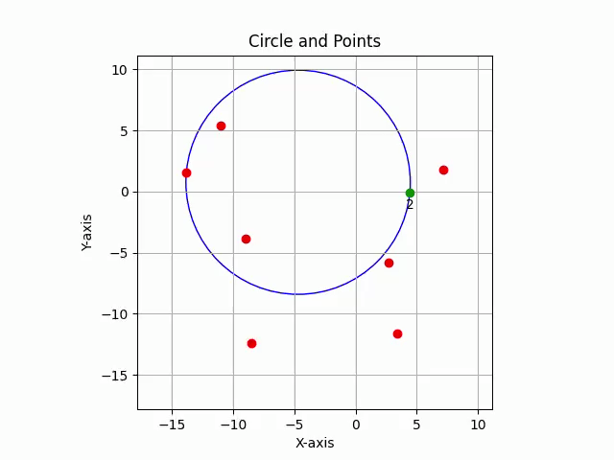
Dry Run of the Algorithm. A visualizer was also made and can be found here.

