Slide 1

Mannual Testing And Automation with Selenium
Presented By:Yogita Kachare

Slide 2
Content
Software Engineering
DBMS and SQL
Mannual Testing
Java
Selenium Webdriver
TDD & BDD
Project Details

Slide 3
Softaware Engineering
Waterfall Model
Iterative Model
Spiral Model
Incremental Model
V-Model
Big-Ban Model
Agile Model

Slide 4
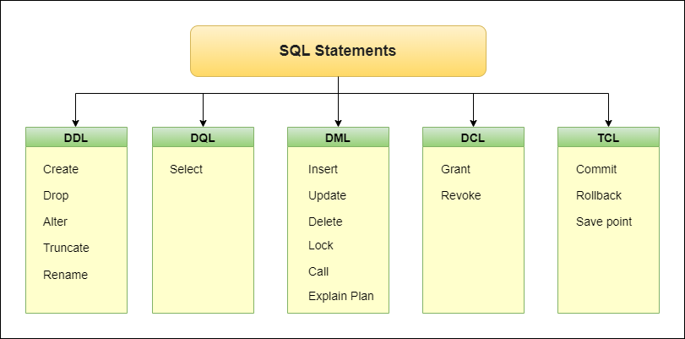
DBMS & SQL

Slide 5
DBMS & SQL
Row and Columns
Queries
Operators
Clause
Join
Foreign Key, Primary Key, Unique Key
Normalization

Slide 6
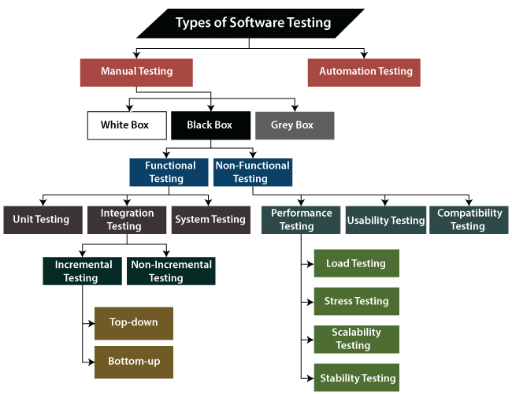
Mannual Testing

Slide 7
JAVA
Java Fundamentals.
Data types,KeyWords,Token,Identifier,Array
OOPs Concepts.
Overloading & Overriding.
Inheritance with Interface and Abstract Class.
Exception Handling.
Constructor
Packages.
Collections.
Multithreading.

Slide 8
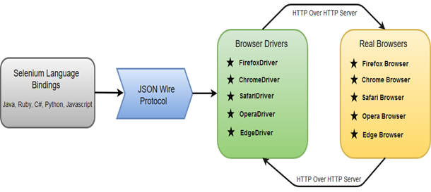
Selenium Webdriver

Slide 9
Selenium Webdriver
Find Element
Locators
Drop-Down
Action Class
Multiple Window
Wait
Ifame
Cookie
Screenshot

Slide 10
TDD &BDD
Maven
TestNG
Assertion
Framework
Page Factory
Feature file
Gherkin Language

Slide 11
Project Details
Project Name : SAUCEDEMO
Url :https://www.saucedemo.com/
Programming language : core java
Automation Technology :Selenium Webdriver
Automation Testing Environment: TestNG
Build in Tool : Maven

Slide 12
Other Project details
ATM java project
Mannual Documentation
Selenium IDE some modules
Cucumber some modules
Mannual Documentation

Slide 13


