Slide 1

CORONA VIRUS ANALYSIS
By Yogita Patil

Slide 2
Overview
The CORONA VIRUS pandemic has had a significant impact on public health and has created an urgent need for data-driven insights to understand the spread of the virus. As a data analyst, you have been tasked with analyzing a CORONA VIRUS dataset to derive meaningful insights and present your findings.

Slide 3
Description of each column in the dataset.
Province: The administrative division within a country where the data was recorded. This column may sometimes be null or contain general regions instead of specific provinces.
Country/Region: The name of the country or region.
Latitude: The geographic latitude coordinate of the location.
Longitude: The geographic longitude coordinate of the location.
Date: The date when the data was recorded. This typically represents a daily time series.
Confirmed: The number of confirmed cases of CORONA VIRUS reported on the given date and location.
Deaths: The number of deaths due to CORONA VIRUS reported on the given date and location.
Recovered: The number of recovered cases of CORONA VIRUS reported on the given date and location.
These columns together provide a comprehensive view of the spread and impact of CORONA VIRUS across different regions and over time.

Slide 4
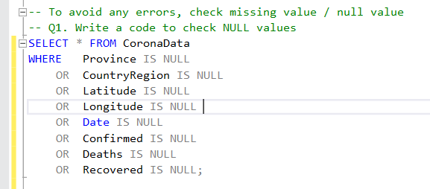
-- To avoid any errors, check missing value / null value
-- Q1. Write a code to check NULL values

Slide 5
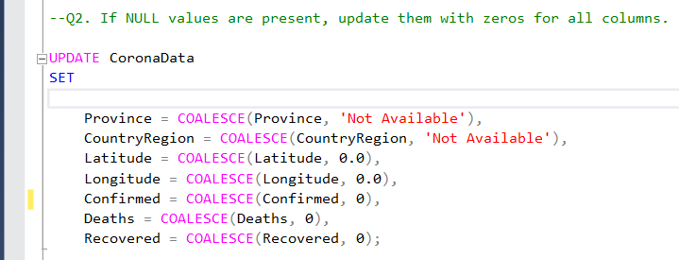

--Q2. If NULL values are present, update them with zeros for all columns.

Slide 6
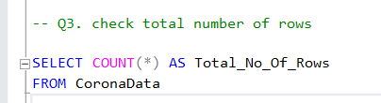

-- Q3. check total number of rows

Slide 7
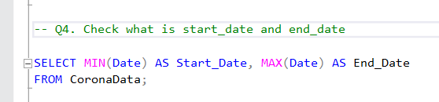
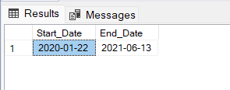
-- Q4. Check what is start_date and end_date

Slide 8
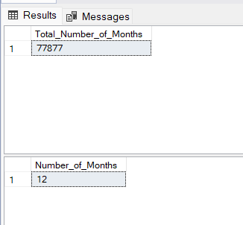
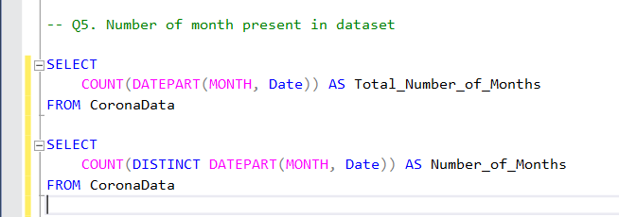
-- Q5. Number of month present in dataset

Slide 9
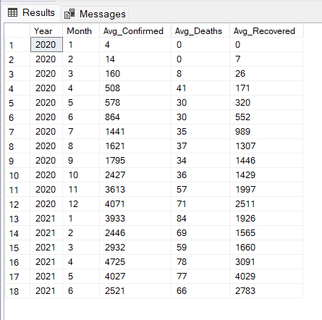
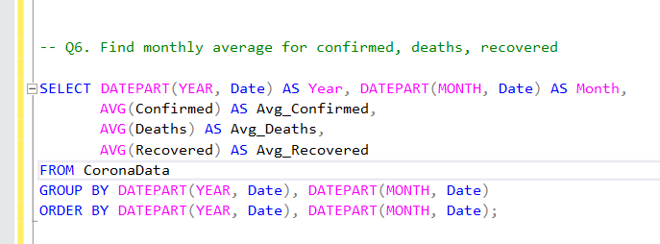
-- Q6. Find monthly average for confirmed, deaths, recovered

Slide 10
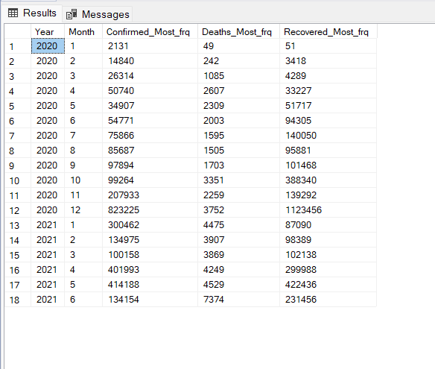
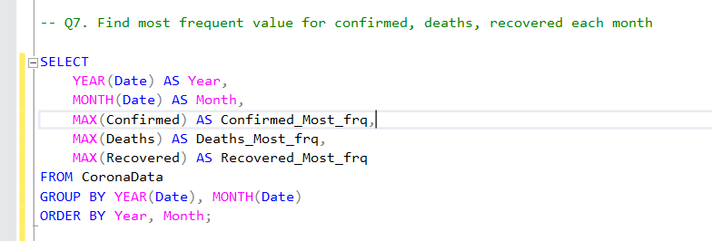
-- Q7. Find most frequent value for confirmed, deaths, recovered each month

Slide 11
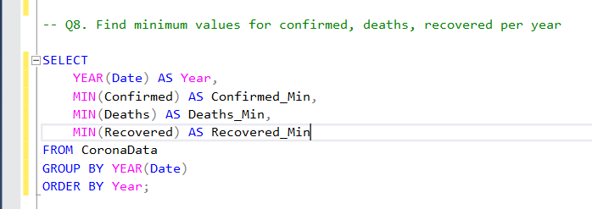
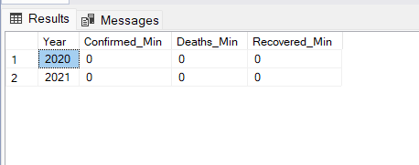
-- Q8. Find minimum values for confirmed, deaths, recovered per year

Slide 12
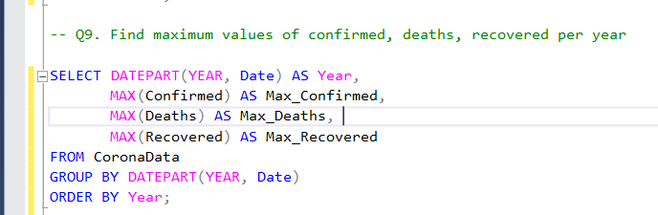
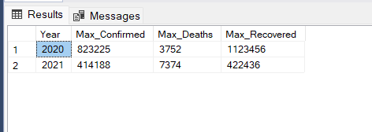
-- Q9. Find maximum values of confirmed, deaths, recovered per year

Slide 13
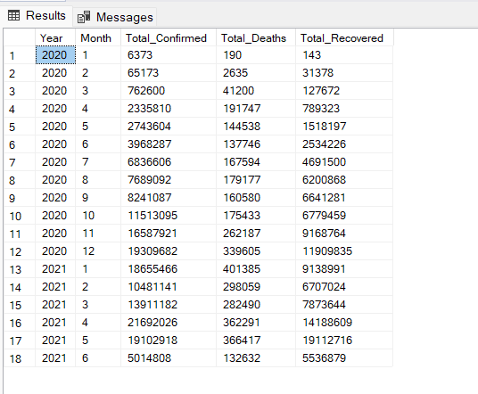
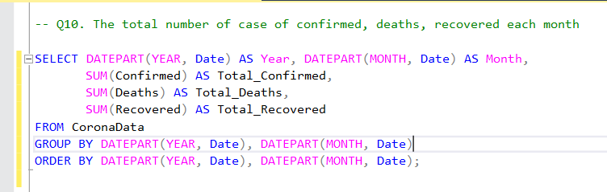
-- Q10. The total number of case of confirmed, deaths, recovered each month

Slide 14
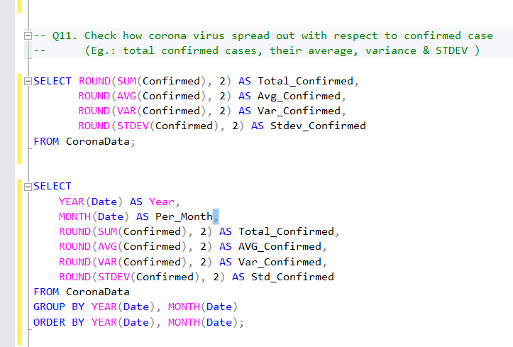
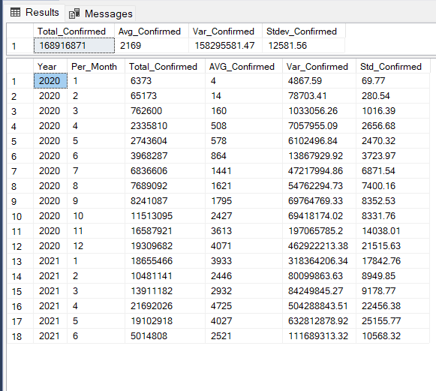
-- Q11. Check how corona virus spread out with respect to confirmed case

Slide 15
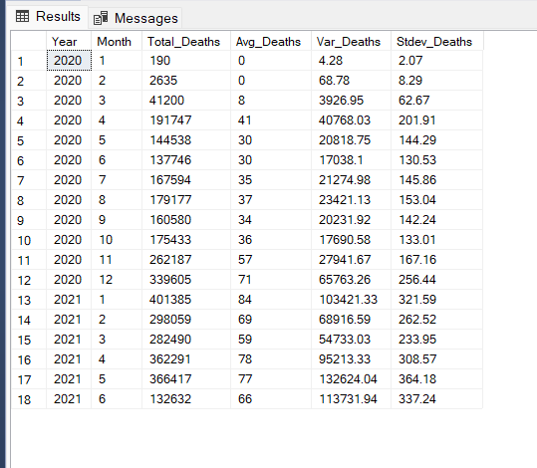
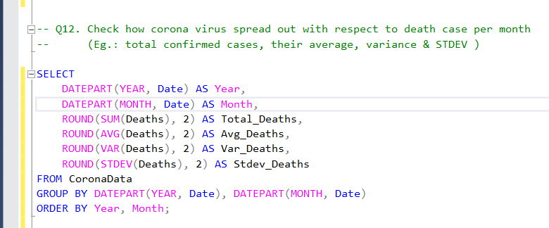
-- Q12. Check how corona virus spread out with respect to death case per month

Slide 16
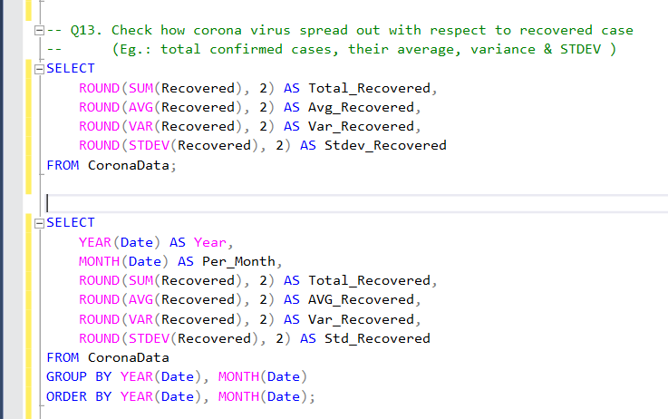
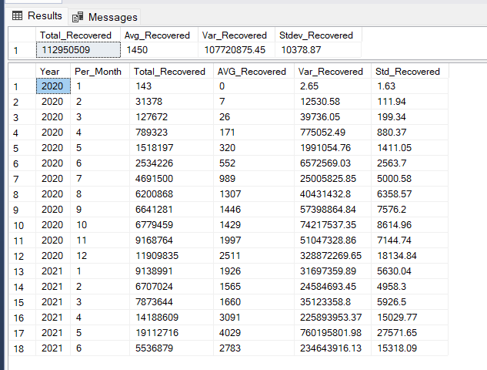
-- Q13. Check how corona virus spread out with respect to recovered case

Slide 17
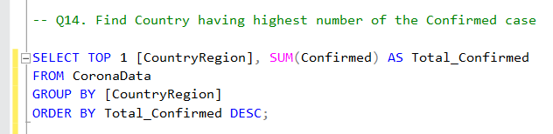
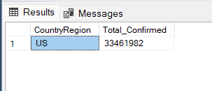
-- Q14. Find Country having highest number of the Confirmed case

Slide 18
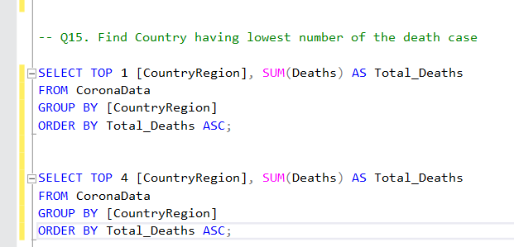
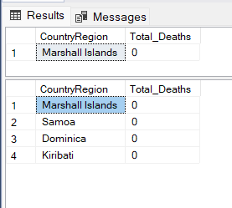
-- Q15. Find Country having lowest number of the death case

Slide 19
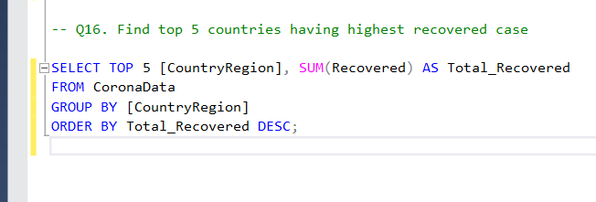
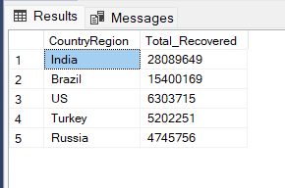
-- Q16. Find top 5 countries having highest recovered case

Slide 20
Insights
CORONA VIRUS Pandemic started on 22 January 2020 and stayed till 13 June 2021.
India has the highest number of recovered cases.
Samoa, Kiribati, Dominica, and The Marshall Islands have the lowest number of Deaths.
The US leads in confirmed CORONA VIRUS cases.
Peak confirmed cases were recorded in April 2021.
Peak death recorded in January 2021.

Slide 21
THANK YOU
Submitted By: Yogita Patil

