Slide 1

UNDERSTANDING BAR GRAPHS
~YOGITA PATIL

Slide 2
TOPICS TO BE COVERED
WHAT IS BAR CHARTS?
TYPES OF BAR GRAPH
KEY COMPONENTS OF BAR CHART
STEPS TO CREATE BAR CHARTS
HOW BAR CHARTS HELP IN COMPARING DATA?
PRACTICAL USES
OF BAR CHART
ADVANTAGES OF BAR GRAPHS
LIMITATIONS OF BAR GRAPH
CONCLUSION

Slide 3
WHAT IS BAR CHARTS?
MAIN PAGE
A bar chart is a graphical representation of data using bars of different heights or lengths.
Each bar represents a category of data.
The bar's length or height corresponds to the category's value or frequency.

Slide 4
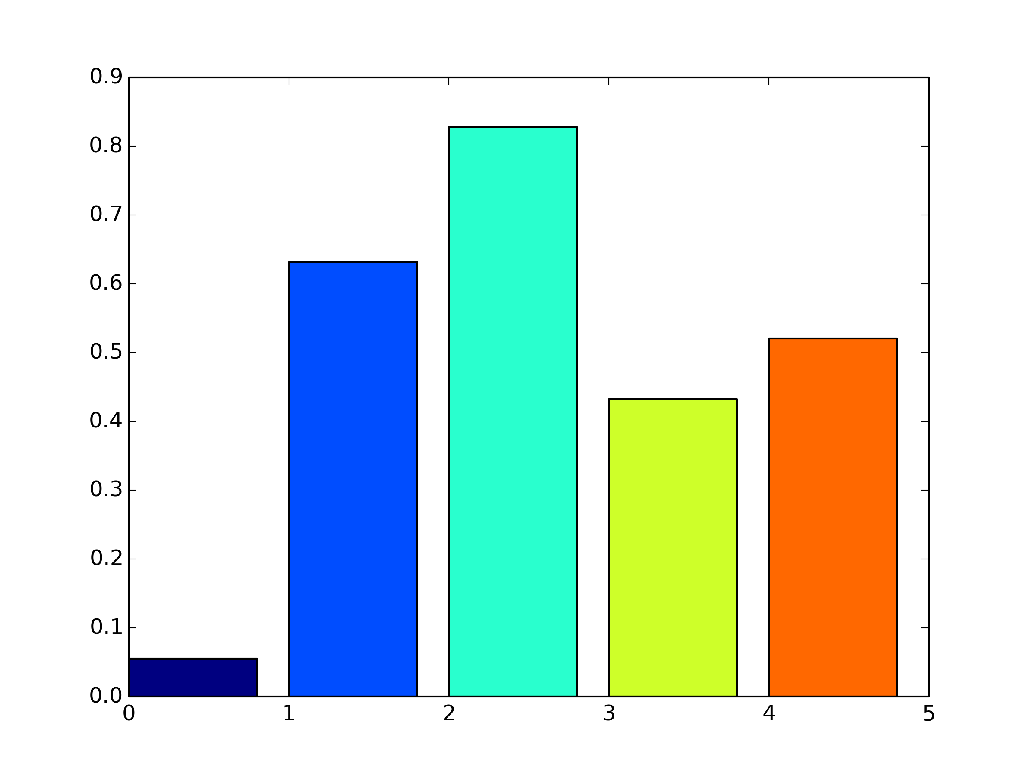
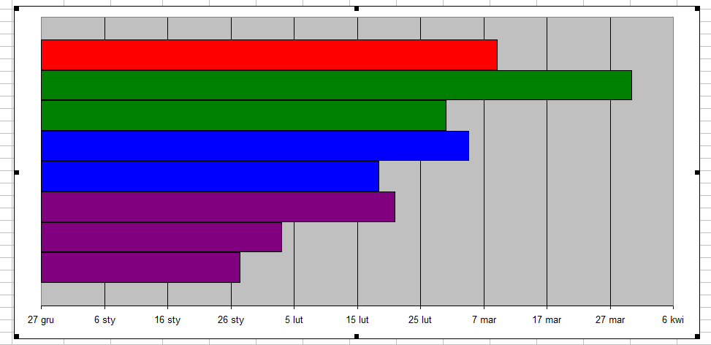
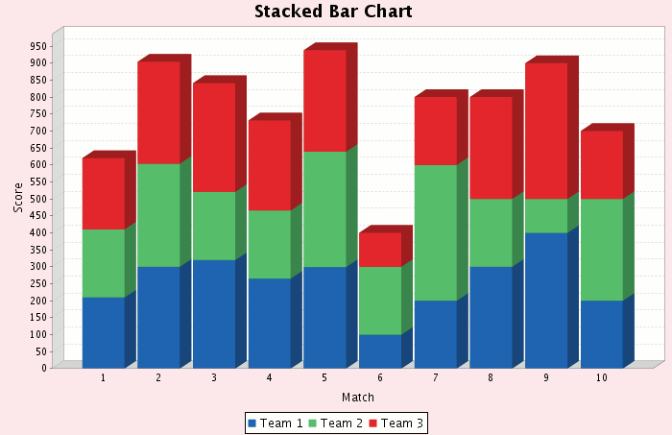
TYPES OF BAR CHARTS
Vertical Bar Charts: Bars extend vertically from the horizontal axis.
Horizontal Bar Charts: Bars extend horizontally from the vertical axis.
Stacked Bar Charts: Bars are divided into sub-bars representing different sub-categories.
MAIN PAGE
ThePhoto by PhotoAuthor is licensed under CCYYSA.

Slide 5
KEY COMPONENTS OF BAR CHART
MAIN PAGE
Axes: Two perpendicular lines. The horizontal axis (x-axis) represents categories, and the vertical axis (y-axis) represents values.
Bars: Rectangles representing the data for each category.
Labels: Text indicating the categories and values.
Title: Describes the content of the chart.
Legend: Explains the meaning of colors or patterns in the chart (if applicable).

Slide 6
STEPS TO CREATE BAR CHARTS
MAIN PAGE
Collect Data: Gather the categorical data you want to represent.
Choose the Type: Decide whether a vertical or horizontal bar chart best suits your data.
Label Axes: Label the x-axis with categories and the y-axis with values.
Draw Bars: Drawbars for each category with lengths proportional to their values.
Add Details: Include titles, labels, and a legend if needed.

Slide 7
HOW BAR CHARTS HELP IN COMPARING DATA?
Bar charts make it easy to compare the values of different categories at a glance.
The visual length or height of bars allows for quick assessment of relative sizes.
Ideal for presenting categorical data where precise comparison between categories is needed.

Slide 8
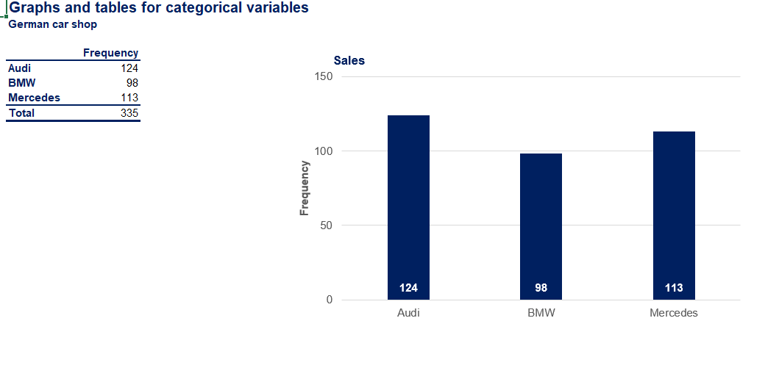
The bar chart below represents the sales data of a German car shop. The chart compares the sales of three car brands: Audi, BMW, and Mercedes.

Slide 9
Explanation of the Example
In the example, the frequency of sales for each car brand is represented by the length of the bars:
- Audi: 124 sales
- BMW: 98 sales
- Mercedes: 113 sales
This visual representation allows for a quick comparison of the sales performance of each brand.

Slide 10
PRACTICAL USES OF BAR CHART
MAIN PAGE
Business: Comparing sales across different products or regions.
Education: Displaying student performance across subjects.
Healthcare: Showing the number of cases for different diseases.
Survey Results: Representing responses to survey questions.

Slide 11
ADVANTAGES OF BAR GRAPHS
MAIN PAGE
Easy to read and interpret.
Effective for comparing multiple categories.
Can display both positive and negative values.
Versatile and widely used in various fields.

Slide 12
LIMITATIONS OF BAR GRAPH
MAIN PAGE
Not suitable for displaying continuous data.
Can become cluttered if too many categories are included.
May not effectively show trends over time (line charts are better for this).

Slide 13
CONCLUSION
MAIN PAGE
Bar charts are powerful tools for comparing categorical data.
They provide a clear and concise visual representation.
Understanding how to create and interpret bar charts is essential for effective data communication.

